Slide 1
Intuit Codathon
SolFinder Research

Slide 2
Cashflow Alert
The Cashflow Alert app highlights the discrepancy between cash availability and liabilities at a given point of time.
Scenario: Suppose I have a liability of Rs. 1000 after 30 days.
Cash at hand after 30 days can be calculated using:
Cash today
Liabilities for the upcoming 30 days
Expected Cash income during 30 days period
Other payables on the 30th day
This can be used to determine my ability to payoff my future cash liability on any given day.

Slide 3
Cashflow Alert
It is important for small businesses and potential lenders to understand cashflow characteristics to engage in credit transactions.
Integration with Quickbooks platform can help access and update the accounting information for current cash status and future projected cash demands.
The user can come to know the days when his cash availability is expected to be less than cash payment liabilities enabling him to take remedial action(e.g., borrow or call in receivables)
Helps reduce the uncertainty of business environment.
GUI interface helps present the status intuitively.

Slide 4
Cashflow Alert
The App enables the user to determine the cash availability vis-à-vis liabilities during a specified period. For example:
At a given date: 30/12/2020
During a given period : Next 30 days
Between 2 specified dates: 01/01/2021 – 01/02/2021
During discontinuous periods: Jan 2021, March 2021
Since the analysis requires an element of future state, it is most useful when analysing periods which are not too distant in future.
This is because it makes assumptions about cashflows based on currently available information.

Slide 5
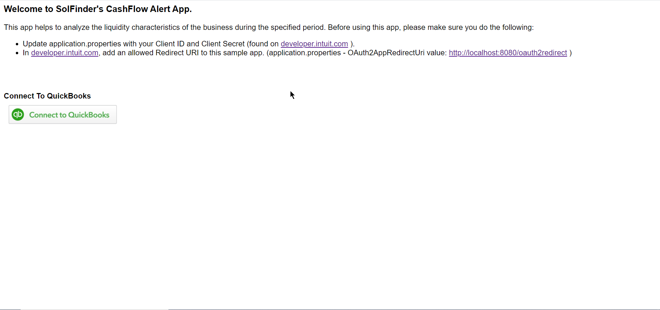
Cashflow Alert – Home Page

Slide 6
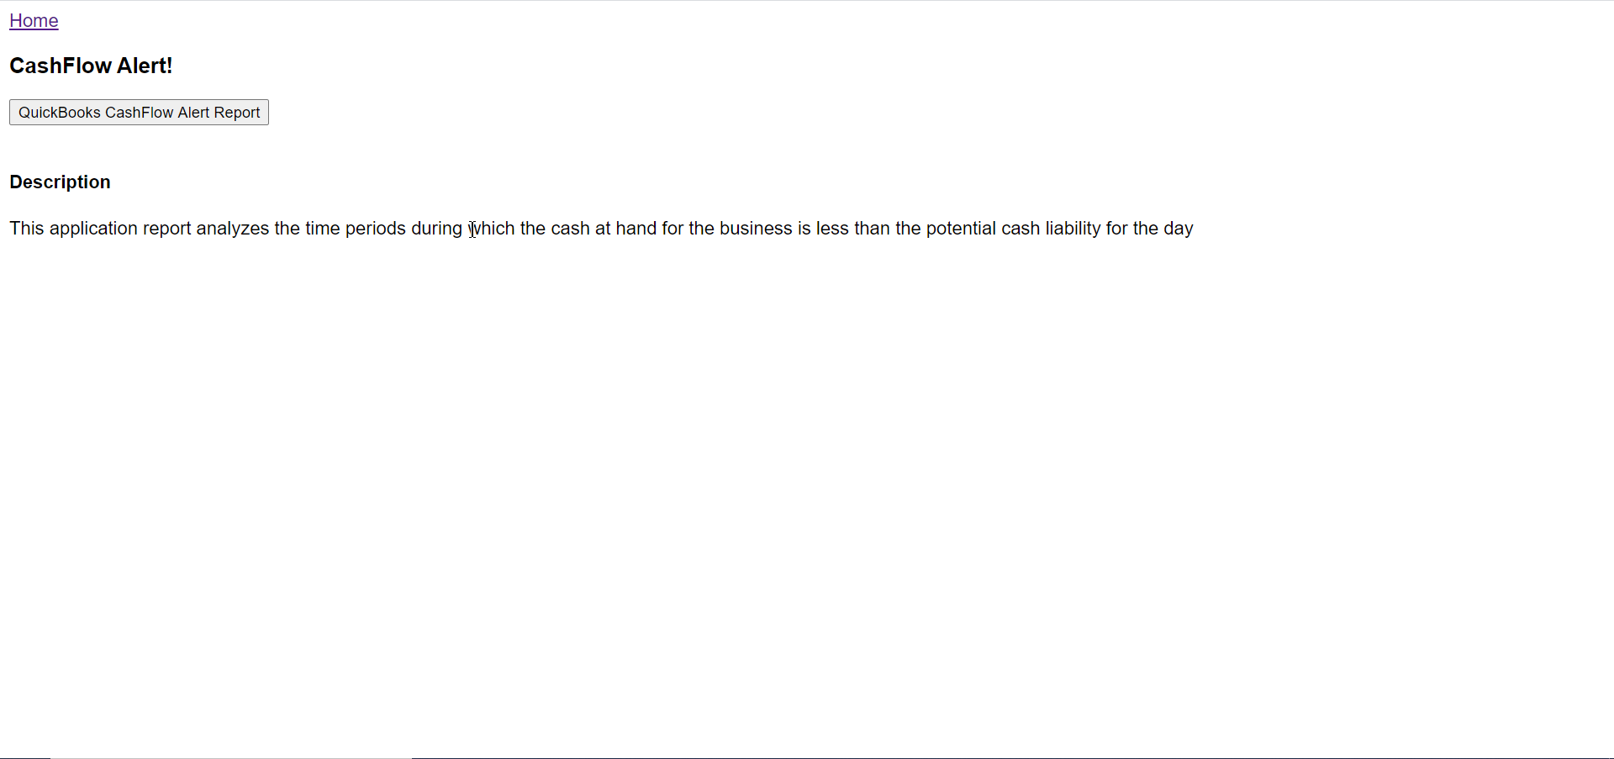
Cashflow Alert – Quickbook Connect

Slide 7
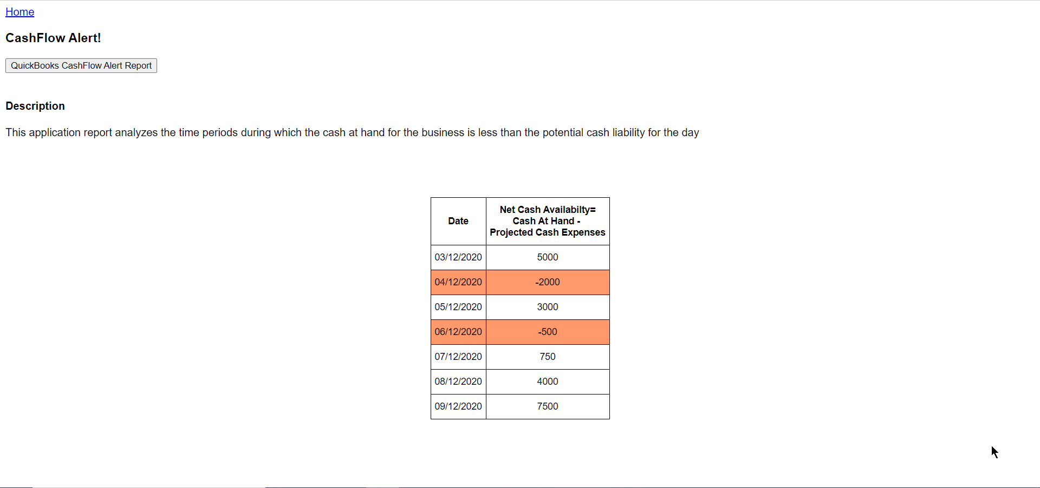
Cashflow Alert – Report

Slide 8
Cashflow Alert – Demo Video
Demo Link:
https://youtu.be/v4hOgDaHD1Y

Slide 9
Cashflow Alert
Future enhancements:
The App can be integrated with Balance sheet,income statements and cashflow statements from past years to provide a historical context.
For example:
Last January there were 3 days when your net cash requirement was more than your net cash availability.
Over the last 3 years, the net cash availability at year end has been consistently decreasing.
Based on trend analysis of previous year’s data, your net cash in hand on March 01’2021 is expected to be Rs. 2,50,200.

