Slide 1
Web application integration with Ambikon
Robert Buels

Slide 2
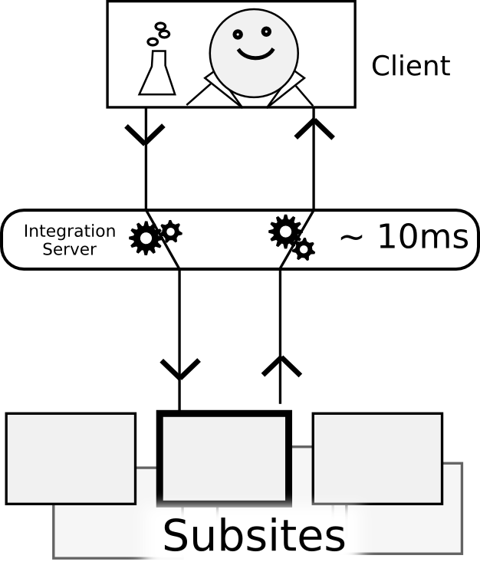
Request Flow
Normal reverse proxy
GET /foo
<html>
GET /foo
<html>

Slide 3
Request Flow
Normal reverse proxy
Can modify request or response
GET /bar/foo
href=”/bar/foo”
GET /foo
href=”/foo”

Slide 4
Request Flow
Normal reverse proxy
Can modify request or response
GET /bar/foo
href=”/bar/foo”
GET /foo
href=”/foo”

Slide 5
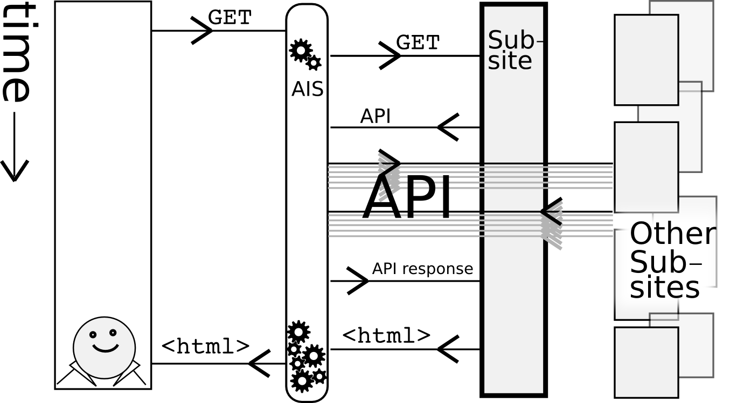
Request Flow
Normal reverse proxy
Smart reverse proxy
Internal service requests
Parallelized!

Slide 6
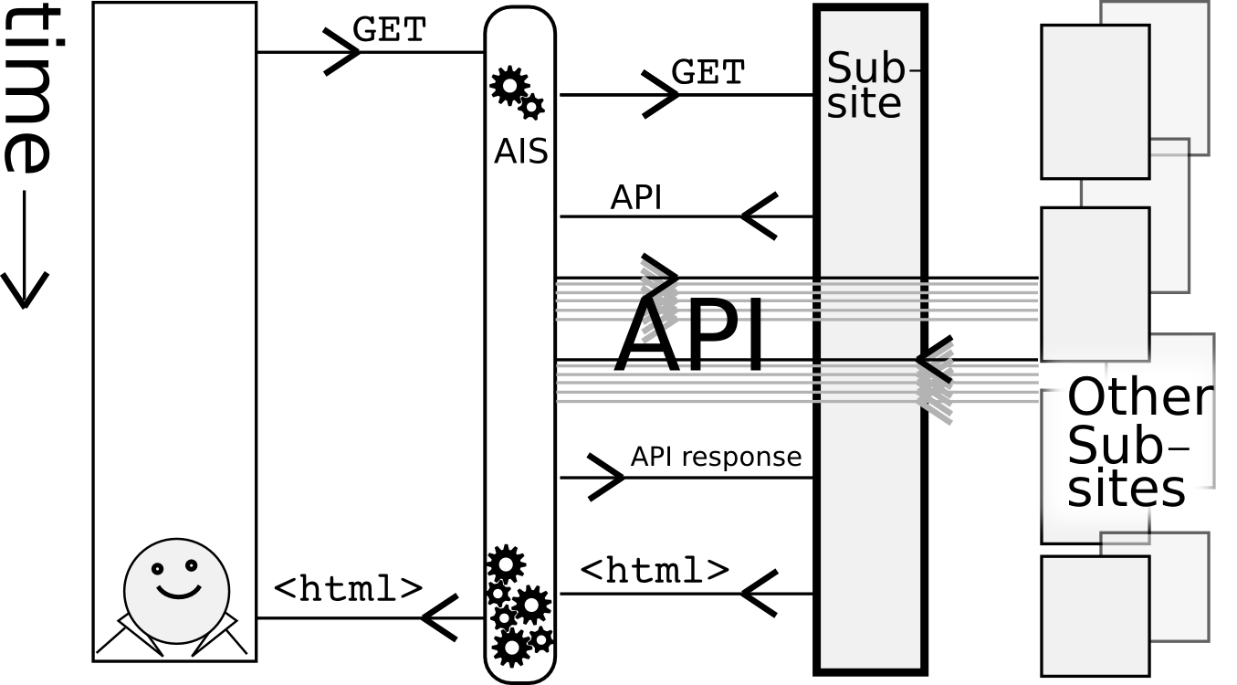
Request Parallelization

