Slide 1
Does money buy happiness?
The Happiness Hunters
David Nassif - DataFrame Framer
Vaishall Pradeepkumar - The Calculator
Solicia Xu - Plot Builder

Slide 2
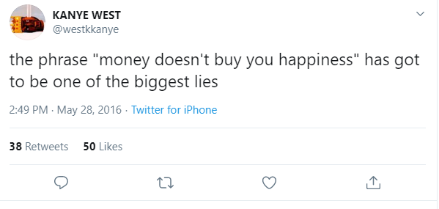

Old School vs New Age

Slide 3

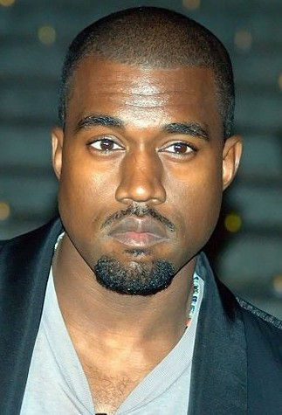
To answer this age-old question….
…….we use Python.

Slide 4
Questions that challenged us…
Does freedom or money correlate better with happiness?
Is the Consumer Electronics Revenue per capita related to a country’s happiness?
For countries whose happiness changed the most (or least), what factors influenced those changes?
How closely are different variables related to happiness correlated to each other?

Slide 5
Data Sources:
World Happiness Report 2019
World Bank API
Consumer Electronics Revenue from statista.com

Slide 6
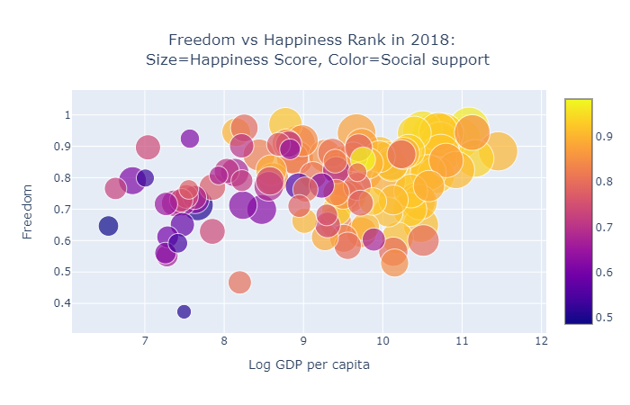

Does freedom or money correlate better with happiness?
Happiness vs Log GDP per capita: p-value was too small to print
Happiness vs Freedom: p-value = $6.76∗{10}^{−118}$

Slide 7
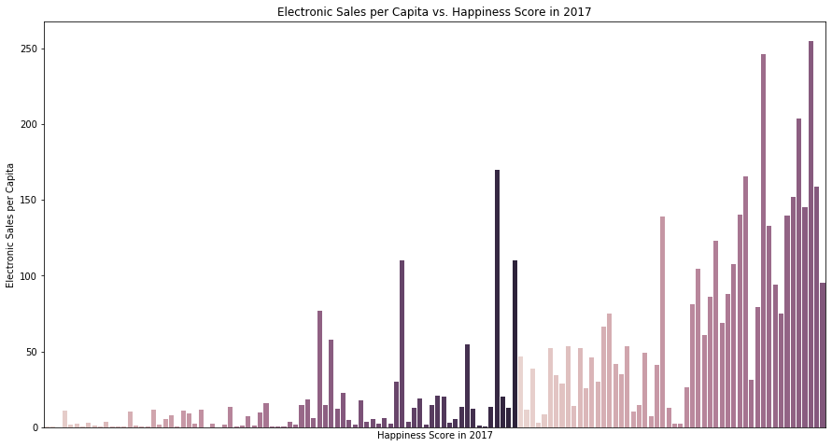
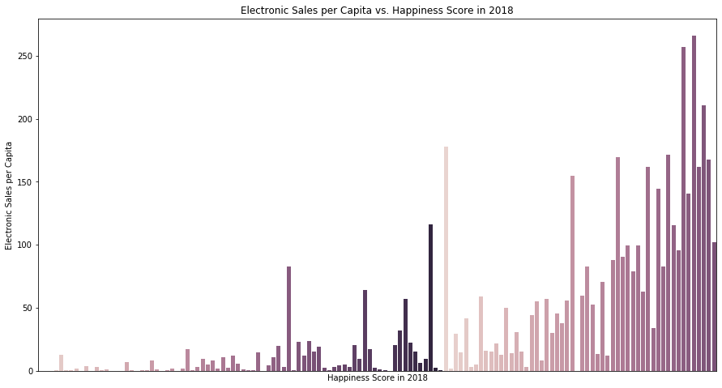
Is the Consumer Electronics Revenue per capita related to a country’s happiness?
Happiness vs Consumer Electronics Revenue: p-value = $1.63∗{10}^{−39}$

Slide 8
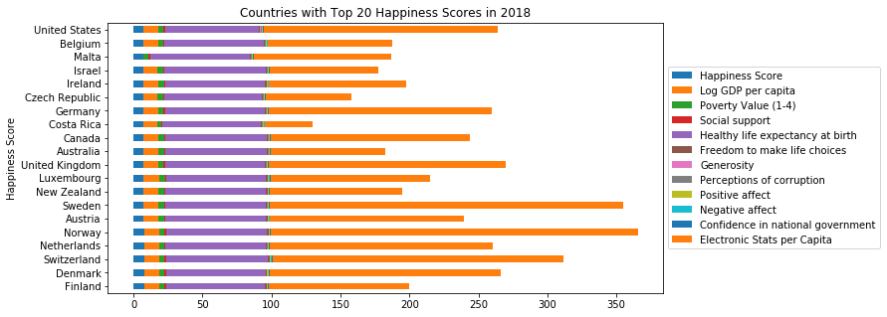
For countries whose happiness changed the most (or least), what factors influenced those changes?

Slide 9
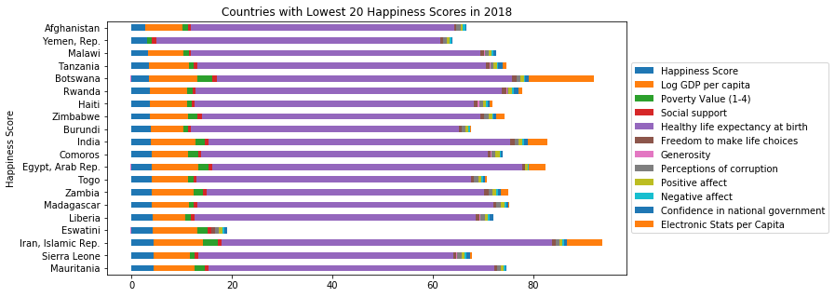
For countries whose happiness changed the most (or least), what factors influenced those changes?

Slide 10
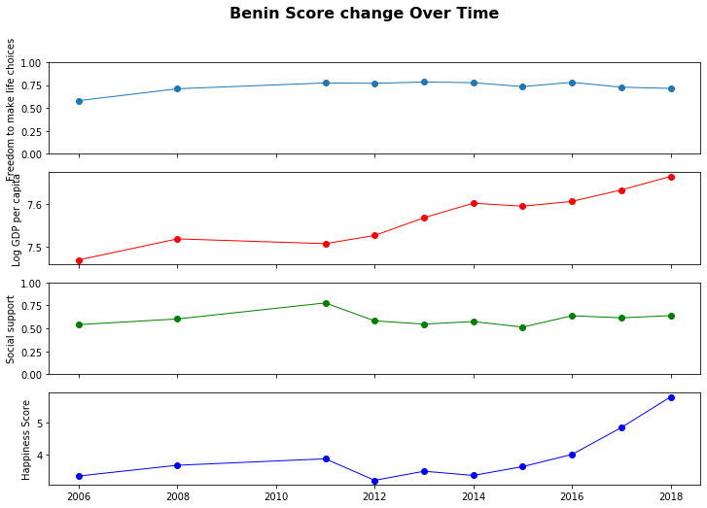
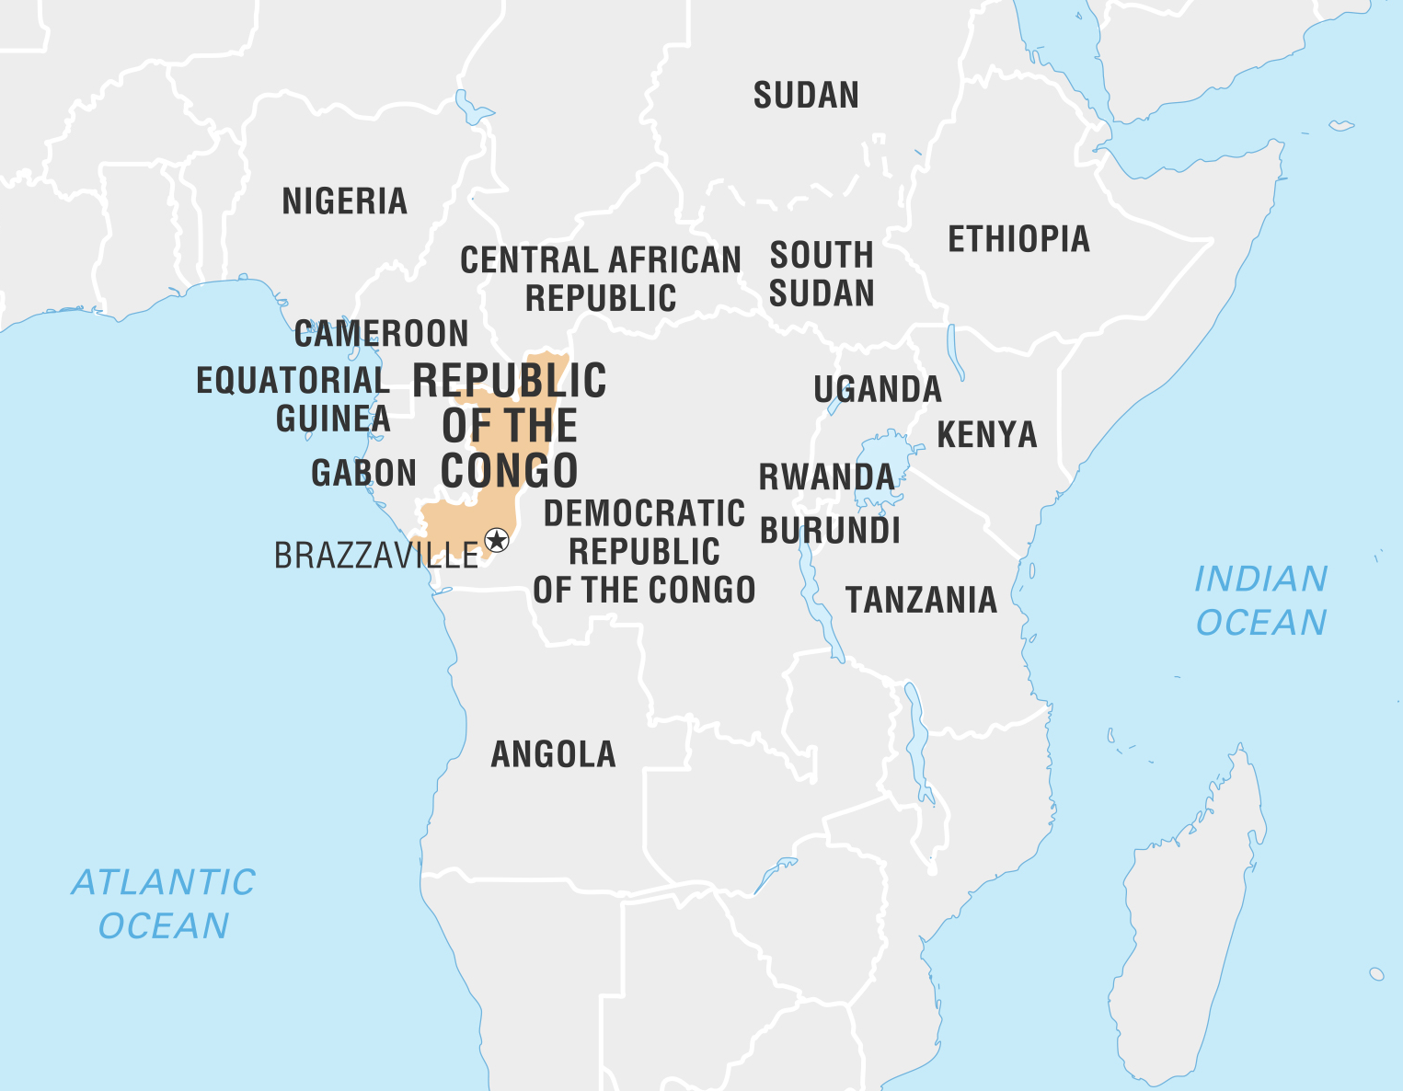
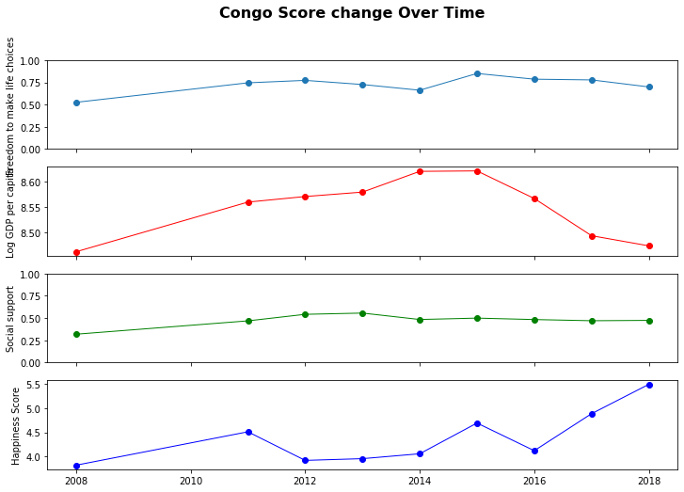
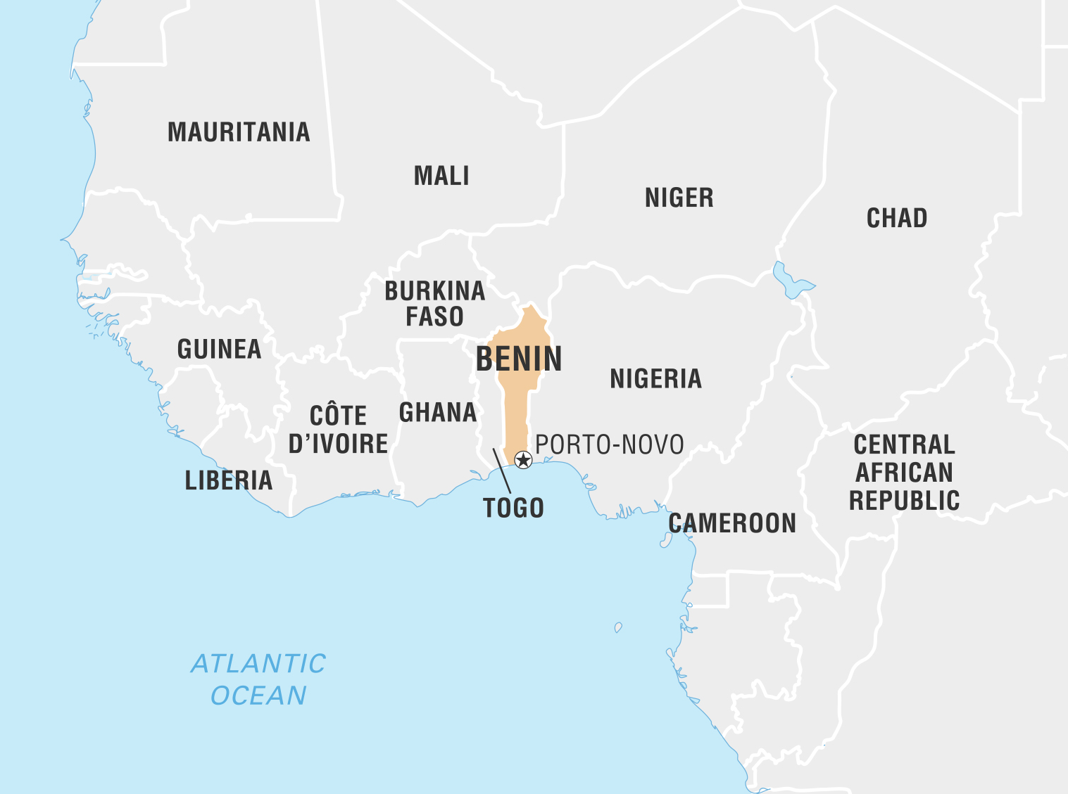

Slide 11
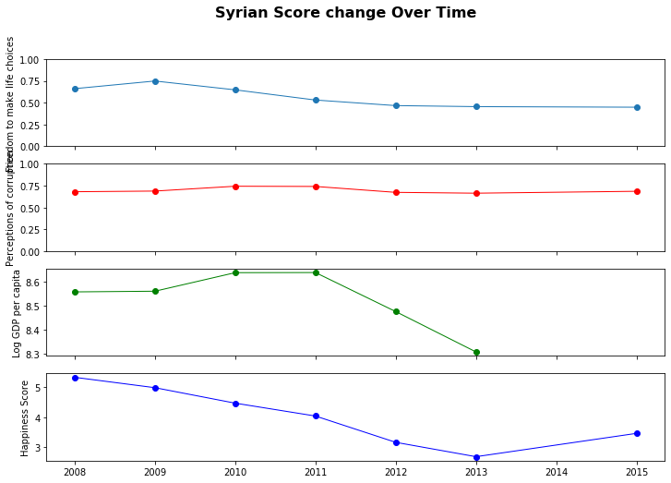
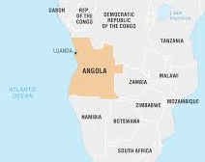
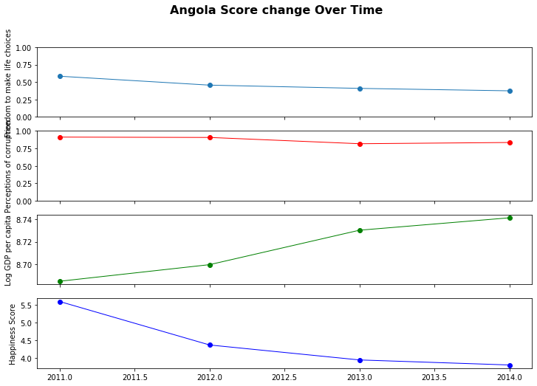
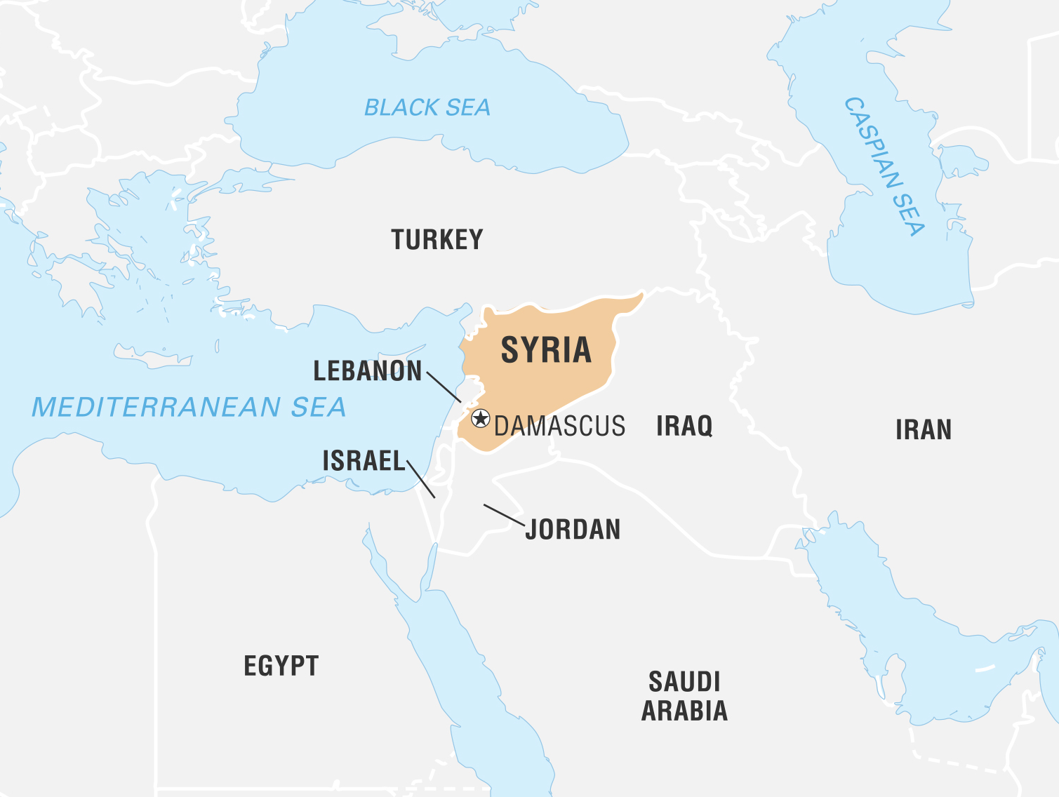

Slide 12
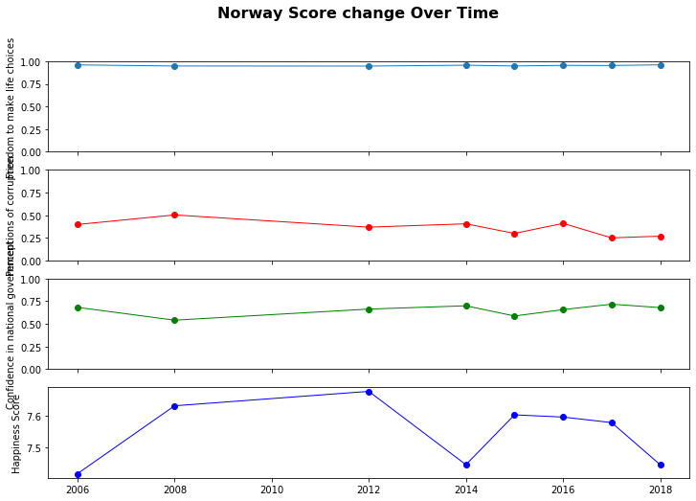
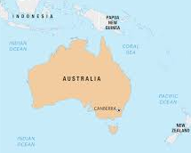
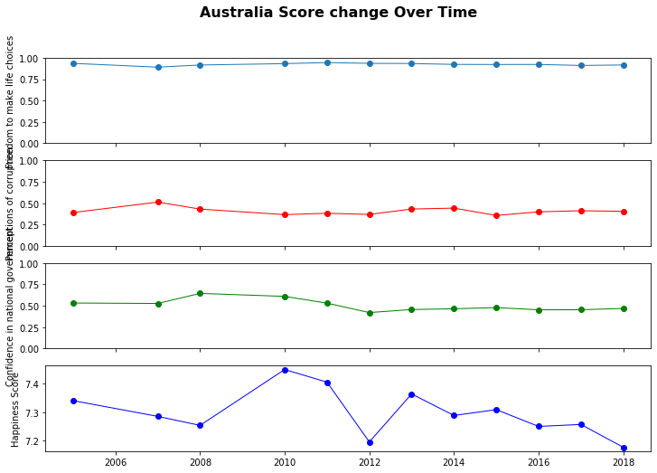
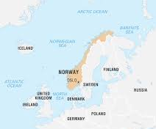

Slide 13
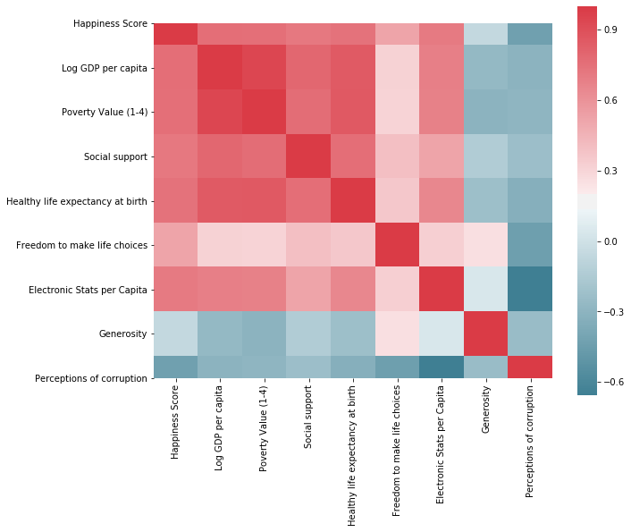
How closely are different variables related to happiness correlated to each other?

Slide 14
Conclusions:
The correlations between happiness, Log GDP per capita, Social Support, Life Expectancy at birth, Electronic Sales per Capita, and Freedom are extremely strong.
Log GDP per capita was the variable most closely correlated with happiness; thus money indeed does buy happiness (or being happy bring in more money).

Slide 15

Next Steps

Slide 16
NEXT STEPS
Why are there some countries that have high Electronic Revenue Sales but relatively low happiness?
Use machine learning techniques to predict happiness scores for the future.
Find further supporting data sets for Electronic Sales i.e. availability of electricity, internet, etc.
Are there alternatives to the World Happiness Report whose findings corroborate those found in the World Happiness Report?

