Slide 1
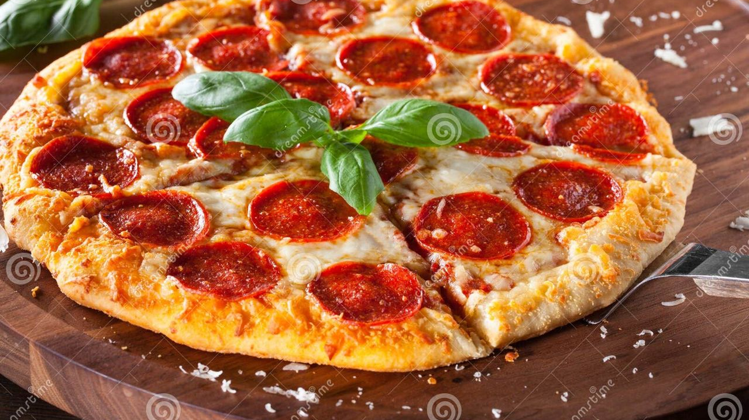
Pizza Perfection: From Dough to Delicious!
🍞
Making pizza from scratch is simpler than you think — with just flour, yeast, tomatoes, and cheese, you can create a masterpiece in your own kitchen.
🍅
This guide breaks pizza-making into four easy steps: mix the dough, craft the sauce, pile on your favorite toppings, and bake until golden perfection.
🧀
Whether you're a confident cook or a total beginner, homemade pizza beats delivery every time with its fresh taste and endless customization.
🔥
Get ready to impress your family and friends with a piping-hot, crispy-yet-chewy pizza made entirely by your own hands!
1 / 9 🍕

