Slide 1
UFT/QTP 云集成方案
旋极科技

Slide 2
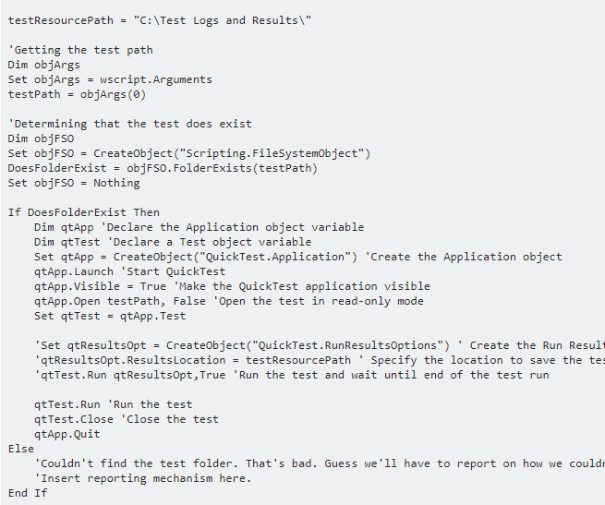
脚本调用
https://stackoverflow.com/questions/13907603/how-can-i-run-a-qtp-test-from-the-command-line
https://www.softwaretestingmaterial.com/vbscript-automation-qtpuft-testing-part-3/

