Slide 1

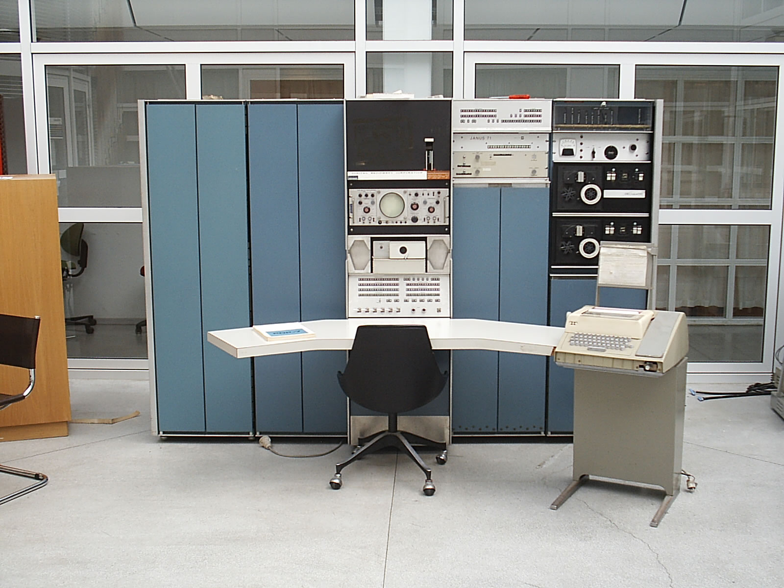
How to Test Data Acces Code or
Rube Goldberg:Software Developer

Slide 2



Who am I?
Jonathan Baker
bakerj@oclc.org
solidjb@hotmail.com
Notes:
I am currently a Consulting Software Engineer @ OCLC
Over 10 years of Java development exp.

Slide 3


Testing Data Access Code

Slide 4
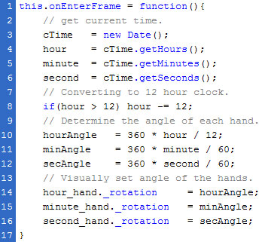
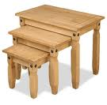
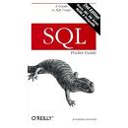

Testing Data Access Code
What?
Code
Tables
SQL
Test Data

Slide 5
Definitions
Unit testing - a software verification and validation method in which a programmer tests if individual units of source code are fit for use
Integration Testing
System testing - testing conducted on a complete, integrated system to evaluate the system's compliance with its specified requirements
From Wikipedia
Notes:
Unit tests work on one thing and one thing only. Lets be dogmatic about the definition and pragmatic about the implementation.
System testing test an entire system together. (This is typically how we test our database stuff)
Integration tests are anything more than a unit test, and anything less than a system test for the purposes of this talk.

Slide 6
Unit Testing Data Access Code
Why?
Red
TDD
Green
Refactor
Notes:
TDD – allows developer to develop code around the query without having to figure out the query. You can establish what you want to do with the results, and how to handle errors without having to know if the query is correct or not.

Slide 7
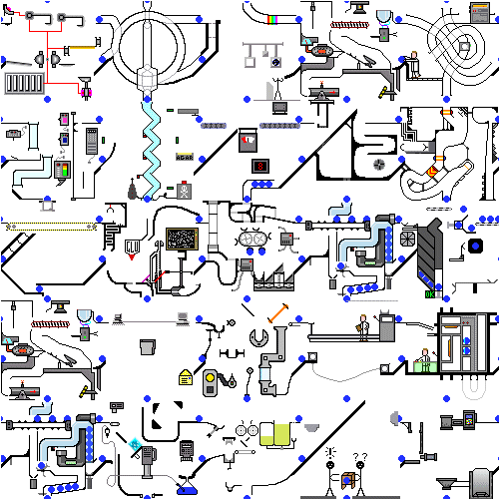
Unit Testing Data Access Code
Why Not?
http://blueballfixed.ytmnd.com/
Notes:
Writing your own mocking framework is almost always a mess.
Even when using an established mocking framework things are difficult because many calls are made to the DataSource object.
The tests can grow exceedingly complex when compared to the code.

Slide 8
Unit Testing Data Access Code
How?
Home-grown mocking
Standard Mocking libraries (mockito, JMock, Easy Mock, etc.)
Specialized DB mocking - MockRunner

Slide 9

Unit Testing Data Access Code
How?
To the code…
Notes:
Show the PhoneBookDAOUnitTest…
Whats nice about MockRunner is it mocks the jdbc layer, so you can use it with spring-jdbc, hibernate, jpa, etc.
Mockrunner doesn’t force you to set expectations (except for what the query will be) you can just verify.

Slide 10

Unit Testing Data Access Code
The Problem
Notes:
The unit tests are only the beginning. To ensure that your code is actually correct you need to verify 4 things.

Slide 11
Unit Testing Data Access Code
What?
Code
Tables
SQL
Test Data
Notes:
Unit testing will not verify your sql, your table structure or your test data.

Slide 12
Integration Testing Data Access Code
What?
Code
Tables
SQL
Test Data
Notes:
Integration tests will enable you to test not only your code, but your sql, your table structure, and your test data.

Slide 13

Integration Testing Data Access Code
Why?
Notes:
TDD – allows developer to develop code around the query without having to figure out the query. You can establish what you want to do with the results, and how to handle errors without having to know if the query is correct or not.

Slide 14
Integration Testing Data Access Code
Why Not?
http://blueballfixed.ytmnd.com/
Notes:
Same problem really. This is a complex issue, and so there are no simple solutions.

Slide 15
Integration Testing Data Access Code
How?
Database – existing, test-specific (in-memory or stand-alone)
Table structure – sql scripts, liquibase, dbdeploy, c5-db-migration, dbmaintain, scala-migrations
Test data – sql scripts, spring testing infrastructure, dbunit, unitils,
Test harness – junit, test NG, etc.

Slide 16
Integration Testing Data Access Code
How?
To the code…
Notes:
Show the PhoneBookDAOUnitTest…
Whats nice about MockRunner is it mocks the jdbc layer, so you can use it with spring-jdbc, hibernate, jpa, etc.
Mockrunner doesn’t force you to set expectations (except for what the query will be) you can just verify.

Slide 17
Integration Testing Data Access Code
Test using an existing database
(i.e. assume all table structure is already there)
Pros
Should be exact type of database as used in prod
Therefore no impedance mis-match between test db and real db.
Cons
Fragile
  db down = tests fail, junk data = tests fail, etc
Take a long time to run.
Expensive – if licenses required

Slide 18
Integration Testing Data Access Code
Test using an fresh external database
(i.e. create db every time)
Pros
Should be exact type of database as used in prod
Therefore no impedance mis-match between test db and real db.
Test data is always fresh
Cons
Fragile, but not as Fragile
  db down = tests fail,
How to ensure table structure is correct?
Take a long time to run.
Expensive – if licenses required

Slide 19
Integration Testing Data Access Code
Test using an in-memory database
(i.e. create in-memory db everytime)
Pros
Not fragile, everything is within our control
Should run faster than running against an actual db
No licensing issues with open-source in-memory databases
Cons
Database mismatch – cannot replicate vendor specific features
What about stored procedures?
How to ensure table structure is correct?

Slide 20
Integration Testing Data Access Code
Recommendations
Database - Use an in-memory database for integration testing.
  H2 – supports compatibility modes (i.e. mysql, oracle, etc)
  Derby
  HSQLDB
Table Structure - Use source-controlled database scripts to create table structure
  Liquibase – vendor agnostic XML DSL
  Sql scripts
  Other tech (Unitils/dbdeploy/c5-db-migration/dbmaintain/scala-migrations)

Slide 21
Integration Testing Data Access Code
Recommendations
Test Data
  Use spring SimpleJdbcTestUtils to load simple sql data scripts (i.e. inserts)
  DBUnit
  Unitils
Test Harness (junit 4 or test NG)
  Use Spring integration-testing support. (context loading, transactions, etc)
  Unitils
  DBUnit

Slide 22
Technologies
Java 6
Spring - 3.0.5.RELEASE
Junit - 4.8.2
Liquibase – 2.0-rc7
Hamcrest - 1.1
MockRunner - 0.4 – Please note the maven artifact in the public maven repo is incorrectly configured.
H2 - 1.2.137
C3P0 - 0.9.1.2
Mysql driver - 5.1.14
Maven – 2.2.1

Slide 23
References
Database Testing: How to Regression Test a Relational Database
7 Strategies for Unit Testing DAOs and other Database Code
Unit testing database code
Spring Docs - Testing

Slide 24

Questions?
How much wood would a woodchuck chuck if a woodchuck could chuck wood?

