Slide 1
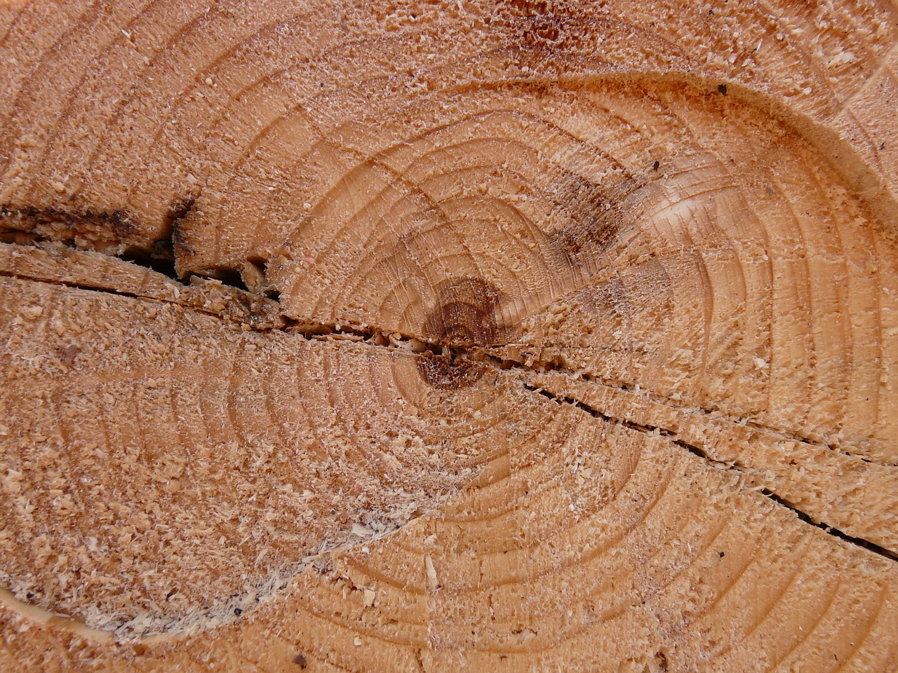
Looking for Logs
In All the Wrong Places
Notes:
Intro was choppy – need to introduce myself and talk about why I am here – discuss all of the benefits we have received – especially increased exposure (shared interest across all groups – dev, ops, product)
15-20 minutes to assemble all logs you wanted to use to debug a problem -> instantaneous to hone in on the exact problem.
Real life OCLC examples – as part of the intro (or right after the architecture) talk about ops and dev sharing links
In kibana – dragging across the graph, show how clicking on mag-glass creates filters, filters + queries
Much more slowly describe how I am using the dashboards.
Transition to json and code was abrupt
When starting demo describe logstash and elasticsearch are running locally (with command line) and then show logstash config input and output before moving into kibana.
Once in kibana, describe all the parts of the default dashboard.
Kibana doesn’t know anything about your app or your logs
Talk about all of the fields in the full event
Request overview dashboard = access log centric
Discuss logstash config and talk about running logstash and elasticsearch on laptop
On the first dashboard describe each element of kibana – once I find the problem (either too long or a blow up) show the share link.

Slide 2



Jonathan Baker
bakerj@oclc.org
https://github.com/solidjb
http://www.linkedin.com/pub/jonathan-baker/5/414/7b2
Notes:
Im a consulting software engineer at OCLC on the End User Services Discovery Team.
I like making developer’s lives easier.

Slide 3


OCLC
Notes:
We are a nonprofit library cooperative providing research, programs and services that help libraries share the world’s knowledge and the work of organizing it. The needs of our members guide our actions and investments. Through a shared governance structure, librarians manage and direct the cooperative.

Slide 4


What We Do
Notes:
Worldcat Discovery
We help people find the things they are interested in.

Slide 5



Agenda
Problems
What is ELK?
Demo

Slide 6
Problems
Notes:
First problem so bad I couldn’t even make a slide – No access (not even read) to production hosts.

Slide 7

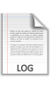
Logs Across Servers
Notes:
We started out with a monolithic application.
Load Balancing and redundancy have caused us to have multiple servers for the same application.

Slide 8
Logs Across Apps
Notes:
We started out with a monolithic application.
Service-Oriented Architecture has increased the number of services or applications that are involved in a single user or client interaction.

Slide 9
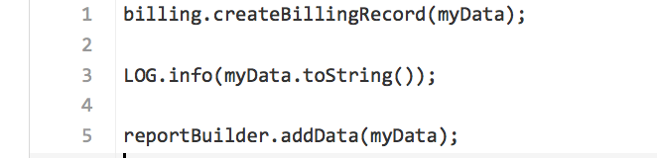
Duplicated Instrumentation

Slide 10



ELK
Elasticsearch
Logstash
Kibana
Notes:
With ELK –
15-20 minutes to assemble all logs you wanted to use to debug a problem -> instantaneous to hone in on the exact problem.

Slide 11

Elasticsearch
Notes:
Elasticsearch is a flexible and powerful open source, distributed, real-time search and analytics engine.
Built on top of Apache Lucene, it simplifies Lucene Apis and allows non-java languages to interact with the indexes.

Slide 12
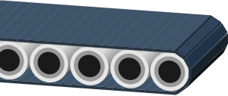
Logstash
Notes:
Logstash is a project similar to Apache Flume if you are famailiar with that project.
Logstash takes logs and other event data from your systems and move them into a central place.

Slide 13



Logstash
Notes:
Logstash converts unstructured data into structured data
Disparate date formats can be consolidated.
Or unstructured data can be treated the same as structured.

Slide 14

Logstash
Notes:
Written in Jruby – entire java ecosystem available to you.

Slide 15
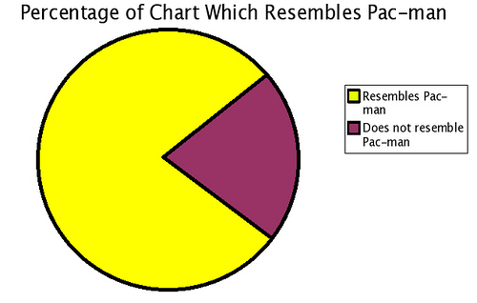
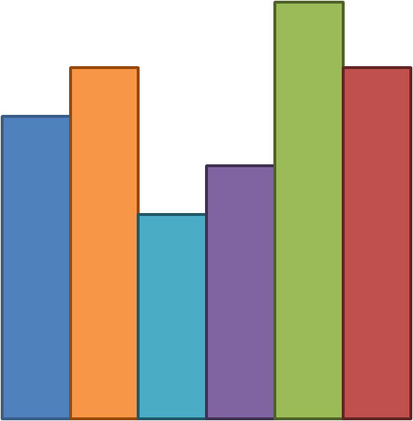
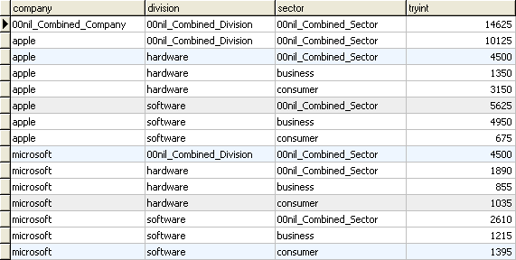
Kibana
Notes:
Kibana allows you to visualize logs and time-stamped data

Slide 16
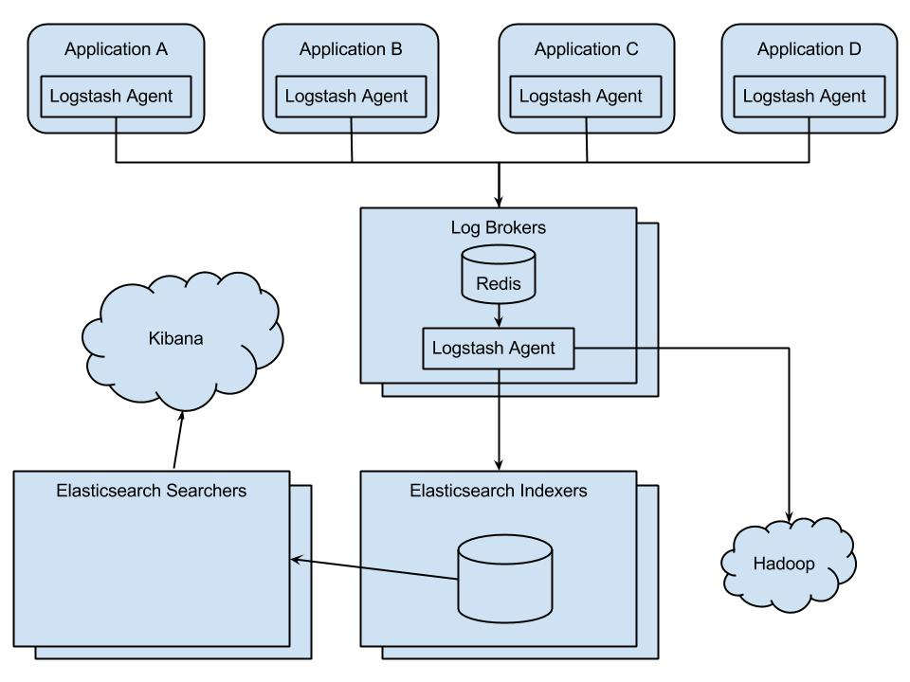
Architecture
Notes:
The stack is open-source
Logging was lowest cost of entry
This all happens out of process.
Informed greatly by http://research.google.com/pubs/pub36356.html (dapper/zipkin)

Slide 17
Architecture
50K Events per minute and growing (OCLC)
Spikes to 150K per minute
15 applications plus networking syslogs
40K Events per minute (Discovery)
Spikes to 125K per minute
6 applications
Events live 14 Days in ES, Forever in HDFS
4 Brokers (1 CPU + 4GB mem)
4 Indexers (2 CPU + 4GB mem)
6 DB Hosts (2 CPU + 16GB mem + 400GB storage)
2 Dedicated Search (2 CPU + 16GB mem)
Notes:
----- Meeting Notes (12/23/14 15:37) -----
should be darker

Slide 18
Demo
Notes:
Show kibana sharing of temporary dashboard

Slide 19

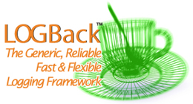
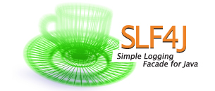

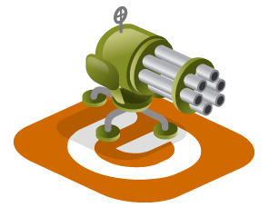
Technology
Notes:
Spring boot
Spring boot actuator health checks
Gatling Load test tool

Slide 20
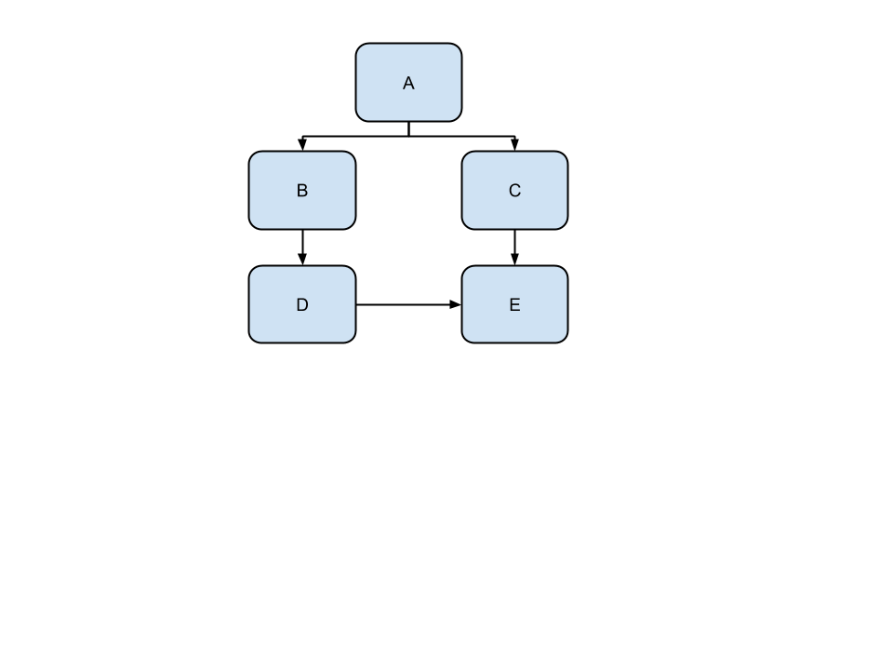
Architecture

Slide 21
Amount of Work
Event propagation = ~300 lines of code
Client propagation = ~40 lines of code
Logging outgoing http = ~80 lines of code
Logback integration = ~600 lines of code
(All found in elk-demo-logging-support module)
Notes:
Highly influenced by Google Dapper paper (open source implementation = Zipkin)
Open source alternatives for the logback and logback-access encoders, we pre-date them, so we are investigating how to switch..

Slide 22
Resources
https://github.com/solidjb/elk-demo
http://logstash.net/
http://www.elasticsearch.org/
http://www.elasticsearch.org/overview/kibana/
http://projects.spring.io/spring-boot/
http://www.slf4j.org/
http://logback.qos.ch/
http://gatling.io/
http://research.google.com/pubs/pub36356.html
http://twitter.github.io/zipkin/
http://oclc.org/careers.en.html

Slide 23
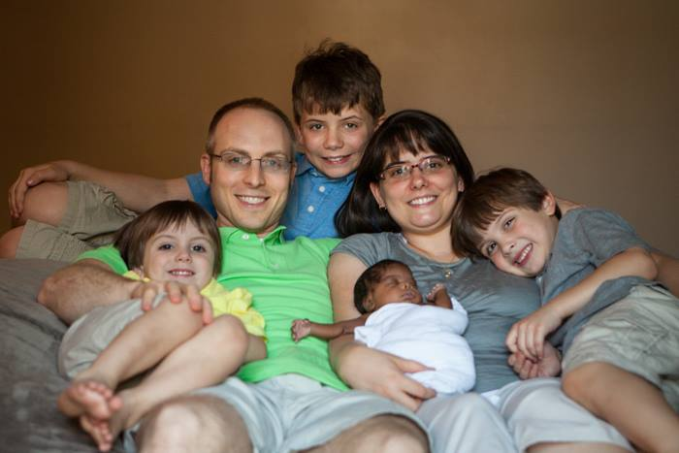
Jonathan Baker

