Slide 1
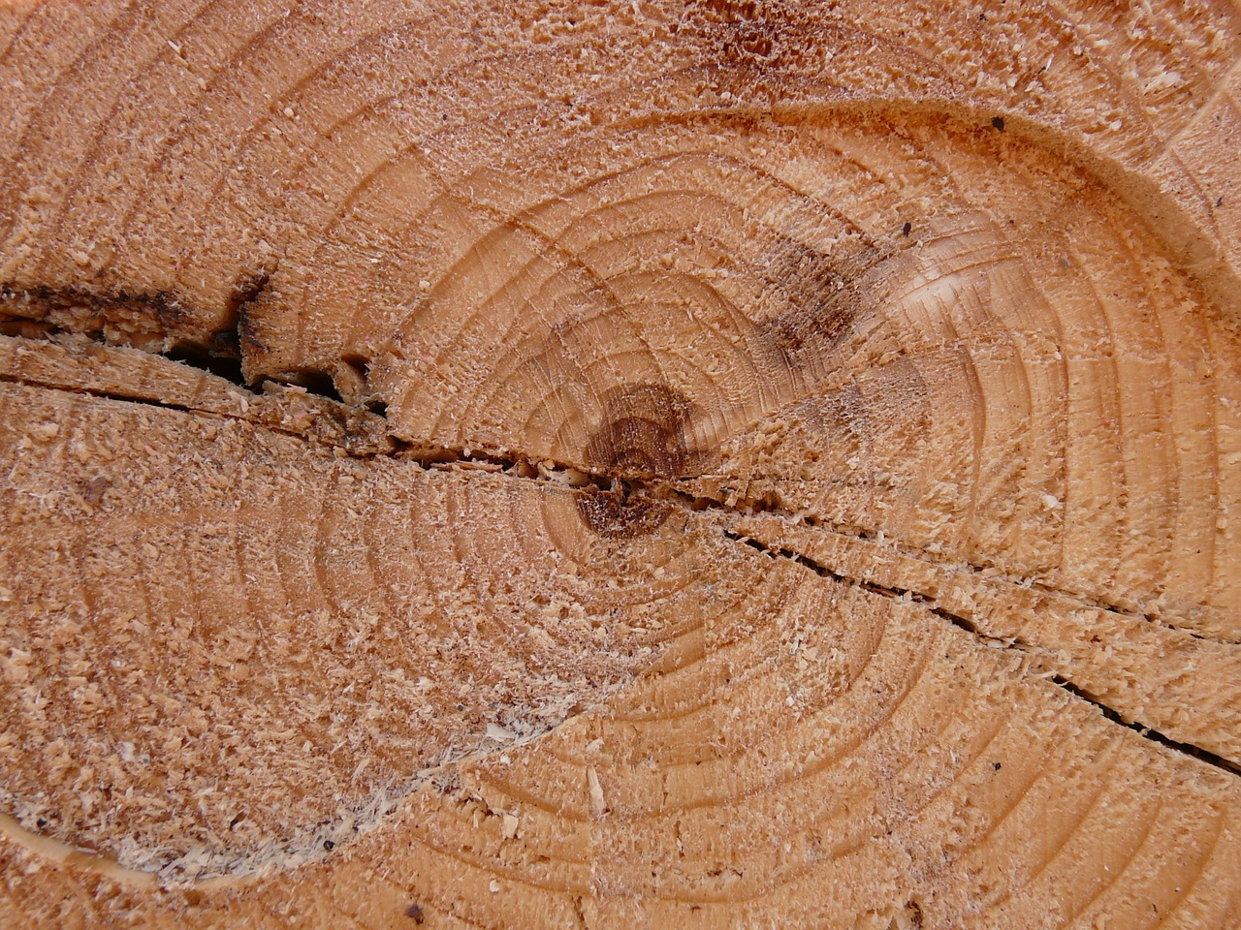
Looking for Logs
In All the Wrong Places
Notes:
Who here has to look at logs?
Who here enjoys it?
I assume since you are at this talk, that means it is unpleasant.
I’d like to tell you about where I work, and the issues we had, and then what we did to fix them.

Slide 2


OCLC
Notes:
We are a nonprofit library cooperative providing research, programs and services that help libraries share the world’s knowledge and the work of organizing it.

Slide 3



What We Do
Notes:
Worldcat Discovery
We help people find the things they are interested in.

Slide 4

Problems
Notes:
All software experiences problems.
These are not the problems I am here to discuss.
I want to talk about the problems you experience when trying to figure out an issue with an application.

Slide 5

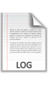
Multiple Logs on a Server
Notes:
We actually can use both access (web-centric) and application logs to figure out a problem.
Garbage collection and operational logs are useful in some cases too.

Slide 6
Logs Across Servers
Notes:
We started out with a monolithic application.
Load Balancing and redundancy have caused us to have multiple servers for the same application.

Slide 7
Logs Across Apps
Notes:
We started out with a monolithic application.
Service-Oriented Architecture has increased the number of services or applications that are involved in a single user or client interaction.

Slide 8

Production Access
Notes:
To add insult to injury - No access (not even read) to production hosts.
We were provided a log service that let us select the files we wanted and download them.

Slide 9



What Did This Mean?
Notes:
20 minutes of pointing and clicking through a UI, could get us the files we think that we need.

Slide 10
What Did This Mean?
GREP
Notes:
Using grep on those files + time proximity would allow us to try to discern problems.
Is this familiar to anyone else? You can make a career being good at this…

Slide 11

What Did We Want?
Notes:
We wanted magic.
Instant access to the log events we care about.
So we started with ELK

Slide 12




ELK
Elasticsearch
Logstash
Kibana

Slide 13

Elasticsearch
Notes:
Elasticsearch is a flexible and powerful open source, distributed, real-time search and analytics engine.
Built on top of Apache Lucene, it simplifies Lucene Apis and allows non-java languages to interact with the indexes.

Slide 14

Logstash
Notes:
Logstash takes logs and other event data from your systems and move them into a central place.
Logstash is a project similar to Apache Flume if you are famailiar with that project.

Slide 15



Logstash
Notes:
Logstash converts unstructured data into structured data
Disparate date formats can be consolidated.
Or unstructured data can be treated the same as structured.

Slide 16

Logstash
Notes:
Written in Jruby – entire java ecosystem available to you. Most of ruby ecosystem is available to you.

Slide 17
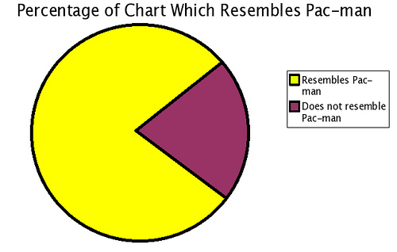

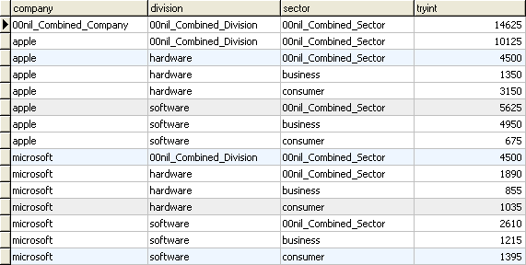
Kibana
Notes:
Kibana allows you to visualize logs and time-stamped data
ELK gave us the ability to centralize all of our log events, and a highly functional UI to zoom in and out of what we were looking for

Slide 18
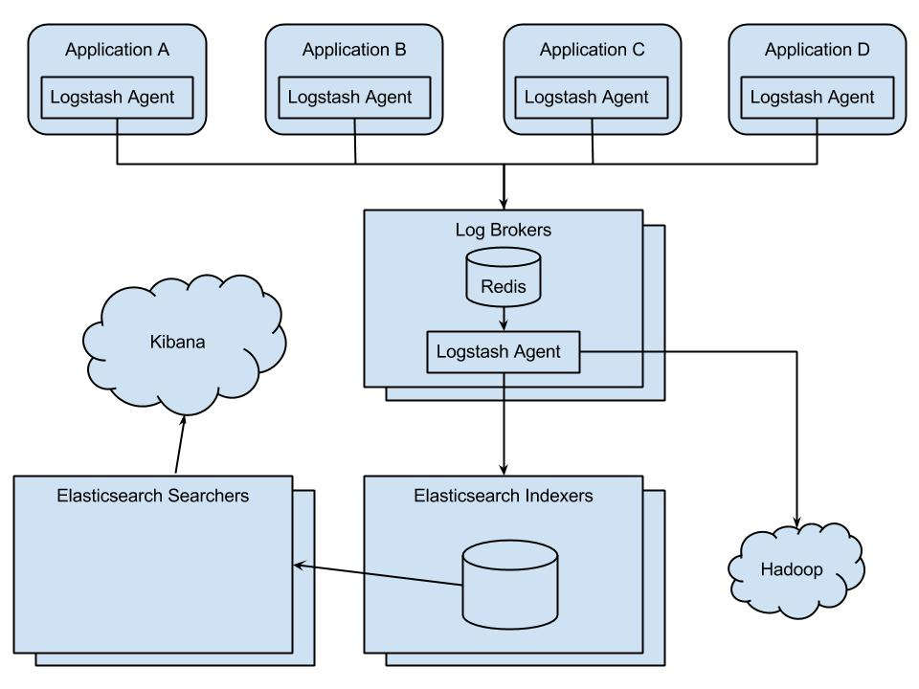
Architecture
Notes:
The stack is open-source
Logging was lowest cost of entry
This all happens out of process.
Informed greatly by http://research.google.com/pubs/pub36356.html (dapper/zipkin)

Slide 19
Architecture
50K Events per minute and growing (OCLC)
Spikes to 150K per minute
15 applications plus networking syslogs
40K Events per minute (Discovery)
Spikes to 125K per minute
6 applications
Events live 14 Days in ES, Forever in HDFS
4 Brokers (1 CPU + 4GB mem)
4 Indexers (2 CPU + 4GB mem)
6 DB Hosts (2 CPU + 16GB mem + 400GB storage)
2 Dedicated Search (2 CPU + 16GB mem)

Slide 20
What Did We Want?
Notes:
Remember what it is we were shooting for: Magic!
All of this infrastructure, and still no magic (yet)

Slide 21
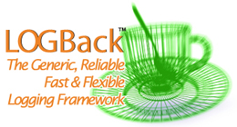

SLF4J
Notes:
Simple Logging Façade for Java
This is java-centric, but other languages hopefully support something similar.

Slide 22

Mapped Diagnostic Context
MDC
Notes:
"Mapped Diagnostic Context" is essentially a map maintained by the logging framework where the application code provides key-value pairs which can then be inserted by the logging framework in log messages.
Stick an identifier in the MDC – it ends up on every appropriate log event.

Slide 23
Markers
Message 1
Message 2
Message 3
Notes:
Markers are named objects used to enrich log statements.
Allows you to categorize events on additional dev selected field. (Multiples allowed)
We map these markers to logstash Tags.

Slide 24
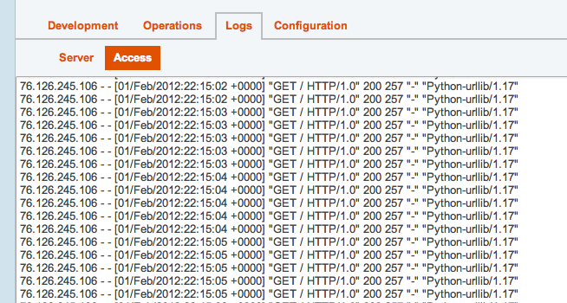
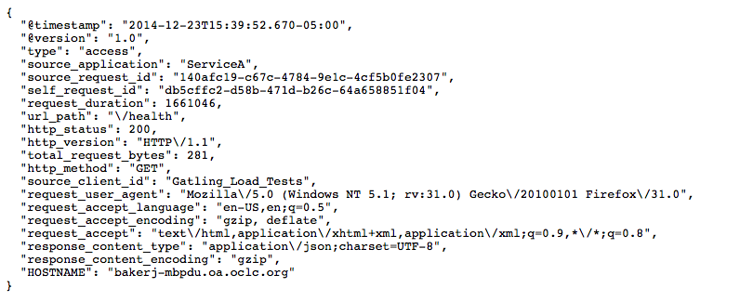
Json Logs
Notes:
It was easier for us to output json logs to ease the burden on logstash – easier to write an encoder than regex parsing in logstash.
Logstash could handle the raw logs, but why?

Slide 25

Demo

Slide 26



Technology
Notes:
Spring boot
Spring boot actuator health checks
Gatling Load test tool

Slide 27
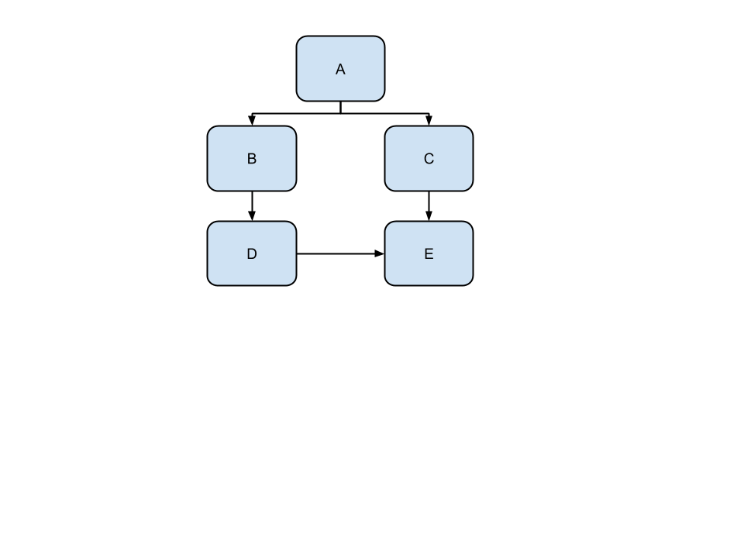
Architecture
Notes:
Explain that there are random wait times and random failures injected into each service.
When starting demo describe logstash and elasticsearch are running locally (with command line) and then show logstash config input and output before moving into kibana.
Once in kibana, describe all the parts of the default dashboard.
Much more slowly describe how I am using the dashboards.
In kibana – dragging across the graph, show how clicking on mag-glass creates filters, filters + queries
Kibana doesn’t know anything about your app or your logs
Talk about all of the fields in the full event
Request overview dashboard = access log centric
Discuss logstash config and talk about running logstash and elasticsearch on laptop
On the first dashboard describe each element of kibana – once I find the problem (either too long or a blow up) show the share link.

Slide 28
Amount of Work
Event Id propagation = ~400 lines of code
Client Id propagation = ~40 lines of code
Logging outgoing http = ~80 lines of code
Logback integration = ~600 lines of code
(All found in elk-demo-logging-support module)
Notes:
Highly influenced by Google Dapper paper (open source implementation = Zipkin)
Open source alternatives for the logback and logback-access encoders, we pre-date them, so we are investigating how to switch..

Slide 29
Resources
https://github.com/solidjb/elk-demo
http://logstash.net/
http://www.elasticsearch.org/
http://www.elasticsearch.org/overview/kibana/
http://projects.spring.io/spring-boot/
http://www.slf4j.org/
http://logback.qos.ch/
http://gatling.io/
http://research.google.com/pubs/pub36356.html
http://twitter.github.io/zipkin/
http://oclc.org/careers.en.html

Slide 30


Jonathan Baker
bakerj@oclc.org
https://github.com/solidjb
http://www.linkedin.com/pub/jonathan-baker/5/414/7b2
Notes:
Im a consulting software engineer at OCLC on the End User Services Discovery Team.
I like making developer’s lives easier.

Slide 31
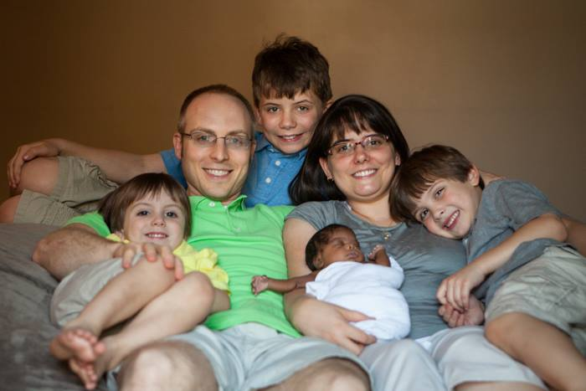
Jonathan Baker

