Slide 1
solidMatter
Concept & Architecture

Slide 2
Table of Contents
Design goals
Architecture
Examples
Current state

Slide 3
Design Goals
…the usual suspects
Flexibility
Extensibility
Security
Performance

Slide 4
Design Goals
…more specific
Equally suitable for
  Content Management
  Webapplications
Separating content & presentation
  Different styles
  Interchangable GUIs
  Multilanguage
Data storage
  Objects & properties
  Hierarchical
  Referential integrity

Slide 5
Architecture – Layers overview
Presentation
Interface
Application
Data Storage

Slide 6
Architecture – Layers
…in detail
Webbrowser (Flash? Silverlight? …?)
HTML / XHTML / XML / Binary etc.
Interface logic (PHP or Flash etc.)
not
necessarily
separate
instances
XML (or DOM Object)
Framework & Modules (PHP)
Repository objects
Content Repository (PHP/Database)

Slide 7
Architecture – Interface Layer default mode of operation
Input processing
  Decides how to handle a request
  Sends XMLRequest to application layer
Output Processing
  Usually gets XMLResponse from application layer
  Renders Output if necessary
GET / POST
HTML etc.
Interface
XMLRequest
XMLResponse
Application

Slide 8


Architecture – Interface Layer
…more information
Does not necessarily address Application Layer
  e.g. delivering an image does not require this
  Can also deny requests and use other backend handlers
Can be completely replaced
  e.g. Flash / Silverlight / native GUI frontend possible
  But interface layer has to deal with request/response
Theme files
Interface
deny request
Other handler
?
?
?

Slide 9
Architecture – Application Layer default application flow
XMLRequest
XMLResponse
Controller
Data
instanciates
adds
Handler
adds
instanciates
calls
has
Node
View / Action
operates on

Slide 10
Architecture – Application Layer views & actions
Each Nodetype provides several views
Each view provides at least one action
Actions are called on node instances
Example:
Node: „my Folder“ (Nodetype: Folder)
View: „thumbnails“
Action: „display“
Nodetype
View
View
View
Action
Action
Action
Action
Action
Action
Action
Action
Action

Slide 11
Architecture – Application Layer
…more information
Usually accessed via an OOUI (Object Oriented User Interface)
  An action is called on a node to generate Output
  Actions can call other actions
Transport of Information to Interface Layer
  XMLResponse contains all raw output data
  XMLResponse carries information on how the output should be rendered (URL of XSL-stylesheet, output format)
Extensibility / Flexibility aspects
  Based on modules with own code and data
  Each module can provide new nodetypes and views/actions
  Views/actions can be applied to different nodetypes
  Nodetypes may override default code and add functionality

Slide 12
Architecture – Content Repository basics
Hierarchical structure
Nodes
…with Properties
…and Views
…and Actions
„Once upon
a time…“
Node
3.56632E+13
true
-25
Property

Slide 13
Architecture – Content Repository
API
The standard: JCR
  Java Content Repository (JSR170/JSR281)
  All important features included
  Is being ported to PHP
But… it lacks something
  Only data storage, no functionality attached
  No connection of nodetypes to classes
  Web 2.0? Performance?

Slide 14
Architecture – Content Repository sbCR
partly compatible to JSR281
  Standard classes and features
  Repository, Workspaces, Nodetypes, Nodes
  Shared nodes, Locking, Transactions
But… not completely
  No Properties, these are used as scalar types
  Voting and Tags available on all nodes
  A part of the API not yet supported

Slide 15
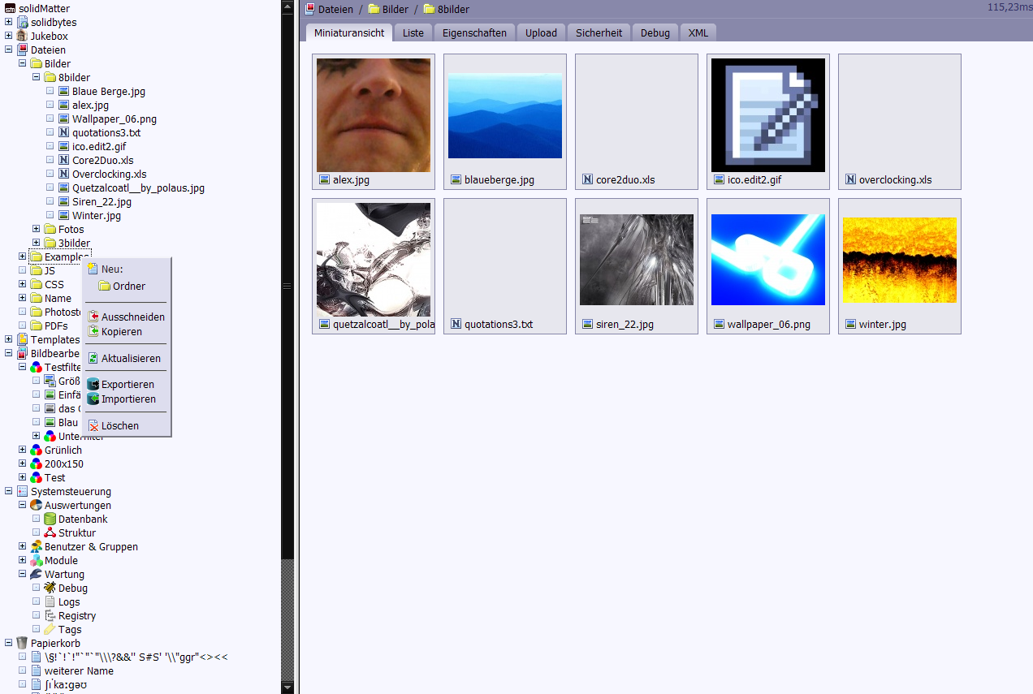
Examples admin backend screenshot

Slide 16
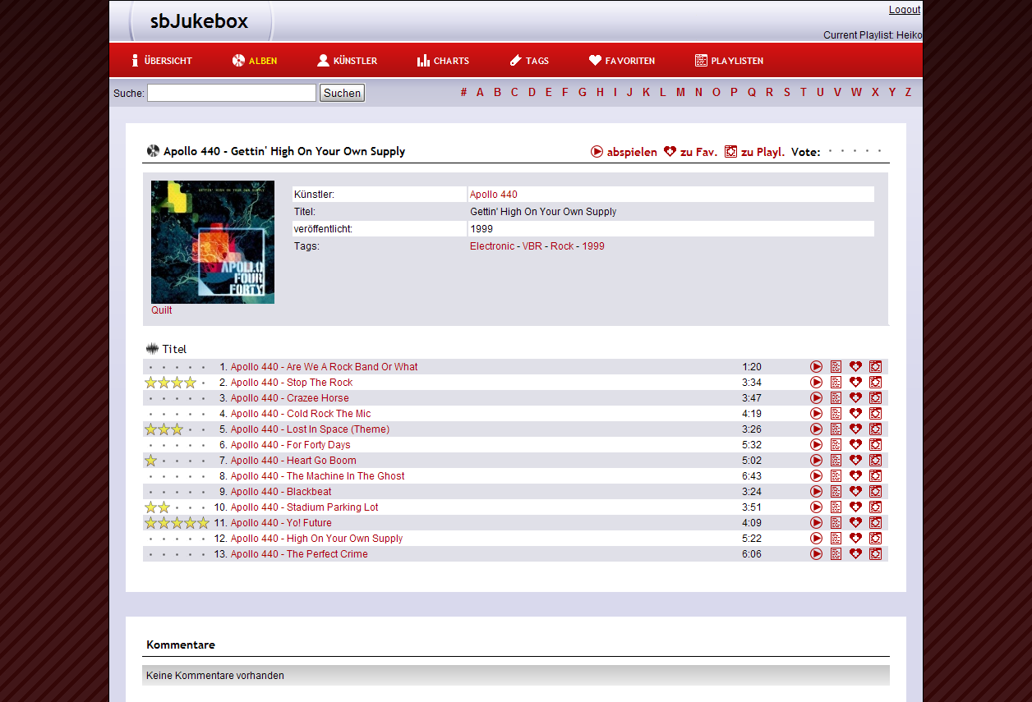
Examples sbJukebox screenshot

Slide 17
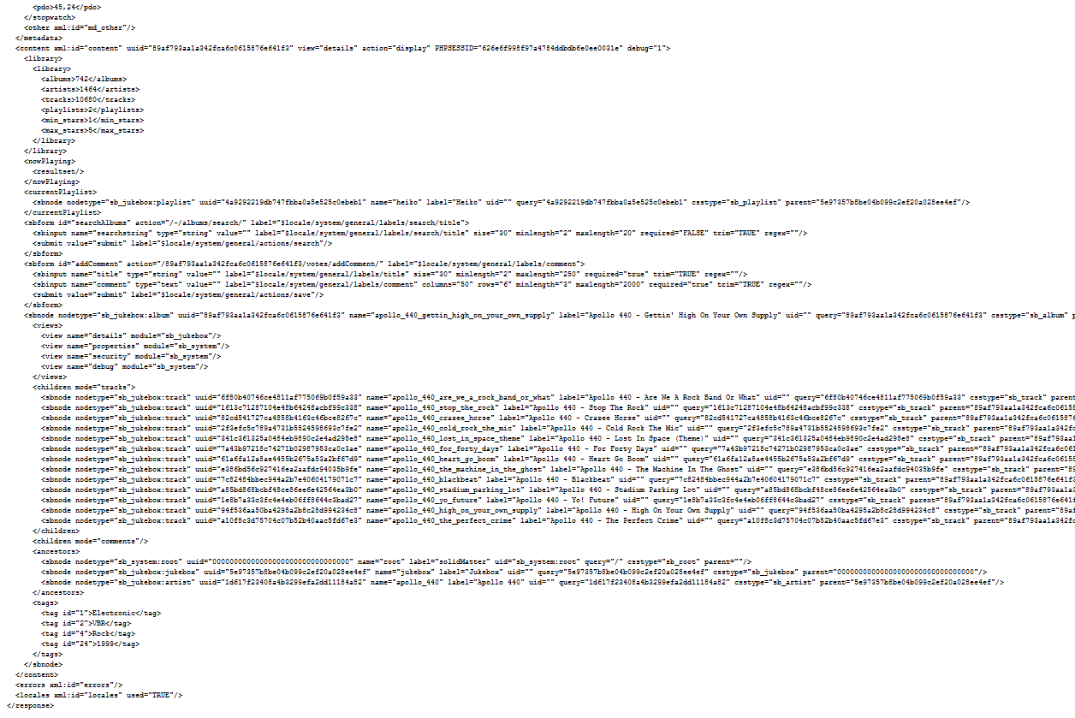
Examples excerpt from response XML

Slide 18
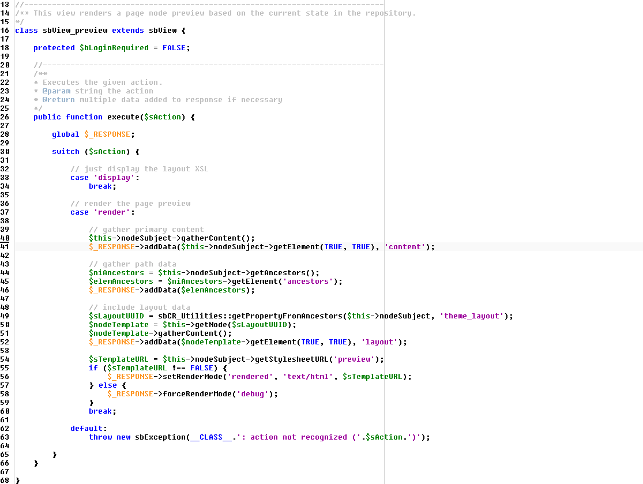
Examples code of a view object

Slide 19
Current State
 most basic functionality is implemented
 good part of administration backend is working
 proof-of-concept exists (sbJukebox)
 part of the API still to be implemented
 some bugfixing and documentation needed
 i have no time to work on it!
→ developers, developers, developers!!!

