Slide 1
Monitoring
Speaker Name

Slide 2
Agenda
Monitoring at the platform level
Monitoring at the application level
Integrating with the partner ecosystem

Slide 3
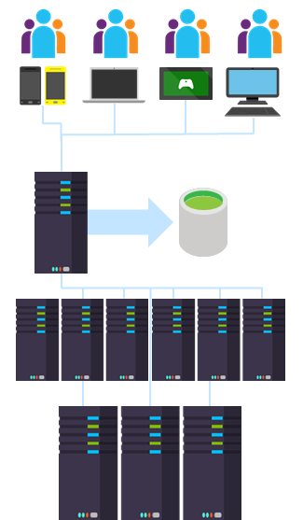
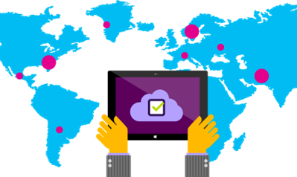
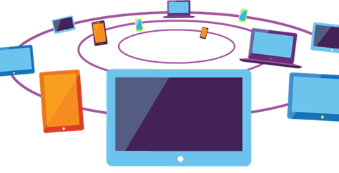
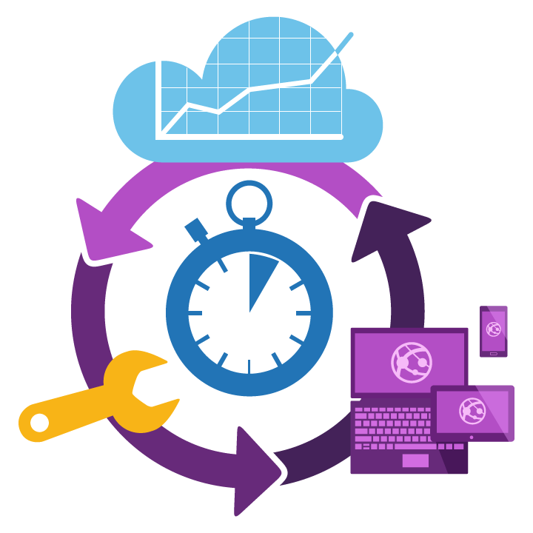
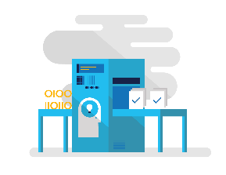
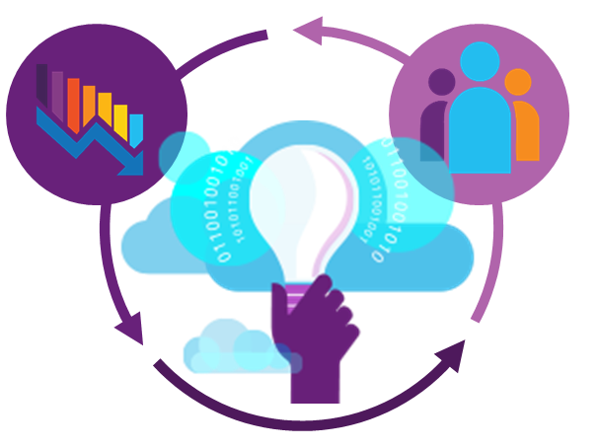
Diagnostics for Modern Applications
Multiple tiers and components
Multiple data centers
Different clients
and browsers
Feature churn
Continuous Delivery
Quickly find and fix

Slide 4
Monitoring Answers Questions
Is my application up or down?
Is my application crashing?
What exactly happened?
What is the root cause?
How many people are impacted?
Is my application fast enough?
Can my server handle the load?
Am I meeting my SLA?

Slide 5
Managing Monitoring Data
Detect
Proactive alerts, synthetic tests and real time metrics
Triage
Application dependencies analysis and real user impact investigations
Diagnose
Failures and performance issues diagnostics, log analytics
Operationalize
Alerts, dashboards and ALM integration

Slide 6
Metrics Beyond Virtual Machines
VMs (host-level metrics)
VM Scale Sets (host-level metrics)
Batch
App service - Sites
App service - Server farms
SQL DB (v12)
Elastic SQL Pool
Redis Cache
Logic Apps
Service Bus namespace (Premium SKU)
Event Hub namespace
IoT Hub
Networking - Application Gateway
Search
Notes:
https://azure.microsoft.com/en-us/documentation/articles/monitoring-supported-metrics/

Slide 7
Monitoring Experience On Azure
Azure Portal
3rd party products, integrate via REST API, Event Hub, Storage log files
Azure Monitor
(platform monitoring)
Application Monitoring (Application Insights)
Log Analytics, Automation, Solutions (OMS)
On-prem, hybrid/ external cloud data
Azure services

Slide 8
Monitoring begins at the platform level

Slide 9
Azure Monitor
Built-In monitoring support for Azure resources
Out-of-box metrics and logs
Alert rules to get notified & take automated actions
APIs for 3rd party integration
Enable advanced monitoring and analytics experiences

Slide 10
Activity Log
Contains log of management operations on resources
Consume via portal or REST API
90-day data retention
Export to Blob storage or stream to Event Hub
Built-in analytics via Log Analytics
Notes:
Record of all actions taken by the Azure control plane/fabric

Slide 11
Metrics
Azure resources provide metrics
1-minute granularity
Metrics are stored for 30 days
Activity log entries are stored for 90 days
Diagnostics logs are not stored
Use a storage account for longer retention (pricing separate)
Consume via Portal or REST API
Opt-in to detailed monitoring on VMs

Slide 12
Alert Rules
Manage alerts all in one place
Alert on platform, app, and custom metrics with email and webhook notifications
Alerts on Activity Log and Service Health notifications
Manage alerts easily using Notification Groups

Slide 13
Diagnostic Logs
Manage diagnostics settings in one place
Blob storage for archival or offline reporting
Stream to Event Hub for custom app or 3rd party integration
Route to OMS Log Analytics for advanced analysis

Slide 14
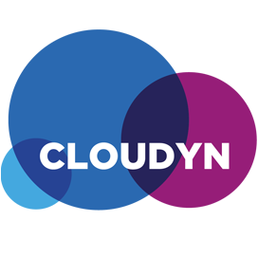



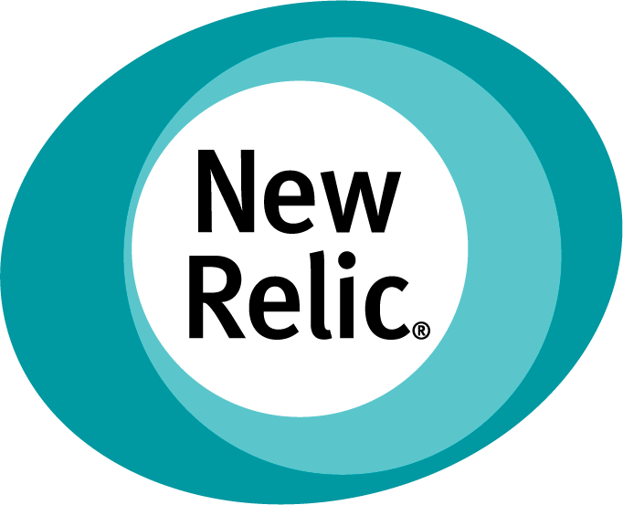



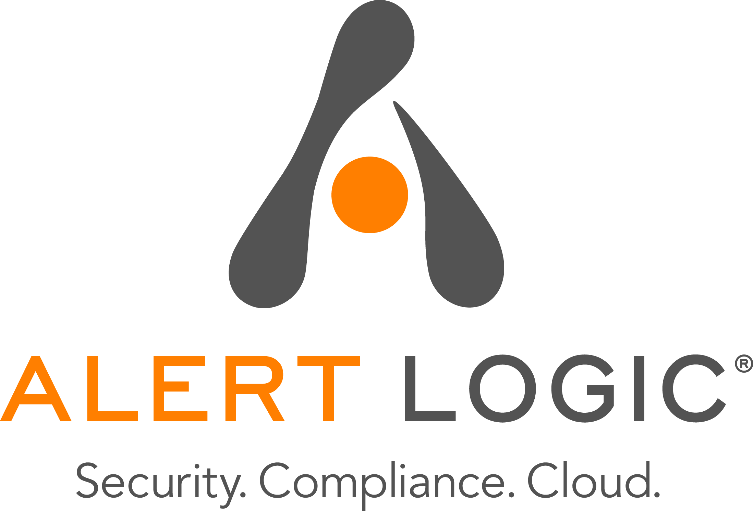


3rd Party Integrations

Slide 15
Demo
Azure Monitor
Notes:
Open azure portal
Show metrics
Show audit logs
Show export to storage, event hubs, web hooks

Slide 16
Monitoring from the inside out

Slide 17
Application Insights
Consolidated analytics across server and client
Analyzes usage patterns
Detect, triage, and diagnose performance issues
Support for mobile and web applications
Built-in tooling for a variety of IDE’s and frameworks

Slide 18
Sources of Telemetry Data
Outside-in monitoring
1
URL pings and web tests from 16 global points of presence
Observed application behavior
4
No coding required – service dependencies, queries, response time, exceptions, logs, etc.
Observed user behavior
2
Real user monitoring for deeper diagnostic insights
5
Infrastructure performance
System performance counters
Developer traces and events
3
Whatever the developer would like to send to Application Insights

Slide 19
Proactive Monitoring
Analyzes and detects potential problems based on historical telemetry data
Looks for abnormal patterns such as a rise in failures
Ping and multi-step web tests from 16 locations worldwide

Slide 20
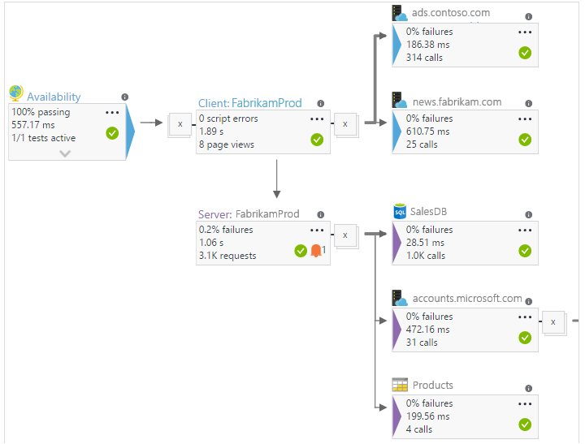
Managing Dependencies
Application Map is a visual depiction of app components Highlights potential problems regarding performance and failure rate

Slide 21


Managing Data Flow
Application
Insights
Application
Adaptive Sampling
Fixed-Rate Sampling
Filtering
Application
Ingestion
Sampling
Application
Notes:
https://azure.microsoft.com/en-us/documentation/articles/app-insights-sampling

Slide 22
Extending Application Insights
Open source SDKs to power insights for any web app
Continuously export data to Azure Blob Storage or SQL
Visualize data with PowerBI content pack
Data access via REST APIs

Slide 23
Custom Instrumentation
TrackPageView
TrackEvent
TrackMetric
TrackException
TrackRequest
TrackTrace
TrackDependency
Properties
Metrics
Sampling
Filtering
Perf Counters

Slide 24
Demo
Application Insights
Notes:
Show app insights resource
Show .NET with live site capabilities
Show web test

Slide 25
Getting Started
Instrument & Re-Deploy
Visual Studio
Open Source SDKs
Monitor without Re-Deployment
Azure Extensions
Status Monitor Agent
Eclipse
JavaScript Snippet
Pipe Existing Data
ASP.NET, Java, HTML/JS, Ruby, PHP, Node.JS, Python, etc. etc.

Slide 26
Monitoring from the outside in

Slide 27
Operations Management Suite (OMS)
Single pane of glass for monitoring VMs
Big data solution for logs
Interact with log data via Search and Solutions
Customizable dashboards
Near real time log monitoring

Slide 28
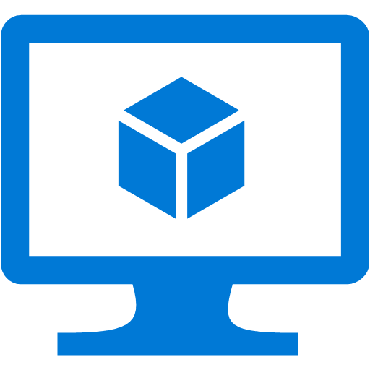


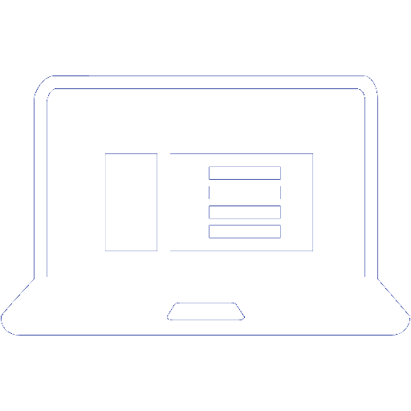
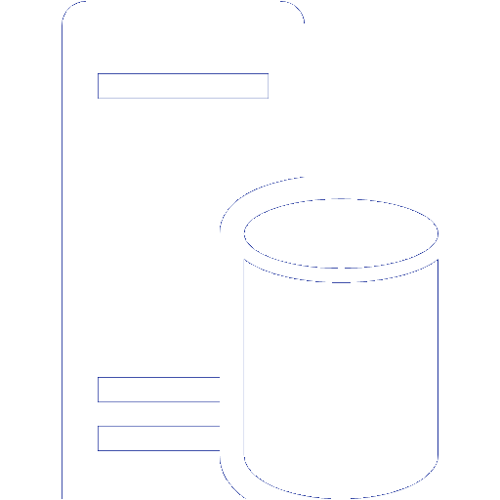
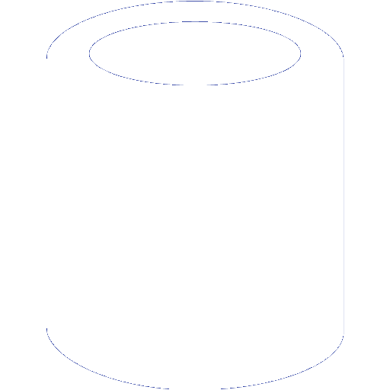
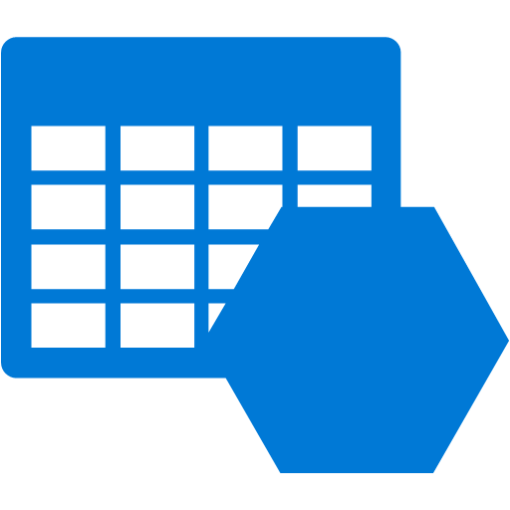


OMS Architecture
OMS Workspace
VM with Agent
Azure VM with Agent
Other Clouds
OMS Service
VM with Agent
SCOM Management Server
Blob Storage
OMS Repository
VM with Agent
Clients
On Premises
Azure

Slide 29
Solution Packs
Solutions are a set of data acquisition rules coupled with analytics logic and visualization that address key challenges for customers.

Slide 30
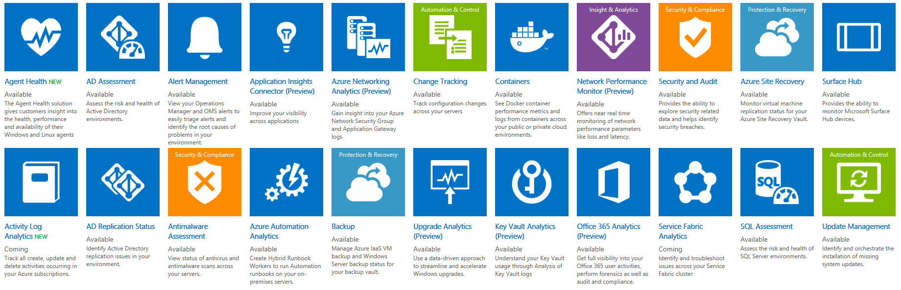
Solution Packs

Slide 31
Search
Pin commonly used search queries and reports to your dashboard for a tailored experience that saves time and enhances focus

Slide 32
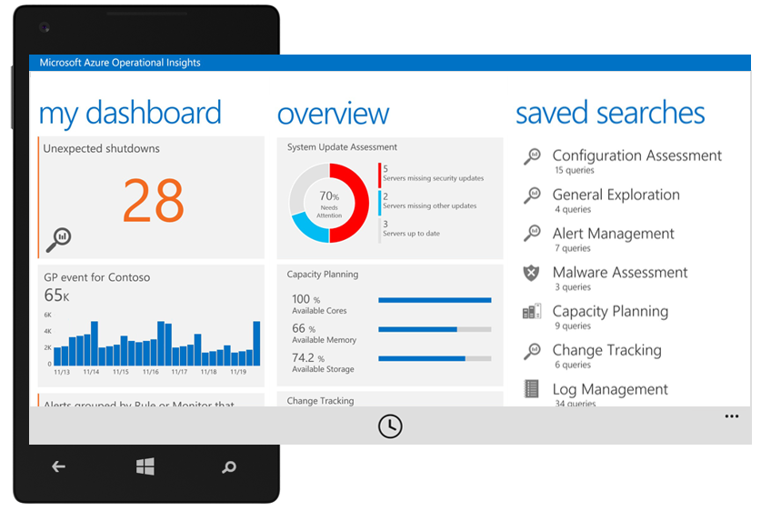
Monitoring on the go
Notes:
iOS and Android coming soon
TODO: Add to the diagram off the cloud service (collapse this slide into earlier diagram slide)

Slide 33
Demo
Operations Management Suite
Notes:
Prereq
Create an OMS portal
Open OMS
Show dashboard
Add VM to OMS
Show the solution packs
Show the search experience

Slide 34
Questions?

Slide 35
HOL Summary
Azure gives you a complete toolset to monitor the status and performance of your applications. It also allows you to run automated performance tests to easily find weaknesses before you go live with your app.
Created an Application Insights instance.
Used SDKs to add telemetry to an application.
Viewed performance metrics in the Azure Portal.

Slide 37
Resources
Azure Monitor Documentation
https://aka.ms/azmondocs

