Slide 1
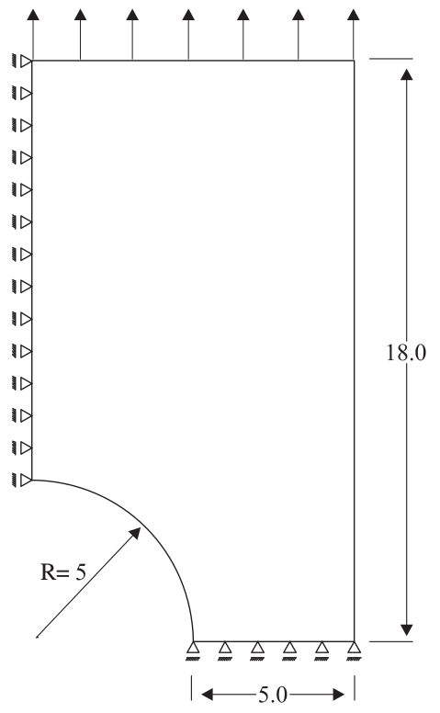
Multi-scale analysis of stretching of an elasto-plastic perforated plate
Geometry, properties, BCs
E=70 GPa
ν=0.2
Ϭy0=0.234 GPa
Hp=0.2 GPa
Top edge displ. increment:
𝛿u = 0.005 mm

Slide 2
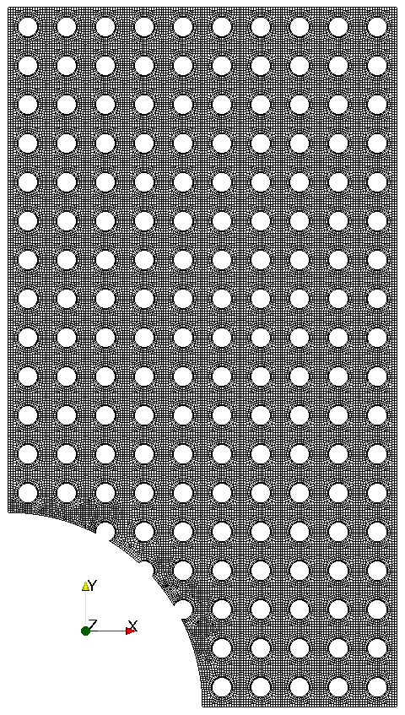
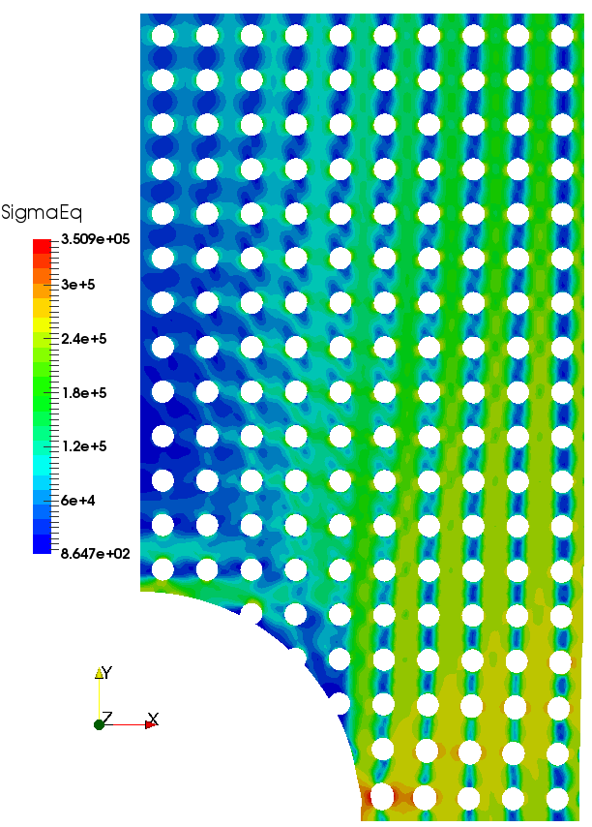
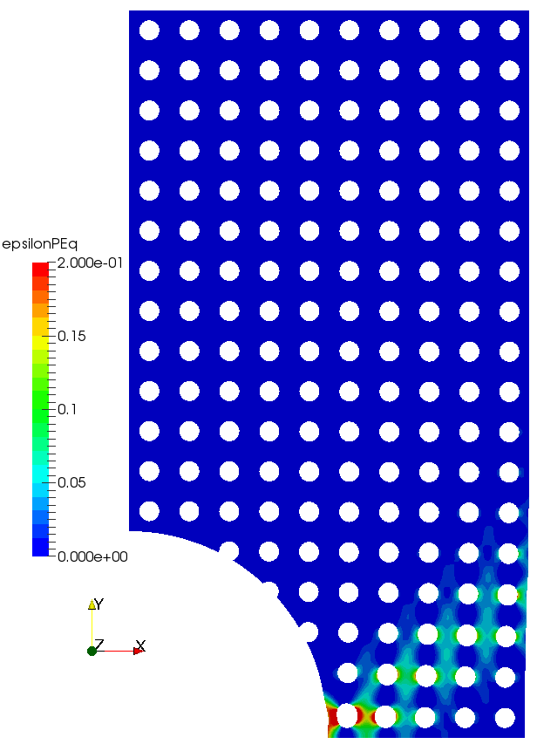
Multi-scale analysis of stretching of an elasto-plastic perforated plate
Single-scale analysis
40774 cells, 85178 faces

Slide 3
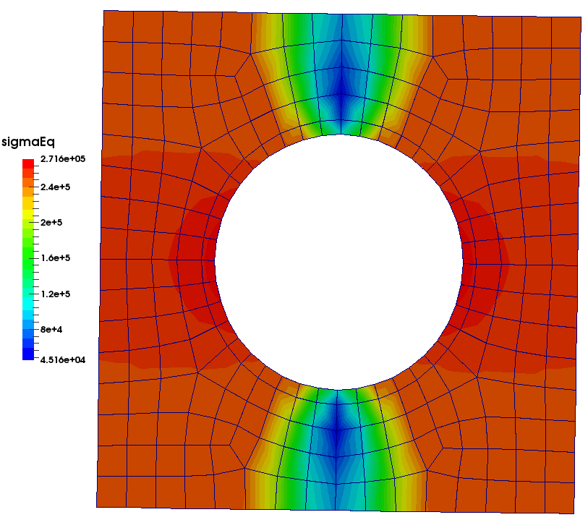
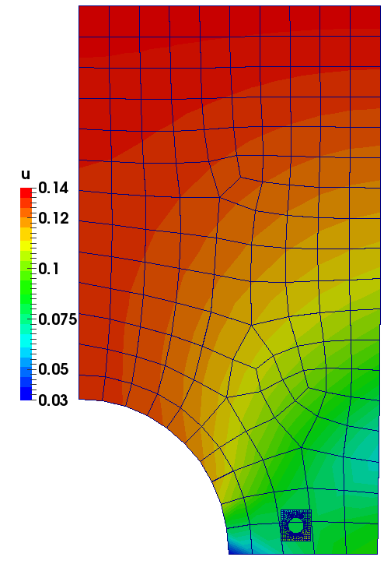
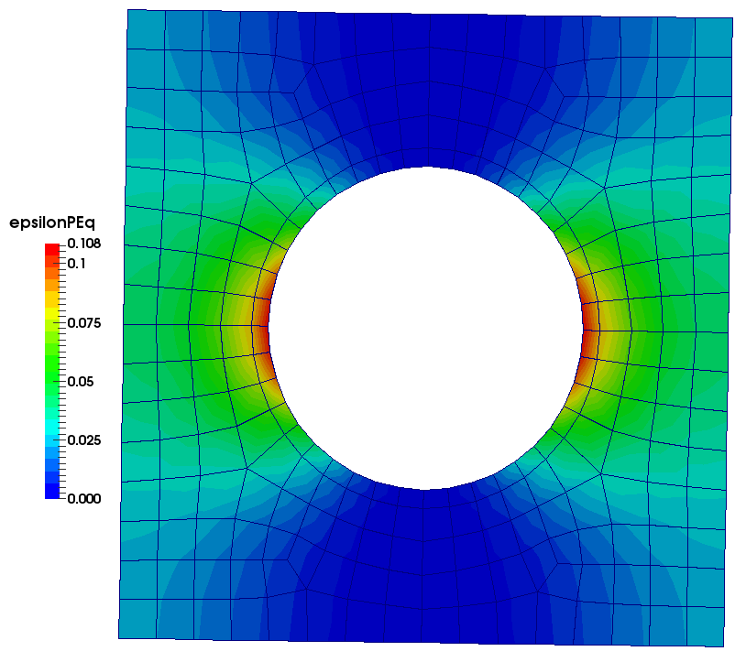
Multi-scale analysis of stretching of an elasto-plastic perforated plate
Two-scale analysis
Macro mesh:
150 cells, 310 faces
RVE mesh:
252 cells, 556 faces

Slide 4
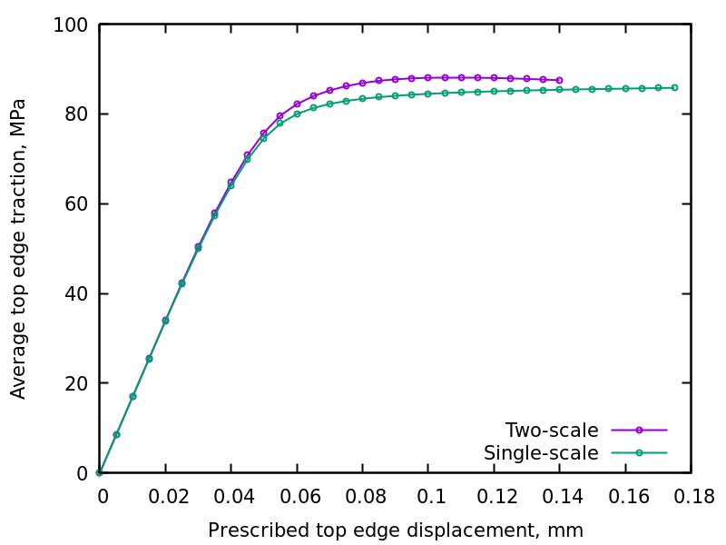
Multi-scale analysis of stretching of an elasto-plastic perforated plate
Two-scale – single-scale comparison

