Slide 1
Table of Contents
Introduction
Limitation
Problem statement
Motivation
Objectives
Literature Review
System Diagram
Requirement Analysis
Implementation
Conclusion

Slide 2
Introduction
In the pandemic time, university used online communication to conduct education system. But they are not actually followed proper system for assigning tasks by the teachers, submitting them by the students. So, using a web-server based dynamic systems with the online tools for enrolling, evaluating, manage in different semesters is more easier and convenient. Also, by using the internet they can be able to access the information from the secured database according to their needs and supervisors can follow up all the assigned tasks in a timely manner and reduce the distance and communication gaps between them.

Slide 3
Limitation of Existing System
01
Vert few systems provide online evaluation for the students
02
Less systems have been built for auto marking the assessment
03
Other advanced systems are built for special lanuage such as Arabic
04
The security issues can not deny for the maximum systems

Slide 4
Problem statement
No proper platform exist in Bangladesh for taking examination and marking
User accessibility is not easier for both
teachers and students
Some existing system is available to access only for particular people
Also automated structural system is not available

Slide 5
Motivation
Academic prospects the relationship between professors and students is usually declining throughout the university as a result of this enormous growth in enrollment. The ratio of lecturers to students has likewise decreased. Also contents, tasks, mark distribution are not well organized, incompatible with the requirement of the students to find or meet with supervisors in order to enhance the connection between lecturers and students.

Slide 6
Objective
To propose a system model accompanied by automated design function as a leading indicator.
To construct a system having reduced complexity and time-consuming.
To develop this system by applying according to the demands of different user interfaces and also establishing a system.
To ensure the security issues for the users when they enter all of their personal data and information.

Slide 7
Literature Review
Title | Type and Publication details | Technique and Findings | Limitations
N. Hamzah, A. Ariffin, and H. Hamid, “Web-based learning environment based on students needs,” in, 2017 | IOP Conference Series: Materials Science and Engineering, vol. 226, p. 012196, IOP Publishing | They did only quantitative research based on a questionnaire survey. They just collected data o be ensure that an evaluation system was needed for those survey students. | They were not able to propose any system or build any system.
R. Dadi, S. N. Pasha, M. Sallauddin, C. Sidhardha, and A. Harshavardhan, “An overview of an automated essay grading systems on content and non content based,” in, 2020 | IOP Conference Series: Materials Science and Engineering, vol. 981, p. 022016, IOP Publishing | The study highlights the importance of assessment in the education system and the increasing interest in using automatic tools to aid in the assessment process. It Assessed the writing papers by NLP (Natural Language Processing) tools. | The system was not able to provide any kind of scores.

Slide 8
Literature Review
Title | Type and Publication details | Technique and Findings | Limitations
James F. “Lessons the higher education sector can learn from the Coronavirus crisis. QS.com” 9 October 2021. | Volume 58, - Issue 6: Special Edition: Online doctoral supervision and support for supervisors Submit an artic | According to studies, they still appreciate a sense of community and belonging, according to anecdotal evidence. Both still prefer face-to-face instruction over the virtual or remote methods used to meet the pedagogical needs of students during the pandemic digital tools are only meant to supplement face-to-face learning. | No online module was created in their study and only worked with a fixed area of students and teachers
Crossouard. “Developing Alternative Models Of Doctoral Supervision With Online Formative Assessment. Studies in Continuing Education”, vol. 30, no. 1, pp. 51–67, 2018. | Volume 30, - Issue 1: Studies in Continuing Education | Discovered that there have been changes to higher education courses that have an impact on how teachers and students communicate using computers, and he pushed supervisors to adopt online monitoring as well. The interpretation of vocal and textual communication in online monitoring using computers | Permanently not built any online platform to monitor and followed the traditional tools.

Slide 9
Literature Review
Title | Type and Publication details | Technique and Findings | Limitations
A. Shehab, M. Faroun, and M. Rashad, “An automatic Arabic essay grading system based on text similarity algorithms”, 2018 | International Journal of Advanced Computer Science and Applications, vol. 9, no. 3 | It highlights the advantages of auto-grading systems such as cost, time, and effort-saving compared to manual grading. The study also focuses on the specific challenge of developing auto-grading systems for Arabic languages due to complexities in morphology, semantics, and syntax. | The system was fully built in Arabic language and there were no guidelines to work in different language in that system.

Slide 10
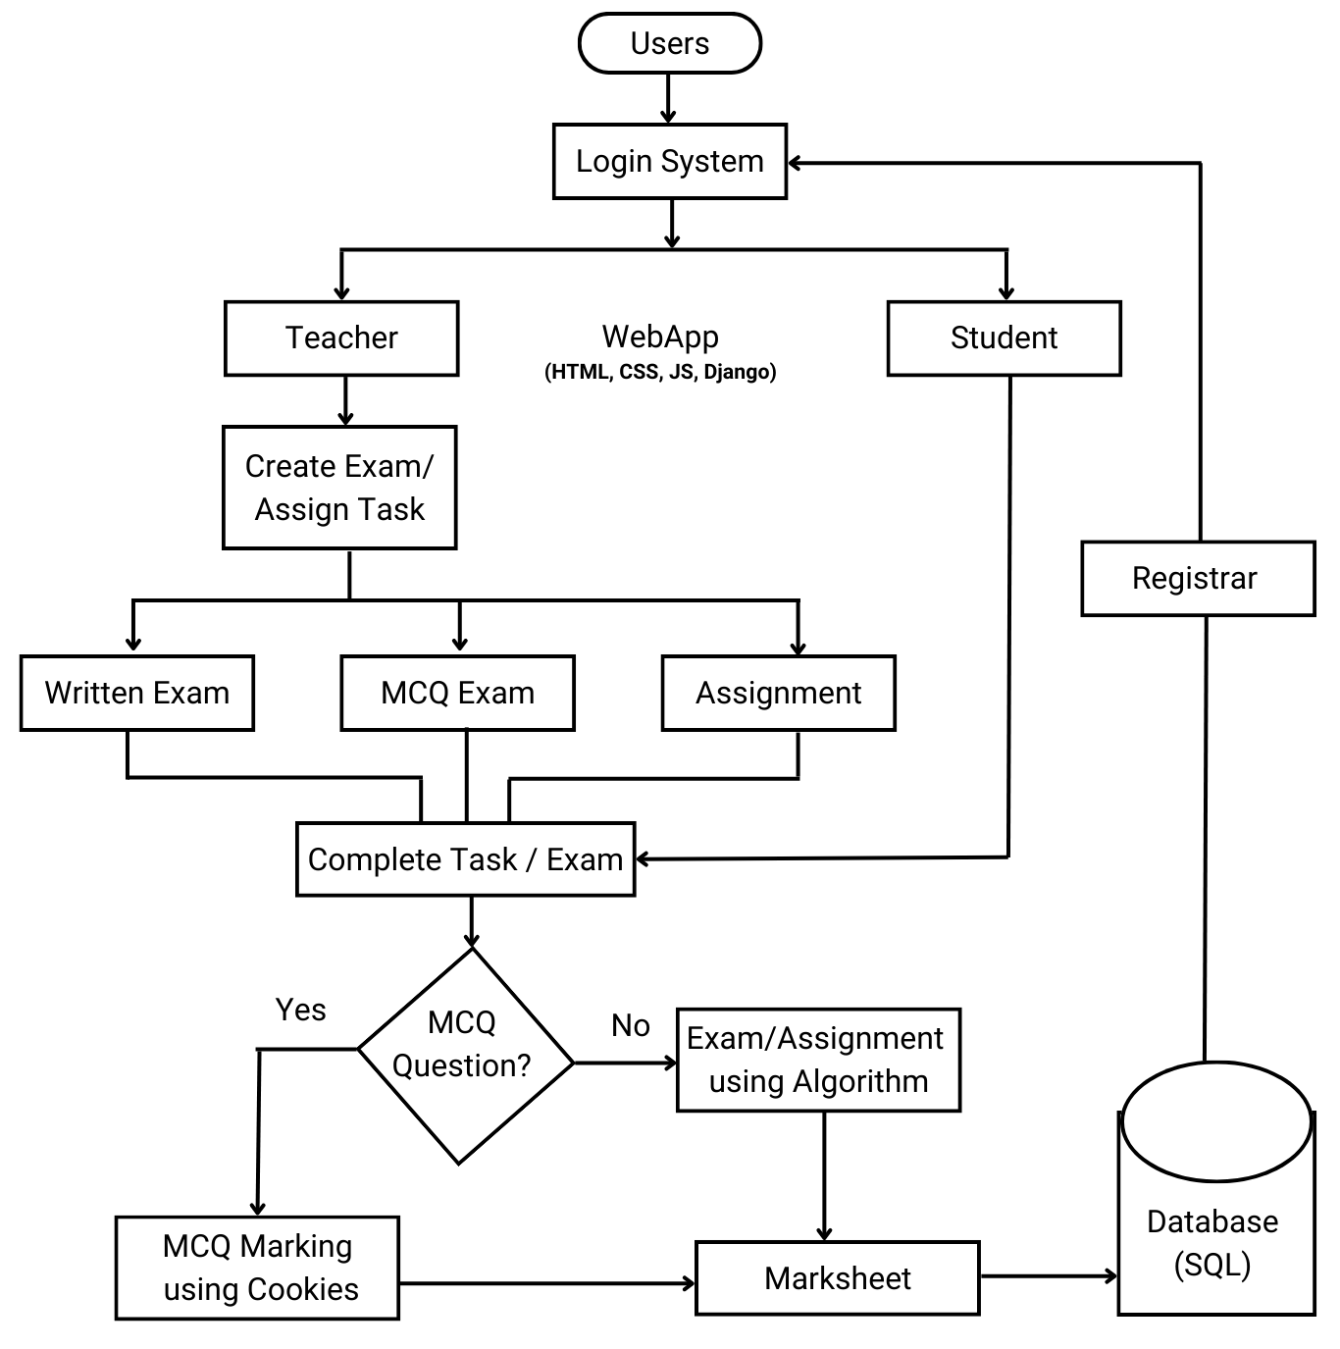
System Diagram
The students and the teachers will need to sign-up and login before enrolling in the system. For designing the process front-end HTML,CSS and JS. For the back-end Django and for database Sqlite3 will be used. Registrar have database access of students and teachers.

Slide 11






Requirement Analysis
HTML
CSS
JavaScript
Markup language used to
create and display web pages.
Design, control the layout, and visual appearance of pages.
Make dynamic, interactivity and functional of a web page.
Sqlite3
Django
Vs Code
Shortage of resources space
Gap between teacher and students
Hard to manage or complete tasks

Slide 12
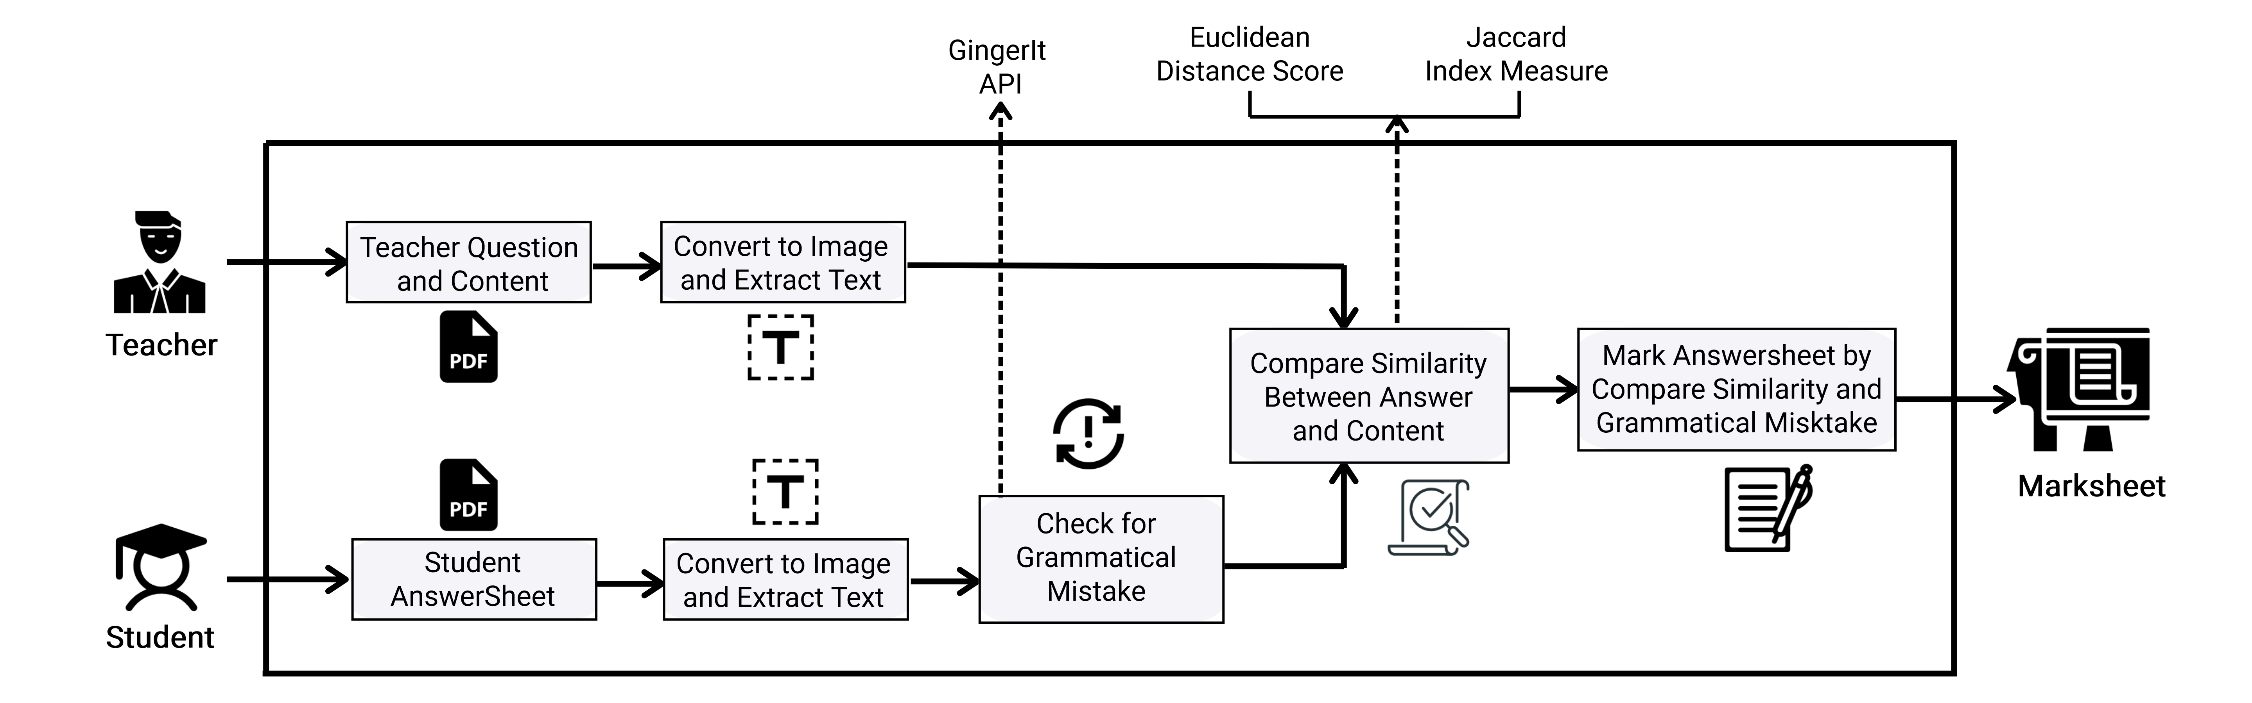
Written Paper Evaluation Process

Slide 13
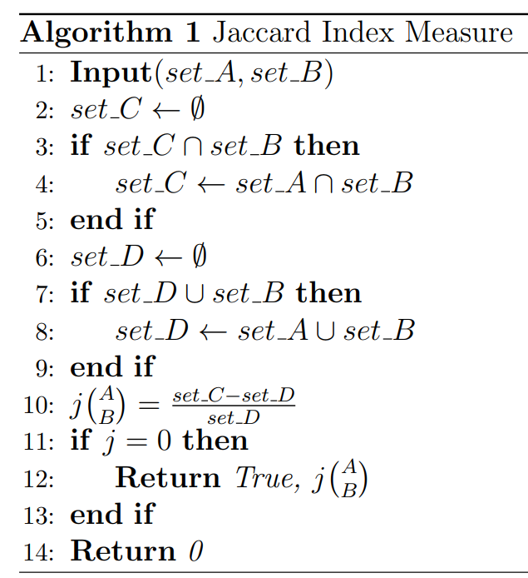
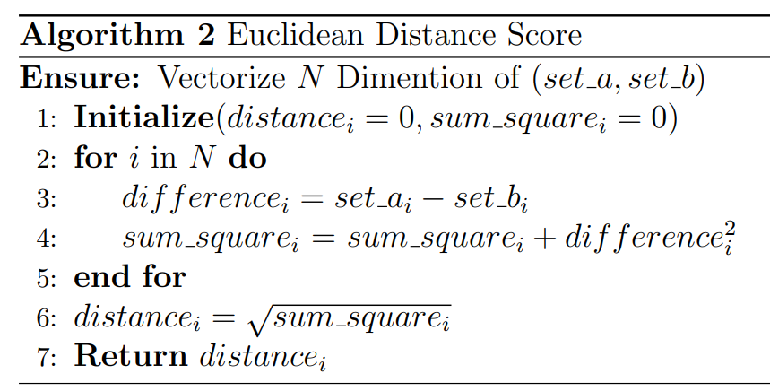
Grammar Check and Compare Texts
To check spelling and grammar mistake in process by using GingerIt API based on the context of complete sentences.

Slide 14
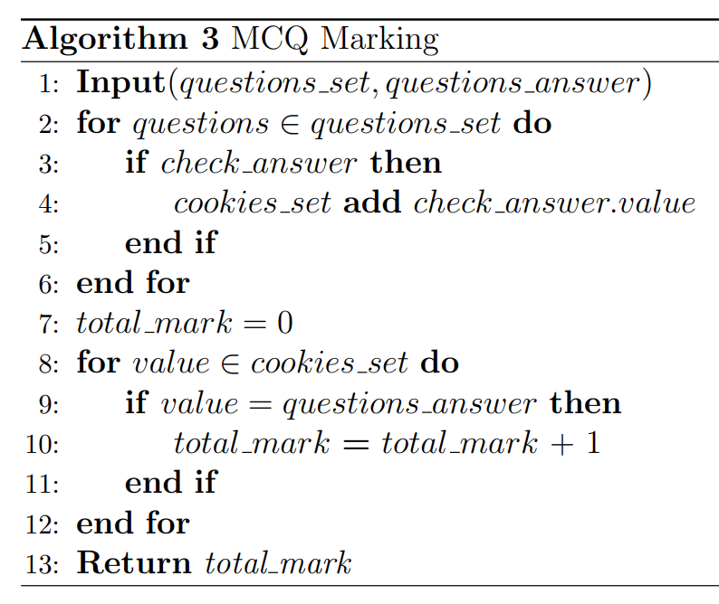
MCQ Evaluation Process
For MCQ evaluation student answer will be saved to the browser cookies. If the answer is clicked, the value of the corresponding question is added
to cookies. After checking all answers, then iterates through
the cookies and compares the values to the correct answers and calculate total marks.

Slide 15
Gantt Chart
2022
2023
October
December
January
February
March
April
May
Background Research
Research Design Planning
Requirment Analysis
Design
Implementaion
Testing and Maintainence

Slide 16
Conclusion and Future Scope
This project aims to develop an environment of evaluation system for the faculty of universities utilized by students and teachers. The main benefit of this system is its potential to provide more convenience and greater accessibility for examination tasks with easier, faster automated processes. System will move the faculty to a higher level of productivity, efficiency, flexibility and performance by generating era.
In future, we will improve written paper evaluation process and exam scheduling system. Also will add lecture content distribution and video conversation system.

Slide 17
Thanks!
Do you have any questions?

