Slide 1
GitHub DevSecOps
Sergei Vorobyov, Solita Info Session 2023-02-17

Slide 2
What is DevSecOps?
DevSecOps extends the advantages of a DevOps approach, including agility and responsiveness, to IT security.
The idea is to integrate security early in the development process and throughout the Software Development Lifecycle (SDLC).
This involves fostering a culture of flexibility and ongoing collaboration between development and security teams, and incorporating security protocols into the development process.
Automation of security testing is the key!
More frequent (many times a day) software releases = more need for security automation!

Slide 3
Common DevSecOps Practices
Integrating code analysis tools into the development pipeline, to prevent compromised code from reaching production
Automating and continually testing the production environment to detect weaknesses
Carrying out fixes and patches before deployment, not after
Automated or semi-automated security gates that enable careful review of software without slowing down the workflow

Slide 4
DevSecOps = Shifting Security Left
Tests and fixes are performed earlier in the development pipeline - “more to the left
“Test early and often” by building security testing into all stages of the SDLC
In DevSecOps security testing and remediation shifts left
The core of DevSecOps is to address security at all stages of the delivery chain, from requirements and planning to development, testing, deployment and release
The goal is to improve the coverage and effectiveness of security processes, increase software quality, shorten test cycles, and reduce the security debt
Most importantly: it is easier and less expensive to apply security fixes as early as possible in the SDLC cycle

Slide 5
The Skills Gap = Major Challenge
Most engineers and operations experts aren’t experts in security
Security analysts have limited understanding of development processes, tools and tradeoffs, have insufficient throughput
Start little by little, rely on security test automation (manual is inadmissible!)

Slide 6
GitHub: an Excellent DevSecOps Starting Point
Azure DevOps is an enterprise DevOps platform, but
GitHub (acquired by M$ 4-5 years ago) with Actions gains momentum
Both are actively developed and maintained but seems GitHub is faster/favorite
If you are a little bit familiar with Actions / workflows, then you are all set!
Every workflow = sequence of steps / shell scripts / action invocations
You just need to appropriately insert security-related actions in your workflows!
(J S Bach was asked if it is difficult to play the organ - There is nothing to it. You simply strike the right notes at the right time, and the instrument plays itself.)

Slide 7
Three Types of GitHub Repositories
Public: seen by everyone on the Internet
Internal: seen by everyone in an organization
Private: only to you and to people you delegate access to
Public – you have the MAXIMUM of security features enabled (if you work on public projects, you are best served for FREE!)
Internal and Private – you have FEWER security features enabled
Unless you have GitHub Enterprise with GHAS (GitHub Advanced Security) license (we do NOT have it at Solita Enterprise GitHub)

Slide 8
GitHub Advanced Security, GHAS
Code scanning / SAST (Static Application Security) CodeQL - Search for potential security vulnerabilities and coding errors in your code
Secret / credentials scanning - detect secrets, keys, and tokens that have been checked into repositories
Dependencies scanning, Dependabot – search for vulnerable third-party package dependencies you pull/import/require in you projects

Slide 9
Security Features by Repository Type
 | Public repos | Private w/o GHAS | Private with GHAS
Code Scan SAST CodeQL | Yes | No | Yes
Secrets scan | Yes | No | Yes
Dependencies SCA Dependabot | Yes | Yes | Yes

Slide 10
Types of Security Scans: Red=Early in Pipelines
SAST – Static Application Security Testing Finding vulnerabilities in your code (code injection, buffer overflow, unverified deserialization,…)
SCA – Software Composition Analysis Finding vulnerabilities in dependencies (.whl, npm, jar, … packages) you pull into your applications, direct or indirect; OS base images and packages On the average, 90-95% of an application are pulled dependencies
Secrets Scan – potential secrets/credentials/tokens leaks
DAST - Dynamic Application Security Testing Analyzing a web application through the front-end to find vulnerabilities through simulated attacks
IAST – Interactive Application Security Testing

Slide 11
Demo: GitHub Public Repo – No-Code Security
Just enable:
Code Scan (CodeQL) – SAST
Open Source Dependencies Scan (Dependabot) – SCA
Secrets Scan
And you get them covered in your repo!
Ticking a few checkboxes does the job!
Remember: this works only for PUBLIC repos! (unless you have Enterprise+GHAS)

Slide 12
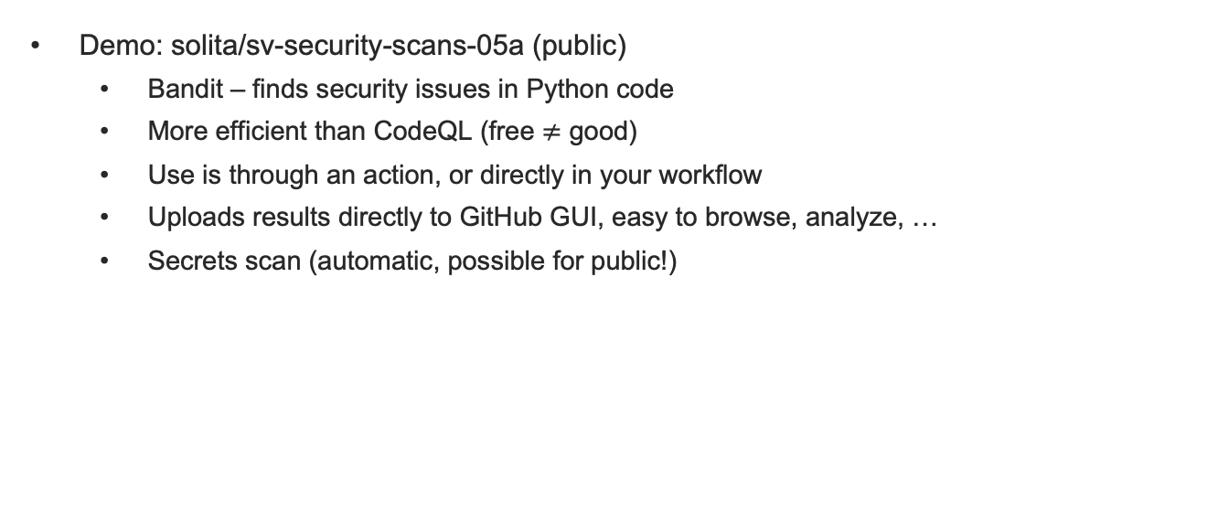
Advanced: Create Your Workflow with Actions
Demo: solita/sv-security-scans-05a (public)
Bandit – finds security issues in Python code
More efficient than CodeQL (free $≠$ good)
Use is through an action, or directly in your workflow
Uploads results directly to GitHub GUI, easy to browse, analyze, …
Secrets scan (automatic, possible for public!)

Slide 13
GitHub Internal: No Free Goodies (Except SCA)
Demo solita/sv-security-scans-01 (internal)
Dependabot (SCA) works! Finds vulnerable dependencies you pull/import/require
GitLeaks – a mightly secrets/credentials scanning tool
Checkov – a vigorous IaC (Infrastructure as Code) scanning tool Terraform, Pulumi, …
TFSec – also excellent for Terraform
Trivy – a superb scanning tool for Docker images and filesystems
(Also, remember Bandit – open source for Python Security)
All open-source and free (so far), you can use in private/internal repos
You do not need GHAS Advanced Security! Have SAST, SCA, Secrets, IaC covered!

Slide 14
Workflows 1
$ find sv-security-scans-0*/.github/workflows -name "*.yml"
sv-security-scans-01/.github/workflows/pip-audit-01.yml (-01 = Internal repo)
sv-security-scans-01/.github/workflows/trivy-01-image.yml
sv-security-scans-01/.github/workflows/gitleaks-01.yml
sv-security-scans-01/.github/workflows/checkov-01.yml
sv-security-scans-01/.github/workflows/trivy-02-fs.yml
sv-security-scans-01/.github/workflows/tfsec-01.yml
sv-security-scans-02/.github/workflows/trigger-01.yml
sv-security-scans-02/.github/workflows/codeql-01.yml
sv-security-scans-03/.github/workflows/triggered-02.yml
sv-security-scans-04/.github/workflows/eslint-01.yml
sv-security-scans-04/.github/workflows/gitleaks-02.yml
sv-security-scans-04/.github/workflows/checkov-02.yml
sv-security-scans-04/.github/workflows/trivy-03-image.yml

Slide 15
Workflows 2
$ find sv-security-scans-0*/.github/workflows -name "*.yml"
sv-security-scans-05a/.github/workflows/bandit-02.yml
sv-security-scans-05a/.github/workflows/ci-static-analysis-py-alg.yml
sv-security-scans-05a/.github/workflows/bandit-04-aws.yml
sv-security-scans-05a/.github/workflows/bandit-03-alg.yml
sv-security-scans-05a/.github/workflows/bandit-03-aws.yml
sv-security-scans-05a/.github/workflows/ci-static-analysis-aws-enc.yml
sv-security-scans-05a/.github/workflows/bandit-04-alg.yml
sv-security-scans-05a/.github/workflows/trivy-04-fs.yml

Slide 16
Key Takeaways
If you work with GitHub and have a public repo (or Enterprise+GHAS), try a few ticks in “Settings/Security” and see the results in “Security” tab
Do not be upset to see hundreds of vulnerabilities! (Some may be false positives, some irrelevant. When you gain confidence, you can mask them, mark as resolved, …
Always look for available actions on the Marketplace, Google
Try to find the best for you purpose/language
Browse for security actions featured on GitHub (click on “New workflow”)
Useful to have a few alternative tools/actions for the same purpose, to be confident
Try to understand security alerts, to figure if they are relevant, how to eliminate them
85% of deployed code is vulnerable, but you want to be in secure 15%
Maybe try something commercial?

Slide 17
Snyk Developer-First Security Platform
Snyk Code (SAST)
Snyk Open Source (SCA)
Snyk Container image vulnerabilities analysis (OS, packages, composition, permissions,…)
Snyk IaC
Snyk Cloud
All eggs in one basket? But maintenance / learning curve are better
Alternatives: Palo Alto Networks, Fortify/MicroFocus, Sonatype, SonarQube, AquaSec, Trend Micro,…

