Slide 1
DevSecOps with GitHub and Azure DevOps
Sergei Vorobyov, Solita Info Session 2023-03-15

Slide 2
Agenda
DevSecOps: what, why, and how?
How to start easily?
Use GitHub, Azure DevOps, etc. (GitLab, CircleCI, …)
Sample security workflows / pipelines
Easily roll your own

Slide 3
Course Material
https://github.com/solita/sv-security-scans-07-crash-course (Public)
…
https://github.com/solita/sv-security-scans-06 (Public)
Semgrep
https://github.com/solita/sv-security-scans-05a (Public)
Bandit (Python static analyzer), CodeQL, Snyk

Slide 4
Contemporary Security Challenges
Enterprise applications create a prime target for malicious actors—resulting in devastating data breaches
Clouds, distributed applications, increase attack vectors
Modern development increases speed and security risks
Security teams are challenged keeping up with the growth and speed of continuous integration/continuous deployment (CI/CD) cycles and their dynamic components

Slide 5
Prevalence of Open Source Software (OSS)
Growing use of OSS components in application development
80% organizations use OSS
½ of codebases consist of 50-75% OSS
Developers save time by leveraging existing open source code in their applications so they can spend more time building custom unique functionality of their software
Important to make sure this doesn’t introduce security risks
Organizations are looking to fully understand their OSS components and can quickly respond if a vulnerability is found

Slide 6
Secret Scanning in Git Repositories
Increased number of heterogeneous software components
Require credentials for communication / authentication / authorization
31% of organizations have had secrets stolen from a source code repository in the last 12 months

Slide 7
Infrastructure as Code (IaC)
Increasing use of Infrastructure as Code (IaC)
83% respondents say they are experiencing an increase in IaC template misconfigurations
Security dangers because misconfigured cloud infrastructures represent broad exposure and large attack surface

Slide 8
DevSecOps
Organizations are embracing DevSecOps practices in response to security challenges
Leverage CI/CD tools that integrate security early
Applications are scanned for vulnerabilities, as they are being built
Test suites/scans are integrated into pipelines, rather than run as an afterthought
Better software, more safety and stability for end users
Development times, expenditure, and overall stress are significantly reduced

Slide 9
What is DevSecOps?
DevSecOps extends the advantages of a DevOps approach, including agility and responsiveness, to IT security.
The idea is to integrate security early in the development process and throughout the whole Software Development Lifecycle (SDLC).
This involves collaboration between development and security teams, as well as incorporating security protocols into the development process.
Automation of security testing is the key!
More frequent (many times a day) software releases = more need for security automation!

Slide 10
Incorporating Security into Development
Organizations are making efforts to incorporate security processes in development so that the faster release cycles do not expose them to an unmanageable amount of security risk
This includes cybersecurity user stories in agile software development processes, security-as-code (SaC), and GitOps
While 59% say they have implemented security-as-code, respondents believe it will be a highly relevant approach in the next two years
Although most see the utility of adopting SaC, organizations are still determining how to implement it or how to implement it across projects and teams given its maturity and the ongoing cybersecurity skills shortage

Slide 11
Common DevSecOps Practices
Integrating security code analysis tools into the development pipeline, to prevent compromised code from reaching production
Automating and continually testing the production environment to detect weaknesses
Carrying out fixes and patches before deployment, not after
Automated or semi-automated security gates that enable careful review of software without slowing down the workflow

Slide 12
DevSecOps = Shifting Security Left
Tests and fixes are performed earlier in the development pipeline - “more to the left
“Test early and often” by building security testing into all stages of the SDLC
In DevSecOps security testing and remediation shifts left
The core of DevSecOps is to address security at all stages of the delivery chain, from requirements and planning to development, testing, deployment and release
The goal is to improve the coverage and effectiveness of security processes, increase software quality, shorten test cycles, and reduce the security debt
Most importantly: it is easier and less expensive to apply security fixes as early as possible in the SDLC cycle

Slide 13
You Need To Start NOW (already yesterday)
There are plenty of security scanning tools, both commercial and free OSS
Difficult to choose, unless you already know the hallmarks
I will demonstrate a few free (but excellent) tools that can be started with
Commercial tools are expensive, and once a commitment is done, difficult to revert
Difficult to understand what commercial tools are useful for
You need to understand what you need, and which tool are good for your purpose

Slide 14
GitHub: an Excellent DevSecOps Starting Point
Azure DevOps is an enterprise DevOps platform, but
GitHub (acquired by M$ 4-5 years ago) with GitHub Actions gains momentum, biggest user base
Both are actively developed and maintained but seems GitHub is faster/favorite
If you are a little bit familiar with Actions / workflows, then you are all set!
Every workflow = sequence of steps / shell scripts / action invocations
You just need to appropriately insert security-related actions in your workflows!

Slide 15
Three Types of GitHub Repositories
Public: seen by everyone on the Internet
Internal: seen by everyone in an organization
Private: only to you and to people you delegate access to
Public – you have the MAXIMUM of security features enabled (if you work on public projects, you are best served for FREE!)
Internal and Private – you have FEWER security features enabled
Unless you have GitHub Enterprise with GHAS (GitHub Advanced Security) license (we do NOT have it at Solita Enterprise GitHub)

Slide 16
GitHub Advanced Security, GHAS
Code scanning / SAST (Static Application Security) CodeQL - Search for potential security vulnerabilities and coding errors in your code
Secret / credentials scanning - detect secrets, keys, and tokens that have been checked into repositories
Dependencies scanning, Dependabot – search for vulnerable third-party package dependencies you pull/import/require in your projects

Slide 17
Security Features by Repository Type
 | Public repos | Private w/o GHAS | Private with GHAS
Code Scan SAST CodeQL | Yes | No | Yes
Secrets scan | Yes | No | Yes
Dependencies SCA Dependabot | Yes | Yes | Yes

Slide 18
Types of Security Scans: Red=Early in Pipelines
SAST – Static Application Security Testing Finding vulnerabilities in your code (code injection, buffer overflow, unverified deserialization,…)
SCA – Software Composition Analysis Finding vulnerabilities in dependencies (.whl, npm, jar, … packages) you pull into your applications, direct or indirect; OS base images and packages On the average, 90-95% of an application are pulled dependencies
Secrets Scan – potential secrets/credentials/tokens leaks
DAST - Dynamic Application Security Testing Analyzing a web application through the front-end to find vulnerabilities through simulated attacks
IAST – Interactive Application Security Testing

Slide 19
Demo: GitHub Public Repo – No-Code Security
Just enable:
Code Scan (CodeQL) – SAST
Open Source Dependencies Scan (Dependabot) – SCA
Secrets Scan
And you get them covered in your repo!
Ticking a few checkboxes does the job!
Remember: this works only for PUBLIC repos! (unless you have Enterprise+GHAS)

Slide 20
Simple “Drop-In” Strategy: Add Scans to Your Code
Your current code repo:
Dir1/
Dir2/
Dir3/
Dir4/
…
Your NEW code repo:
.github/workflows/*.yml
Dir1/
Dir2/
Dir3/
Dir4/
…
YAML workflows in .github/workflows/*.yml AUTOMATICALLY do security scans!

Slide 21
Drop-In Strategy Pros and Cons
Pros:
Simplicity
Set and forget
Easy to (re)configure
Easy to start with
Cons:
Workflow code replication
Difficult to upgrade for a large number of repos

Slide 22
Gentleman’s Set of Security Workflows
SAST ():
Semgrep
Bandit
Snyk Code
SCA ():
Trivy
IaC ():
TFSec
Checkov
Secrets/credentials:
Gitleaks

Slide 23
Separate / Dedicated Scan Repositories
Scan Repository
Code Repository
Pull

Slide 24
Pros and Cons
Pros:
The same scan pipeline/workflow may be reused for many code repos
Easier to upgrade
More secure, since not everyone is admitted to scan repos
Easier to implement common governance and compliance
Cons:
More complicated
More complicated triggering, especially in GitHub (easy in Azure DevOps)
More complicated gating/conditioning

Slide 25
.sarif - Static Analysis Results Interchange Format
Based on JSON
Unified format numerous security analysis tools produce
Standard
GitHub understands .sarif files
There is a special GitHub action
- name: Upload SARIF file uses: github/codeql-action/upload-sarif@v2 # requires Public, or GHAS license! with: sarif_file: results.sarif

Slide 26
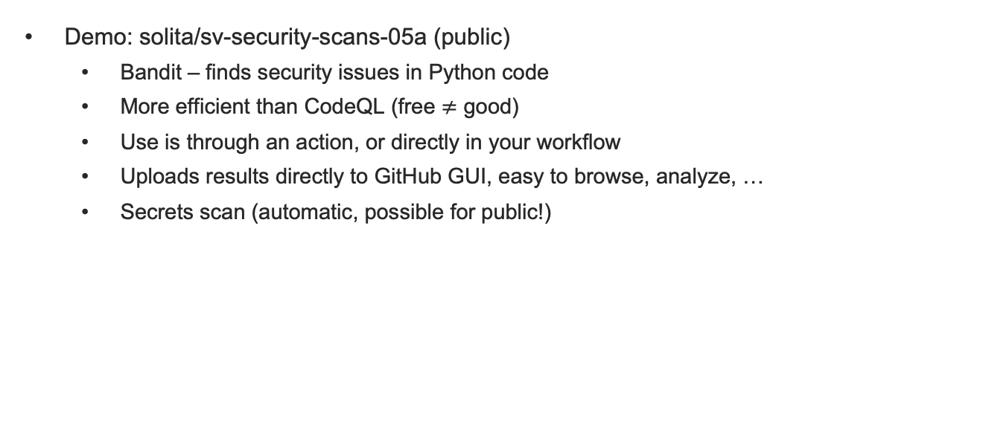
Advanced: Create Your Workflow with Actions
Demo: solita/sv-security-scans-05a (public)
Bandit – finds security issues in Python code
More efficient than CodeQL (free $≠$ good)
Use is through an action, or directly in your workflow
Uploads results directly to GitHub GUI, easy to browse, analyze, …
Secrets scan (automatic, possible for public!)

Slide 27
GitHub Internal: No Free Goodies (Except SCA)
Demo solita/sv-security-scans-01 (internal)
Dependabot (SCA) works! Finds vulnerable dependencies you pull/import/require
GitLeaks – a mightly secrets/credentials scanning tool
Checkov – a vigorous IaC (Infrastructure as Code) scanning tool Terraform, K8s, …
TFSec – also excellent for Terraform
Trivy – a superb scanning tool for Docker images and filesystems
(Also, remember Bandit – open source for Python Security)
All open-source and free (so far), you can use in private/internal repos
You do not need GHAS Advanced Security! Have SAST, SCA, Secrets, IaC covered!

Slide 28
Azure DevOps vs GitHub
Both are very good
Azure DevOps is more advanced in pipeline syntax and features
GitHub has a bigger user base, numerous useful actions
Both are extremely useful for DevSecOps
You just easily incorporate security-related actions/jobs/steps into pipelines / workflows

Slide 29
Snyk Developer-First Security Platform
Snyk Code (SAST)
Snyk Open Source (SCA)
Snyk Container image vulnerabilities analysis (OS, packages, composition, permissions,…)
Snyk IaC
Snyk Cloud
All eggs in one basket? But maintenance / learning curve are better
Alternatives: Palo Alto Networks, Fortify/MicroFocus, Sonatype, SonarQube, AquaSec, Trend Micro,…

Slide 30
Key Takeaways
If you work with GitHub and have a public repo (or Enterprise+GHAS), try a few ticks in “Settings/Security” and see the results in “Security” tab
Do not be upset to see hundreds of vulnerabilities! (Some may be false positives, some irrelevant. When you gain confidence, you can mask them, mark as resolved, …
Always look for available actions on the Marketplace, Google
Try to find the best for you purpose/language
Browse for security actions featured on GitHub (click on “New workflow”)
Useful to have a few alternative tools/actions for the same purpose, to be confident
Try to understand security alerts, to figure if they are relevant, how to eliminate them
85% of deployed code is vulnerable, but you want to be in secure 15%
Maybe try something commercial?

Slide 31
Keywords
Gitleaks, TFSec, Checkov, Trivy, Semgrep, Bandit (Python SAST), Pip-Audit (Python SCA), Snyk…

