Slide 1
Software design and architectural style
——2016/2
Teacher: 黄武
Telephone： 13088058715
Email： tmezl@126.com
上午 03:14
26

Slide 2

Teacher introduction
Teacher: Huangwu
Research: Embedded system, medical intellective instrument
Teaching: Courses about software engineering, for example:
software architecture,
software development tool and environment,
software construction and software testing
上午 03:14
26

Slide 3

1. Data acquisition and analysis system
上午 03:14
26

Slide 4
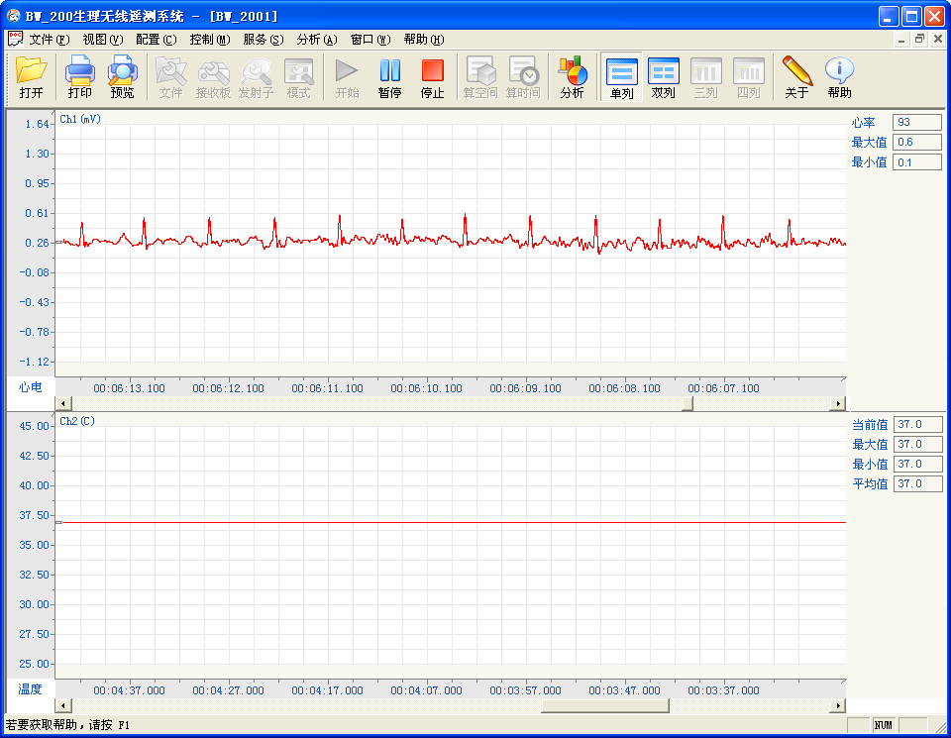
2. Physiological wireless signal acquisition system
上午 03:14
26

Slide 5
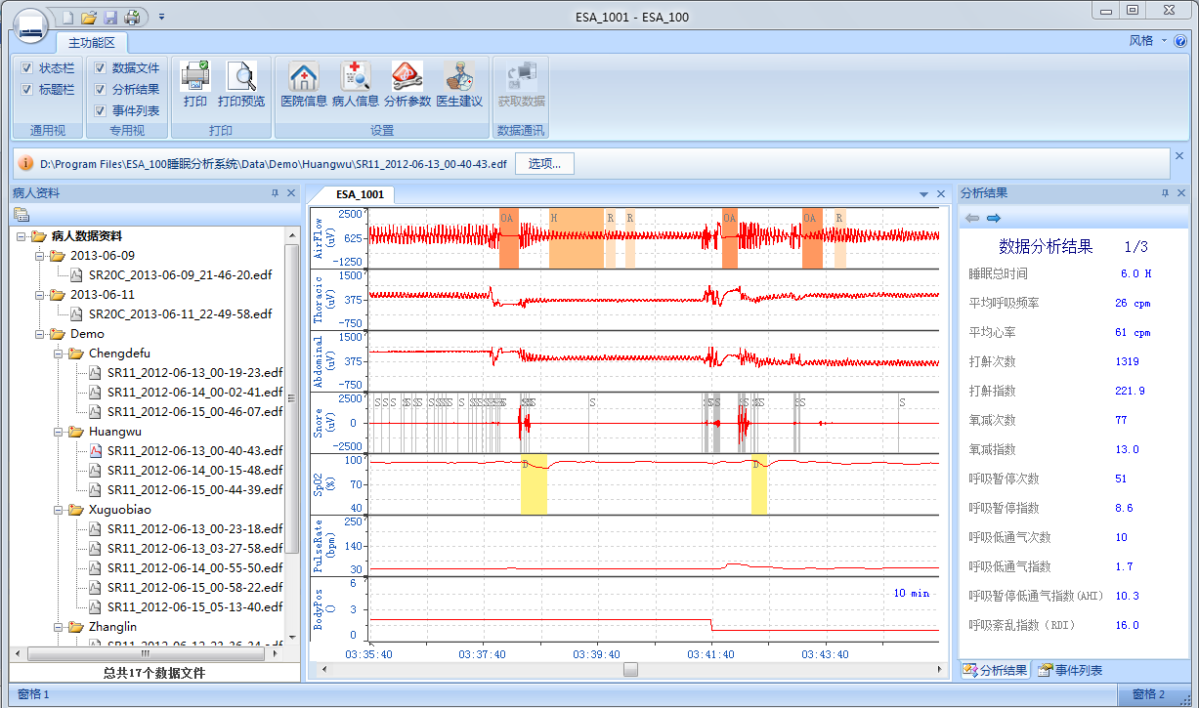
3. Sleep analysis system
上午 03:14
26

Slide 6
Assistant information
Afternoon
屈媛媛
Telephone： 18683726327
Email： 578882958@qq.com
Night
曾嘉彦
telephone： 13908210181
Email： zjy736@163.com
上午 03:14
26

Slide 7
Outline
Some problems
Course arrangement
software architecture in the software engineering
How do you become architect
上午 03:14
26

Slide 8


1. Some problems
How does your company achieve success if you established a company？
上午 03:14
26

Slide 9


1.1 Some problems
How do your manufacture a good product？
What is important about a product? creative or quality?
上午 03:14
26

Slide 10


1.2 Some problems
How do your make a good software？
上午 03:14
26

Slide 11
2. Course arrangement
Purpose
How do you study
Course arrangement
Reference book
Score
上午 03:14
26

Slide 12
2.1 Purpose
Make good software
Understand and master the knowledge of making a good software, for example , quality attributes and tactics, software pattern and style, developing and evaluating the software architecture
Study how can we take advantage of the knowledge in practice
上午 03:14
26

Slide 13
2.2 How do you study
First, good studying attitude
Second, master the most important theories, including quality attributes and tactics etc.
Then, apply the theory to practice by discussion and program
上午 03:14
26

Slide 14
2.3 Course arrangement
Teaching times：15
Teaching form：Teacher mainly teaches, student discuss
Project：Design a web travel booking system, similar to the elong or ctrip.
How do you realize the modifiability, security?
上午 03:14
26

Slide 15
2.3 Course arrangement
First: course introduction. Architecture introduction
Second: Why does the architecture be important
Third: The relationship between architecture and environment
上午 03:14
26

Slide 16
2.3 Course arrangement
Fourth: Introduction of quality attributes
Fifth: Availability quality attributes and tactics
Sixth: Modifiability quality attributes and tactics
上午 03:14
26

Slide 17
2.3 Course arrangement
Seventh: Performance quality attributes and tactics
Eighth: security quality attributes and tactics
Ninth: Testability and usability quality attributes and tactics
上午 03:14
26

Slide 18
2.3 Course arrangement
Tenth: Other quality attributes and tactics.
The mid-term exam
Eleventh: Architectural patter1
Twelfth: Architectural patter2
上午 03:14
26

Slide 19
2.3 Course arrangement
Thirteenth: architectural design(ADD)
Fourteenth: architectural evaluation
Fifteenth: architectural application(product line)
上午 03:14
26

Slide 20
2.4 Reference book
Teaching book
Software architecture in practice.3e, by Bass.Len, Clements. Paul and Kazman.Rick
Tsinghua university press, 2013.2
ISBN: 978-7-302-31293-2.
Price: 79￥
上午 03:14
26

Slide 21
2.4 Reference book
Software architecture in practice.2e Len.Bass, Clements. 清华大学出版社
软件设计与体系结构. 齐志昌. 高等教育出版社. 2010.2. ISBN: 978-7-040-28408-9
软件体系结构. Mary.Shaw, David.Garlan. 清华大学出版社. 2007.9. ISBN: 978-7-302-14550-9
设计模式. Erich.Gamma, Richard Helm. 机械工业出版社. 2007.4. ISBN: 987-7-111-07575-2
上午 03:14
26

Slide 22
2.5 Score
No | Item | Per-cent | Explain
1 | attendance | 10% | 5 times testing
2 | Homework | 10% | 10 times homework
3 | Project | 10% | Document of the architecture
4 | Mid-term exam | 20%
5 | Final exam | 50%
6 | discussion | 10% | Additional scores
上午 03:14
26

Slide 23
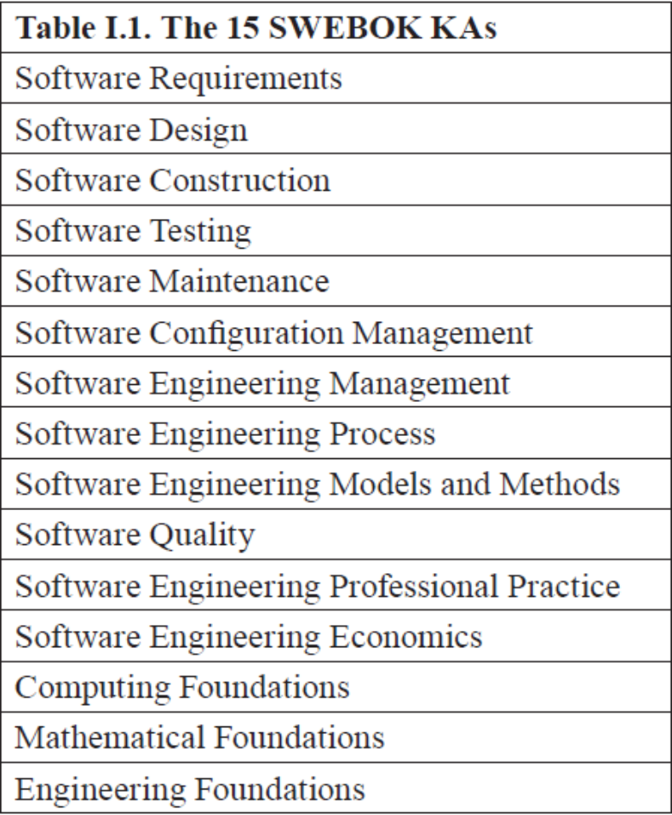
3. Architecture in the software engineering
SWEBOK V3.0
Guide to the software engineering body of knowledge
IEEE 2014
上午 03:14
26

Slide 24
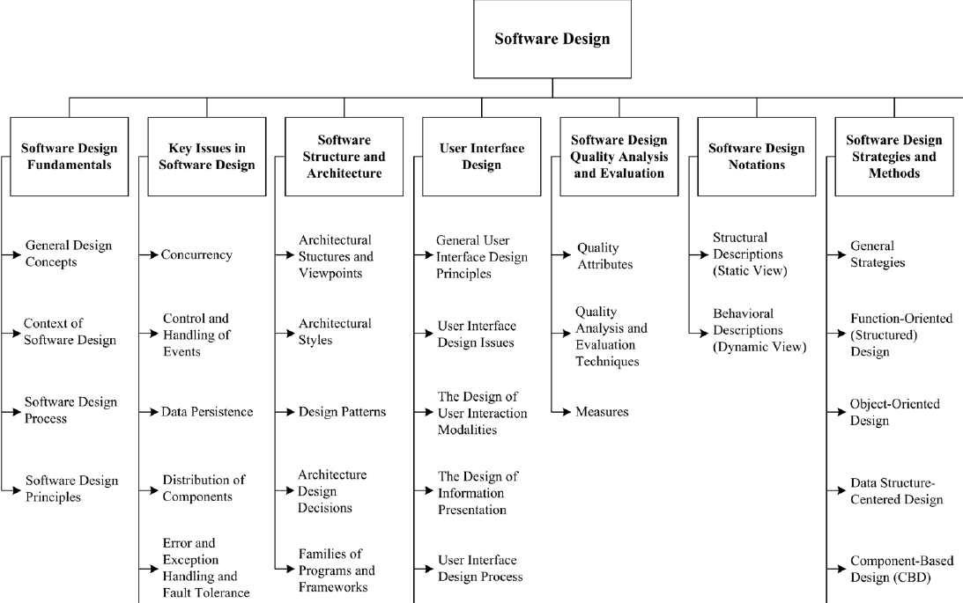
上午 03:14
26

Slide 25
4. How to become a architect
You can’t become a architect only study theory
  Seed: practical programmer
  Sapling: mastered the theory, experience of team development and software management
  Architect: Chance, Endeavor and talent
    Technique is mastering and overall
    Training the comprehensive ability
    Chance
上午 03:14
26

Slide 26
4.1 Career develop of software engineer
How can you become the expert?
  Enrich your experience
  Develop your technique and the skill of leadership and communication
  Study the architecture
Junior engineer
Senior engineer
Team leader
Engineer
Architect
Improve responsibility, range and challenge
上午 03:14
26

