Slide 1
What is software architecture
——2016/3
Teacher: Huangwu
Telephone： 13088058715
Email： tmezl@126.com
上午 08:21
61

Slide 2
Outline
The concept of software architecture
System, enterprise and software architecture
Architectural structures and views
Architectural Patterns
What makes a good architecture
上午 08:21
61

Slide 3
1. The concept of software architecture
The software architecture of a system is the set of structures needed to reason about the system, which comprise software elements, relations among them, and properties of both
The architecture is a bridge between business goals and the final resulting systems
A
B
C
D
上午 08:21
61

Slide 4
1.1 Explain the concept
Architecture is a set of software structure
Architecture is an abstraction
Every software has a software architecture
Architecture includes behavior
Not all architectures are good architecture
上午 08:21
61

Slide 5
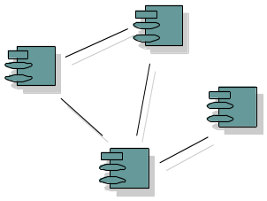
1.1.1 Architecture is a set of structure
A structures is simply a set of elements held together by a relation
There are three categories of architecture structures:
Module structure
Component-and-connector(C&C) structure
Allocation structure
上午 08:21
61

Slide 6
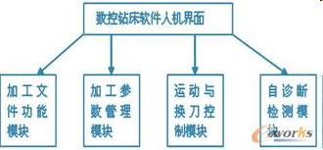
1.1.1.1 Module structure
Module structures partition systems into implementation unit
Module are assigned specific computational responsibilities, and are the basis of work assignment
Module structures are static structure
上午 08:21
61

Slide 7
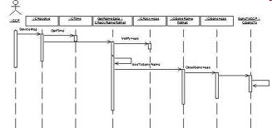
1.1.1.2 C&C structure
C&C structures focus on the way the elements interact with each other at runtime to carry out the system’s functions
For example: the service system
上午 08:21
61

Slide 8
1.1.1.3 Allocation structure
Allocation structures map software structures to the system’s environment
For example:
module assigned to file
Components are deployed onto hardware
Deployment view:
physical model + mapping
A
C
D
B
TCP/IP over Ethernet
bandwidth, availability
上午 08:21
61

Slide 9
1.1.2 Architecture is an abstraction
In modern systems, elements interact with each other by means of interface
Interface partition the details of an element into public and private parts
Architecture is concerned with the public side of interface
This abstraction is essential to tame the complexity of a system
上午 08:21
61

Slide 10
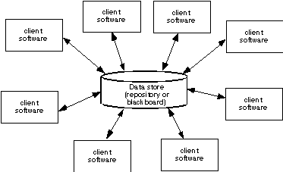
1.1.3 Every system has a software architecture
Every system can be shown to comprise elements and relations among them
Architecture can exist independently of its description(source code) or specification(document)
上午 08:21
61

Slide 11
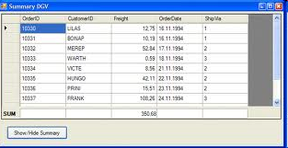
1.1.4 Architecture includes behavior
The behavior of each elements is part of the architecture
The behavior can be used to reason about the system
The behavior include the function of system and the interact of elements
上午 08:21
61

Slide 12
1.1.5 Not all architecture are good architectures
The definition is indifferent as to whether the architecture for a system is a good one or a bad one
An architecture may permit or preclude a system’s achievement of its behavioral, quality attribute and requirements
Therefore, the architecture evaluation is important.
上午 08:21
61

Slide 13
2. System, enterprise and software architecture
System architecture
Enterprise architecture
The relationship of three architectures
上午 08:21
61

Slide 14
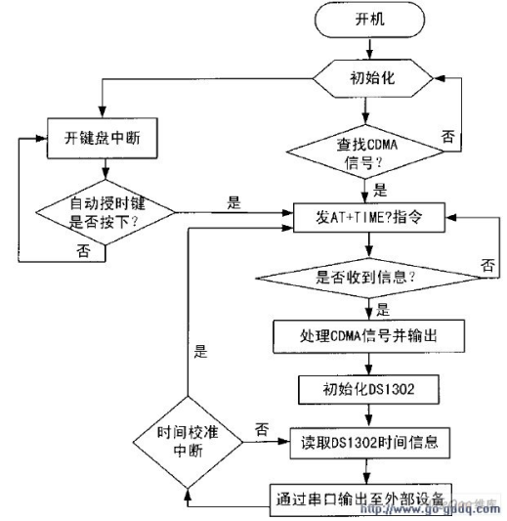
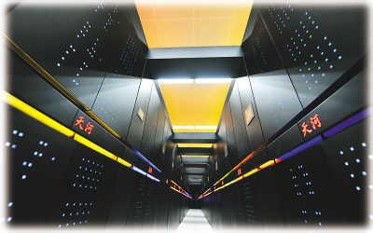
2.1 System architecture
System architecture maps functionality onto hardware and software
System architecture is concerned with a total system, including hardware, software and humans
上午 08:21
61

Slide 15
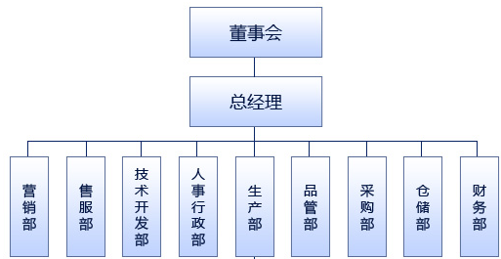
2.2 Enterprise architecture
Enterprise architecture is a description of the structure and behavior of an organization’s process, information flow, personnel and subunits
上午 08:21
61

Slide 16
2.3 The relationship of three architectures
The system and the enterprise provide environments for and constraints on the software architecture
The software architecture must live within system and enterprise
System architecture
Impact on
Software architecture
Enterprise architecture
上午 08:21
61

Slide 17
2.4 Problem
What are the commonalities of the three architecture?
上午 08:21
61

Slide 18
3. Architectural structures and views
Why do we need many structures for representing the architecture?
The concept of view and structure
Module structures
Component-and connector structures
Allocation structures
The relationship among different structures
上午 08:21
61

Slide 19
3.1 Why do we need many structures for the architecture
Modern system are frequently too complex to grasp all at once
We restrict our attention at any one moment to one of the software system’s structure
上午 08:21
61

Slide 20
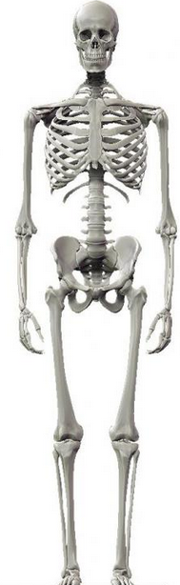
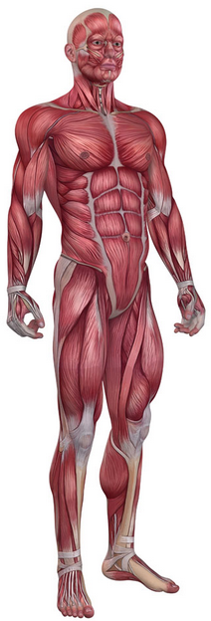
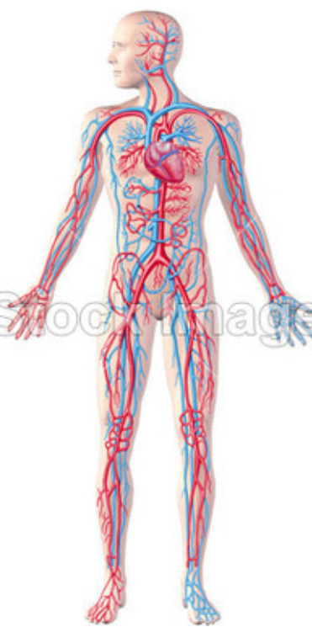
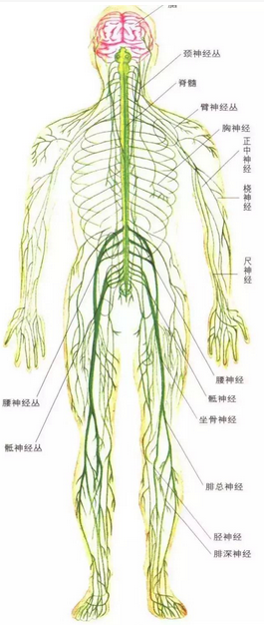
3.2 The example of complex system
Skeletal
Muscle
circulatory
nervous
Different view of human body
上午 08:21
61

Slide 21
3.2 The concept of view and structure
A structure is a set of elements itself and it’s relation, as they exist in software or hardware
A view is a representation of a coherent set of architectural elements, as written by and read by system stakeholders
上午 08:21
61

Slide 22
3.2.1 The relationship of view and structure
Architect design structures
Architect document views of those structures
A view is a representation of a structure
For example, module structure is a set of the system’s modules and their relation. A module view represent the structure.
上午 08:21
61

Slide 23
3.3 Module structures
Module structure is a composition structure of a system
Module structures embody decisions as to how the system is to be structured as a set of code or data units that have to be constructed in any module structure
上午 08:21
61

Slide 24
3.3.1 The elements and relation of module structure
Elements: module of some kinds
for example: classes, layers or unit of function etc.
Relation: is a… or use
上午 08:21
61

Slide 25
3.3.2 Role of Module structure
Module structure answer the questions:
What is the primary function responsibility of each module
What other elements allowed to use
What software does it use and depend on
What modules are related to others by generalization or specialization
上午 08:21
61

Slide 26
3.3.3 Some useful Module structure
Decomposition structure
Uses structure
Layer structure
Class structure
Data model structure
上午 08:21
61

Slide 27
3.3.3.1 Decomposition structure
This structure showing how modules are decomposed into smaller modules.
Element: Module
Relation: Is a submodule of
Useful for: Resource allocation and project structuring and planning; information hiding, encapsulation; configuration control
Quality Attributes affected: Modifiability
上午 08:21
61

Slide 28
3.3.3.2 Uses structure
This structure showing how modules use other modules or subset of module.
Element: Module
Relation: Uses( i.e., requires the correct presence of)
Useful for: Engineering subsets, engineering extensions
Quality Attributes affected: Subsetability, extensibility
上午 08:21
61

Slide 29
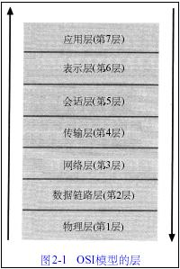
3.3.3.3 Layers structure
A layer provides a cohesive set of services. Layer are allow to use other layers in a strictly managed fashion.
Element: Layer
Relation: Uses the services of
Useful for: Incremental development, implementing systems on top of virtual machines(VM)
Quality Attributes affected: Portability
上午 08:21
61

Slide 30
3.3.3.4 class structure
Class structure supports reasoning about collections of similar behavior.
Element: Class, object
Relation: Is an instance, shares access methods of
Useful for: Factoring out commonality; planning extensions of functionality
Quality Attributes affected: Modifiability，extensibility
上午 08:21
61

Slide 31
3.3.3.5 Data model structure
The data model describe the static information structure in terms of data entities and their relationships.
Element: Data entity
Relation: data generalizes, specializes
Useful for: Engineering global data structures for consistency and performance
Quality Attributes affected: Modifiability，performance
上午 08:21
61

Slide 32
3.4 C&C structures
Component and connector structure represent the runtime properties of a system
C&C structures embody decisions as to how the system is to be structured as a set of elements that have runtime behavior(components) and interactions (connectors)
上午 08:21
61

Slide 33
3.4.1 The elements and relation of C&C structure
Elements: runtime component
for example: computational unit, services , clients, peers and filters etc.
Relation: connector
for example: call-return, process synchronization operators, protocol and pipes etc.
上午 08:21
61

Slide 34
3.4.2 Role of C&C structure
C&C structure answer the questions:
What are the major executing components
What are the major shared data stores
Which parts of the system are replicated
How does data progress through the system
What parts of the system can run in parallel
上午 08:21
61

Slide 35
3.4.3 Some useful C&C structure
Service structure
Concurrency structure
上午 08:21
61

Slide 36
3.4.3.1 Service structure
This structure showing how services were found and provided.
Element: Service, registry
Relation: Runs concurrently with, excludes, precedes
Useful for: Scheduling analysis, performance analysis
Quality Attributes affected: Interoperability, modifiability
上午 08:21
61

Slide 37
3.4.3.2 Concurrency structure
This structure determining opportunities for parallelism and the locations where resources contention may occur.
Element: Processes, threads
Relation: Can run in parallel
Useful for: Identifying locations where resource contention exists, or where threads may fork, join, created or killed
Quality Attributes affected: Performance, availability
上午 08:21
61

Slide 38
3.5 Allocation structures
Allocation structure represents the relationship between software system and it’s environment
Allocation structures embody decisions as to how the system will relate to nonsoftware structures in its environment
上午 08:21
61

Slide 39
3.5.1 The elements and relation of allocation structure
Elements: module, environmental elements
for example: module, components, file, hardware etc.
Relation: map
上午 08:21
61

Slide 40
3.5.2 Role of allocation structure
Allocation structure answer the questions:
What processor does each software element execute on
In what directories of files is each element stored during development, testing, and system building?
What is the assignment of each software element to development teams?
上午 08:21
61

Slide 41
3.5.3 Some useful allocation structure
Deployment structure
Implementation structure
Work assignment structure
上午 08:21
61

Slide 42
3.5.3.1 Deployment structure
This structure showing how software is assigned to hardware.
Element: Components, hardware element
Relation: Allocated to, migrates to
Useful for: Performance, availability, security analysis
Quality Attributes affected: Performance, security, availability
上午 08:21
61

Slide 43
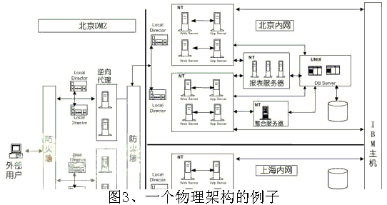
Example of Deployment structure

Slide 44
3.5.3.2 Implementation structure
This structure showing how software elements are mapped to file structure.
Element: Modules, file structure
Relation: Store in
Useful for: Configuration control, integration, test activities
Quality Attributes affected: Development efficiency
上午 08:21
61

Slide 45
3.5.3.3 Work assignment structure
This structure assigns responsibility to the teams who will carry it out
Element: Modules, organizational units
Relation: Assigned to
Useful for: Project management, best use of expertise and available resources, management of commonality
Quality Attributes affected: Development efficiency
上午 08:21
61

Slide 46
3.6 The relationship among different structures
Each of these structures provides a different perspective and design handle on a system
These structures are dependent, elements of one structure will be relate to elements of other structures
Individual projects sometimes consider one structure dominant and cast other structures
上午 08:21
61

Slide 47
3.6.1 The relationship example
System
C3
C4
C2
Client
C5
S1
C1
Server
C6
C8
C7
Key:
Module
Key:
Component
Request-Replay
Decomposition View
Client-Server View
Two views of a client-server system
上午 08:21
61

Slide 48
4. Architectural Patterns
Architectural pattern is a common architecture
In architectural pattern elements are composed in ways that solve particular problems
Architectural pattern provide packaged strategies for solving some of the problems facing a system
上午 08:21
61

Slide 49
4.1 Some architectural Patterns
Layered pattern
Shared-data pattern
Client-server patter
Multi-tier patter
Competence center patter
上午 08:21
61

Slide 50
4.1.1 Layered Pattern
A layer is a coherent set of related functionality
Layered pattern uses relation among software elements is strictly unidirectional, for example, the layer i can only uses the layer i-1 function
Layers are usually designed to hide implementation of each other
上午 08:21
61

Slide 51
4.1.2 Shared-data Pattern
Shared –data pattern comprises components and connectors that create, store and access persistent data
The elements is a repository usually takes the form of a database.
The connectors are protocols for managing the data, such as SQL
上午 08:21
61

Slide 52
4.1.3 Client-Server Pattern
Client-server pattern is a most common useful pattern
The components are the clients and servers
The Connectors are protocols and messages that share among each other to carry out the system’s work
上午 08:21
61

Slide 53
4.1.4 Multi-tier Pattern
Multi-tier pattern describes how to distribute and allocate the components of a system in distinct subsets of hardware and software.
The pattern specializes the generic deployment structure
上午 08:21
61

Slide 54
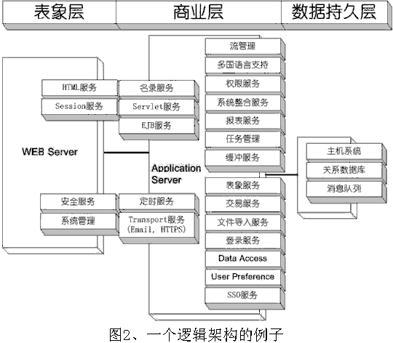
4.1.4.1 Example of Multi-tier Pattern

Slide 55
4.1.5 Competence center and platform pattern
The pattern specializes a software system’s work assignment structure
In Competence center, work is allocated to sites depending on the technical or domain expertise
In platform, one site is tasked with developing reusable core assets of a software product line
上午 08:21
61

Slide 56
5. What Makes a "Good" Architecture
there are rules of thumb that should be followed when designing an architecture
process recommendations
product (or structural) recommendations
上午 08:21
61

Slide 57
5.1 process recommendations
Single architect or small group with identified leader
Must have system technical requirements and articulated, prioritized qualitative properties
Architecture must be well-documented using an agreed-on notation that all can understand
Architecture should be actively reviewed by all stakeholders
上午 08:21
61

Slide 58
5.1 process recommendations
Analyze architecture for applicable quality measures and formally review early in process
Architecture should allow creation of a skeletal system on which functionality can incrementally grow
Architecture should result in specific resource restriction/allocation models (memory, bandwidth, time)
上午 08:21
61

Slide 59
5.2 product recommendations
Well-defined functional modules using information hiding, separation of concerns, and well-defined interfaces
Quality attributes should be achieved using well-known architectural tactics specific to each attribute
Never depend on a particular version of a commercial product or tool; make change straightforward and inexpensive
上午 08:21
61

Slide 60
5.2 product recommendations
Separate data producers from data consumers
Parallel processing: well-defined processes and tasks that may not mirror module structure
Process or task assignment to processors must be easily changed, even at run-time
Consistently use a small number of simple interaction patterns
上午 08:21
61

Slide 61
Summary
Software architecture of a system is the set of structures needed to reason about the system
A structure is a set of elements and the relations among them
A view is a representation of structure
There are three categories of structures:
Module structures
Component-and-connector structures
Allocation structures
上午 08:21
61

Slide 62
Homework
Write a short paper about the software architecture in your view. (about 500 words, you can use chinese language)
You can collect materials from the internet, then you must analyze the materials and summary to become your knowledge
上午 08:21
61

Slide 63
Discuss
Which recommendations do we abide by when we design the architecture？
Do the different students get the same result to design the same project? Why?
What is your goal for developing a program? Finish or do well?
上午 08:21
61

