Slide 1
Why is software architecture important
—— 2016/3
下午 04:02
46

Slide 2
Outline
Introduction
Why an architecture is important
下午 04:02
46

Slide 3
1. Introduction
Why an architecture is important from a technical perspective
There are thirteen important reasons
It supports or inhibits the quality attributes
It allow you to reason about and manage change as the system evolves
It enables early prediction of qualities
It carries early design decisions
下午 04:02
46

Slide 4
1.1 Introduction continue1
It defines constraints on implementation
It can provide the basis for evolutionary prototyping
It reduces design and system complexity by restricting design alternatives
It dictates the structure of an organization
It can help project manager accurately estimate the cost and schedule
下午 04:02
46

Slide 5
1.1 Introduction continue2
It supplies a transferable and reusable model
It supports incorporation of independently developed components
It’s documents enhances communication among stakeholders
It can be the foundation for training a new team member
下午 04:02
46

Slide 6
2. Inhibiting or enabling a system’s quality attributes
The system’s quality attributes is substantially determined by its architecture
For example:
Performance
Modifiability
Scalability
下午 04:02
46

Slide 7
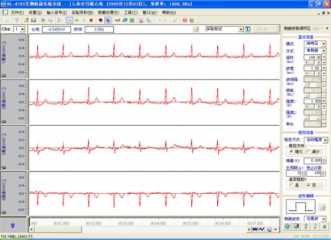
2.1 Example of performance
You need managing the time-based behavior and interact of elements for achieving the performance
If we construct a real time data acquisition system, what architecture pattern do you select？
C2
S
C1
Client/Server
？
F1
F2
F3
Pipe and Filter
下午 04:02
46

Slide 8
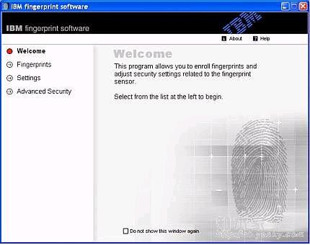
2.2 Example of security
You need to manage and protect inter-element communication and control element access to information
What specialized elements do you introduce for the security
Authorization
Introduce
Audit
下午 04:02
46

Slide 9
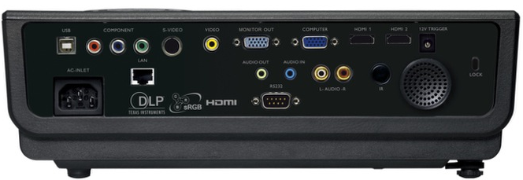
2.3 Example of reusability
You need to restrict inter-element coupling, so that you extract an element with many attachments
How do you reduce the coupling of elements
Device 1
Interface
Device n
下午 04:02
46

Slide 10

2.4 Quality is a integral
Architecture alone cannot guarantee the functionality or quality of a system
The downstream design or implementation decision take the responsibility for the quality also
For example, the algorithm directly influence the performance
Design is important
Detail is important also
下午 04:02
46

Slide 11
3. Reasoning about and managing change
Roughly 80 percent of a typical software system’s total cost occurs after initial deployment
Many programmers and designers never get to work on new development; they work under the constraints of the existing architecture and the code
下午 04:02
46

Slide 12

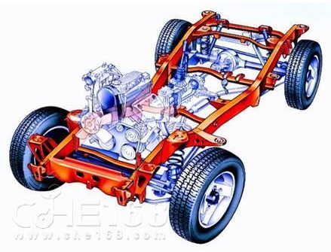
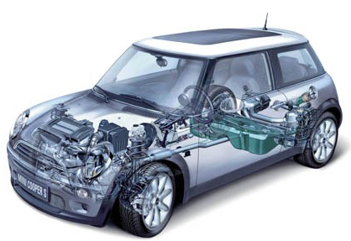
3.1 How do you implement the modifiability
Every architecture partitions possible changes into three categories
Local
Nonlocal
architectural
下午 04:02
46

Slide 13
3.2 Local change element
A local change can be accomplished by modifying a single element
The rapid changing part of a system should be set the local element
For example:
The USB communication interface
The computation unit for analyzing the heart rate
下午 04:02
46

Slide 14
3.3 Nonlocal change element
A nonlocal change requires multiple element modifications but the architecture is intact
For example:
Changing the data table in the DB, not only you modify the data structure, but also you modify the inter-element to interact with these data
下午 04:02
46

Slide 15
3.4 Architectural change
An architectural change affects the fundamental ways in which the elements interact with each other and will probably require changes all over the system
For example
From the simple client/server structure to the peer-to-peer structure
下午 04:02
46

Slide 16
3.5 Implement easily modify
Local change are the most desirable, and so an effective architecture is one in which the most common changes are local
You must anticipate the changes for a system
下午 04:02
46

Slide 17


4. Predicting system qualities
Although architecture alone can not support the qualities, but it can predict the system qualities
We can predict the system qualities based solely on an evaluation of its architecture
下午 04:02
46

Slide 18
4.1 Predict quality is important
The earlier you can find a problem in your design, the cheaper, easier, and less disruptive it will be to fix
The relationship between modifying phase and cost
Modifying cost
Curve of affect stakeholders
Curve of Modifying cost
Requirement
Design
Coding
Testing
Release
下午 04:02
46

Slide 19
4.2 Example of predict quality
Architecture analysis and evaluation can help predict the system qualities
For example
If you want to develop cross platform system, you need introduce the virtual layer to avoid the difference of different platform
下午 04:02
46

Slide 20
5. Carrying early design decisions
Any design can be viewed as a set of decisions，
Software architecture is a set of earliest design decisions about a system. Early design decisions have higher weight
The early design decisions constrain the decisions that follow, and changing these decisions cause a ripple effect; sometimes the architecture must be redesigned
下午 04:02
46

Slide 21
5.1 Some important decisions
There are some important earlier decisions:
The system run on one or multiple processors
Synchronously or asynchronously communicate
What operating system will we use
What communication protocol to chose
Whether the data flow are encrypted
下午 04:02
46

Slide 22
5.2 The example of decision
How do we develop a software cross platform?
Develop for each platform
Develop a layer by yourself for screening the difference of different platform
Used the infrastructure to achieve the ability of cross platform, for example, use HTML5 develop
下午 04:02
46

Slide 23
6. Defining constrains on an implementation
The architecture is the constrains to the implementation
An implementation must conform to the architecture for achieving the qualities
Concretely, the implementation including elements and relations of the elements must be dictated by the architecture
下午 04:02
46

Slide 24
6.1 Example of constrain
For example
The communication among elements is message, you must define these messages and don’t direct call-return the function in implementation
The only access to other elements across interface for reducing couple by design, the implementing code can not directly access properties of other elements
下午 04:02
46

Slide 25
7. Enabling evolutionary prototyping
Once an architecture has been defined, it can be analyzed and prototyped as a skeletal system
The skeletal system includes some infrastructure: how the elements initialize, communicate, share data, access resource, report errors and log
The element maybe a stub in prototype
下午 04:02
46

Slide 26
7.1 Role of prototype
The prototype can analyze and verify the design
The prototype reduces the potential risk in the project
For example, the approach allows potential performance problems to be identified early
下午 04:02
46

Slide 27
8. Restricting the vocabulary of design alternatives
The architectural patterns are useful
Restricting the combine mode can minimize the design complexity
下午 04:02
46

Slide 28
8.1 Benefit of using pattern
Enhanced reuse
More regular and simpler design that are more easily understood and communicated
More capable analysis
Shorter selection time
Greater interoperability
下午 04:02
46

Slide 29
9. Influencing the organization structure
Generally, project manager assigns the different tasks of a large project to different work groups, this is called wok-breakdown structure of a system
The architecture is the basis of work breakdown structure
These work breakdown structure gradually become the organization structure
下午 04:02
46

Slide 30
9.1 Example of organization
The company of developing operation system
The organization maybe is below:
User interface group
File management group
Resource management group
Device drivers group
Other
In the industrial company, for example, plane and automobile company, it’s organizational structure is conformed to the project structure
下午 04:02
46

Slide 31
9.2 The side effect
A side effect of establishing the work-breakdown structure is freeze some aspects of the software architecture
A group that is responsible for one of the subsystems will resist having its responsibilities distributed across other group
下午 04:02
46

Slide 32
10. Improving cost and schedule estimates
Cost and schedule are important tools for the project manager both to acquire the necessary resources and to monitor progress on the project
The architecture is to help project manager create cost and schedule estimates early in the project life cycle
下午 04:02
46

Slide 33
10.1 How to estimate
The architecture decomposes the whole system into small element and assign the works to different work team
Each team can estimate their cost and schedule more accurately
The estimate bases on the top-down and bottom-up understanding of the system’s pieces
下午 04:02
46

Slide 34
11. Supplying a transferable, reusable model
Reuse of architectures provides tremendous leverage for systems with similar requirements
Not only can code be reused, but also can the requirements, design and experience can be reused
下午 04:02
46

Slide 35
11.1 Product line
A software product line or family is a set of software systems that are all built using the same set of reusable assets
Chief asset is the architecture
The architecture defines what is fixed and what is variable of product line
Product line has many payoffs: such as time to market, cost, productivity and quality
下午 04:02
46

Slide 36
12. Allow use independently developed components
Architecture cares about the elements and the relation among them
Architecture-based development often focuses on composing or assembling elements that are likely to have been developed separately
You can use commercial off-the shelf components, open source software etc.
下午 04:02
46

Slide 37
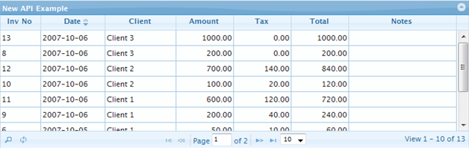
12.1 Example
Grid component(Excel)
Word process
Media player
Internet Brower
下午 04:02
46

Slide 38
12.2 Benefit
The benefit of using separately developed components
Decreased time to market
Increased reliability
Lower cost
Flexibility
下午 04:02
46

Slide 39
13. Enhancing communication among stakeholders
Software architecture represents a common abstraction of a system that is the basis for communicating among stakeholders
It let the most nontechnical people can understand and discuss the system
下午 04:02
46

Slide 40
13.1 Various stakeholder care about different matters
For example:
The user concerns the system is fast, reliable and available
The customer concerns the architecture can be implemented on schedule and budget
The manager cares about architecture will allow teams to work independently
下午 04:02
46

Slide 41
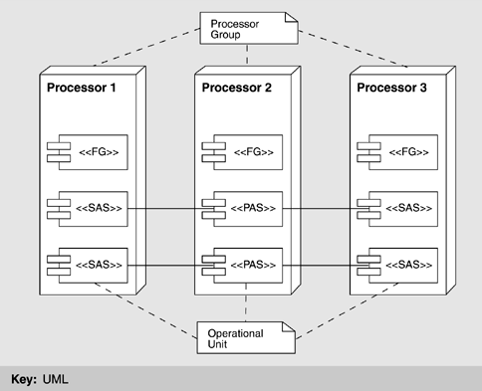
13.2 Architecture improves communication
Architecture provides a common language in which different concerns can be expressed, negotiated and resolved etc.
Software redundancy
下午 04:02
46

Slide 42
14 Providing a basis for training
The architecture can serve as the first introduction to the system for new project member
Module views are excellent for showing someone the structure of a project
C&C views are excellent for explaining how the system is expected to work and accomplish its job
下午 04:02
46

Slide 43
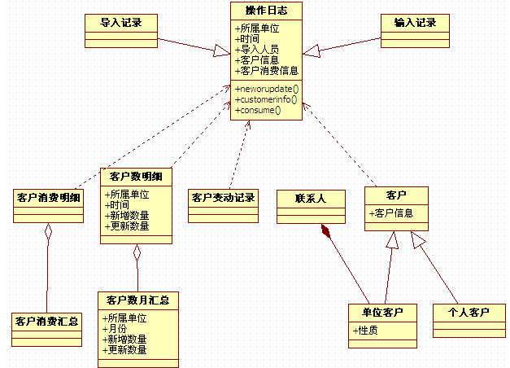
14.1 Example of training
The view is more clear than the word description
下午 04:02
46

Slide 44
Summary
The architecture is a set of early design decision inhibit or enable quality attributes.
Help project manager manage project
Architecture is transferable abstraction of a system
Architecture is communication among stakeholders
下午 04:02
46

Slide 45
Homework
Why the architecture is important? You can answer the question with your own idea.
下午 04:02
46

Slide 46
Discuss
Which recommendations do we abide by when we design the architecture？
Do the different students get the same result to design the same project? Why?
What is your goal for developing a program? Finish or do well?
下午 04:02
46

