Slide 1
The Many Contexts of Software Architecture
—— 2016/3
上午 11:32
50

Slide 2
Outline
Introduction
Architecture in Technical Context
Architecture in a Project Life-Cycle Context
Architecture in a Business Context
Architecture in a Professional Context
Stakeholder
Architecture Influence Cycle ( AIC )
上午 11:32
50

Slide 3

1. Introduction
New Yorker’s view of the world by Saul Steinberg in 1976
上午 11:32
50

Slide 4
1.1 Some contexts with architecture
Some contexts with architecture:
Technical: What technical role does the software architecture play in the system
Project life cycle: How does a architecture relate to the other phases of development life cycle
Business: How does affect the business
Professional: What is the role of a architect in an organization or project
上午 11:32
50

Slide 5
1.2 Architect’s Challenge
All contexts impact on the software architecture
The architect’s challenge is to envision what in their context might change and to adopt mechanisms to protect the system and its development if the envisioned changes come to pass
Adapt the context
上午 11:32
50

Slide 6
2. Technical Context
Technical context is the first factor influence the architecture to achieve the quality attributes of a system
Architectures inhibit or enable the achievement of quality attributes
Architectures and the technical environment
上午 11:32
50

Slide 7
2.1 Impact on quality attributes
An architecture will inhibit or enable the achievement of a system’s quality attributes
You can predict many aspects of a system’s qualities by architecture
An architecture makes it easier for you to reason about and manage change
上午 11:32
50

Slide 8
2.1.1 Example
Testability requires the inner states of each elements will be observed and controlled
For the usability, you have to concerned about isolating the details of the user interface and those elements responsible for the user experience from the rest of the system
上午 11:32
50

Slide 9

2.2 Technical Environment
The story of Vasa warship
上午 11:32
50

Slide 10
2.2.1 The Lesson from Vasa
Successful architectural practices is important. So as to help set the technical playing field of the day
Methods to assess an architecture before any system is built from it, so as to mitigate the risks
Techniques for incremental architecture-based development, so as to uncover design flaws
上午 11:32
50

Slide 11
3. Architecture in a Project Life-Cycle Context
Software development processes are standard approaches for developing software system
Architecture relate to the development process and some activities
Some development processes
Some development activities
上午 11:32
50

Slide 12
3.1 Some development processes
There are four dominant software development process
Waterfall
Iterative
Agile
Model-Driven development
上午 11:32
50

Slide 13
3.1.1 Waterfall
Define
Feasibility
Requirement
Preliminary design
Development
Detailed design
Coding
Integration
Testing
Use and Maintenance
Maintenance
Expired
Waterfall process
上午 11:32
50

Slide 14
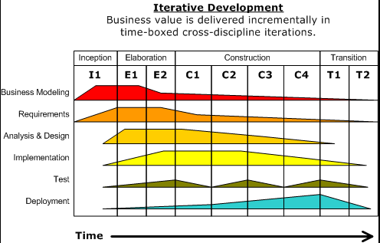
3.1.2 Iterative
Software development as a series of short cycles through the steps
The cycles are called iterations
Unified Process
上午 11:32
50

Slide 15
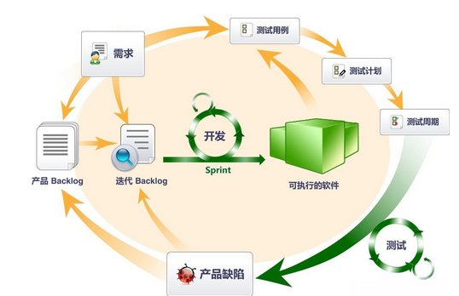
3.1.3 Agile
Agile software development refers to a group of software development methodologies, such as: Scrum, Extreme Programming and Crystal Clear
Iterative
Incremental
上午 11:32
50

Slide 16
3.1.3.1 The Features of Agile
All agile development methods assume requirements always change and avoid substantial up-front work
The features of agile development
Early and frequent delivery of software
Close collaboration between developers and customers
Self-organizing teams
Focus on adaptation to change
上午 11:32
50

Slide 17
3.1.4 Model-driven development
Model-driven development is based on the idea that humans should not be writing code in programming languages
Human create a platform-independent model(PIM), which is combined with a platform-definition model(PDM) to automatically generate running code
上午 11:32
50

Slide 18
3.2 Some development activities
Making a business case
Understanding the requirement
Creating or selecting the architecture
Documenting the architecture
Analyzing or evaluating the architecture
Implementing and testing system based on the architecture
Ensuring the implementation conforms to the architecture
上午 11:32
50

Slide 19
3.2.1 Making a Business case for the System
A business case helps organization make decision by predicting how they will affect organization:
Pursuing a new business opportunity
Assess the opportunity’s expected costs, benefits and risks
Creating a business case is broader than simply assessing the market need for a system
上午 11:32
50

Slide 20

3.2.1.1 Influence on the architect
Architect help answer the question:
How much should the product cost
What is its targeted market
What is its targeted time to market and lifetime
Will it need to interface with other systems
Are there system limitation
上午 11:32
50

Slide 21
3.2.2 Understanding the Significant Requirements
Understanding the architecturally significant requirements is the beginning of designing the architecture
You can get the requirement by methods
Object-oriented analysis
Finite-state-machine models
Previous system
Creating a prototypes
上午 11:32
50

Slide 22
3.2.3 Creating the architecture
The principle of creating or selecting an architecture is conceptual integrity
Conceptual integrity is the key to sound system design
Conceptual integrity can only be had by a small number of minds coming together to design the system’s architecture
上午 11:32
50

Slide 23
3.2.3 Documenting and Communicating the Architecture
Architecture is the backbone of project’s design
it must be communicated clearly and unambiguously to all of the stakeholders
Architecture’s documentation should be informative, unambiguous and readable by many people with varied backgrounds
上午 11:32
50

Slide 24
3.2.4 Analyzing or Evaluating the Architecture
Choosing among the competing designs in a rational way is one of the architect’s greatest challenges
Evaluating an architecture for the qualities that it supports is essential to ensuring that the system constructed from that architecture satisfies its stakeholders’ needs (ATAM method)
上午 11:32
50

Slide 25
3.2.5 Implementing and Testing the system Based on the Architecture
It is important to keep the developers faithful to the architecture
Architect help developer conform to the architecture:
Communication with the developer
Well documented architecture and disseminated
Design is clear and ground-level
上午 11:32
50

Slide 26
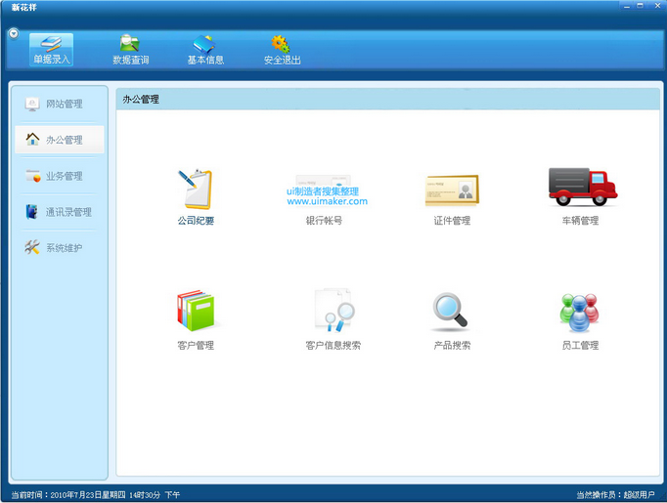

3.2.6 Ensuring the Implementation Conforms to the Architecture
In the maintenance phase, The documented architecture must be synchronous to the actual architecture
上午 11:32
50

Slide 27
4. Architecture in a Business Context
Architectures and systems are not constructed frivolously. They serve some business purposes
Architecture and business goal
Architecture and the development Organization
上午 11:32
50

Slide 28
4.1 Architecture and business goal
System are created to satisfy the business goals of one or more organizations
Development organizations want to
Make a profit
Capture market
Help customers do their jobs better
Keep their staff gainfully employed
Make their stockholders happy
上午 11:32
50

Slide 29
4.1.1 Influence the architecture
The business goal impact on the architecture
Business Goals
Quality Attributes
Nonarchitectural
Solutions
Architecture
上午 11:32
50

Slide 30
4.2 Architecture and Development Organization
Organization influences on the business goal that impacts on the architecture
Organization invests in asset
Organization make a long-term business investment in an infrastructure
Organizational structure can shape the software architecture, and vice versa
上午 11:32
50

Slide 31




4.2.1Architectures Are Influenced By The Developing Organization
immediate business
long-term business
organizational structure
Different organization develop different quality products
For example: small or big company
上午 11:32
50

Slide 32
5. Architecture in a Professional Context
Architect need more skills and knowledge
Communication skills
Technical knowledge( up-to-date knowledge，such as: pattern, web, cloud, mobile etc.)
上午 11:32
50

Slide 33
5.1 Architects’ Background and Experience
Experience
Architect's education and training, exposure to successful architectural patterns
Exposure to systems that have worked particularly poorly or particularly well
上午 11:32
50

Slide 34
6. Stakeholder
Stakeholder is who interesting in a software system
For example
the customer
the end users
the developers
the project manager
the maintainers
Seller…
上午 11:32
50

Slide 35
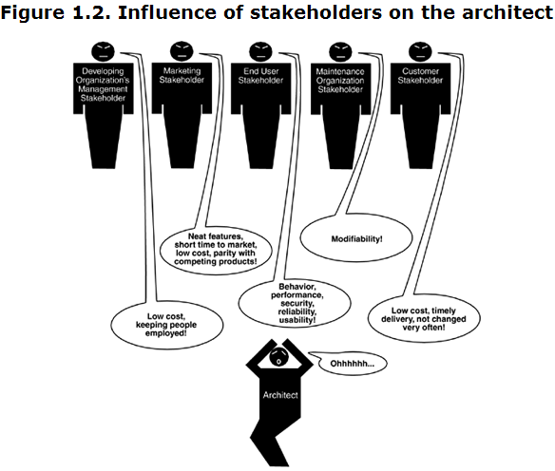
6.1 Stakeholders have different concerns
上午 11:32
50

Slide 36

6.1.1 Stakeholder Architect
Architect: Responsible for the development of the architecture and its documentation
Interest in: Negotiating and making tradeoffs among competing requirements and design approaches. Providing evidence that the architecture satisfies its requirements
上午 11:32
50

Slide 37

6.1.2 Stakeholder Business Manager
Business manager: Responsible for the functioning of the business/organizational entity that owns the system
Interest in: Understanding the ability of the architecture to meet business goal
上午 11:32
50

Slide 38

6.1.3 Stakeholder Customer
Customer: Pays for the system and ensures its delivery. The customer often speaks for or represents the end user
Interest in: Assuring required functionality and quality will be delivered; gauging progress; estimating cost
上午 11:32
50

Slide 39


6.1.4 Stakeholder User
User: The actual end users of the system. There may be distinguished kinds of users, such as administrators
Interest in: Use architecture documentation to check whether desired functionality is being delivered
上午 11:32
50

Slide 40

6.1.5 Stakeholder Implementer
Implementer: Responsible for the development of specific elements according to designs, requirements, and the architecture
Interest in: Understanding inviolable constraints and exploitable freedoms on development activities
上午 11:32
50

Slide 41
7. How is architecture influenced
Architect’s Influences
Business
Architect
Technical
Stakeholders
Architecture
Project
System
Professional
Influences on the architect
上午 11:32
50

Slide 42
7. What Do Architectures Influence
Architectures have an influence on the very factors that influence them
Technical context
Project context
Business context
Professional context
上午 11:32
50

Slide 43
7.1 Technical context
The architecture can affect stakeholder requirements for the next system by giving the customer the opportunity to receive a system in a more reliable, timely and economical manner
Software product lines have the same effect on customers who cannot be so flexible with their requirements
上午 11:32
50

Slide 44
7.2 Project Context
The architecture affects the structure of the developing organization
architecture prescribes the units of software that are the basis for the development project's structure
上午 11:32
50

Slide 45
7.3. Business Context
A successful system built from an architecture can enable a company to establish a foothold in a particular market area
The architecture can provide opportunities for the efficient production and deployment of similar systems
上午 11:32
50

Slide 46
7.4 Professional Context
A system that was successfully built will engender similar systems built the same way in the future
On the other hand, architectures that fail are less likely to be chosen for future projects
At all events, success or failure, build a system is affluent the experience of architect
上午 11:32
50

Slide 47
7.5 Architecture Influence Cycle
The architecture influence by and feedback mechanism call Architecture Influence Cycle ( AIC )
Architect’s Influences
Business
Architect
Architecture
Technical
Stakeholders
Project
System
Professional
上午 11:32
50

Slide 48
Summary
Architectures exist in four different contexts
Technical
Project life cycle
Business
Professional
Architecture Influence Cycle
上午 11:32
50

Slide 49
Homework
What kinds of business goals have driven the construction of the following:
The World Wide Web
Amazon’s EC2 cloud infrastructure
Google’s Android platform
上午 11:32
50

Slide 50

Discuss
Whether or not does agile process need the architecture ?
(Reference chapter 15)
上午 11:32
50

