Slide 1
Modifiability
—— 2016/4
上午 09:51
47

Slide 2
Outline
Introduction
Modifiability general scenario
Tactics for modifiability
A design checklist for modifiability
Summary
上午 09:51
47

Slide 3

1. Introduction
Adapt or perish, now as ever, is nature’s inexorable imperative
上午 09:51
47

Slide 4

1.1 The Inevitability of Software Change
Study show that most of the cost the typical software system occurs after it has been initially released
Software change is not only constant but ubiquitous, therefore we must adapt to the software change
上午 09:51
47

Slide 5
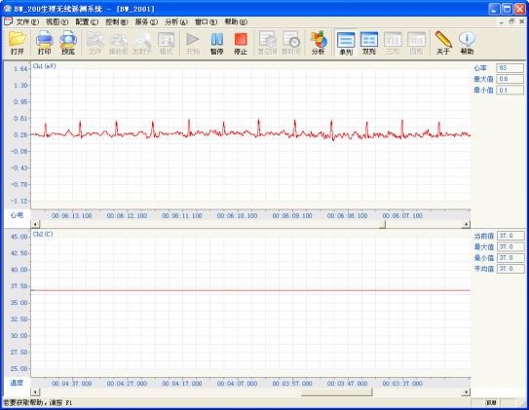
1.2 The Aspects of Software Change
Add new function
Fix defect
Tighten security
Improve performance
Enhance the user’s experience
Embrace new technology
Make systems work together, even if they were never designed to do so
上午 09:51
47

Slide 6
1.3 What’s Modifiability
Modifiability is about change, it centers on the cost and risk of making changes
Architect has to consider four questions to plan for modifiability
What can be changed？
What is the likelihood of the change
When is the change made and who makes it
What is the cost of the change
上午 09:51
47

Slide 7
1.3.1 What can be changed
A change can occur to any aspect of a system
The function (add, modify or delete)
The qualities (reliability, performance)
The capacity (number of users supported)
The environment (communicate protocol)
The platform (hardware, operation system, middleware)
上午 09:51
47

Slide 8
1.3.2 What is the likelihood of the Change
One cannot plan a system for all potential change, but can predict some
The system would never be changed
If it was changed it would be far too expensive and would likely suffer quality attribute
Architect has to make the tough decisions about which changes are likely, and determine what change to be supported
上午 09:51
47

Slide 9

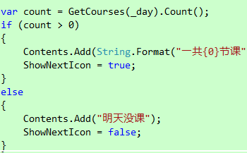
1.3.3 When is the change made and who makes it
Change segment is below:
Implementation ( source code )
Compile ( compile-time switches )
Build ( by choice of libraries )
Configuration setup ( parameter settings )
Execution( parameter settings, plugins )
Above changes were made by developer, end user, system administrator
上午 09:51
47

Slide 10

1.3.4 What is the cost of the change
Two type of cost:
The cost of introducing the mechanism to make the system more modifiable
The cost of making the modification using the mechanism
上午 09:51
47

Slide 11
1.3.4.1 The Example of Simplest Mechanism of Change
The simplest mechanism for making a change is to wait for a change request to come in, then change the source code to accommodate the request
The cost of introducing the mechanism is zero
The cost of exercising it is the cost of changing the source code and revalidating the system
上午 09:51
47

Slide 12
1.3.4.2 The Example of Complex Mechanism of Change
An application generator, such as user interface builder
The cost of introducing the mechanism is the cost of constructing the UI builder, which can be substantial
The cost of using it is the cost of producing the input to feed the builder, the cost of running the builder and then the cost of whatever testing
上午 09:51
47

Slide 13
1.3.4.3 The formula
For N similar modifications, the formula for comparing cost of change is below
N ×Cost1 ≤ Cost2 + ( N ×Cost3 )
Cost1: The cost of making the change without the mechanism
Cost2: The cost of installing the mechanism
Cost3: The cost of making the change using the mechanism
上午 09:51
47

Slide 14

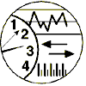
2.Modifiability General Scenario
General scenario of modifiability with parameters
Artifact:
What:
Code, interface, resources etc.
Stimulus:
Response：
Change:
Function
Quality
Capacity
Technology
How:
Make modify
Test modify
Deploy modify
Response measure：
Source:
Environment:
Who:
Developer
End user
administrator
When
Runtime
Compile time
Design time
Cost:
Effort
Time
Money
上午 09:51
47

Slide 15
2.1 General Quality-Attribute Table of Modifiability
Portion of Scenario | Possible Value
Source | End user, developer, system administrator
Stimulus | A directive to add/delete/modify functionality, or change a quality, capacity, or technology
Artifact | Code, data, interfaces, components, resources, configurations
Environment | Runtime, compile time, build time, initiation time, design time
Response | Make modification, Test modification, Deploy modification
Response Measure | Cost in terms of the following: Number, size, complexity of affected artifacts Effort, Calendar time, Money Extent to affects other functions or qualities New defects introduced
上午 09:51
47

Slide 16



2.2 Stimuli of Modifiability
A change can be:
Function ( add/modify/delete )
Qualities ( availability, usability )
Capacity ( users number was supported)
Technology ( porting the system to a different type of computer or communication network )
上午 09:51
47

Slide 17
2.3 A Concrete Scenario of Modifiability
Artifact:
Code
Response：
Stimulus:
Wishes to change UI
Change made and unit tested
Response measure：
Source:
Environment:
Developer
Design time
In three hours
The developer wishes to change the user interface by modifying the code at design time. The modifications are made with no side effects within three hours
上午 09:51
47

Slide 18

4. Tactics for Modifiability
Tactics to control modifiability have as their goal controlling the complexity of making changes, as well as the time and cost to make changes
Tactics to Control Modifiability
Change Arrives
Change Made within Time and Budget
上午 09:51
47

Slide 19
4.1 Factors relate to modifiability
Modifiability relate to two factors
Cohesion: measures how strongly the responsibilities of a module are related. The higher cohesion is good
Coupling: measures the probability that a modification to one module will propagate to the other. The lower coupling is good
上午 09:51
47

Slide 20
4.2 Parameters for Motivating the Modifiability Tactics
The parameters to motivate modifiability tactics is below:
Size of module
Coupling
Cohesion
Binding time of modification: Modifications were made late in the life cycle cost less than were made earlier
上午 09:51
47

Slide 21
4.2 Categories of Modifiability Tactics
Modifiability tactics includes four categories：
Reduce size of a module
Increase cohesion
Reduce coupling
Defer binding time
上午 09:51
47

Slide 22
4.2.1 The Graph of Classifying Modifiability Tactics
Modifiability
Reduce Size of a Module
Increase Cohesion
Reduce Coupling
Defer Binding
Change made within time and budget
Change Arrives
Split Module
Increase semantic coherence
Encapsulate
Use an intermediary Restrict dependencies Refactor
Abstract common services
Modifiability tactics
上午 09:51
47

Slide 23
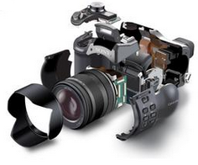
4.3 Reduce the Size of a Module
Slit module tactic
Reason: if the module being modified includes a great deal of capability, the modification costs will likely be high
Solution: refining the module into several smaller modules should reduce the average cost of future changes
上午 09:51
47

Slide 24
4.4 Increase cohesion
Increase sematic coherence tactic
Reason: if the responsibilities A and B in a module do not serve the same purpose, they should be placed in different modules
Solution: identify responsibilities to be moved is to hypothesize likely changes that affect a module
Calculate(x, y), Add( x, y ), Sub( x, y )…
上午 09:51
47

Slide 25
4.5 Reduce Coupling
There are five categories tactics
Encapsulate
Use an intermediary
Restrict dependencies
Refactor
Abstract Common Services
上午 09:51
47

Slide 26
4.5.1 Encapsulate
Encapsulate introduces an explicit interface to a module
Encapsulation reduces the probability that a change to one module propagates to other modules
Interface limits the ways in which external responsibilities can interact with the module
Component
上午 09:51
47

Slide 27
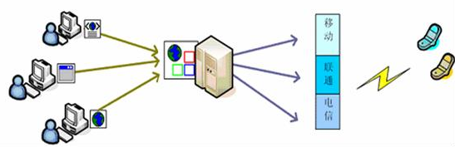
4.5.2 Use an intermediary
Use an intermediary breaks a dependency
For example
A publish-subscribe intermediary will remove the data producer’s knowledge of its consumers
In a service-oriented architecture in which services discover each other by dynamic lookup, the directory service in an intermediary
上午 09:51
47

Slide 28
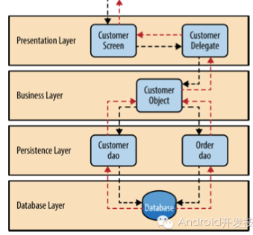
4.5.3 Restrict dependencies
The tactic restrict the modules that a given module interacts with or depends on
In practice, this tactic is achieved by restricting a module’s visibility and by authorization
For example，The layered architecture, in which a layer is only allowed to use lower layers
上午 09:51
47

Slide 29
4.5.3.1 Dependencies
We identify eight types of dependencies:
Syntax ：Data and Service are Consistent
Semantics ： Data and Service are Consistent
Sequence ： Data and Control are Consistent
Identity of an interface of A.

Slide 30
4.5.2.2 Dependencies(2)
Location of A (runtime): Location of A must be consistent with the assumptions of B.
Quality of service/data provided by A :A must be consistent with B's assumptions
Existence of A: A must exist
Resource behavior of A :A must be consistent with B's assumptions

Slide 31
4.5.4 Refactor
Refactor is a tactic undertaken when two modules are affected by the same change because they are duplicates of each other
By co-locating common responsibilities, making them submodules of the same parent module
上午 09:51
47

Slide 32
4.5.5 Abstract Common Services
Two modules provide the similar services, it may be cost-effective to implement the services just once in a more general form
Any modification to the service would then need to occur just in one place, reducing modification costs
A common way to introduce an abstraction is by parameterizing the description of a module’s activities
Analysis( type, parameters )
上午 09:51
47

Slide 33
4.6 Defer Binding
If we design artifacts with build-in flexibility, then exercising that flexibility is usually cheaper than hand-coding a specific change
Parameters are perhaps the best-know mechanism for introducing flexibility， binding time is a parameters
上午 09:51
47

Slide 34
4.6.1 Defer Binding Tradeoff
In general, the later in the life cycle we can bind values, the better
However, putting the mechanisms in place to facilitate that late binding tends to be more expensive
This is a tradeoff
上午 09:51
47

Slide 35
4.6.2 Defer Binding mechanism
Bind values at compile time
Component replacement
Compile-time parameterization
Bind values at deployment time
Configuration-time binding
Bind values at startup or initialization
Resource files
上午 09:51
47

Slide 36
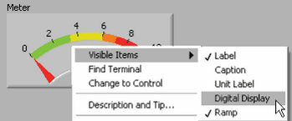
4.6.2 Defer Binding mechanism
Bind values at runtime
Runtime registration
Dynamic lookup
Interpret parameters
Name servers
Plug-ins
Publish-subscribe
Shared repositories
Polymorphism
上午 09:51
47

Slide 37
5 A Design for Modifiability
The design for modifiability include:
Allocation of responsibilities
Coordination model
Data model
Mapping among architectural elements
Resource management
Binding time
Choice of technology
上午 09:51
47

Slide 38
5.1 Allocation of Responsibilities
Determine which changes are likely to occur in technical, legal, social, business, and customer
Determine the responsibilities that would be added, modified, or deleted to make the change
Determine what responsibilities are impacted by the change
Determine an allocation of responsibilities to modules that will be changed together in the same module
上午 09:51
47

Slide 39
5.2 Coordination Model
Determine which functionality or quality attribute can change at runtime and how this affects coordination
Determine which devices, protocols, and communication paths used for coordination are likely to change
Use a coordination model that reduces coupling such as SOA structure defers bindings
上午 09:51
47

Slide 40
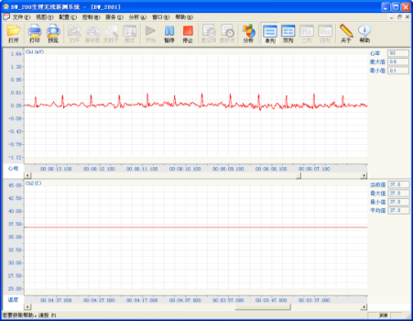
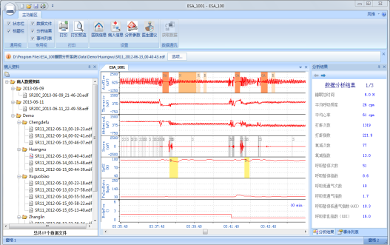
5.3 Data Model
Determine which changes to the data abstractions, their operations, or their properties are likely to occur
The data abstraction change include data creation, initialization, persistence, manipulation, translation or destruction
The number of Channel
The resolution of screen
上午 09:51
47

Slide 41
5.3.1 Data Model Change
Determine which data would need to be added, modified to make change
Determine whether there would be any changes to the creation, persistence or destruction of these data
Determine which other data are impacted by the change
Ensure an allocation of data that minimizes the number and severity of modification by the change( multi-channel sampling)
上午 09:51
47

Slide 42
5.4 Mapping Among Architectural Elements
Determine the way in which functionality is mapped to computational elements at runtime, compile time, design time or build time
Determine the extent of modifications necessary to accommodate the addition, deletion, or modification of a function or a quality attribute
上午 09:51
47

Slide 43
5.4.1 Extent of Modifications
Ensure below changes are performed with mechanisms that utilize deferred binding of mapping decisions
Execution dependencies
Assignment of data to databases
Assignment of runtime elements to processes, threads, or processors
上午 09:51
47

Slide 44
5.5 Resource Management
Determine how the addition, deletion, or modification of a responsibility or quality attribute will affect resource usage: new, remove or limit the resource
Ensure the resources are sufficient after the modification
Encapsulate all resource managers and ensure binding are deferred to the extent possible
上午 09:51
47

Slide 45
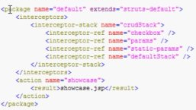
5.6 Binding Time
For each change or category of change
Determine the latest changing time
Choose a defer-binding mechanism
Determine the cost of introducing the mechanism and the cost making changes using the chosen mechanism
Do not introduce so many binding choices that change is impeded because the dependencies among the choices are complex and unknown
上午 09:51
47

Slide 46
5.7 Choice of Technology
Determine What modifications are made easier or harder by your technology choices
Will your technology choices help to make, test and deploy modifications
How easy is it to modify your choice of technologies( HTML5 cross platform )
上午 09:51
47

Slide 47
Summary
Modifiability deals with change and the cost in time or money of making a change
Tactics for modifiability are categorized into:
Making modules smaller
Increasing cohesion
Reducing coupling
Deferring binding
上午 09:51
47

Slide 48
Homework
The abstract common services tactic is intended to reduce coupling, but it also might reduce cohesion. Why?
上午 09:51
47

Slide 49
Discuss
How does the cloud service realize the high availability?
Reference the chapter 26 ”Architecture in the Cloud”
上午 09:51
47

