Slide 1
Performance
—— 2016/4
61

Slide 2
Outline
Introduction
Concurrency
Performance General Scenario
Tactics for Performance
A Design Checklist for Performance
Summary
61

Slide 3
1. Introduction
Performance is about time and the software system’s ability to meet timing requirements
Performance relate to event arriving and response to the event
Event property and the system or element’s time-based response to those events is the essence of performance
61

Slide 4
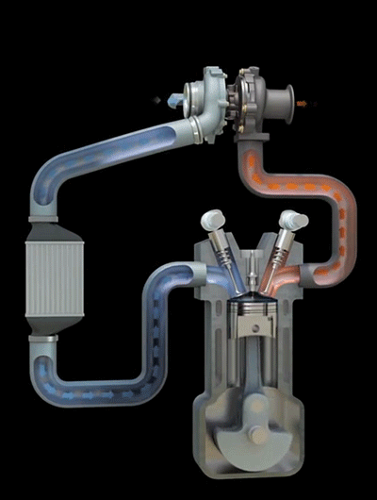
1.1 Event pattern is important
In performance, the pattern of events arriving and the pattern of response will be characterized
A web-based system, the desired response might be expressed that the number of transactions processed in a unit time
For the engine control system, the response might be the allowable variation in the firing time
61

Slide 5
1.2 The Performance and the Other Qualities
In history of software engineering, the performance has been the driving factor in system architecture
As the price/performance ratio of hardware continues to plummet and the cost of developing software continues to rise, other qualities have emerged as important competitors to performance
61

Slide 6
1.3 All System need performance
All systems have performance requirements. It continues to be a fundamentally quality attribute
For example, a word processing tool may not have any explicit performance requirement, but no doubt nobody can endure the slow response to a operation, such as insert a picture, save as etc.
61

Slide 7
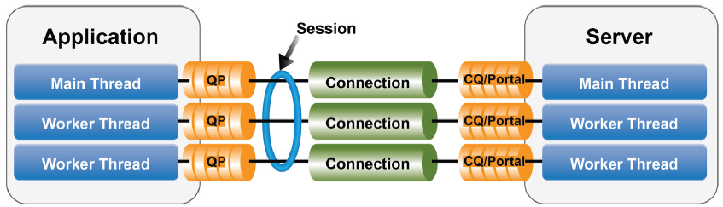
2. Concurrency
Concurrency refers to operations occurring in parallel
Concurrency occurs any time your system creates a new thread
Multi-tasking on your system is supported by independent threads
61

Slide 8
2.1 Parallel computation
You should consider concurrency when parallel algorithms, parallelizing infrastructures such as map-reduce, or NoSQL databases are used, or utilize one of a variety of noncurrent scheduling algorithms
Concurrency relate to parallel computation
61

Slide 9
2.2 Race condition in concurrency
Because of the interleaving phenomenon referred to as a race condition, concurrency must be managed by the architect
Race conditions can occur when there are two threads of control and there is shared state
61

Slide 10
2.3 Race condition problems
Race conditions are one of the hardest types of bugs to discover
The occurrence of the bug is sporadic and depends on differences in timing
For example, the author of the book had a race condition problem in a software. He took over a year for the bug to recur
61

Slide 11
2.4 The technology to prevent race condition
There are two technologies to prevent race condition
Use locks to enforce sequential access to state
Partition the state based on the thread executing a portion of code. That is, there are two instances of x, x is not shared by the two threads and there will not be a race condition
61

Slide 12
2.5 Using Concurrency
Concurrency use parallel technique to improve the performance
Do not let the difficulties associated with concurrency dissuade you from utilizing this very important technique
Use it with the knowledge that you must carefully identify critical sections in your code and prevent the race condition
61

Slide 13
2.6 Question
Supposed there are two same threads, the code of the thread below:
x = 1;
x++
What is the value of x after both threads have executed those statements? Why?
61

Slide 14

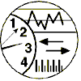
3.Performance General Scenario
General scenario of performance with parameters
Artifact:
System components
Stimulus:
Response：
Periodic
Sporadic
Stochastic
Process event
Change level of service
Response measure：
Source:
Environment:
Internal, External
Normal
Emergency
Peak load
Overload
Latency
Deadline
Throughput
Jitter
Miss rate
61

Slide 15
3.1 General Quality-Attribute Table of Performance
Portion of Scenario | Possible Value
Source | Internal or external to the system
Stimulus | Arrival of a periodic, sporadic, or stochastic event
Artifact | System or one or more components in the system
Environment | Operational mode: normal, emergency, peak load, overload
Response | Process events, change level of service
Response Measure | Latency, deadline, throughput, jitter, miss rate
61

Slide 16
3.2 Stimuli of Performance
Periodic event：event arrive predictably at regular time intervals. It is most often seen in real-time systems
Stochastic event：event arrive according to some probabilistic distribution. It is most seen in the client/server
Sporadic event：event arrive is neither periodic nor stochastic.
61

Slide 17
3.3 Response of Performance
Latency：The time between the arrival of the stimulus and the system’s response
Deadline in process: The threshold time before it the event must be processed
Throughput：The number of transactions the system can process in a unit of time
The jitter：The allowable variation in latency
Miss rate：The number of events not processed because the system was too busy to respond
61

Slide 18
3.4 A Concrete Scenario of Performance
Artifact:
System
Response：
Stimulus:
Initiate Transactions
Transactions Are processed
Response measure：
Source:
Environment:
Users
Normal operation
Average Latency of two seconds
User initiate transactions under normal operations. The system processed the transactions with an average latency of two seconds
61

Slide 19
4. Tactics for Availability
The goal of performance tactics is to generate a response to an event arriving at the system within some time-based constraint
Response Generated within Time Constraints
Tactics to Control Performance
Event Arrives
61

Slide 20
4.1 The Impact Factors of the Performance
Two basic contributors to the response time:
Processing time: the system is working to respond
Blocked time: the System is unable to respond
61

Slide 21
4.1.1 Processing Time
Processing consumes resources, which takes time
Hardware resources: CPU, data stores, network communication band width, memory
Software resources: entities defined by the system under design. For example, buffers must be managed and access to critical sections must be made sequential
61

Slide 22
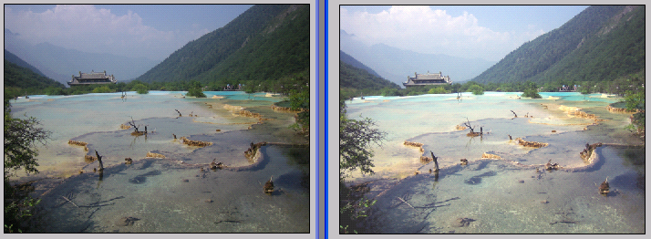
4.1.1.1 Processing Time example
Image process consumption multitude resource: add, subtract, multiply, divide calculating etc。
61

Slide 23
4.1.2 Blocked Time
A computation can be blocked because of contention for some needed resource
There are two reasons of blocked time
The resource is unavailable
The computation depends on the result of other computations that are not yet available
61

Slide 24
4.1.2.1 Blocked Time types
Contention for resources: Multiple streams compete on the same resource
Availability of resources: resource is unavailable, may be caused by offline of network or failure of component
Dependency on other computation: A computation may have to wait because it must synchronize with the results of another computation
61

Slide 25
4.1.2.2 Contention for Resources
Process A
Process B
Process C
Wait to read
Write data
Wait to read
Data Base
Contention for resources : Critical resource access
61

Slide 26
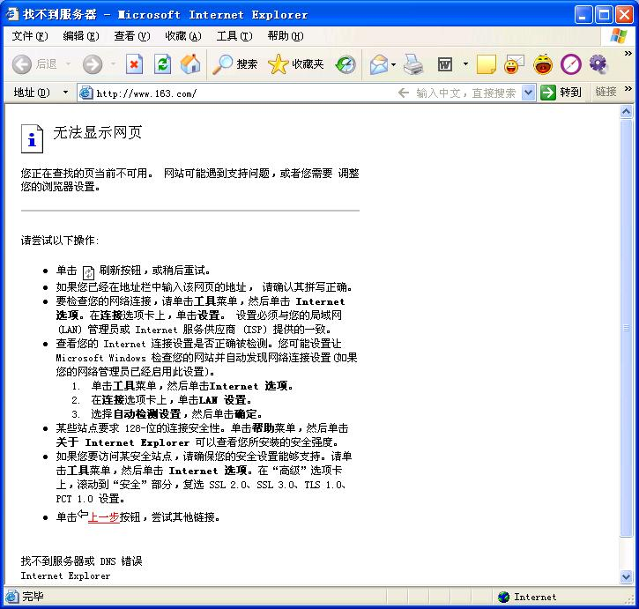
4.1.2.3 Availability of Resources
Availability of resources: Computation cannot proceed if a resource is unavailable
Unavailability may be caused by the resource being offline or by failure of the component or for some other reason
61

Slide 27
4.2 Two categories of Performance Tactics
Control resource demand: This tactic operates on the demand side to produce smaller demand on the resources that to service the events
Mange resources: This tactic operates on the response side to make the resources at hand work more effectively in handling the demands put to them
61

Slide 28
4.2.1 The Graph of Classifying Performance Tactics
Performance
Control Resource Demand
Prevention
Response Generated within Time Constraints
Manage Sampling Rate
Limit Event Response
Prioritize Events
Reduce Overhead
Bound Execution Times
Increase Resource Efficiency
Increase Resources
Introduce Concurrency
Maintain Multiple Copies of Computations
Maintain Multiple Copies of Data
Bound Queue Sizes
Schedule Resources
Event Arrives
Performance tactics
61

Slide 29
4.3 Control Resource Demand
One way to increase performance is to carefully manage the demand for resources
There are two categories of tactics to control resource demand
Reduce the number of events processed
Limit the rate at which the system responds to events
61

Slide 30
4.3.1 Manage Sampling Rate
Manage sampling rate: It is possible to reduce the sampling frequency at which a stream of environmental data is captured, the demand can be reduced
This tactic is typically with some attendant loss of fidelity(Side Effect)
For example: the voice sample rate at 8K, or 44.1K
61

Slide 31
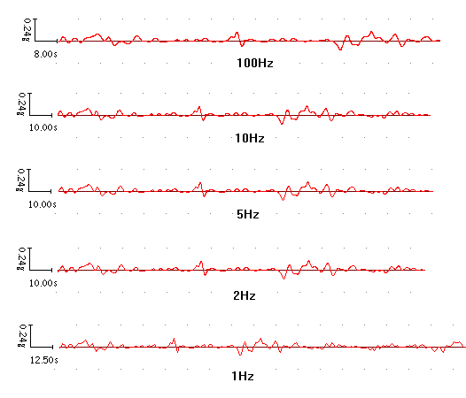
4.3.1.1 The Example of Reducing Sample Rate
Same wave in different sample rate
61

Slide 32
4.3.2 Limit event response
Limit event response: When discrete events arrive at the system too rapidly to be processed, then the events must be queued until they can be processed
This tactic could be triggered by a queue size or processor utilization measure exceeding some warning level
The tactic is unacceptable to lose any event, the system process events only up to a set maximum rate
61

Slide 33
4.3.3 Prioritize events
Prioritize events：If not all events are equally important, you can impose a priority scheme that ranks events to how important it is to service theme
If there are not enough resources available, the low-priority events might be ignored
Ignoring events consumes minimal resources, and thus increases whole performance
61

Slide 34
4.3.4 Reduce Overhead
Reduce overhead: The use of intermediaries increases the resources consumed, remove them improves latency
This is modifiability/performance tradeoff
A strategy for reducing computational overhead is to co-locate resources
61

Slide 35
4.3.4.1 Co-locate Resources
Co-location includes below:
Host cooperating components on the same processor to avoid the time delay of network communication
Put the resources in the same runtime software component to avoid the expense of a subroutine call
Perform a periodic cleanup of resources that have become inefficient
Execute single-threaded servers
61

Slide 36
4.3.5 Bound Execution Times
Bound execution times: place a limit on how much execution time is used to respond to an event
For iterative, limiting the number of iterations is a method for bounding execution times
Bound execution times is usually a less accurate computation
Adopt this tactic, you will need to assess its effect on accuracy and see if the result is good enough
61

Slide 37
4.3.6 Increase Resource Efficiency
Increase resource efficiency: Improving the algorithms used in critical areas will decrease latency
For example: Using binary search algorithm is more efficient than other search algorithm
61

Slide 38
4.4 Manage Resources
Manage Resources tactic is usually applied to the processor but is also effective when applied to other resources such as a disk
Sometimes one resource can be traded for another. For example, intermediate data may be kept in a cache or it may be regenerated depending on time and space resource availability
61

Slide 39


4.4.1 Increase resources
Increase resource: Faster processors, additional processors, additional memory, and faster networks all have the potential for reducing latency
Increasing the resources have some cost. However, in many cases it the cheapest way to get immediate improvement
61

Slide 40
4.4.2 Introduce concurrency
Introduce concurrency: If requests can be processed in parallel, the blocked time can be reduce
Concurrency can be introduced by processing different streams of events on different threads or by creating additional threads to process different sets of activities
61

Slide 41
4.4.3 Maintain Multiple Copies of Computations
Maintain multiple copies of computations: Multiple servers in a client-server pattern are replicas of computation
The purpose of replicas is to reduce the contention that would occur if all computations took place on a single server
A load balancer is needed to assigns new work to one of the available server
61

Slide 42
4.4.4 Maintain Multiple Copies of Data
Maintain multiple copies of data: Caching is a tactic that involves keeping copies of data on storage with different access speeds
Data replication involves keeping separate copies of the data to reduce the contention from multiple simultaneous accesses
Replication usually to predict the cache data or users requests
61

Slide 43
4.4.5 Bound Queue Sizes
Bound Queue Sizes: this tactic controls the maximum number of queued arrivals and the resources used to process the arrivals
Using the tactic, you need to adopt a policy for what happens when the queues overflow and decide if not responding to lost events is acceptable
61

Slide 44
4.4.6 Schedule Resources
Schedule resources: Whenever there is contention for a resource, the resource must be scheduled
Processors are scheduled, buffers are scheduled
You need to understand the characteristics of each resources; use and choose the scheduling strategy that is compatible with it
61

Slide 45
4.7 Scheduling Policies
A scheduling policy conceptually has two parts:
priority assignment（分配优先级）
dispatching（调度）
Competing criteria for scheduling include optimal resource usage, request importance, and minimizing latency etc.
61

Slide 46
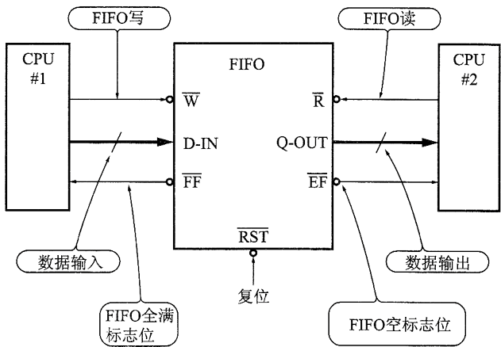
4.7.1 First-in/First-out
FIFO queues treat all requests for resources as equals and satisfy them in turn
One possibility with a FIFO queue is that one request will be stuck behind another one that takes a long time to generate a response
61

Slide 47
4.7.2 Fixed-priority Scheduling
Fixed-priority scheduling assigns each source of resource requests a particular priority and assigns the resources in that priority order
This strategy ensures better service for higher priority requests
Three common prioritization strategies:
Semantic importance
Deadline monotonic
Rate monotonic（短作业优先）
61

Slide 48
4.7.3 Dynamic Priority Scheduling
Dynamic priority scheduling include three:
Round-robin: is a strategy that orders the requests and assigns the resource to the next request in that order
Earliest-deadline-first: Assigns priorities based on the pending requests with the earliest deadline
Least-slack-first: this strategy assigns the highest priority to the job having the least slack time
61

Slide 49
4.7.4 Static Scheduling
Static scheduling: a cyclic executive schedule is a scheduling strategy where the preemption points and the sequence of assignment to the resource are determined offline
61

Slide 50
4.8 Summary Performance Tactics
Performance
Control Resource Demand
Prevention
Response Generated within Time Constraints
Manage Sampling Rate
Limit Event Response
Prioritize Events
Reduce Overhead
Bound Execution Times
Increase Resource Efficiency
Increase Resources
Introduce Concurrency
Maintain Multiple Copies of Computations
Maintain Multiple Copies of Data
Bound Queue Sizes
Schedule Resources
Event Arrives
Performance tactics
61

Slide 51
5 A Design for Performance
The design for performance include:
Allocation of responsibilities
Coordination model
Data model
Mapping among architectural elements
Resource management
Binding time
Choice of technology
61

Slide 52
5.1 Allocation of Responsibilities
Determine the system’s responsibilities that will involve heavy loading, have time-critical response requirements. There are three:
Responsibilities that result from a thread of control crossing process or processor boundaries
Responsibilities to manage the threads of control
Responsibilities for scheduling shared resources or managing resources
61

Slide 53
5.2 Coordination Model
Determine the elements of the system that must coordinate with each other
There are some mechanisms:
Support any introduces concurrency
Can capture periodic, stochastic, or sporadic event arrivals as needed
Have the appropriate properties of the communication mechanisms
61

Slide 54
5.3 Data Model
Determine those portions of the data model that will be heavily loaded
Determine the following:
Whether maintaining multiple copies of data
Whether partitioning data would benefit performance
Whether reducing the processing requirements for the data abstractions
Whether adding resources to reduce bottlenecks
61

Slide 55
5.4 Mapping among Architectural Elements
Determine whether co-locating some components
Determine where introducing concurrency
Determine whether the choice of threads of control and their associated responsibilities introduces bottlenecks
Ensure that components with heavy computation requirements are assigned to processors with the most processing capacity
61

Slide 56
5.4 Resource Management
Determine which resources in your system are critical for performance. Below is:
System elements that need to be aware of, and manage, time and other performance-critical resources
Process/thread models
Prioritization of resources and access to resources
Scheduling and locking strategies
Deploying additional resources on demand
61

Slide 57
5.6 Binding Time
For each element that will be bound after compile time, Determine the following:
Time necessary to complete the binding
Additional overhead introduced by using the late binding mechanism
Ensure that these values do not pose unacceptable performance penalties on the system
61

Slide 58
5.7 Choice of Technology
The choice of technology is below
Scheduling policy
Priorities
Policies for reducing demand
Allocation of portions of the technology to processors
Other performance-related parameters
61

Slide 59
Summary
Performance is about the management of system resources to achieve acceptable timing behavior
Performance can be improved by reducing demand or by managing resources more appropriately
61

Slide 60
Homework
Write a set of concrete scenarios for performance using each of the possible responses in the general scenario
Every system has real-time performance constraints. Discuss. Or provide a counterexample
The fourth question in page 146
61

Slide 61
Discuss
How do you express the quality of a system? How do you get the quality? How do you design to implement the quality for a system? Make a example
61

