Slide 1
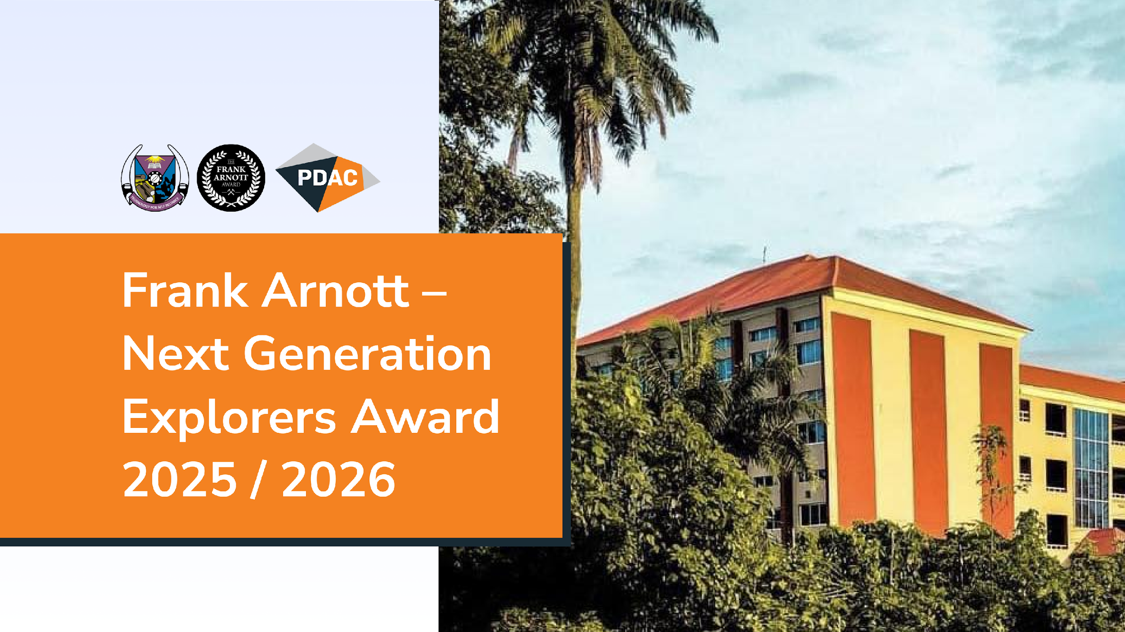

Slide 2
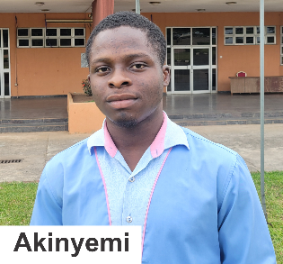
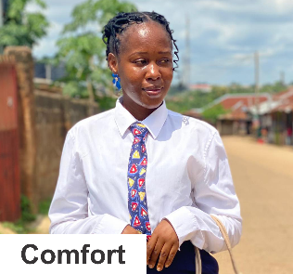
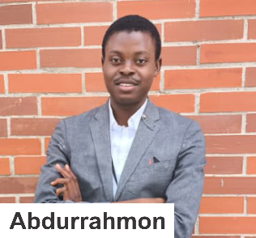
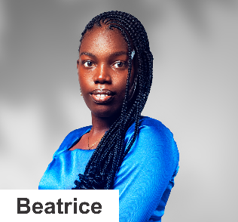
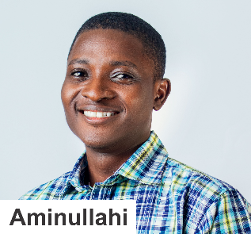
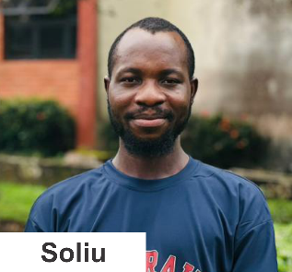
Our Team and Mentors
Team Snapshot | Title Slide | Project
TEAM
MENTOR
Olawoye Akinyemi Elijah (B.Tech FUTA)
Prof. Amigun John Olurotimi
Data Processing / Applied Geophysics
Federal University of Technology, Akure, Applied Geophysics Department
Akinleu Toyin Comfort (B.Tech FUTA)
Dr. Akinlalu Ayokunle Adewale
Geochemical and structural interpretation/ Applied Geology
Federal University of Technology, Akure, Applied Geophysics Department
Dr. Idris Adebayo Musa
Akesire Abdurrahmon Abiodun (B.Tech FUTA)
Federal University of Technology, Akure, Mining Engineering
Data Integration / Applied Geophysics
Dr. Adepoju M.O
Stephen Opeyemi Beatrice (B.Tech FUTA)
Federal University of Technology, Akure, Applied Geology Department
Mr. Daniel Oluwafunmilade Afolabi
3D Drilling modelling and Mining
University of Calgary, Canada, Earth Energy and Environment
Ismail Aminullahi Olamide (B.Tech FUTA)
Mr. Tomiwa Akanbi
Data Processing / Applied Geophysics
Nigerian Geological Survey Agency, Applied Geophysics Department
Mudashiru Soliu Ademola (M.Tech FUTA)
Mr. Adisa A.L
Machine Learning / Applied Geophysics
Federal University of Technology, Akure, Applied Geology Department
FUTA - Federal University of Technology, Akure

Slide 3


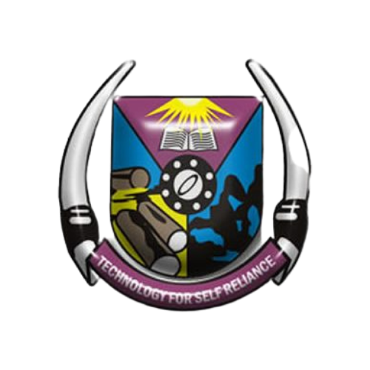


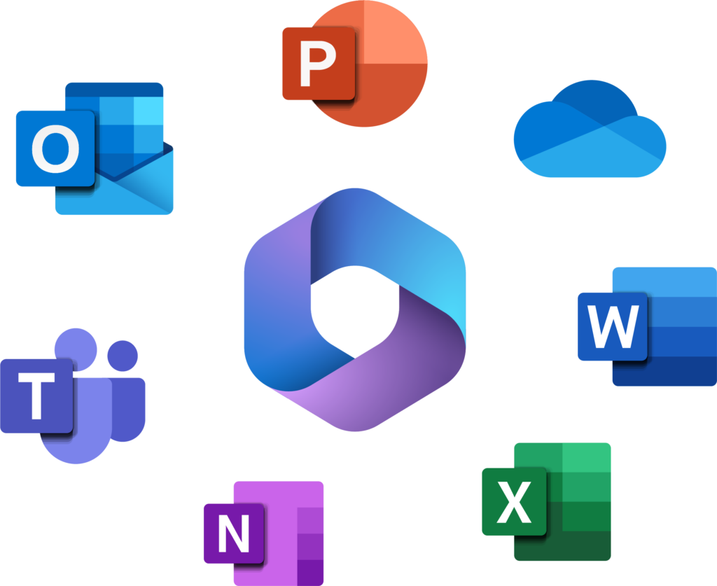
Teamwork Strategy
WhatsApp
External communication
For a quick way to message teammates;
convenient call feature.
Researchers and industry experts were contacted to help us further refine our ideas, gather additional datasets, and advise us on any roadblocks.
Email
For meeting summaries and outcomes,
file sharing, and longer responses.
Nigeria Geological Survey Agency – NGSA
Federal university of Technology, Akure Professors
Regular meetings
External communication
Planning strategy and formulating ideas
over September break and updating the group with personal progress every day.
Virtual meetings done if someone couldn’t attend physically.
Unlimited real-time storage on box provided by The Federal university of Technology, Akure and the ability to open and edit Microsoft 365 formats in box made it our go-to collaboration software.

Slide 4
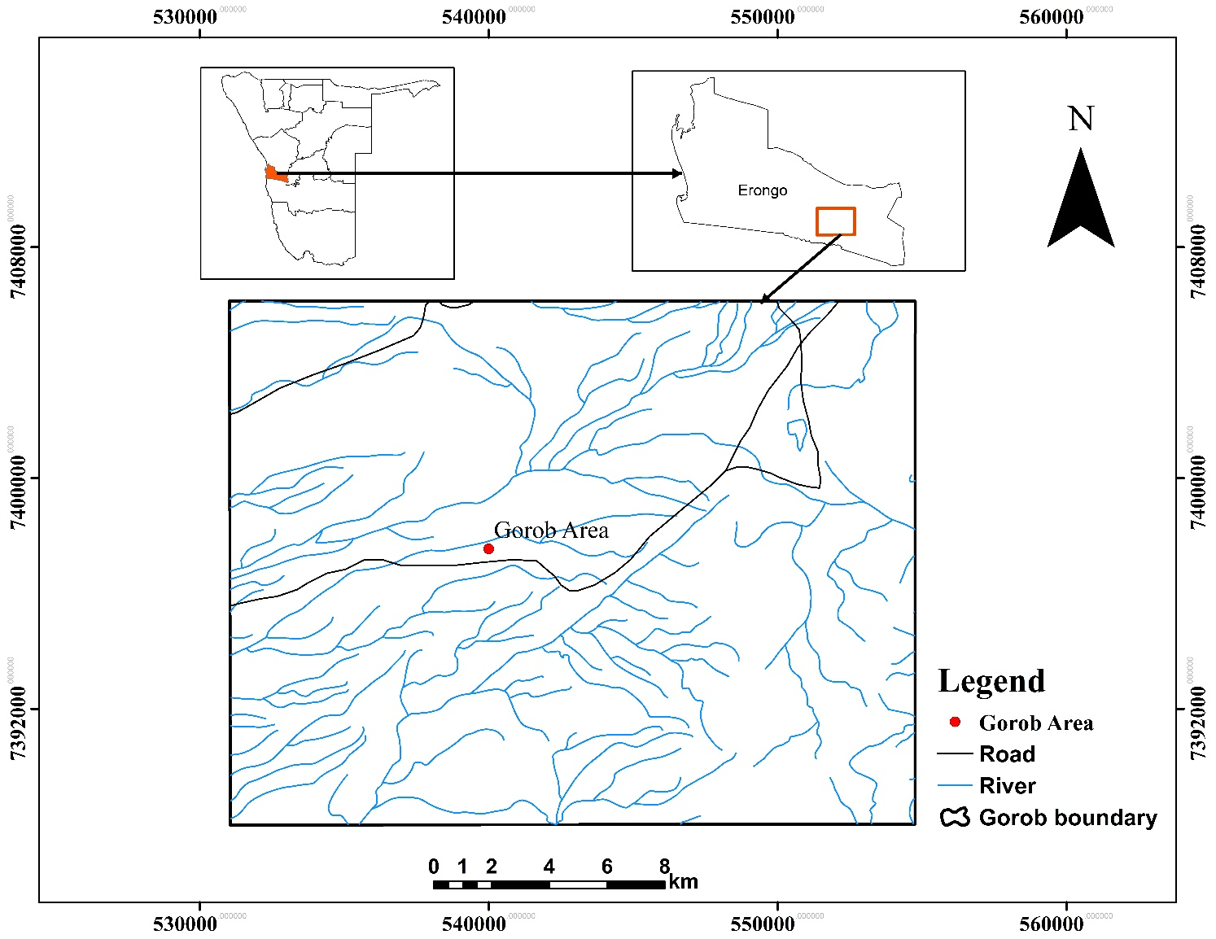
Introduction
Team Snapshot | Title Slide | Project
Project Title
Machine Learning Framework for Copper Exploration Towards its Economic Viability in Namibia: Insights from Multi-source Datasets
Project Area
Gorob Area, Namibia.
Datasets
Literature
Geology
Geophysics:
Aero-Magnetic
Aero-Radiometric
Remote Sensing: DEM/Landsat 8
Geochemical
Drill Hole
Figure 1: Basemap of the study area

