Slide 1



The Impact of Free Fatty Acid on Biodiesel Production Using a Homogeneous Catalyst
Sarah Oliver
October 13, 2011

Slide 2

Contents
Objectives
Experiments
Data
Conclusion
Recommendations
Sources
Questions

Slide 3
Objectives
Find the amount of biodiesel produced based on the amount of free fatty acid content.
Find the ease of separating the biodiesel product from by-products and unreacted materials.

Slide 4
Wanted Reaction
1 mol triglyceride (soybean oil) + 3 mol of methanol -> 1 mol glycerol + 3 mol biodiesel
1 mol tall oil + 1 mol methanol -> 1 mol water + 1 mol biodiesel
Unwanted Reaction
1 mol sodium hydroxide + 1 mol tall oil -> CH₃-Na (soap) + 1 mol water

Slide 5
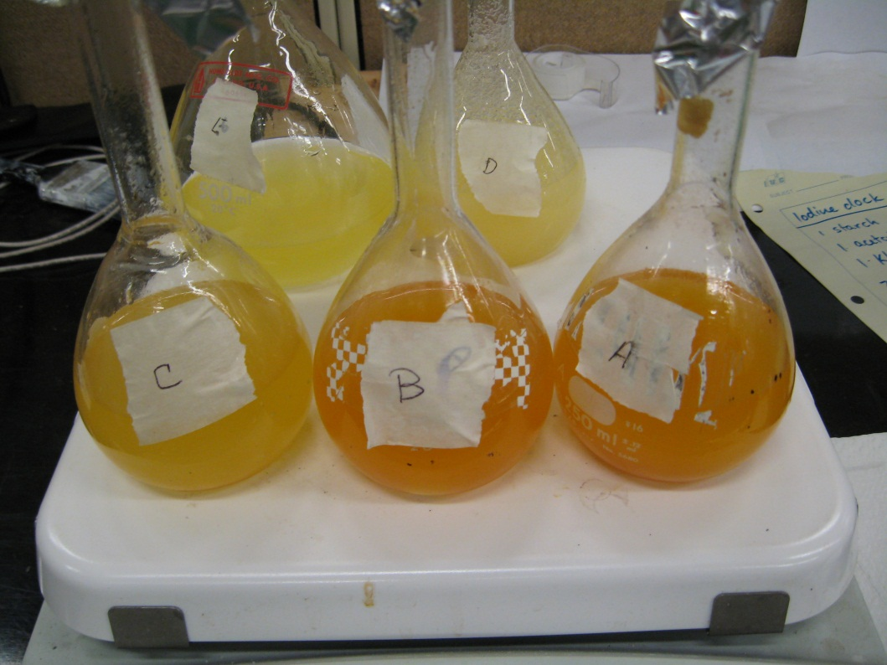
Pelletized sodium hydroxide (96-100%) was used as a catalyst at a mass ratio of 1 g per 100 grams of oil.
The methanol used was twice the stoichiometric amount.
The reaction was done with constant agitation.
The temperature was kept at 60 degrees Celsius.

Slide 6
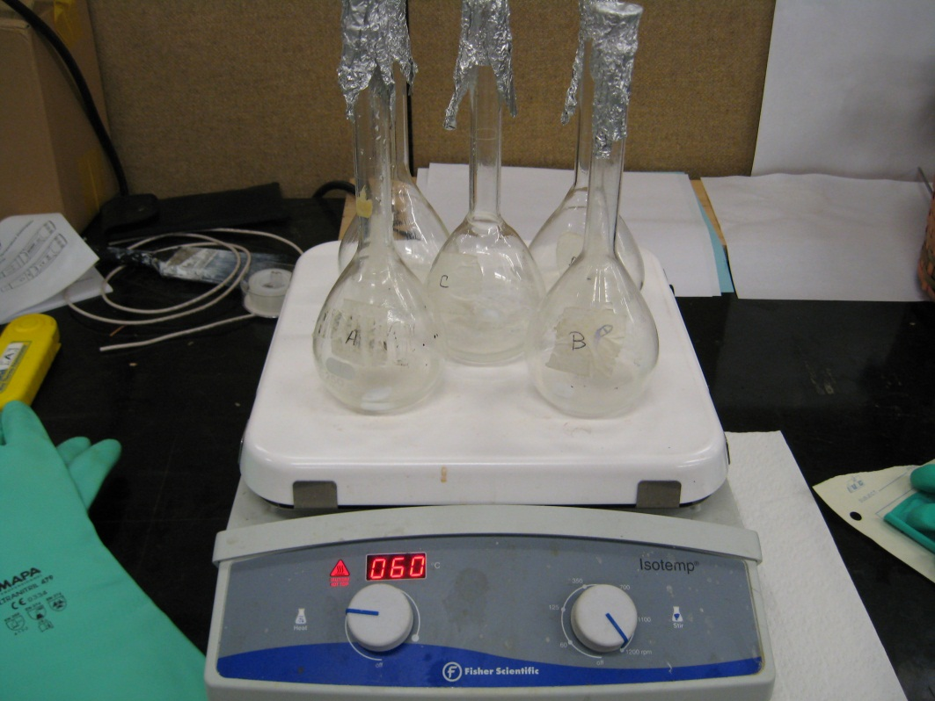
It was found that the reaction happens more efficiently if the sodium hydroxide was allowed to dissolve in the methanol before adding oil. The experiment also gave better results if covered when heated so the methanol was not allowed to evaporate out.

Slide 7
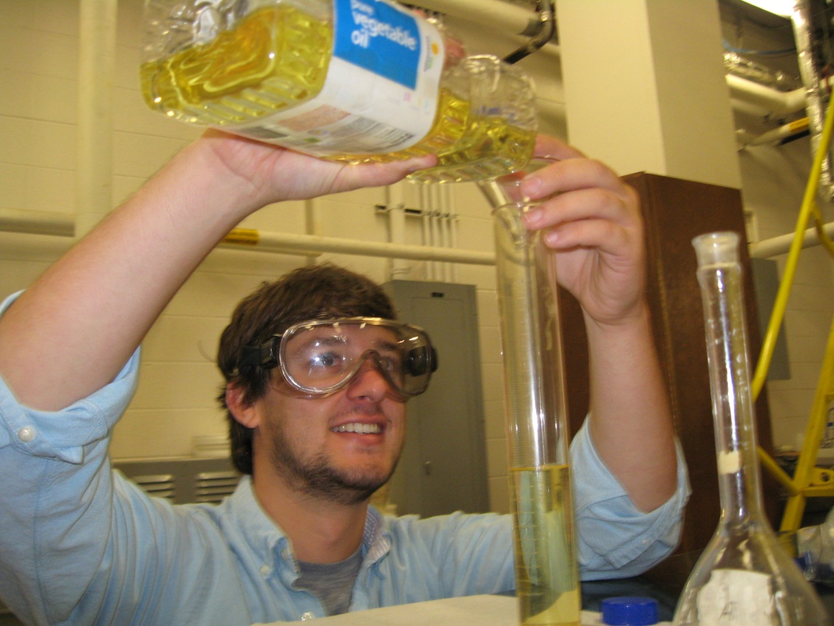
Different ratios of tall oil vs. vegetable oil were used in experimental testing in order to find the impact free fatty acid has on biodiesel production.

Slide 8
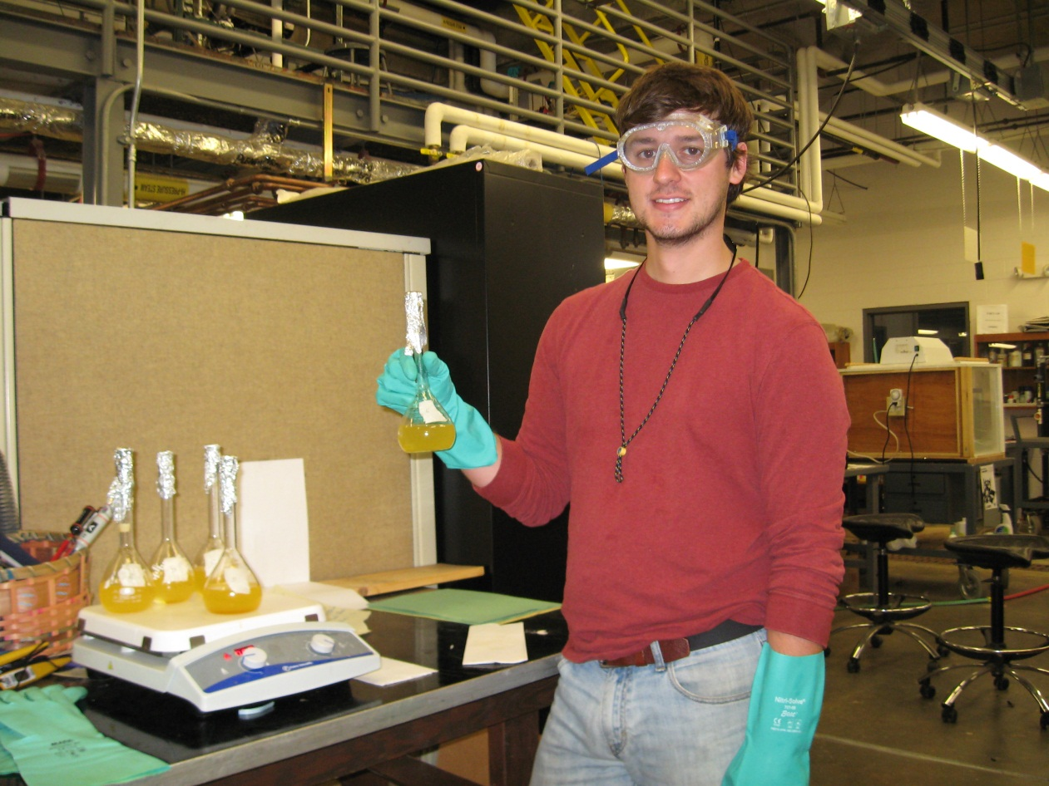
The reactants were cooked and agitated for about an hour in the lab in order for the transesterification to occur.

Slide 9
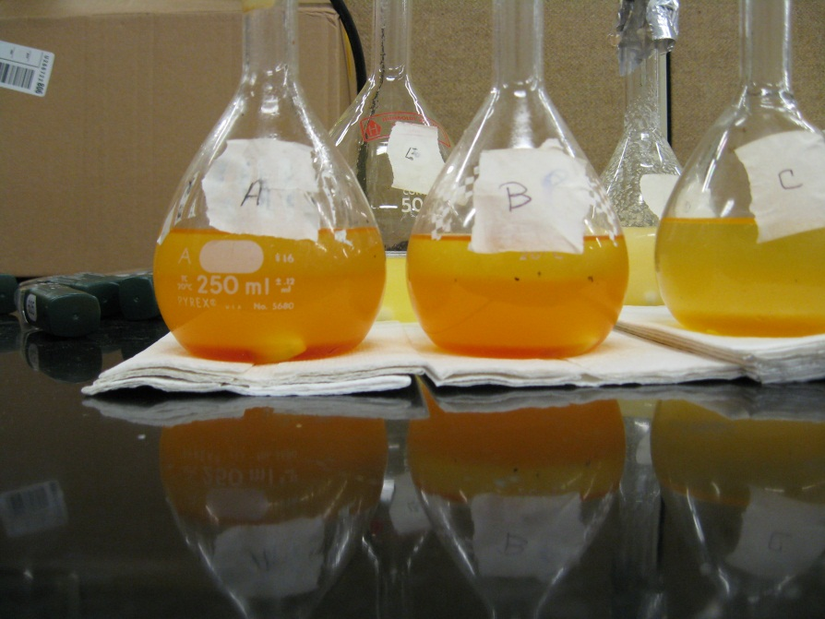
The products separated nicely into two layers when given enough time to separate. The product is expected to be glycerol in the bottom dark layer with a density of 1.26 grams/cm³ and the top yellow layer is expected to be our diesel product layer with a density of 0.88 grams/cm³.

Slide 10
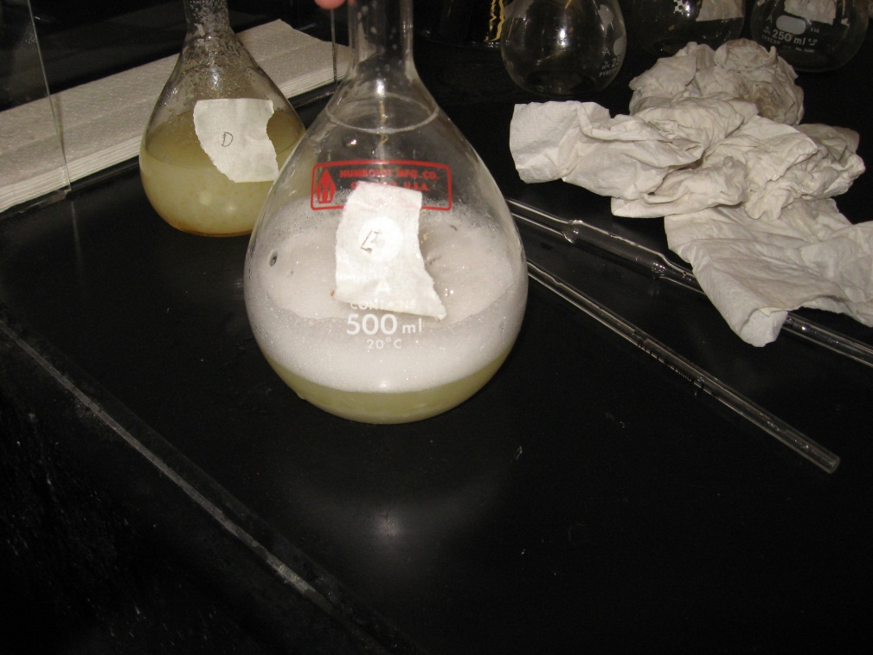
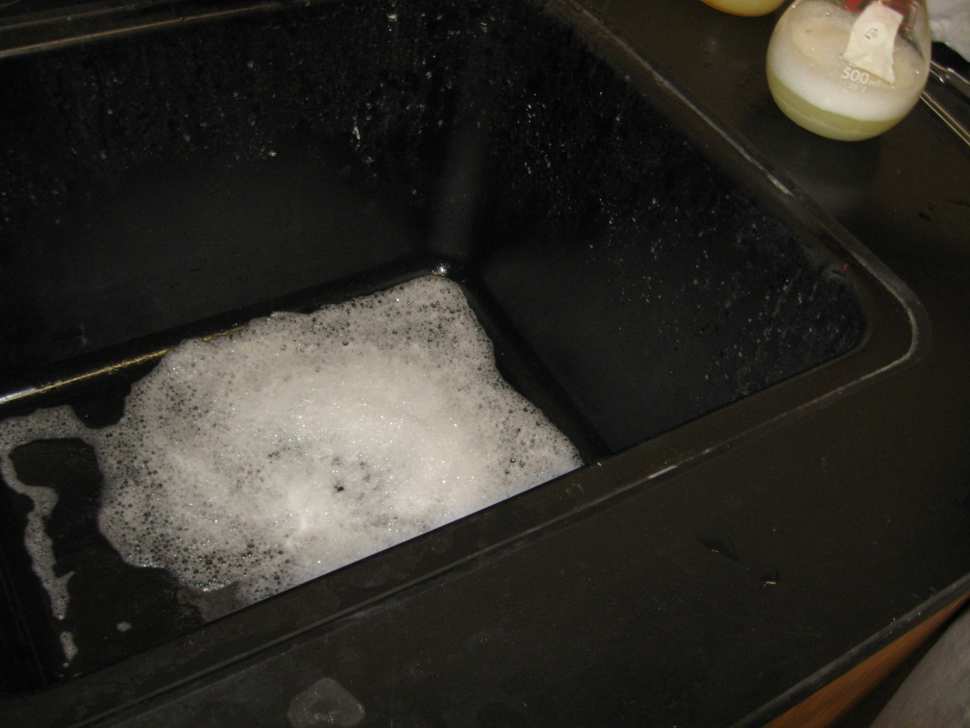
Soap was another one of our by-products in this experiment
That was obtained when using large amounts of tall oil.

Slide 11
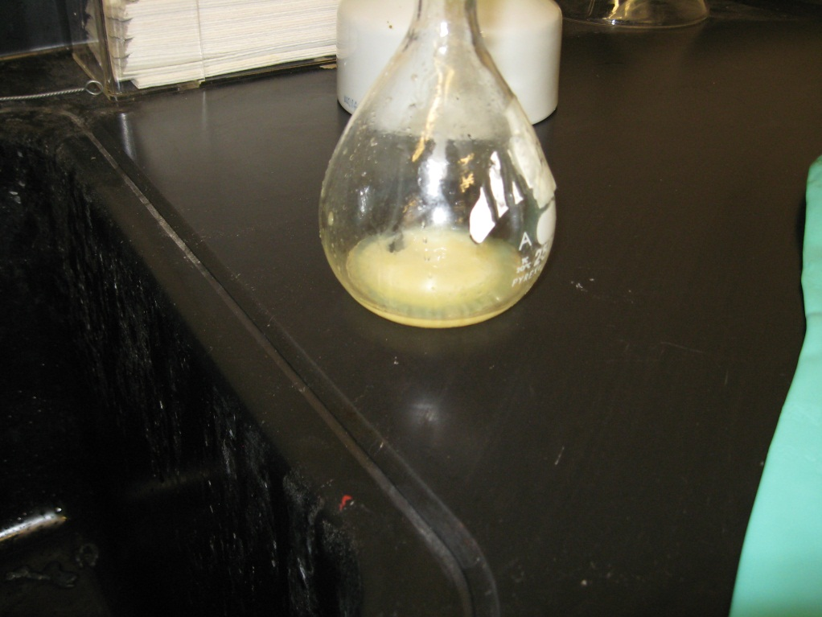
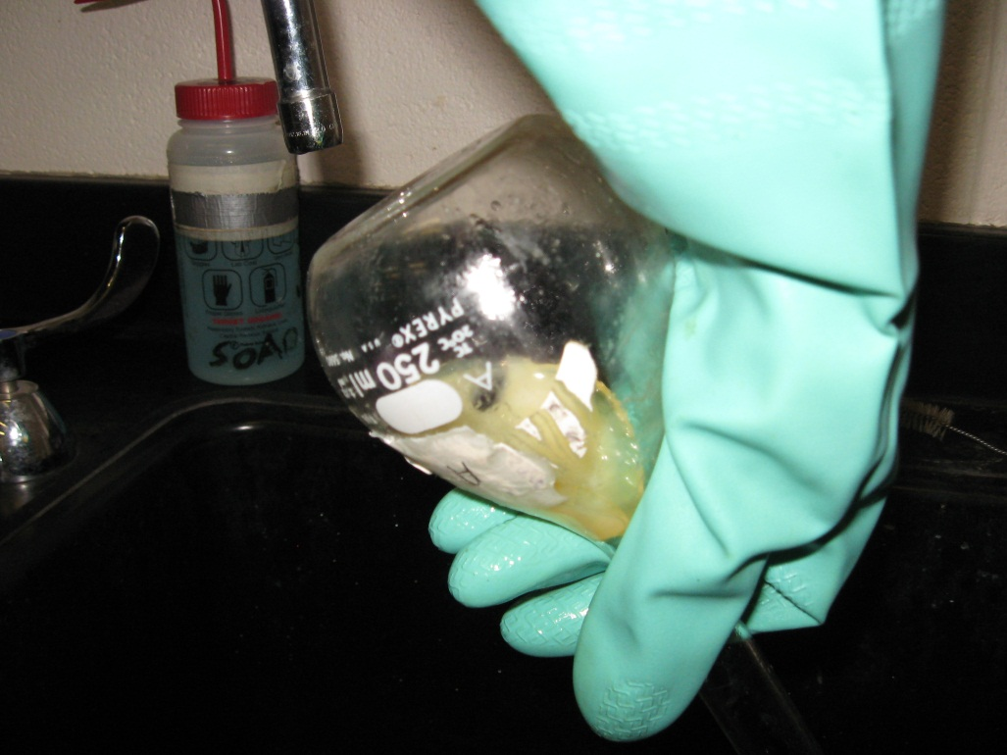
When using large amounts of tall oil and the product was allowed to sit over night, it formed a solid (bar of soap).

Slide 12
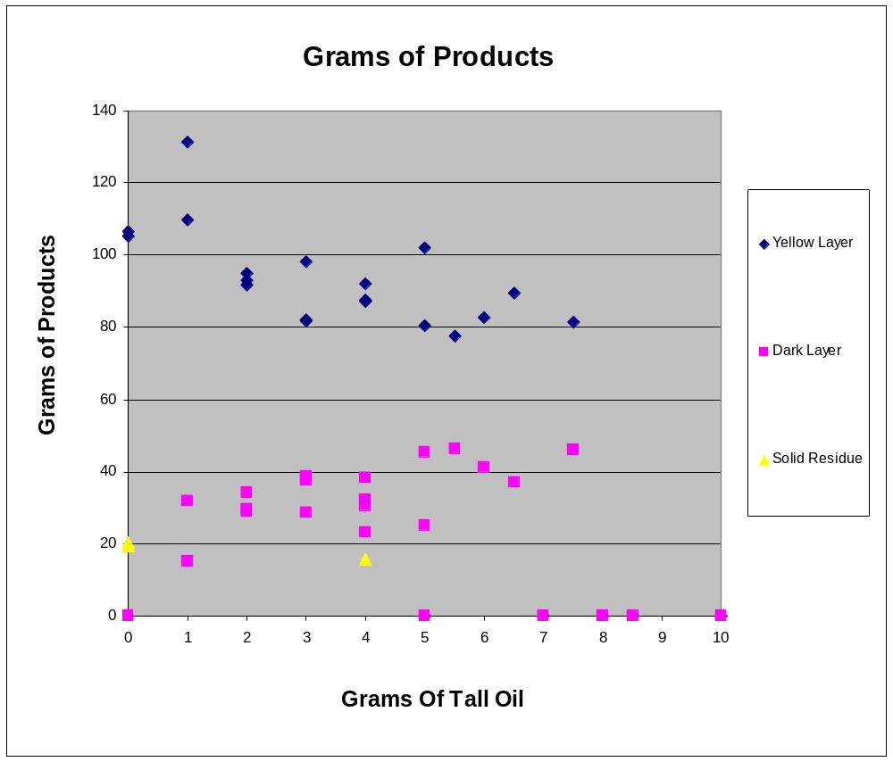

Slide 13
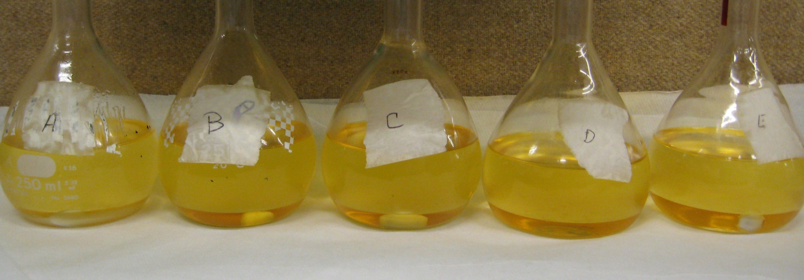
The more tall oil (free fatty acid) used the more bottom layer (glycerol) and the less top layer (biodiesel).
Less tall oil
More tall oil

Slide 14
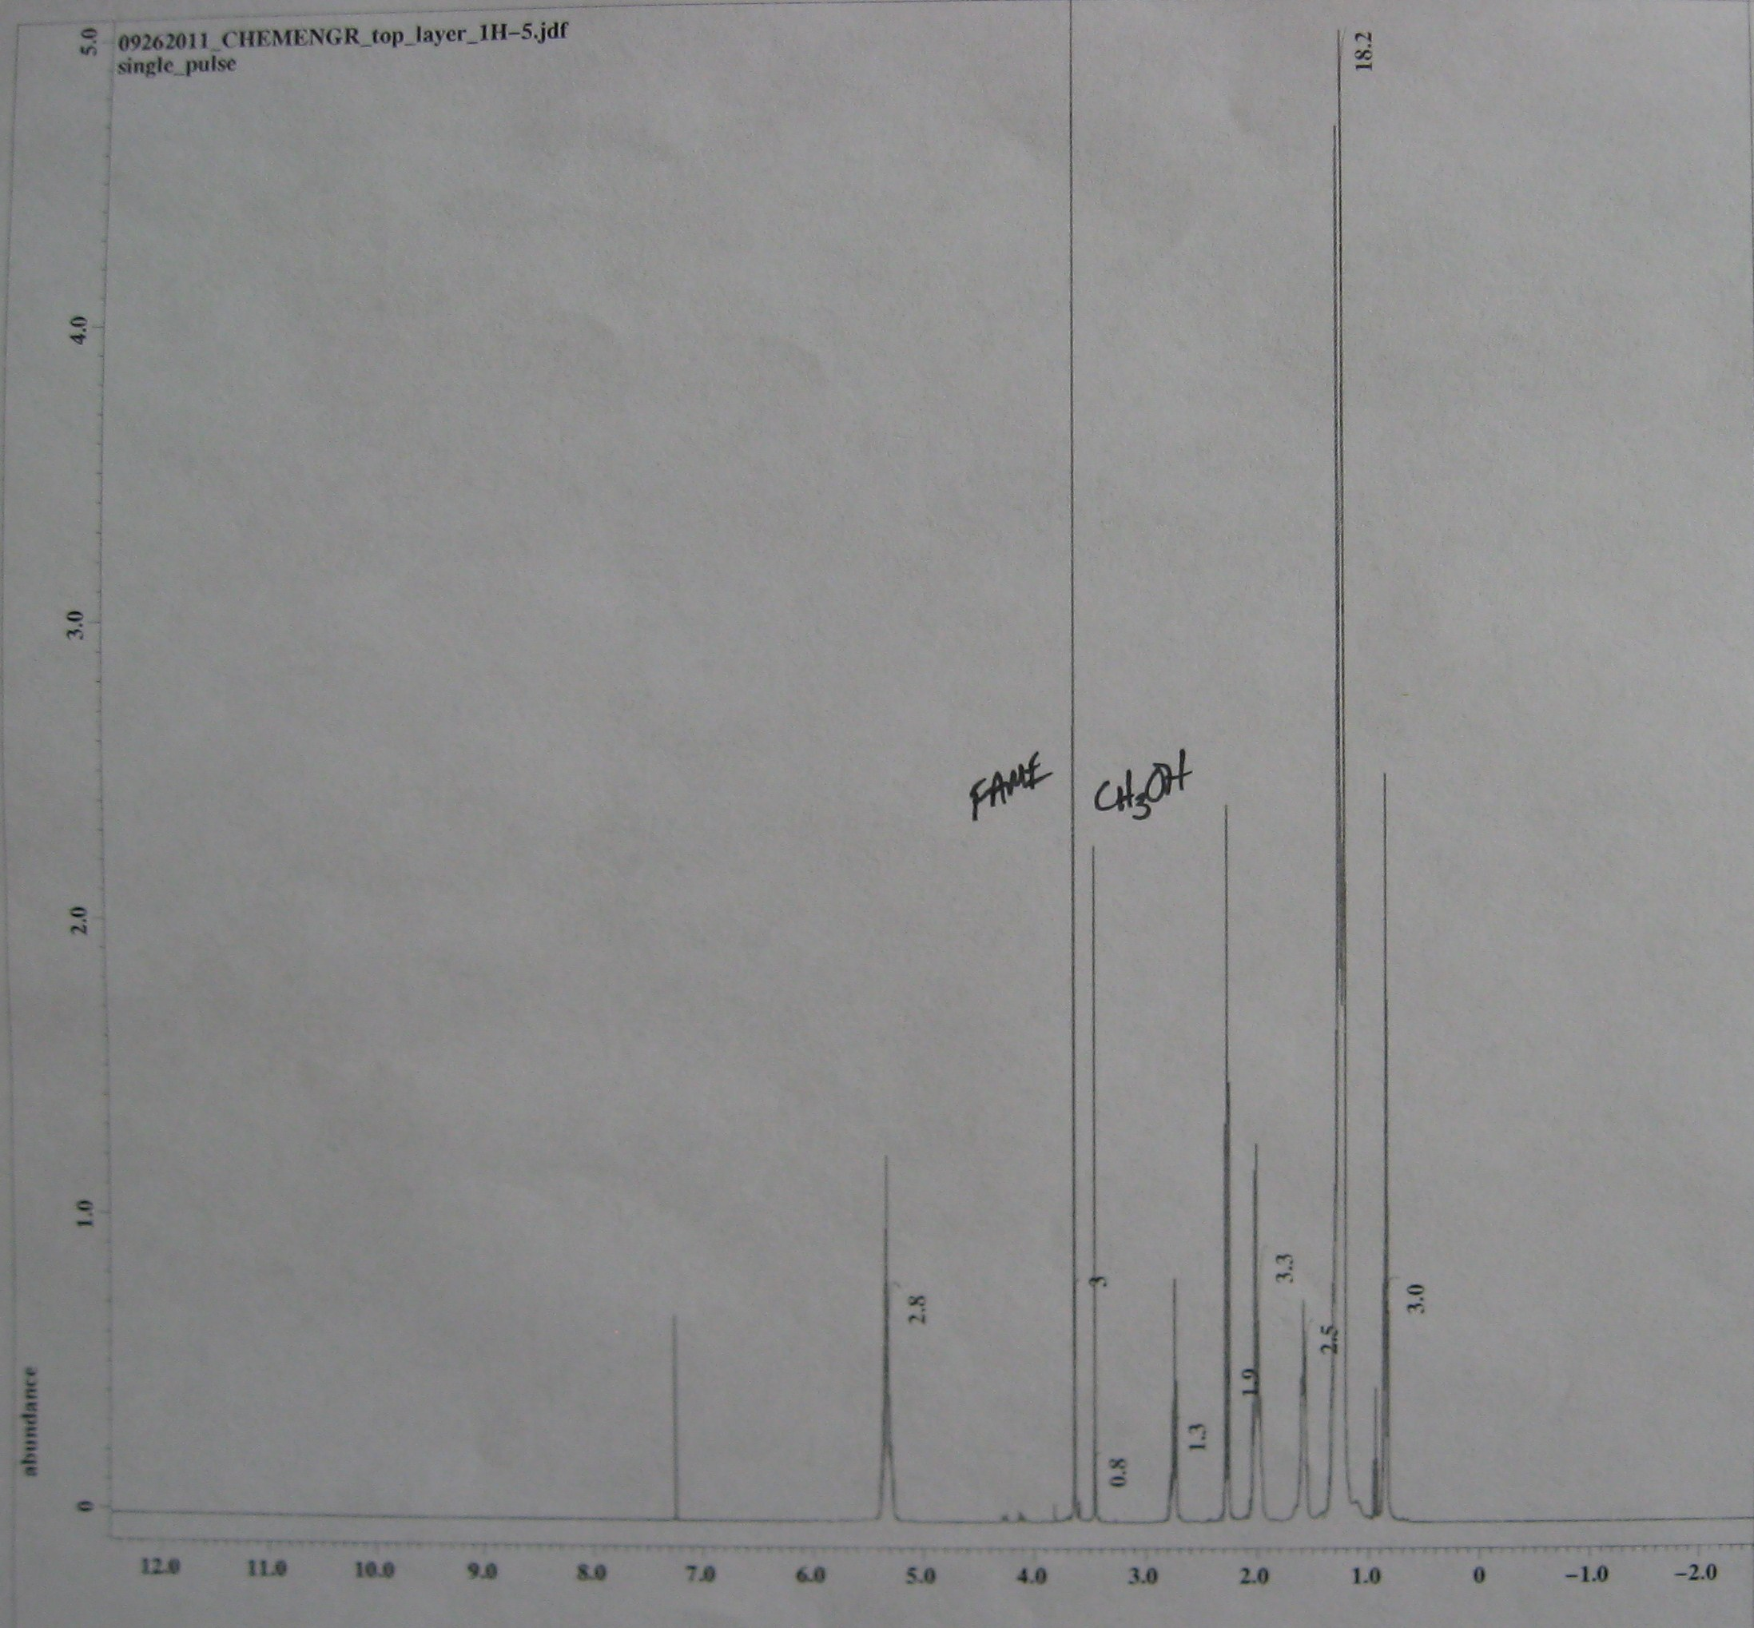
Hydrogen 1 NMR of the top product layer.

Slide 15
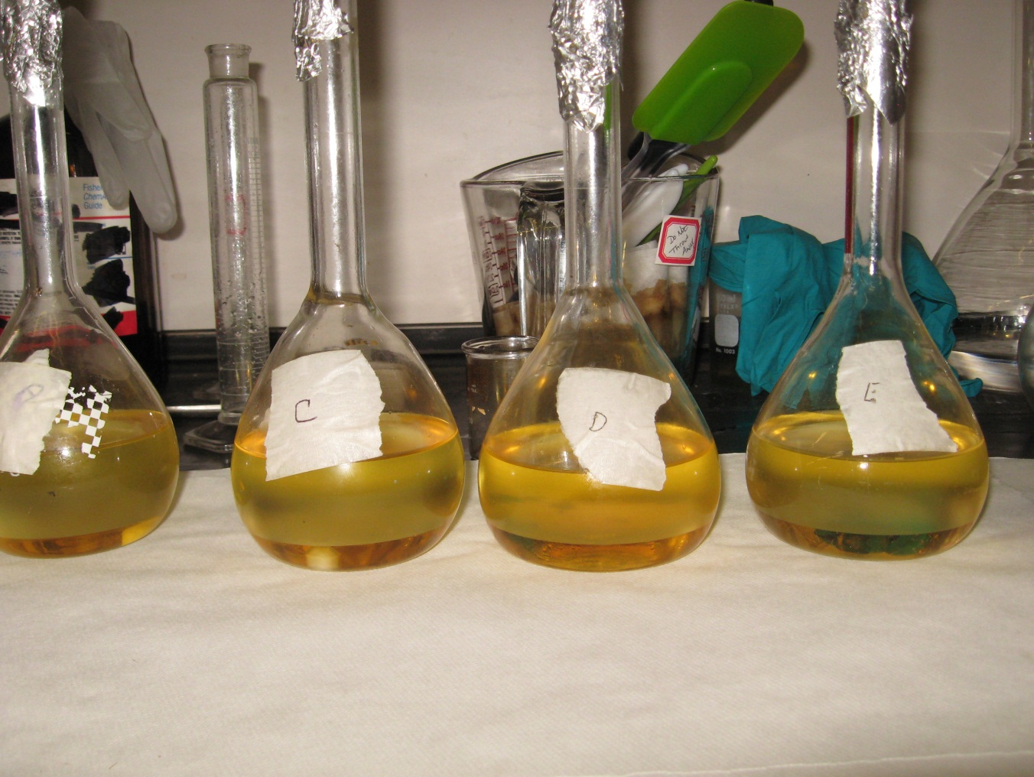
Our top yellow layer actually is FAME but also contains large amounts of unreacted methanol as well.

Slide 16
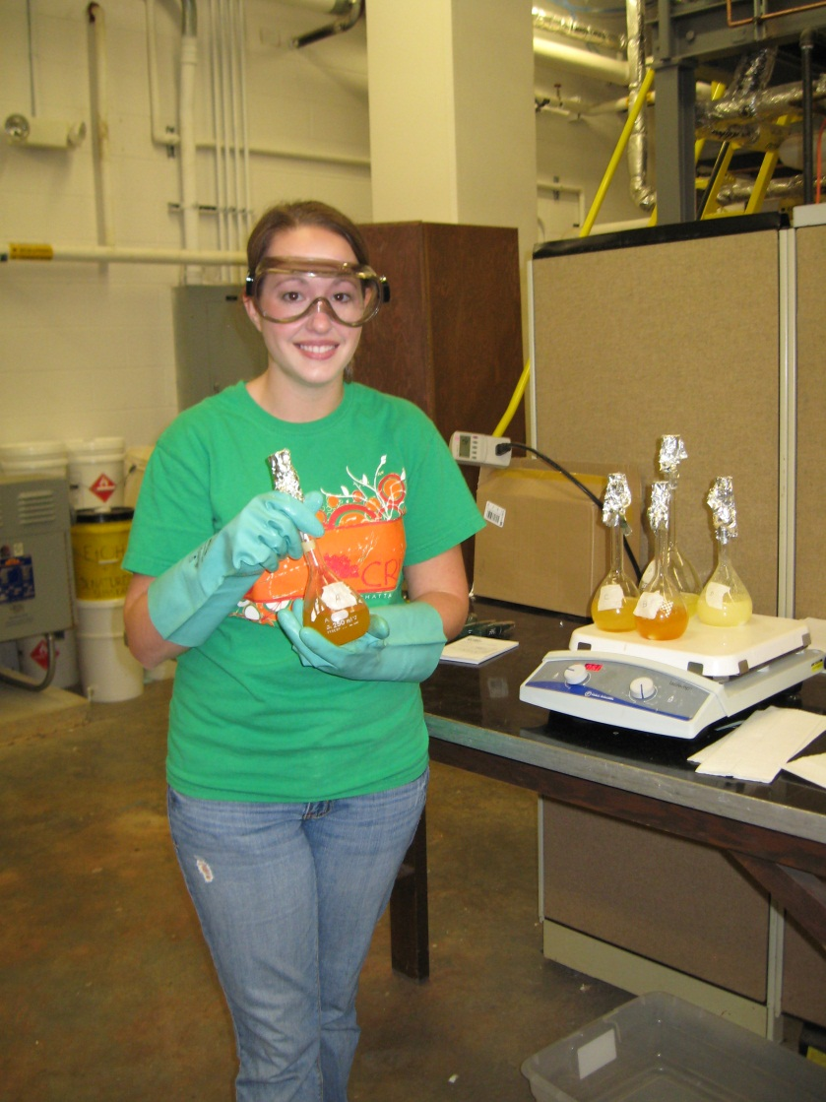
Conclusion
In biodiesel production the more tall oil used the less desired product obtained and when using over 6.3% tall oil or free fatty acid only soap is obtained.

Slide 17
Recommendations
Allow products to sit over night before analyzing.
Mix reactants in order.
Add fragrance to the runs with large amounts of tall oil so the soap will smell good.
Try using different molar amounts of methanol.

Slide 18
References
"AIST:RIO-DB Spectral Database for Organic Compounds,SDBS." 産総研： RIO-DB. SDBS. Web. 04 Oct. 2011. <http://riodb01.ibase.aist.go.jp/sdbs/cgi-bin/direct_frame_top.cgi>.
"Alternative Fuels and Advanced Vehicles Data Center: Biodiesel Production." EERE: Alternative Fuels and Advanced Vehicles Data Center Program Home Page. U. S. Department of Energy, 28 Dec. 2010. Web. 04 Oct. 2011. <http://www.afdc.energy.gov/afdc/fuels/biodiesel_production.html>.
"Biodiesel Reaction." Biodiesel Production and Quality. 26 Apr. 2011. Web. 14 Sept.2011.<http://www.biodiesel.org/pdf_files/fuelfactsheets/prod_quality.pdf>.
"Image."Http://mysite.verizon.net/dtclean/sitebuildercontent/sitebuilderpictures/logo.jpg.DTEnterprises.Web.14Sept.2011.<http://mysite.verizon.net/dtclean/sitebuildercontent/sitebuilderpictures/logo.jpg>.
Van, Gerpen J., B. Shanks, R. Pruszko, D. Clements, and G. Knothe. Biodiesel Production Technology. Rep. no.NREL/SR-510-36244. Golden: NRL, 2004. Print.

Slide 19
Special Thanks
Dr. Robert C. Mebane
UTC Chemistry Department
Analysis of the final product

Slide 20
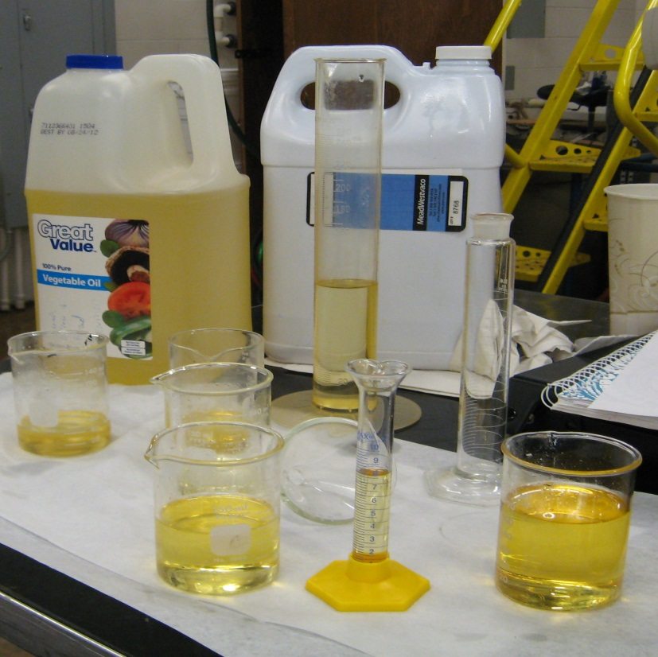
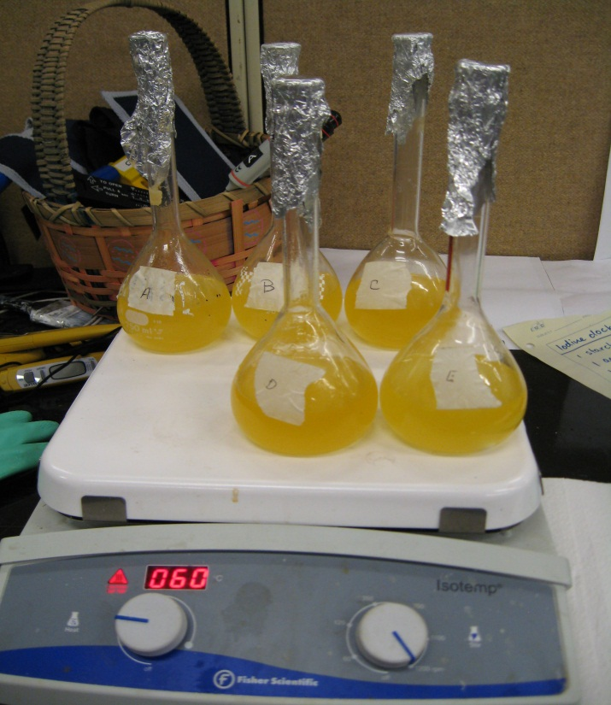
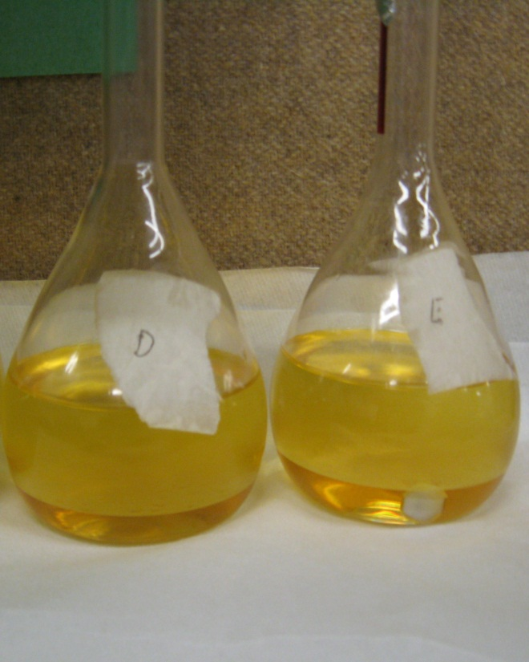
Questions

