Slide 1
OData w Javie
wprowadzenie do Apache Olingo™
Warszawa, 1 lipca 2017

Slide 2

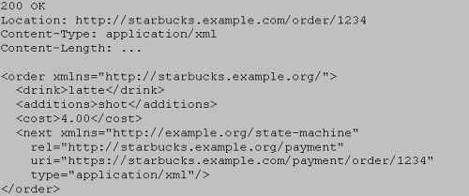

Jak integrować?
Droga serwisów
WADL?
RAML?
HTTP/RPC
RESTful
HATEOAS
RSDL?
Źródła w URI
Czasowniki z HTTP
Bezstanowość
Content Negotiation
Czasowniki
Endpointy URI
Relacje oddane
np. Hypermediami
https://www.infoq.com/articles/webber-rest-workflow
Notes:
RAML – RESTful API Modeling Language bazuje na YAML-u
WADL – Web Application Description Language is a machine-readable XML description of HTTP-based web services. WADL is the REST equivalent of SOAP's Web Services Description Language (WSDL), which can also be used to describe REST web services.
RSDL – RESTful Service Description Language is a machine- and human-readable XML description of HTTP-based web applications (typically REST web services).
Unlike WADL, it concentrates on describing URIs as stand-alone entry points in to the application which can be invoked in different ways, does not require traversing over URI components to figure out URI structure, and supports URI/Headers/body parameters overloads. This makes it human-readable and easily consumed by both humans and machines.
HATEOAS – Hypermedia as the Engine of Application State, is a constraint of the REST application architecture that distinguishes it from most other network application architectures. The principle is that a client interacts with a network application entirely through hypermedia provided dynamically by application servers.

Slide 3
OData – szybki przegląd
Przykład – cz. 1
accounts
ID
number
name
...
addresses
city
street
country
...
policies
ID
number
date
...

Slide 4

OData – szybki przegląd
Przykład – cz. 2
root/api/policies/
/1/
/1
/account/
/addresses/
root/OData.svc/Policies('1')/Account/Addresses('1')
POST {}
DELETE
PUT {}
GET {}
GET [{},{}]
root/OData.svc/Policies?$filter=Account/Number eq 'abc12342' and year(Date) eq 2002 &$select=Number&$expand=Account($select=Name)&$format=JSON

Slide 5


OData – szybki przegląd
Źródła wiedzy + Java
http://docs.oasis-open.org/odata/odata/v4.0/errata03/ – dokumentacja OASIS OData
http://www.odata.org/ – strona główna protokołu
http://services.odata.org/V4/OData/OData.svc/ – OData 4, przykładowy serwis
https://olingo.apache.org/doc/odata4/index.html – Apache Olingo tutorial

Slide 6
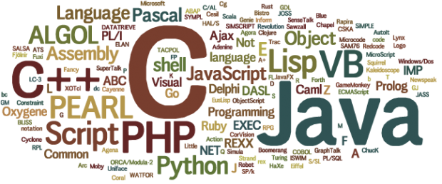
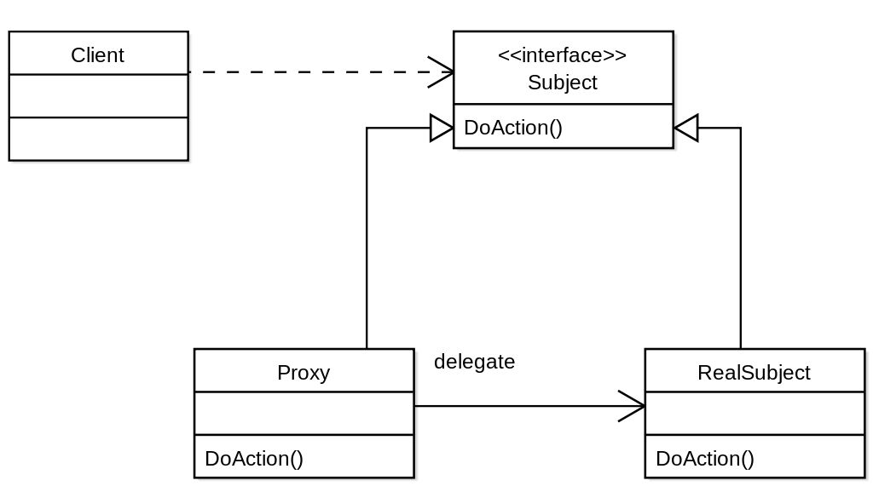

OData & Apache Olingo
Ekosystem
CSDL
EDM
Entity

Slide 7
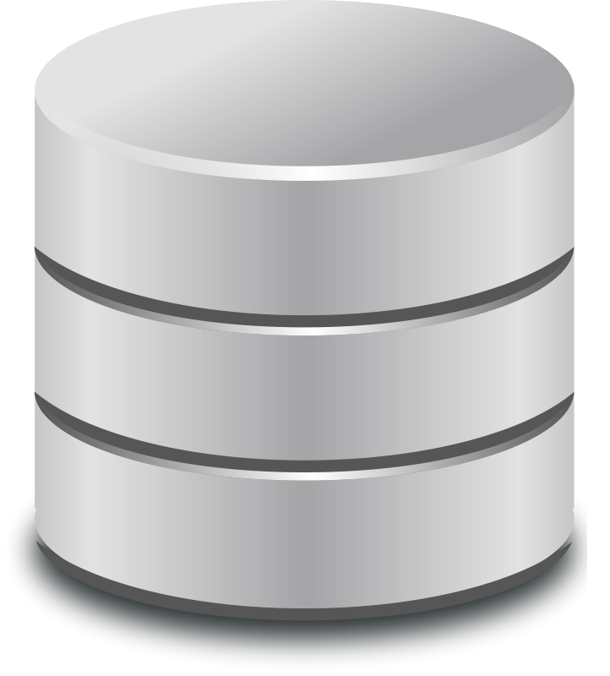
Apache Olingo – pierwszy krok
CsdlEdmProvider
(XML) whitelist
Builder/mapper
CsdlEdmProviderImpl
Annotation parser
CsdlEdmProviderImpl

Slide 8
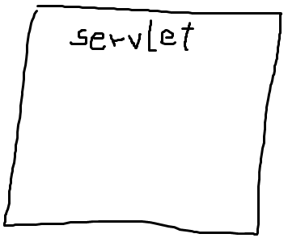











Apache Olingo – idea
Jak „podpiąć”?

Slide 9
Apache Olingo setup
App repository
Snapgram – ani to Snapchat ani Instagram, kolejny upload zdjęć
Na razie tylko odczyt (~budżet...)
Wspieranie wszystkich klientów, na wszystkich urządzeniach
https://github.com/sollersconsulting/confitura2017/tree/master/snapgram
Notes:
2 – typowy konsulting
Ostatnie – REST; typowe wymaganie biznesowe, jasno zdefiniowane, zamykalne w jednej historyce
Manager sprzedał, developer musi zakodzić

