Slide 1
Vectorization
Vector embeddings, vector databases, and vector search
Notes:
The goal of this presentation is to introduce you to the concepts of vector embeddings, vector databases, and vector search, and their relevance in modern AI-enabled applications. We will end this presentation with a couple of demos using two vector database and search options available in Azure (Cosmos DB for NoSQL and Azure Database for PostgreSQL).
Understanding vector embeddings and vector databases is crucial for data engineers for several reasons:
Enhanced Search Capabilities: Vector embeddings enable semantic search, which improves search accuracy by understanding the context and meaning of queries rather than relying solely on keyword matching. This is particularly useful in applications like recommendation systems and natural language processing.
Efficient Data Management: Vector databases are designed to handle high-dimensional data efficiently. They support fast similarity searches and can manage large-scale vector data, which is essential for applications involving machine learning and AI.
Integration with AI Models: Many modern AI models, such as those used in image recognition, natural language processing, and recommendation systems, rely on vector embeddings. Understanding how to store, index, and query these embeddings allows data engineers to build more intelligent and responsive systems.

Slide 2
Agenda
Describe vector embeddings
What are vector databases
  What vector database options are available in Azure?
Vector search
  Querying data using vectors
How vectors relate to using RAG patterns

Slide 3
Vector embeddings
1
Notes:
We will start the conversation by talking about vectors, also known as embeddings or vector embeddings. At a high level, vectors are mathematical representations of data in a high-dimensional space. They represent various types of information — text, images, audio — in a format that machine learning models can process.

Slide 4
What’s a token?
LLMs are trained on text to predict text.
Like other natural language processing (NLP) systems, they use tokenization as the essential text preprocessing step.
Tokenization aims to parse the text into non-decomposing units called tokens.
Tokens can be characters, subwords, symbols, or words, depending on the size and type of the model.
Eventually the tokens end up as an integer or binary sequence.
“‘tokens are not a real thing. they are a computer generated illusion created by a clever engineer”
—@dril_gpt
Don
’
t
011
100
101
Don’t
Do
n’t
101
111
Sources to learn more
Between Words and Characters: A brief history of open-vocabulary modeling and tokenization in NLP
Notes:
However, before we get started with vectors, let’s take a moment to review tokens. When an AI model receives text input, it first tokenizes the text into tokens. Each token is then converted into its corresponding embedding. This conversion process can be done using an embedding generation model, such as Azure OpenAI Embeddings or Hugging Face on Azure. The model processes these embeddings through multiple layers, capturing complex patterns and relationships within the text. The output embeddings can then be converted back into tokens if needed, generating readable text.
So, what are tokens?
Tokens are small chunks of text generated by splitting the input text into smaller segments. These segments can either be words or groups of characters, varying in length from a single character to an entire word. For instance, the word hamburger would be divided into tokens such as ham, bur, and ger while a short and common word like pear would be considered a single token.

Slide 5
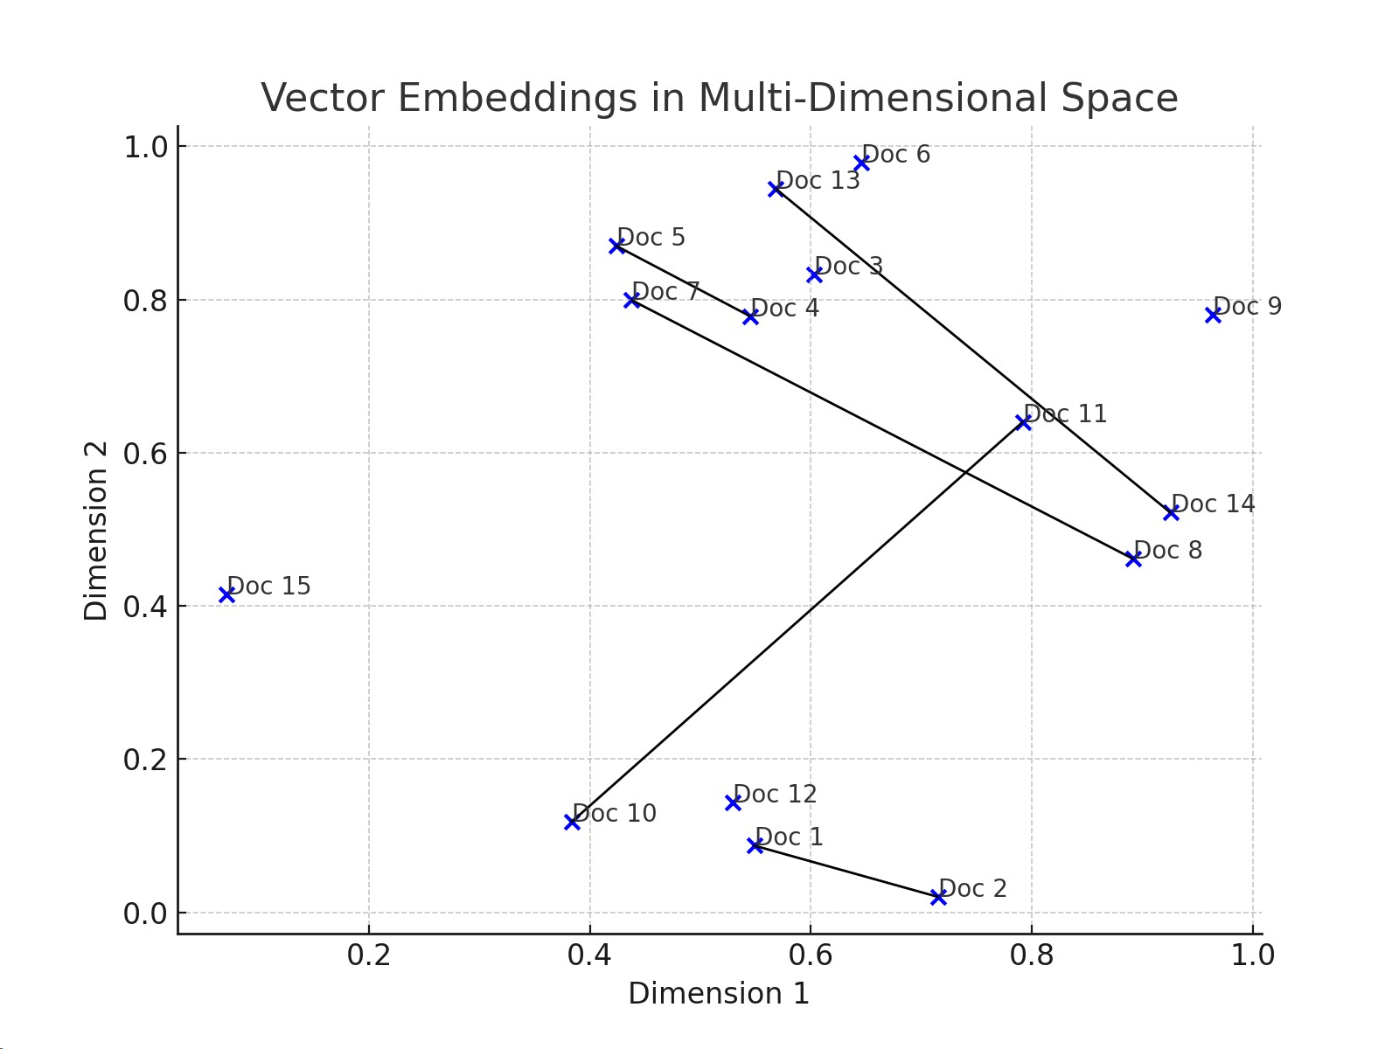
What are vector embeddings?
A vector embedding is an information-dense representation of the semantic meaning of a piece of text
Vector embeddings are numerical representations of textual data, transforming words, sentences, or documents into vectors in a high-dimensional space. Embeddings capture semantic meaning and relationships, enabling efficient and meaningful comparisons of textual data.
A vector of floating-point numbers, such that the distance between two embeddings in the vector space is correlated with semantic similarity between two inputs in the original format. The similarity search can be achieved through different metrics, such as cosine similarity, Euclidean distance, hamming distance, jaccard index, etc.
This diagram shows various documents represented as points in a two-dimensional space, with Euclidean distance lines indicating semantic similarities between them.
Notes:
Vector embeddings are numerical representations of textual data, transforming words, sentences, or documents into vectors in a high-dimensional space, or put more simply, an embedding is a sequence of numbers that represent the concepts within content. An embedding is format that machine learning models and algorithms can easily use. They are information-dense representations that capture semantic meaning and relationships, enabling efficient and meaningful comparisons of textual data.
Each embedding is a vector of floating-point numbers, such that the distance between two embeddings in the vector space is correlated with the semantic similarity between two inputs in the original format. For example, if two texts are similar, their vector representations should also be similar.
Vector indexes are ultimately a flavor of a search index; we’re just solving a search problem. Embeddings make it easy for machine learning models and other algorithms to understand the relationships between content and to perform tasks like clustering or retrieval.

Slide 6
What are vector embeddings?
Embeddings basically converts text to coordinates that maintain relative distances between text that has similar meaning.
About Tigers
About Bears

Slide 7
Vector embeddings and indexes:
Foundations for contextual data retrieval
Vector embeddings are numerical representations of textual data, transforming words, sentences, or documents into vectors in a high-dimensional space. Embeddings capture semantic meaning and relationships, enabling efficient and meaningful comparisons of textual data. Vector indexes are ultimately a flavor of a search index; we’re just solving a search problem.
This diagram shows various documents represented as points in a two-dimensional space, with lines indicating semantic similarities between them.
Indexing for retrieval
Indexes are structures that organize these embeddings, allowing for quick retrieval of the most relevant vectors (and thus, the corresponding textual data) in response to a query.
Role in contextual data retrieval
Vector embeddings and indexes are crucial for the retrieval phase in RAG, enabling the model to find the most relevant contextual information efficiently.
Benefits and challenges
Benefits: Speed and relevance in retrieving information, scalability, and ability to handle large datasets.
Challenges: Complexity in creating effective embeddings, computational demands, and maintaining up-to-date indexes.

Slide 8
The embeddings coordinate system is called the Latent Space
Latent Space
Encoder
Decoder
Vector Embedding
The cat named Caya
Caya the cat
It’s useful beyond finding related text, it can also be used in a generative fashion.
Notes:
When we talk about text embeddings, we’re referring to a way of representing words or phrases as vectors of numbers. These vectors exist in a high-dimensional space, which we call the Latent Space.
Here’s a breakdown:
Embeddings: These are the vectors that represent words or phrases. Each word is mapped to a point in this high-dimensional space.
Coordinate System: Just like how we use coordinates (x, y) to locate points on a 2D plane, embeddings use coordinates in a high-dimensional space.
Latent Space: This is the name for the space where these embeddings live. It’s “latent” because it captures hidden or underlying patterns in the data.
In this space, words with similar meanings are located close to each other. For example, “king” and “queen” would be closer together in the latent space than “king” and “apple.”

Slide 9
When to use embeddings
Embeddings basically convert text to coordinates that maintain relative distances between text that has similar meaning
Applications:
Semantic similarity
Clustering
Full-text search
Classification
Recommendations
Notes:
https://beta.openai.com/docs/guides/embeddings/use-cases

Slide 10
Vector
Databases
2
Notes:
Talking Points:
Next, let’s look at how we can store vector embeddings for use in AI-enabled applications.

Slide 11
What is a vector database?
Database designed to store and manage vector embeddings.
Embeddings are indexed and queries through vector search algorithms based on their vector distance or similarity.
Pure vector databases
Integrated vector databases
Designed to store and manage vector embeddings efficiently
Can contain a small amount of metadata
Separate from the source data from which the embeddings are derived
Integrated into a highly performant NoSQL or relational database to provide additional capabilities
Stores and indexes embeddings alongside the corresponding original data
Eliminates the cost of replicating data in a separate pure vector database
Facilitates better multi-modal data operations and data consistency
Notes:
A vector database is a database designed to store and manage vector embeddings.
In a vector database, embeddings are indexed and queried through vector search algorithms based on their vector distance or similarity.
There are two common types of vector database implementations - pure vector database and integrated vector database in a NoSQL or relational database.
A pure vector database, such as Pinecone, is designed to efficiently store and manage vector embeddings, along with a small amount of metadata; it is separate from the data source from which the embeddings are derived.
A vector database that is integrated in a highly performant NoSQL or relational database provides additional capabilities. The integrated vector database in a NoSQL or relational database can store, index, and query embeddings alongside the corresponding original data. This approach eliminates the extra cost of replicating data in a separate pure vector database. Moreover, keeping the vector embeddings and original data together better facilitates multi-modal data operations, and enables greater data consistency, scale, and performance. A highly performant database with schema flexibility and integrated vector database is especially optimal for AI agents.

Slide 12

Vector Databases
Vector databases provide the data structures for storing and querying with vector embeddings.
As an information retrieval pattern they support various forms of nearest neighbor search.
Given an input vector embedding, you can query a vector database for the top k vectors that are “closest” to it in the multi-dimensional space.
Index the document
Query for documents about “Sumatran tiger cubs”
About Tiger Cubs
Doc 15
X
Query
X
Notes:
In truth, vector databases are really more like vector indexes because the way you use them follows these patterns:
Indexing: Load your text documents into the database
Chunk the documents to a certain size.
For each chunk compute the vector embedding.
Store the vector embedding in the database and have it point to the source chunk by some ID
Query: Given a piece of text, get the vector embedding.
Perform a k nearest neighbor search against the vectors.
For each of the top K vectors closest, retrieve the underlying text chunk.
You can expect most databases will become vector databases in the future, adding this “vector index” capability

Slide 13




Vector databases in Azure
Azure Database for PostgreSQL
Azure AI Search
Azure Cosmos DB
NoSQL
MongoDB
Azure SQL Database
Notes:
Azure offers several options for vector databases, which are designed to store and manage vector embeddings for various applications like natural language processing, image recognition, and recommendation systems. Here are some of the primary solutions:
Azure AI Search: This fully managed search service provides vector storage and configurations for vector search and hybrid search, allowing you to combine vector and non-vector fields in the same search corpus. Can be pure or integrated
Azure SQL Database: While primarily a relational database, it can be integrated with vector search capabilities for specific use cases.
Azure Database for PostgreSQL – Flexible Server can be enabled as a vector store using the pgvector extension.
Azure Cosmos DB: This globally distributed, multi-model database service supports vector search capabilities, making it suitable for large-scale applications.
These options offer flexibility depending on your specific needs and the type of data you’re working with.

Slide 14
Vector
Search
3
Notes:
Talking Points:
Lets look at the security considerations

Slide 15
What is vector search?
A method that helps you find similar items based on their data characteristics rather than by exact matches on a property field:
Identify similar images, documents, and songs based on their contents, themes, sentiments, and styles
Identify similar products based on their characteristics, features, and user groups
Recommend contents, products, or services based on individuals' preferences
Recommend contents, products, or services based on user groups' similarities
Identify the best-fit potential options from a large pool of choices to meet complex requirements
Identify data anomalies or fraudulent activities that are dissimilar from predominant or normal patterns
Implement persistent memory for AI agents
Notes:
Vector search is a method that helps you find similar items based on their data characteristics rather than by exact matches on a property field. This technique is useful in applications such as searching for similar text, finding related images, making recommendations, or even detecting anomalies. It works by taking the vector embeddings of your data and query, and then measuring the distance between the data vectors and your query vector. The data vectors that are closest to your query vector are the ones that are found to be most similar semantically.
For example, you can use vector search to:
identify similar images, documents, and songs based on their contents, themes, sentiments, and styles
identify similar products based on their characteristics, features, and user groups
recommend contents, products, or services based on individuals' preferences
recommend contents, products, or services based on user groups' similarities
identify the best-fit potential options from a large pool of choices to meet complex requirements
identify data anomalies or fraudulent activities that are dissimilar from predominant or normal patterns
implement persistent memory for AI agents
Two major types of vector search algorithms are k-nearest neighbors (kNN) and approximate nearest neighbor (ANN). Between kNN and ANN, the latter offers a balance between accuracy and efficiency, making it better suited for large-scale applications.

Slide 16
Distance Functions
Distance functions are mathematical formulas used to measure the similarity or dissimilarity between vectors.
Manhattan distance
Euclidean distance
Cosine similarity
Dot product
Notes:
Distance functions are mathematical formulas used to measure the similarity or dissimilarity between vectors (see vector search). Common examples include Manhattan distance, Euclidean distance, cosine similarity, and dot product. These measurements are crucial for determining how closely related two pieces of data are.
Manhattan distance: measures the distance between two points by adding up the absolute differences of their coordinates. Imagine walking in a grid-like city, such as many neighborhoods in Manhattan; it is the total number of blocks you walk north-south and east-west.
Euclidean distance: measures the straight-line distance between two points.
Cosine similarity: measures the cosine of the angle between two vectors projected in a multidimensional space. Two documents may be far apart by Euclidean distance because of document sizes, but they could still have a smaller angle between them and therefore high cosine similarity.
Dot product: Two vectors are multiplied to return a single number. It combines the two vectors' magnitudes, as well as the cosine of the angle between them, showing how much one vector goes in the direction of another.

Slide 17
Demos:
1. Vector Search with Azure Cosmos DB for NoSQL
2. Azure AI extension for Azure Database for PostgreSQL
Notes:
TALKING POINTS​
​
Let’s put this into reality and show you how it works.​
​

Slide 18
Cosmos demo
TechExcel environment and resources
Talk about how to enable the feature and show while talking about it.
Show how to add a container vector policy and indexing policy on a new container (don’t save)
Talk about Azure function processing the change feed
  Show code
Insert a record using Data Explorer
  Show the log stream for the function app
  Return to data explorer and refresh the record to show embeddings
Execute vector search query in notebook in repo
  Talk about the query and VectorDistance function
Open Streamlit app
  Use vector search page to show how a natural language query can be used to query data
  Use similarity search slider to talk about how you can use this to remove less relevant results
Notes:
Demonstrating vector search in Cosmos DB.
Show how to enable the vector search feature in Cosmos
Set up a new container, setting the container vector policy and selecting a vector indexing policy.
Talk about having to use an Azure Function or worker process to process the change feed, which is external to the database…
Talk about Azure OpenAI embeddings model and how it is used here.
Show capabilities in Cosmos

Slide 19
Postgres demo
Mslearn-postgres environment and resources
Talk about the Azure AI extension and its various components
TODO: Reference the mslearn-postgres repo and the steps there to put this one together.
Notes:
Demonstrate similarity searches in Postgres
Go through lab 13 of the mslearn-postgres repo. Start with ## Create and store embedding vectors.
Talk through how to install the extension (azure_ai and pgvector)
Talk about configuring the extension. Show how to view the endpoint setting…
Show how to use a query to generate embedings for a simple query.
Show adding a vector column to the table.
Talk about how the AI extension allows vectors to be generated directly from the database (no need for external processor, like with Cosmos)
Mention that it is doing the same things as the Azure Function with Cosmos, but that plumbing has been handled for you by the extension…
Talk about pgvector extension

