Slide 1


Portal
Cloud Shell
Infrastructure as Code (IaC)

Slide 2



Slide 3


Slide 4



Sample App Arch – Level 1
Azure
App Service – PHP
Flexible Server

Slide 5
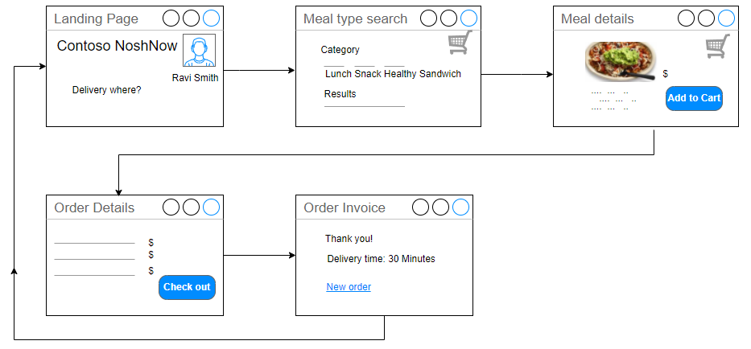
Sample App Site Diagram

Slide 6






Pros
Cons
!
Read More
dsdas

Slide 7
Select resource and metric
Apply time range
Filter
Visualize
Create alerts
Common Azure development resources
Sample application introduction
Architecture and deployment evolution
Set up your environment
Start your journey

Slide 8







Azure Monitor
Define a strategy
Azure Metrics
Log Analytics
Resource Health
Activity Logs
Workbook

Slide 9

X
In accepted
IP range?
No
Failed connection
Yes

