Slide 1
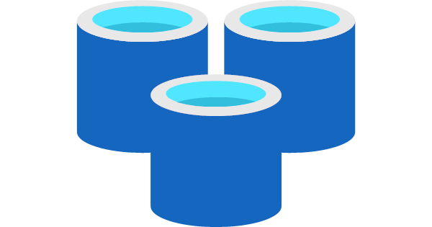
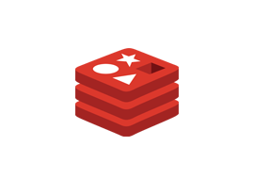
Shared lower cost
PaaS
SaaS
IaaS
Azure Cache for Redis
Redis Azure Hosted VM
Virtual
Redis VMWare or HyperV
Physical
Redis Physical Machine
Dedicated
Higher cost
Higher administration
Lower administration
Notes:
Azure has many security and compliance features that Contoso can take advantage of.
Data sovereignty should be considered with every design.

