Slide 1


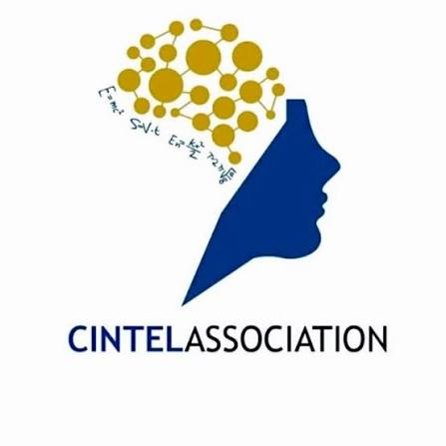
IDEATHON 3.0
CINTEL STUDENT ASSOCIATION
PITCH DECK
TITLE
TEAM NAME
Socius: your open AI ally
California Burrito
TRACK
AI Automation
TURN IDEAS INTO REAL SOLUTIONS
Notes:
Hi, we're California Burrito, and this is Socius. Socius is Latin for 'ally'. In one line: Socius is your open AI ally. It runs on your own device, works with any model, and does whatever skills you give it.

Slide 2

PROBLEM STATEMENT
01 / 06
Personal AI agents are here. They aren't built for India.
01
Closed: they only do what their makers ship
Grok Bot, Muse and Dots remember you and act for you, but nobody else can add a skill. Your college portal or GST filing will never make their roadmap.
02
Priced in dollars, locked to one cloud
USD subscriptions, one company's model, and your personal data on someone else's server.
03
Blind to how India actually works
24 billion UPI payments a month, college portals, GST, Tamil or Hindi replies: none supported.
WHO FEELS IT
Students, freelancers, small businesses. Most haven't heard of AI agents yet.
CINTEL IDEATHON 3.0
Notes:
2025 and 2026 gave us real personal AI agents: Grok Bot, Meta's Muse, OpenAI's Dots. They remember you, act for you and keep working in the background. But they have three problems for us. One, they're closed: you get the features the company decides to build, and nobody can add a skill for an SRM portal or a GST return. Two, they're priced in dollars and tied to one company's cloud, so your data and your model choice belong to them. Three, they ignore how India runs: UPI now does about 24 billion payments a month (NPCI, Sept 2026), and we live on college portals, GST and Tamil or Hindi WhatsApp replies. So the students, freelancers and small businesses who'd gain the most mostly haven't even heard of these agents.

Slide 3



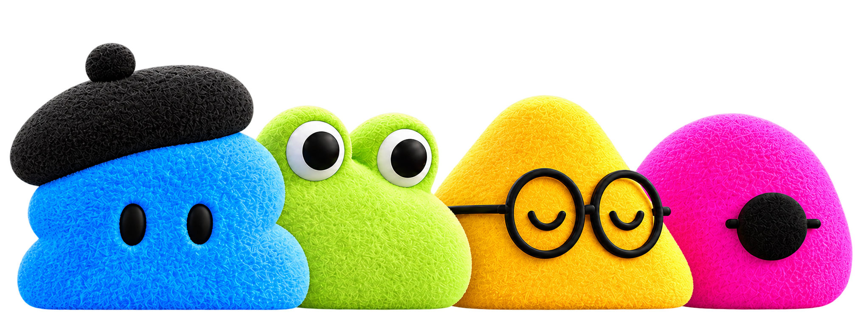
PROPOSED SOLUTION
02 / 06
Socius: an open AI ally that runs on your own device
Lives on your laptop, takes orders from your phone, runs any model (free local Ollama to OpenAI or Anthropic) and learns any skill from an open marketplace.
+
+
=
Meta Muse
Grok Bot
OpenAI Dots
Socius
Remembers you
Teams of bots
Works in the background
Open, local, India-first
CINTEL IDEATHON 3.0
Notes:
Socius takes the best of all three. Muse's memory of you, Grok Bot's teams of bots, Dots' habit of working in the background, and packages it as an open, local-first ally, like Baymax. It runs on your laptop, so your files and memory stay with you. You control it from your phone. You choose the model: free local models through Ollama, or OpenAI and Anthropic if you want more power. And instead of a fixed feature list, it learns skills from an open marketplace.

Slide 4
INNOVATION & KEY FEATURES
03 / 06
An app store for your AI
Any model, any provider
Anyone can publish skills, connectors and bot templates; the community sets the limits.
Free local models via Ollama, or OpenAI and Anthropic. Switch per bot, anytime.
Memory you can see and edit
A team of bots, not one chatbot
Plain Markdown files on your disk. Read, correct or delete anything it knows.
A main bot that builds specialists (researcher, writer) on demand, with your approval.
You stay in control
Built for India
Hard stops on money, passwords and deletes. Approve each action; full activity log.
Tamil and Hindi voice, UPI reminders, DigiLocker, GST and college-portal skills.
Already working in our prototype: marketplace installs, model switching, editable memory and approvals.
CINTEL IDEATHON 3.0
Notes:
What makes Socius original is that it's a platform, not a product. Other assistants have a fixed set of features; Socius has a marketplace of skills, MCP connectors and bot templates that anyone can publish to, like a college attendance skill or a Zerodha connector. Any model, switchable per bot. Memory stored as plain files you can open and edit, so nothing is hidden. A main bot that creates specialist bots when you need them. Hard safety stops: it never touches money, passwords or deletes without you. And it's India-first: Indian-language voice, UPI, DigiLocker, GST. The first four already run in our prototype.

Slide 5
TECHNICAL APPROACH & PROTOTYPE
04 / 06
Laptop: web UI
or Electron
Phone: same
responsive web UI
Authenticated
local API
Tailscale Serve
Agent runtime:
tasks, bots, schedules
Reviewed installation
Marketplace registry
Model adapters:
local or cloud
Editable memory
Policy, approvals
and activity log
WORKING PROTOTYPE SOLID = BUILT, DASHED = NEXT
Tools and MCP connectors
Electron app + local runtime, streaming AI SDK chat (Ollama, OpenAI, Anthropic), verified marketplace installs, Markdown + SQLite memory, approvals that survive restarts, encrypted keys.
Browser worker
Approved local files
CINTEL IDEATHON 3.0
Notes:
Here's the architecture. The same web UI runs on the laptop inside Electron and on the phone through Tailscale, both talking to an authenticated local API. The agent runtime runs tasks and bots, using swappable model adapters, local editable memory, and a policy layer that every tool call passes through: approvals plus an activity log. Tools are MCP connectors, a browser worker and approved local files. Marketplace items go through a reviewed install before the runtime can use them. This isn't just a diagram: the Electron app, local runtime, streaming chat across Ollama, OpenAI and Anthropic, verified marketplace installs, Markdown plus SQLite memory, restart-safe approvals and encrypted keys are built and tested in our repo. Solid boxes are built; dashed boxes are next: phone access through Tailscale, MCP connectors, the browser worker and local file access.

Slide 6
FEASIBILITY & VIABILITY
05 / 06
Built on proven open tech
Business model
Already running
Free, open-source core
Electron + React app with a local runtime, AI SDK chat, SQLite memory and end-to-end tests.
Earn from paid-skill commissions, rupee cloud plans and team plans for colleges and SMBs.
Open standards, no lock-in
Risks we've planned for
MCP connectors, Agent Skills (SKILL.md), Ollama for local models, Tailscale for the phone.
Laptop asleep: jobs pause (cloud option later). Data stays local, ready for DPDP rules (May 2027).
Demand is proven
Open agents like OpenClaw and Hermes Agent have huge followings. None is India-first.
DEMO
Attach notes, get a summary, save it to memory, then switch from Ollama to a cloud model live.
CINTEL IDEATHON 3.0
Notes:
Is it feasible? We've already built the core, on proven open tools: Electron and React, the AI SDK, SQLite, with end-to-end tests. We use open standards, MCP for connectors and Agent Skills for skills, so skills from other agents work in Socius on day one. Demand is proven: open personal agents like OpenClaw and Hermes Agent have huge communities, but none is built for India. Business model: the core stays free and open source. We earn a commission on paid skills, with creators paid over UPI through Razorpay Route, plus optional cloud sync and hosted models priced in rupees, and team plans for colleges and small businesses. Risks: a sleeping laptop pauses jobs, so an always-on cloud computer is on the roadmap; and local-first storage puts us ahead of the DPDP Rules, which apply from May 2027. Vision demo: from a phone, 'summarise the PDFs in Downloads and remind me about the deadline', then switch models live, and the data never left the laptop.

Slide 7
IMPACT & BENEFITS
06 / 06
Who wins, and how Socius scales
Students
Freelancers
College-portal deadlines tracked, notes summarised, all free on a local model.
Research, client follow-ups and replies drafted in their own voice.
Small businesses
Developers
GST reminders, inbox and invoices handled, with approval before anything goes out.
India has the most open-source contributors on GitHub. Here, they earn from skills.
HOW IT SCALES
Each skill a developer publishes works for every user; the community sets the ceiling.
CINTEL IDEATHON 3.0
Notes:
Who benefits? Students get deadlines and notes handled for free on a local model. Freelancers get research and replies in their own voice. Small businesses get GST reminders and inbox work done, with approval before anything is sent. And developers: GitHub's Octoverse 2025 shows India now has more open-source contributors than any other country, and Socius gives them a marketplace to earn from. That's how it scales: every skill one developer publishes works for every user, so the community, not our team, sets the ceiling. Roadmap: desktop agent and skill SDK, then the marketplace and phone control, then Indian-language voice and India Stack. Socius: your open AI ally. Thank you.

