Slide 1



IDEATHON 3.0
CINTEL STUDENT ASSOCIATION
PITCH DECK
An AI workspace for everyday work in India
TITLE
TEAM NAME
Socius
California Burrito
TRACK
AI Automation
TURN IDEAS INTO REAL SOLUTIONS
Notes:
Product sources, checked 15 October 2026: https://github.com/solnikhil/Socius/tree/7b74994 and https://app.notion.com/p/Socius-Ideathon-3-0-3f910c43ad3e81198b7bdf7be7bf6b06 . Current main includes direct orchestration PR 29, reviewed connectors PRs 14-19, paired phone PR 20, routines runtime/API PR 21, scoped skills PR 22, avatars PR 23, composer PR 24, date/time PR 27 and database migration repair PR 28. Browser control PR 30 is open, not implemented on main. Source files in this deck are the current repository snapshot, not the older proposal. Proposed pilots, monetisation and India-specific workflows are plans, not launched features or measured outcomes.
Socius is a personal AI workspace that runs on a user's laptop. The main Socius bot coordinates private specialists, with memory and app actions under the user's control. Team California Burrito. Track: AI Automation. The central outcome is automating work across assistants and connected apps. Open Innovation is the broader alternative, but AI Automation most directly describes the working product. India-first is our intended audience and product direction, not a claim that India lacks AI development.

Slide 2


PROBLEM STATEMENT
01 / 06
People still coordinate the work
between their apps
Repeated context
Every new chat needs another explanation.
Manual follow-through
Notes, deadlines and replies need copying between apps.
22
Local needs, global defaults
Indian languages and local workflows need specific support.
scheduled languages
in India
Starting audience: students, freelancers and small businesses
Source: Rajbhasha, Eighth Schedule
CINTEL IDEATHON 3.0
Notes:
Product sources, checked 15 October 2026: https://github.com/solnikhil/Socius/tree/7b74994 and https://app.notion.com/p/Socius-Ideathon-3-0-3f910c43ad3e81198b7bdf7be7bf6b06 . Current main includes direct orchestration PR 29, reviewed connectors PRs 14-19, paired phone PR 20, routines runtime/API PR 21, scoped skills PR 22, avatars PR 23, composer PR 24, date/time PR 27 and database migration repair PR 28. Browser control PR 30 is open, not implemented on main. Source files in this deck are the current repository snapshot, not the older proposal. Proposed pilots, monetisation and India-specific workflows are plans, not launched features or measured outcomes.
A student organising a campus event may move deadlines from email into a planning chat, ask a separate assistant for a draft, then copy the draft into another app. Freelancers and small businesses face similar coordination work. These audience pain points are hypotheses for our pilot, not findings from a completed survey. India's 22 scheduled languages show the diversity to design for. We do not claim Socius already supports every language or that all other products ignore India.
Language fact source: Government of India, Department of Official Language, https://rajbhasha.gov.in/en/languages-included-eighth-schedule-indian-constitution . Illustration generated with the built-in image tool for this deck: two matte speech tiles, black Devanagari अ and Tamil அ, neutral palette and transparent background. The illustration represents language diversity, not a shipped translation feature.

Slide 3
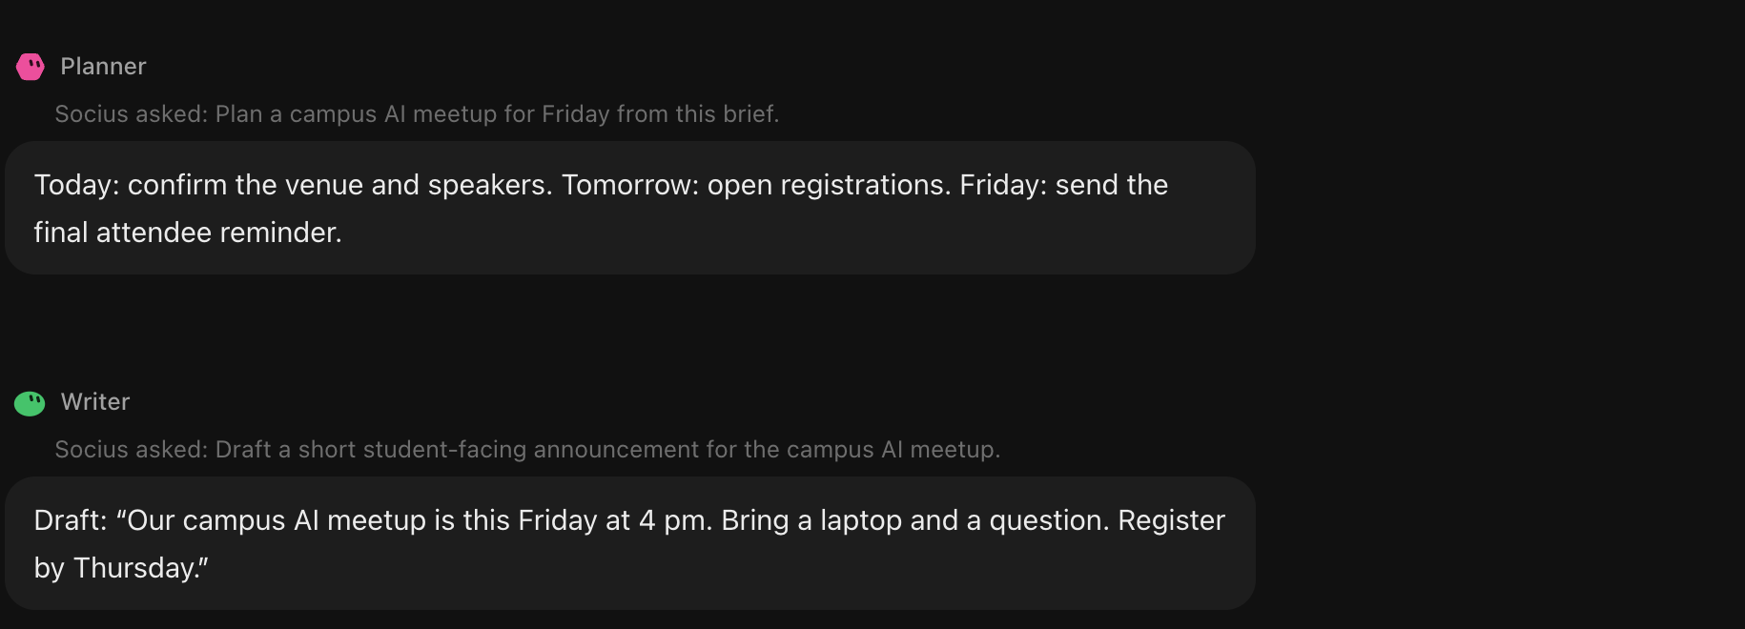

PROPOSED SOLUTION
02 / 06
Your specialists, coordinated by Socius
One desktop workspace with personal bots, editable memory and reviewed app actions.
A personal AI ally
Specialists answer in the same conversation
Same workspace on
laptop and phone.
Actual product UI with demo data
CINTEL IDEATHON 3.0
Notes:
Product sources, checked 15 October 2026: https://github.com/solnikhil/Socius/tree/7b74994 and https://app.notion.com/p/Socius-Ideathon-3-0-3f910c43ad3e81198b7bdf7be7bf6b06 . Current main includes direct orchestration PR 29, reviewed connectors PRs 14-19, paired phone PR 20, routines runtime/API PR 21, scoped skills PR 22, avatars PR 23, composer PR 24, date/time PR 27 and database migration repair PR 28. Browser control PR 30 is open, not implemented on main. Source files in this deck are the current repository snapshot, not the older proposal. Proposed pilots, monetisation and India-specific workflows are plans, not launched features or measured outcomes.
The screenshot shows current main's actual web UI with deterministic demo data. Socius asks Planner for a campus meetup sequence and Writer for an announcement. Their replies appear with their own attribution inside the same Socius conversation. This is a presentation fixture, not a live-model benchmark or evidence that any message was sent. Each specialist keeps its own model, memory, assigned skills and app permissions. Socius supplies an explicit task, not the whole parent transcript. External changes require a separate exact action approval.
Baymax is the user-selected companion metaphor, not Socius hardware or an original character. Original Disney poster source: https://static.filmvandaag.nl/shows/original/8000/8142.jpg?v=1 . High-resolution original pixels and lollipop pose retained in a transparent cutout. No banner or competing mascot equation appears. Cloud models receive context routed to them. Paired phone access controls the same laptop runtime, which must be awake and reachable.

Slide 4







INNOVATION & KEY FEATURES
03 / 06
Delegation stays personal and permissioned
Specialists with boundaries
Memory you can inspect
Each bot has its own instructions,
model, memory and app grants.
Edit or delete notes. Choose whether
Dreaming consolidates them while idle.
Skills you choose
Actions you review
Assign reviewed, versioned skills
to individual bots.
Approve the exact external change.
Inspect the activity history.
REVIEWED APP CONNECTORS
Notion
Linear
GitHub
Gmail
Calendar
Slack
Drive
CINTEL IDEATHON 3.0
Notes:
Product sources, checked 15 October 2026: https://github.com/solnikhil/Socius/tree/7b74994 and https://app.notion.com/p/Socius-Ideathon-3-0-3f910c43ad3e81198b7bdf7be7bf6b06 . Current main includes direct orchestration PR 29, reviewed connectors PRs 14-19, paired phone PR 20, routines runtime/API PR 21, scoped skills PR 22, avatars PR 23, composer PR 24, date/time PR 27 and database migration repair PR 28. Browser control PR 30 is open, not implemented on main. Source files in this deck are the current repository snapshot, not the older proposal. Proposed pilots, monetisation and India-specific workflows are plans, not launched features or measured outcomes.
These mechanisms are implemented in the current product. The main bot can delegate directly or coordinate a group chat. Scoped skills bind exact releases to individual bots and do not grant permissions by being installed. Dreaming is optional idle memory consolidation, with source evidence and correction/deletion protections. Its sensitive-data classification remains incomplete, so this deck does not claim perfect secret exclusion. Reviewed app capabilities are bounded, not arbitrary MCP access. The seven connector implementations exist, but live-account acceptance remains a pilot task. Requests to create a group or change a bot require approval. External writes require their own exact approval.
The seven authentic connector marks are the source SVG assets shipped in apps/web/src/assets/connectors at repository commit 7b74994. They indicate implemented connector packages, not partnerships or connected demo accounts.

Slide 5
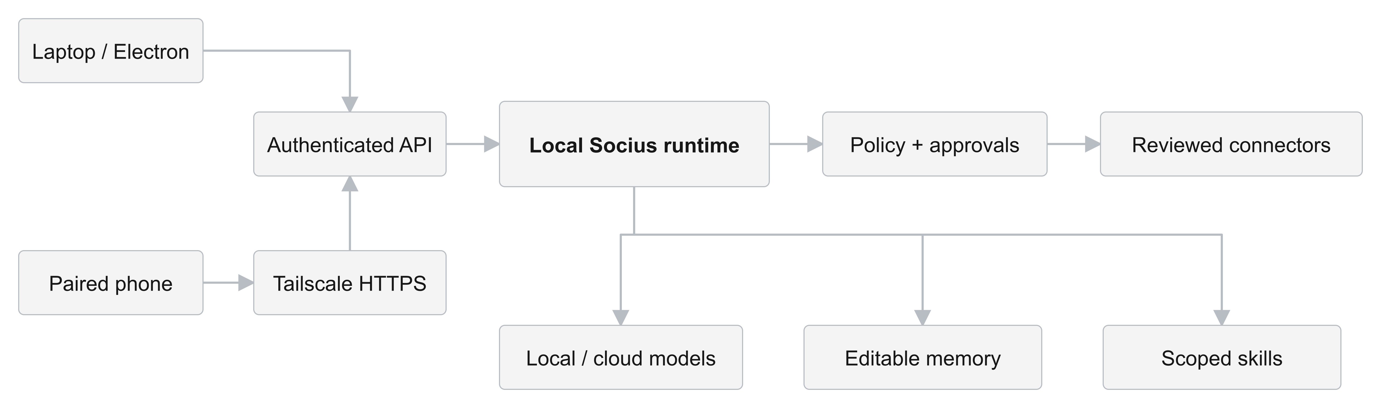
TECHNICAL APPROACH & PROTOTYPE
04 / 06
One runtime, shared across desktop and phone
Tools use the same policy and approval boundary.
React + Electron AI SDK SQLite + Markdown Tailscale HTTPS MCP
CINTEL IDEATHON 3.0
Notes:
Product sources, checked 15 October 2026: https://github.com/solnikhil/Socius/tree/7b74994 and https://app.notion.com/p/Socius-Ideathon-3-0-3f910c43ad3e81198b7bdf7be7bf6b06 . Current main includes direct orchestration PR 29, reviewed connectors PRs 14-19, paired phone PR 20, routines runtime/API PR 21, scoped skills PR 22, avatars PR 23, composer PR 24, date/time PR 27 and database migration repair PR 28. Browser control PR 30 is open, not implemented on main. Source files in this deck are the current repository snapshot, not the older proposal. Proposed pilots, monetisation and India-specific workflows are plans, not launched features or measured outcomes.
The diagram abstracts the working architecture. Laptop Electron and the paired responsive phone interface access an authenticated local API. Phone access uses opt-in Tailscale HTTPS plus independently revocable Socius device sessions. Both share the same local runtime and workspace. The runtime coordinates bots, selected model adapters, editable private memory and scoped skills. Tool execution crosses the same policy/approval boundary before reviewed connectors run. Credentials stay behind the runtime boundary. Registry discovery and reviewed installation feed skill assignments.
The runtime includes routines APIs, schedules, checkpointed runs and durable approvals. A routine UI is still next. Browser control is a separate open PR and is deliberately absent from the implemented connector path. A tailnet is transport, not a replacement for application authentication. Real-tailnet acceptance, SSH/full Serve lifecycle and connected-account acceptance remain to validate. The architecture PNG is a high-resolution technical diagram with a genuine transparent background.

Slide 6
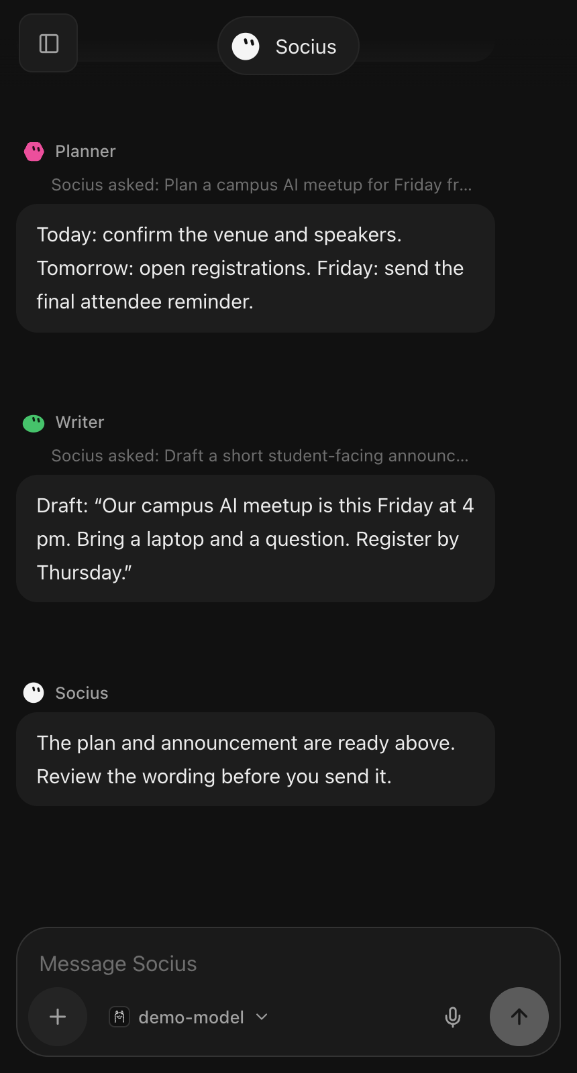
FEASIBILITY & VIABILITY
05 / 06
Working prototype, with a focused path to pilot
Built today
Next to validate
Desktop app and specialist orchestration
Seven reviewed app connectors
Editable memory and paired phone access
Real tailnet and account pilots
Browser control
Routine UI
Automated tests and limited live-provider checks
Proposed business model
Free core. Optional managed hosting in INR,
team plans and paid-skill commission.
Phone UI, demo data
CINTEL IDEATHON 3.0
Notes:
Product sources, checked 15 October 2026: https://github.com/solnikhil/Socius/tree/7b74994 and https://app.notion.com/p/Socius-Ideathon-3-0-3f910c43ad3e81198b7bdf7be7bf6b06 . Current main includes direct orchestration PR 29, reviewed connectors PRs 14-19, paired phone PR 20, routines runtime/API PR 21, scoped skills PR 22, avatars PR 23, composer PR 24, date/time PR 27 and database migration repair PR 28. Browser control PR 30 is open, not implemented on main. Source files in this deck are the current repository snapshot, not the older proposal. Proposed pilots, monetisation and India-specific workflows are plans, not launched features or measured outcomes.
We have a working Electron/React prototype and runtime, not merely a framework selection. Automated desktop/browser fixtures cover product behaviours. There is limited live-provider evidence for model interactions and Dreaming. Fixture coverage does not establish real connected-account or real-tailnet readiness. Phone access is implemented, but end-to-end pilots on real phone/laptop tailnets remain. The phone screenshot is the actual responsive UI from the same controlled demonstration workspace as slide 3. It is not a claim that this screenshot ran over a real tailnet.
Browser control PR 30 proposes headed Chromium/Playwright with visible sessions, user takeover for login/2FA and explicit resume. It is not merged. Routines runtime/API is merged, while the routine UI is next. The laptop must remain awake and reachable for phone-controlled work.
Commercial viability is a proposal: a free core with optional managed hosting priced in INR, team plans and a commission on paid skills. These offers have not launched and no revenue or willingness-to-pay results are claimed. Repository license selection remains an open decision, so this deck does not assert a settled open-source license.

Slide 7
IMPACT & BENEFITS
06 / 06
An India-first pilot, built around everyday work
21.9M
First audience
Students coordinating campus work.
Freelancers handling client follow-ups.
developers in India on GitHub
in 2025
India-focused roadmap
Source: GitHub Octoverse 2025
Hindi and Tamil workflows, local skills
and clear model costs.
Potential builders of local skills
Pilot with one campus
Measure completed tasks, time saved, repeat use and approval accuracy.
CINTEL IDEATHON 3.0
Notes:
Product sources, checked 15 October 2026: https://github.com/solnikhil/Socius/tree/7b74994 and https://app.notion.com/p/Socius-Ideathon-3-0-3f910c43ad3e81198b7bdf7be7bf6b06 . Current main includes direct orchestration PR 29, reviewed connectors PRs 14-19, paired phone PR 20, routines runtime/API PR 21, scoped skills PR 22, avatars PR 23, composer PR 24, date/time PR 27 and database migration repair PR 28. Browser control PR 30 is open, not implemented on main. Source files in this deck are the current repository snapshot, not the older proposal. Proposed pilots, monetisation and India-specific workflows are plans, not launched features or measured outcomes.
India-first means designing the initial pilot around Indian students and freelancers, then inviting developers to build reusable local skills. GitHub's Octoverse 2025 reports 21.9 million developers in India. This is a community opportunity, not Socius's addressable market, traction or projected customers. India is already a major developer community, which supports an optimistic India-first story without claiming that India has no AI development.
Source: GitHub, Octoverse 2025, https://github.blog/news-insights/octoverse/octoverse-a-new-developer-joins-github-every-second-as-ai-leads-typescript-to-1/ .
Hindi/Tamil workflows and Indian app or campus integrations are roadmap candidates, not shipped language support. Browser dictation depends on the browser and may use cloud services. No on-device Indian-language voice, UPI, GST or DigiLocker integration is claimed. The first pilot should compare existing coordination work with Socius on agreed tasks and track completion, assisted time, return use and unwanted or incorrect action approvals. Expected benefits include less copying and repeated explanation. These outcomes still need measurement.

