Slide 1
Waypoint

Slide 2
What is it?
Tool for development lifecycle
Build-deploy-release part of the dev cycle
Use cases
  Temp environemnts in CI
  Dev / Prod environments

Slide 3
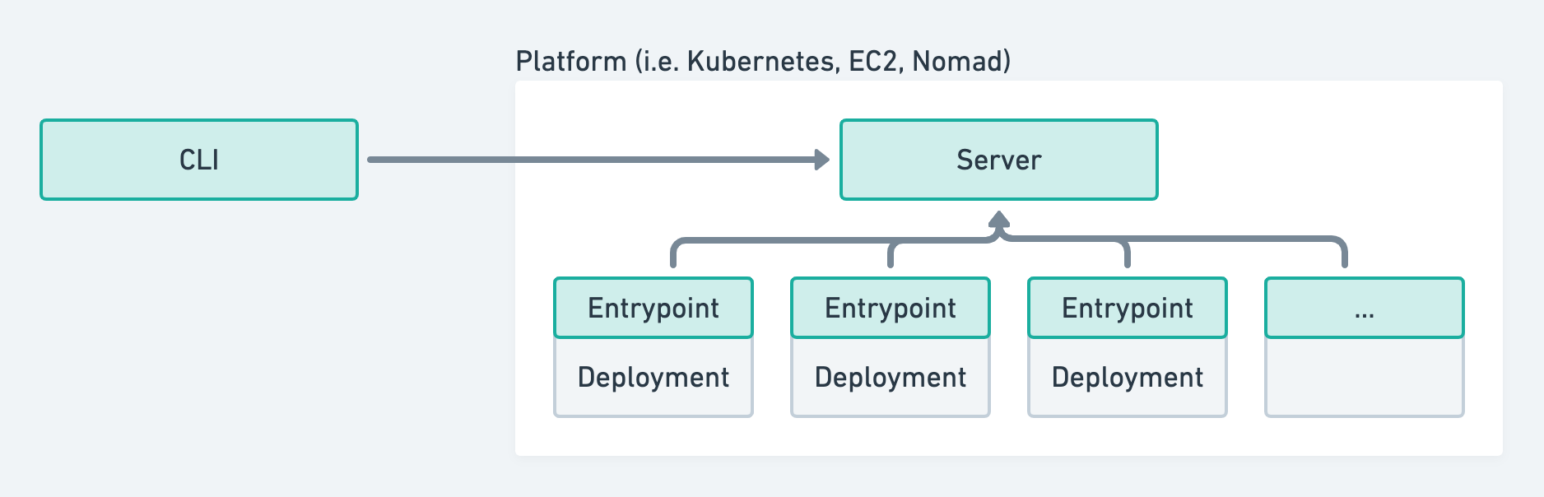
Architecture
source: https://www.waypointproject.io/docs/internals/architecture

Slide 4
Flow
Project
  Apps
    Build
    Deploy
    Release
    Hooks to customize behavior

Slide 5
Demo & Discussion

