Slide 1
Istio EnvoyFilter CRD

Slide 2
Motivation – Why?
Allows to solve for use cases not built into istio
Allows use to use Istio as a general purpose envoy control plane

Slide 3
Why not?
Breakglass config – correctness will not be validated by istio
Complex to use
Currently alpha – config yamls may break in future releases

Slide 4
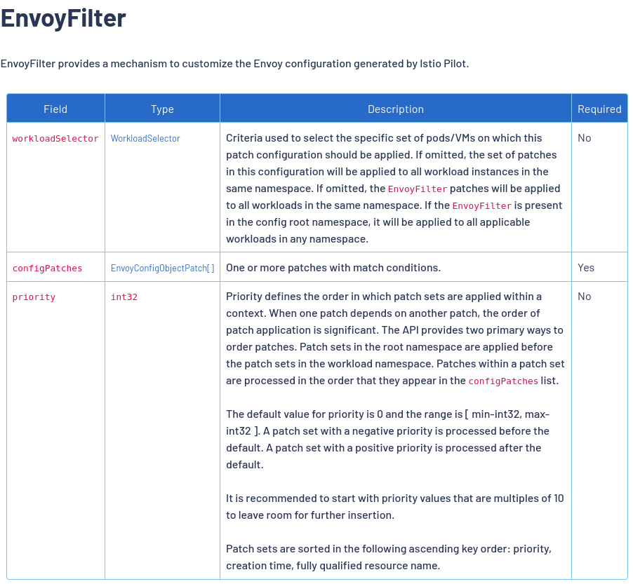
The CRD

Slide 5
Structure
workloadSelector
  Selects a workload (i.e. deployment)
configPatches
  A list of patches to add to the workload’s sidecar

Slide 6
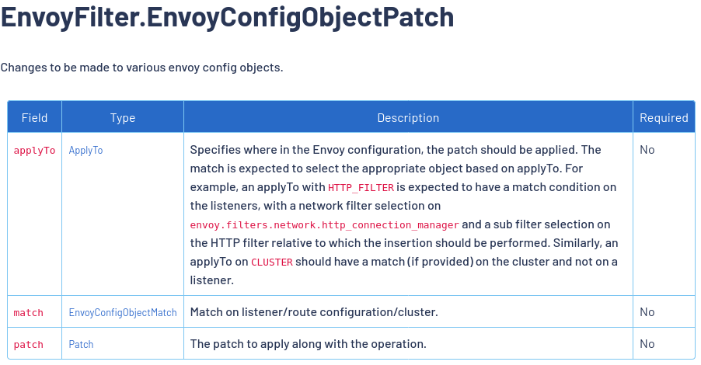

Slide 7
Config Patches
applyTo/match
  applyTo: Where to apply to the patch? i.e. http filter list? Cluster list? Etc…
  match: a filter to limit where to add the patch

Slide 8
Patch
operation: merge/add/remove/…
value: This is yaml/json of the Envoy config. This is the core of the patch
  This will go to envoy with minimal istio validation
  Can use to enable envoy settings that are not exposed in istio

Slide 9
Demo and Further Reading
https://istio.io/latest/docs/reference/config/networking/envoy-filter/

