Slide 1


Health Information System
A Django-based Solution for Healthcare Management

Slide 2

Challenges in Healthcare Management
Efficient Client Management
Tracking Health Program Enrollments
Streamlining patient data and interactions
Accurate participation and progress monitoring
Secure Health Information Access
Protecting sensitive data from unauthorized users

Slide 3
Proposed System Overview
Web-based Access
Client & Program Management
Enrollment Tracking
Interactive Dashboard
Accessible from multiple devices
Real-time updates on program participation
Comprehensive tools for healthcare providers
Summary of key metrics and alerts

Slide 4
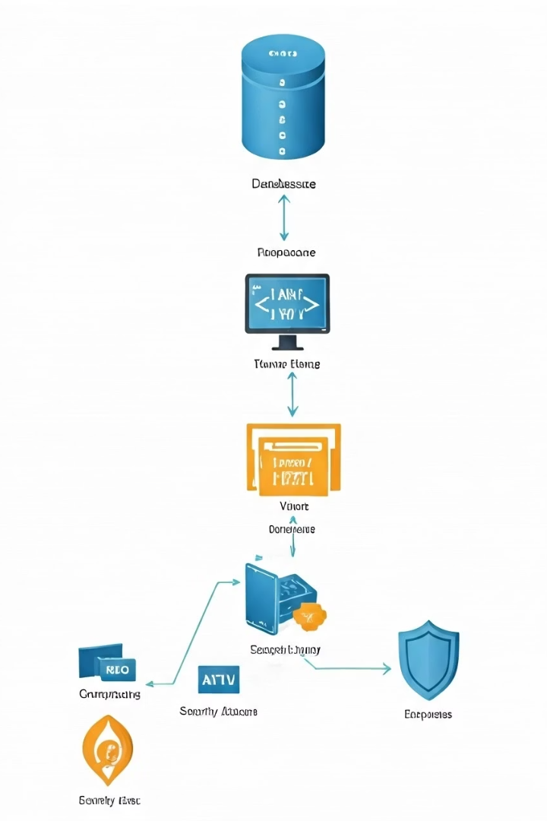
System Architecture
Django MTV Pattern
Model-Template-View division of responsibilities
Database Design
Relational schema for data integrity
Security Layers
Authentication and authorization controls
Responsive UI
Template-based adaptive interfaces

Slide 5
Data Model Highlights
Core Models
Program & Enrollment
User accounts and roles
HealthProgram definitions
Client personal and medical data
Enrollment tracking with constraints

Slide 6





User Interface Features
Dashboard Design
Centralized information hub
Client & Program Interfaces
Easy to navigate and update records
Enrollment Workflow
Smooth process from registration to participation
Mobile Responsiveness
Optimized for smartphones and tablets

Slide 7

Security Features
Authentication & Authorization
1
Role-based access control
2
Form Validation & CSRF
Protect against data tampering
Password Management
3
Strong hashing and reset capabilities
4
Data Access Controls
Strict privacy policies enforcement

Slide 8

Development Approach
Test-Driven Development
Ensures reliable and maintainable code
Component-Based Design
Modular and reusable system parts
Iterative Implementation
Incremental improvements and feedback
Code Quality Standards
Consistent style and best practices

