Slide 1








Confidence-Aware Graph Neural Networks for Social Bot Detection: Message-Passing Reweighting and Similarity-Graph Construction
2027 IEEE 4th International Student Conference on Digital Generation (DG)
February 24-26, 2027
Astana, Kazakhstan
Paper ID-XXX
Section: Computational Intelligence
Authors’ names: Kanalbay Kassymkhan, Lira La
University/company: Astana IT University; L.N. Gumilyov Eurasian National University
City, Country: Astana, Kazakhstan
Notes:
Good morning. I present our study of confidence-aware graph neural networks for social bot detection, and what actually makes graph models work on tabular account data.

Slide 2


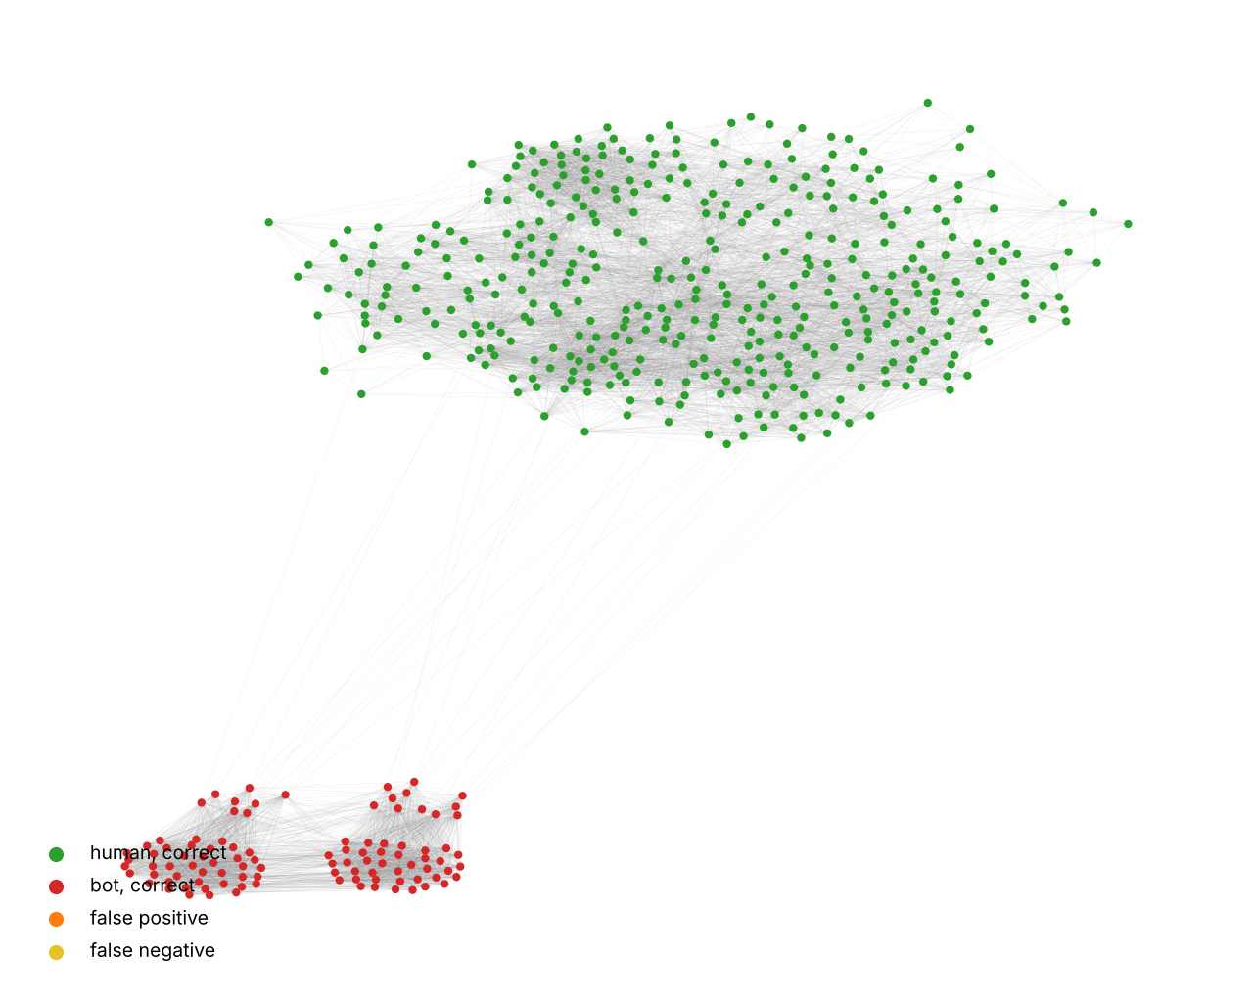
Motivation: Bots, Graphs and a Blind Spot of GCN
Why graph models for bot detection?
Bots inflate metrics and spread disinformation; they act in coordinated clusters
Per-account classifiers miss this structure; GNNs propagate signal along edges
A GCN weights every neighbor by degree only: a borderline account counts as much as a confident one
Hypothesis of our earlier work: down-weight low-confidence neighbors
Synthetic social graph: humans (green) and two dense bot clusters (red)
Earlier single-split result (DG 2026)
+3.0
precision points
−7.6
recall points
Question of this paper: is that gain real, and what really helps?
Notes:
Bots are coordinated, so graph models are attractive. A GCN treats confident and borderline neighbours equally. Last year we proposed to reweight by confidence and saw a precision gain on one split. Today we test it properly.

Slide 3
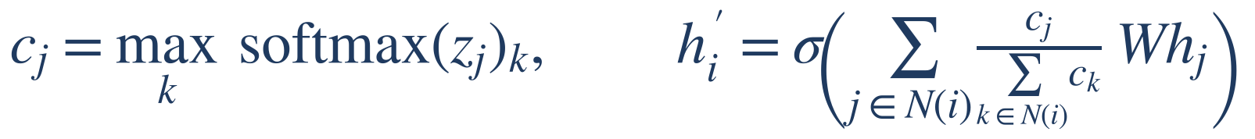
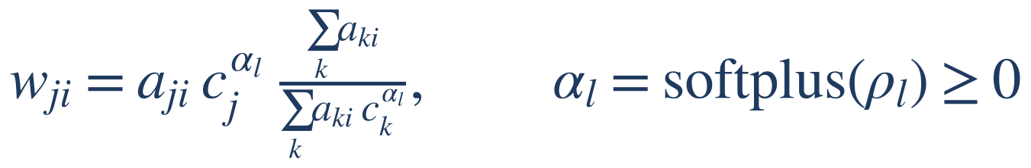
Method: Confidence-Aware Message Passing
1
Conf-GCN: weight neighbors by the model's own confidence
No extra parameters, no gradient through confidence, no labels used. For two classes c ∈ [0.5, 1], so weights differ at most 2×.
2
AC-GCN / AC-SAGE: learnable exponent on the baseline weights
α = 0 gives exactly GCN or GraphSAGE; large α removes the 2× bound.
3
Agreement weights: edge weight = probability both endpoints share a class (can switch edges off)
Self-training: unlabeled nodes with confidence ≥ 0.9 become pseudo-labels
Notes:
Three ways to use confidence: as a neighbour weight, as a learnable redistribution of the baseline's weights, and as a filter for pseudo-labels.

Slide 4
Research Questions
RQ1
Is the single-split precision gain real, and is it caused by the confidence signal?
RQ2
Do learnable exponents, agreement weights or self-training help?
RQ3
How much does the construction of the similarity graph matter?
RQ4
What changes when only a few hundred accounts are labeled?
Notes:
Four questions structure the talk.

Slide 5
Experimental Setup
Data
Three k-NN graphs (k = 10)
Protocol
Twitter human/bot dataset (Botometer + manual labels)
Balanced subsample: 5000 accounts
Features: SBERT description (384) + 6 numeric + 4 binary
Description graph: homophily 0.62
Metadata graph: homophily 0.78
Feature graph (both): homophily 0.76
5-fold CV × 5 seeds = 25 runs per model
Paired Wilcoxon + Holm correction
Baselines: MLP, GCN, GraphSAGE, GAT
Ablations, threshold-matched precision
All models: 3 layers, hidden size 64, dropout 0.5, 100 epochs, identical splits; hyper-parameters selected on validation folds only
Notes:
All models share splits and capacity: three layers, hidden size 64. Twenty-five runs per model let us test significance.

Slide 6
RQ1: The Precision Gain Does Not Replicate
0.732 vs 0.731
precision, Conf-GCN vs GCN (p = 0.83)
−2.5
AUROC points vs GCN
Earlier gain was split noise (run-to-run std ≈ 0.02)
At matched recall a tuned GCN is 0.9 points more precise
Feature-only MLP beats every GCN-type model on this graph
Notes:
With 25 runs, Conf-GCN has the same precision as GCN and loses AUROC. And the plain MLP is the best model on the description graph.

Slide 7
RQ1: Normalization, Not Confidence, Drives the Effect
Variant | F1 | AUROC
Conf-GCN (full) | 0.731 | 0.794
Uniform confidence (c ≡ 1) | 0.736 | 0.795
Shuffled confidence | 0.735 | 0.795
Inverted weighting | 0.733 | 0.797
α = 2 / α = 4 | 0.728 / 0.727 | 0.793 / 0.788
Uniform + self-loop | 0.742 | 0.817
GCN (reference) | 0.740 | 0.819
6.5%
average deviation of confidence weights from uniform aggregation
Removing, shuffling or inverting confidence changes nothing
The AUROC gap came from the missing self-loop
Description graph, 25 runs. Highlighted: adding a self-loop recovers GCN performance.
Notes:
If confidence mattered, shuffling or inverting it should hurt. It does not. The weights stay within a few percent of uniform.

Slide 8
RQ3: Graph Construction Is the Decisive Choice
Description graph: every GCN-type model is worse than the MLP
Metadata graph: every GNN beats the MLP (p < 2·10⁻⁵)
Density matters little: k = 5, 10, 20 changes F1 by < 1 point
Notes:
Changing only the graph reverses the conclusion. Homophily rises from 62 to 78 percent, and all graph models overtake the MLP.

Slide 9
Best Detector: GraphSAGE on the Metadata Graph
0.840
0.921
+9.9
+3.2
F1 score
AUROC
F1 vs original GCN pipeline
F1 vs feature-only MLP
Why it works
Metadata neighbors share the class far more often (homophily 0.78 vs 0.62)
GraphSAGE keeps a node's own features next to the aggregated neighborhood
Precision and recall rise together: 0.842 / 0.838 vs 0.731 / 0.752 (p < 10⁻⁶)
Notes:
The final recipe gives 0.84 F1 and 0.92 AUROC, almost ten points above our original pipeline.

Slide 10
RQ2: Adaptive Confidence Models
AC-GCN fixes the AUROC loss: 0.819 vs 0.794 for Conf-GCN (= GCN)
No significant gain: AC-GCN, AC-SAGE and agreement weights stay within 0.5 F1 of their baselines
Reason: confidence predicts whether a neighbor is correct only moderately (AUROC 0.66)
Given freedom to amplify confidence, the models reduce it
Notes:
When the exponent is learned, it shrinks from one to about 0.6 to 0.8. The models choose to rely less on confidence.

Slide 11
RQ4: Few Labels, Confidence as a Pseudo-Label Filter
+2.0
F1 over MLP at 250 and 500 labels (p = 0.002)
GraphSAGE + self-training is best at 100–500 labels
Self-training adds 0.6 F1 to GraphSAGE at 250 labels (p = 0.014)
The graph matters most when labels are scarce
Notes:
Moderation teams rarely have thousands of labels. With a few hundred, the graph plus confidence-based self-training wins by two points.

Slide 12
Conclusions and Future Work
1
Conf-GCN's single-split precision gain was sampling noise; confidence weights stay near uniform
2
Graph construction is decisive: a metadata k-NN graph makes every GNN beat the MLP
3
Recipe: metadata graph + GraphSAGE → F1 0.840, AUROC 0.921 (+9.9 F1)
4
Few labels: confidence-based self-training gives the best detector
Future work
Real follow/mention graphs (TwiBot-20), calibrated confidence, and learning the graph jointly with the classifier
Notes:
To summarise: build the right graph, keep the node's own features, and use confidence for pseudo-labels rather than for weighting.

Slide 13
Thank You
Thank you for your attention!
Questions are welcome
Kanalbay Kassymkhan — solodancer235@gmail.com
Lira La — Lira.La@astanait.edu.kz
Code and results: github.com/solodancer235-star/confidence-aware-gcn-bot-detection
Notes:
Thank you. I am happy to take questions.

