Slide 1
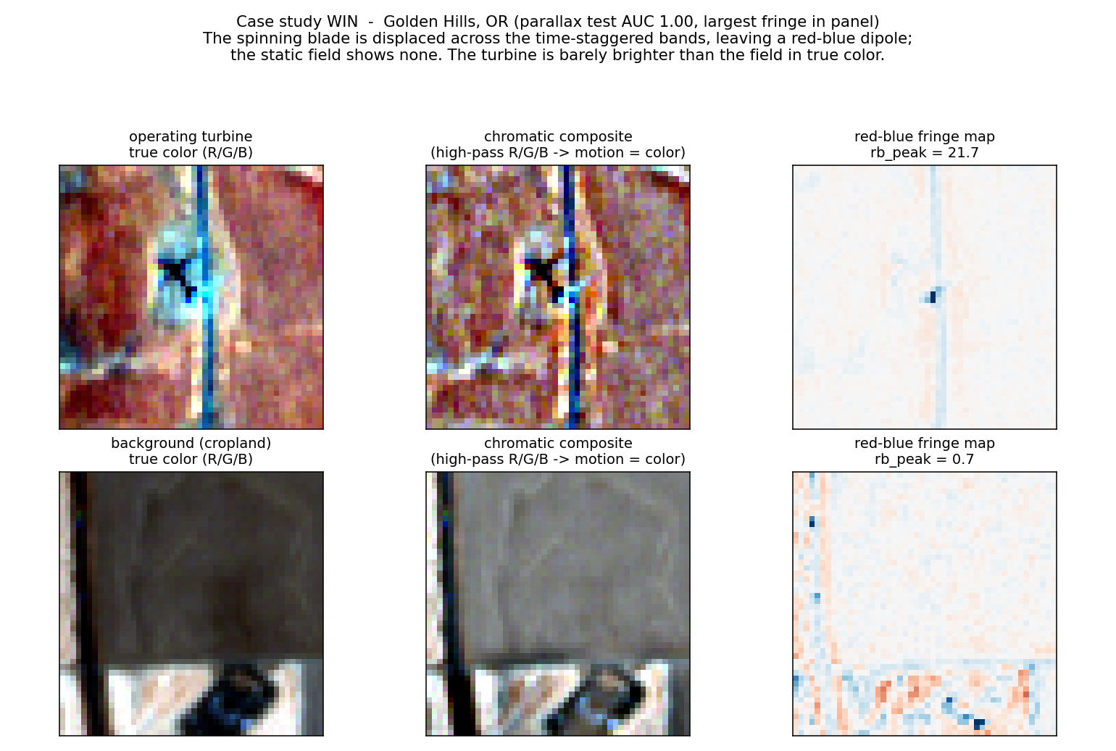
CS131 FINAL PROJECT • DEMO DAY
What Actually
Works at 10 m?
An honest study of static, texture, and blade-motion cues for wind-turbine detection in Sentinel-2
Operating turbine (top) vs background (bottom): the blade-motion fringe is the signal.
[Author One] · [Author Two] · [Author Three]
Stanford University

Slide 2
MOTIVATION & SIGNIFICANCE
Why detect turbines that are actually turning?
Free, every 5 days
Rotation = generation
Data-center power diligence
Sentinel-2 is free and global. Official inventories (USWTDB, EIA-860) lag by months; sub-meter aerial imagery is flown only every 2-3 years and cannot nowcast.
The cue fires only on spinning blades, a direct proxy for whether a turbine is generating, not just installed. Idle turbines are correctly invisible.
For investors in data centers, pairing which nearby turbines are spinning with their capacity estimates the real wind share feeding a project's grid region, and tests its clean-power claims.
The challenge: at 10 m a turbine is only a few pixels, and on bright or textured ground it is resolved but not locally salient, so appearance-based detection fails on most scenes.

Slide 3

THE KEY IDEA
Read blade motion from a sensor artifact
Sentinel-2 exposes its color bands at slightly different times: green +0.324 s and red +1.005 s after blue, because the detectors are offset on the focal plane.
A blade tip moves tens of meters in that window, so an operating turbine sits at displaced pixels across the bands and leaves a localized red-blue color fringe. A static object (field, building, pad) leaves none. We engineer 19 interpretable features from that fringe, from scratch.
This is the exact signal the leading 10 m detector (Mandroux et al.) deliberately discards by using the blue band only.
Real Sentinel-2, Golden Hills OR: the turbine is barely brighter in true color, yet a sharp red-blue dipole appears.

Slide 4
METHODOLOGY
Four cue families, one fair benchmark
CS131 static primitives
Static salience
Gaussian, Sobel, Hough, Harris, matched template. From scratch. The documented fallback.
Center-vs-surround brightness z-scores. The binding appearance cue at 10 m.
HOG + linear SVM
Band-parallax (novel)
A standard generic-appearance baseline (96-D descriptor).
19 interpretable blade-motion features from the inter-band fringe.
Benchmark: 173 US projects, 35 states · 10,634 patches · grouped by whole farm (no leakage) · GroupKFold CV · one locked test

Slide 5
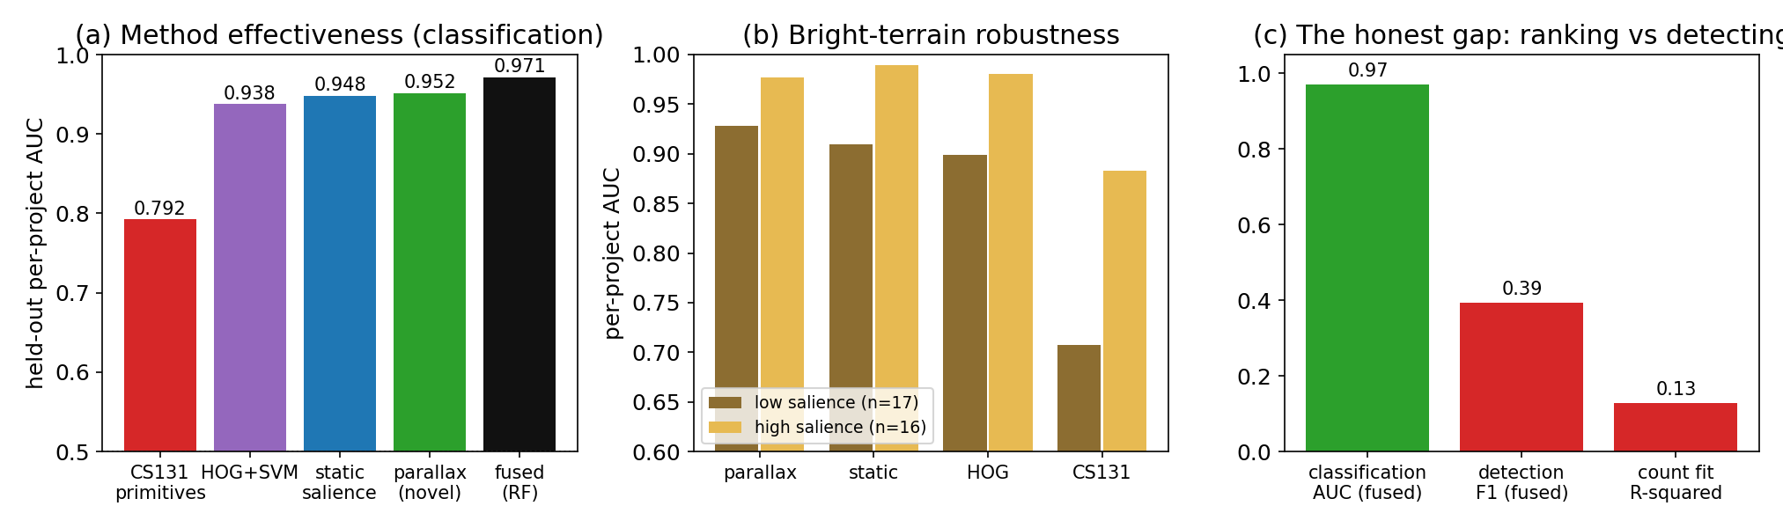
RESULTS
What works: motion beats appearance at 10 m
Parallax alone 0.952
Fused 0.971
Robust on bright terrain
best single family, above HOG (0.938) and salience (0.948)
parallax + salience; adding HOG or CS131 does not help
0.928 where appearance collapses (CS131 falls to 0.707)

Slide 6
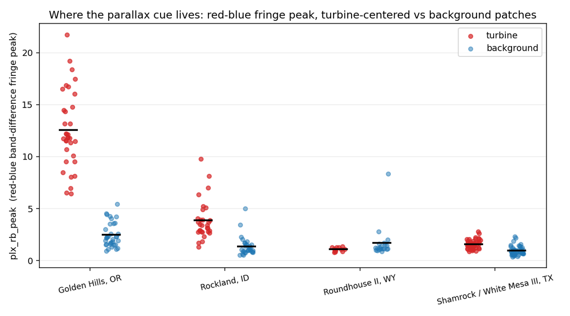
ANALYSIS
Real motion, and where it wins or fails
Is it motion or just contrast?
Residual after removing contrast: AUC 0.763
Within fixed-contrast bins: parallax 0.759 vs salience 0.527 (chance)
Label-shuffle control: 0.490 (no leakage)
The cue measures rotation, not presence.
Wins on spinning fleets: Golden Hills, Rockland (even on hard terrain).
Fails on idle fleets: Roundhouse and Shamrock (48 visible turbines, 0 detected) were not turning, so there is no fringe to read.
Red-blue fringe peak, turbine vs background, on four re-fetched projects.

Slide 7
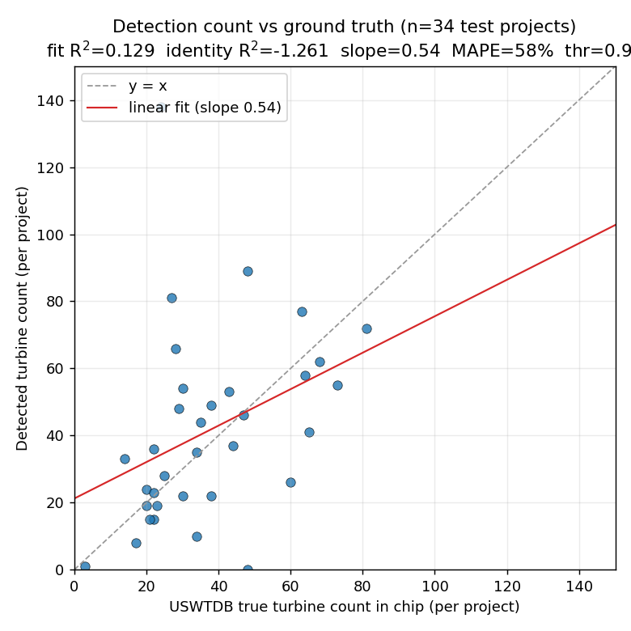
DISCUSSION & LEARNINGS
The honest gap: ranking is not detecting
0.97
classification AUC (rank a candidate point)
Learnings
Ranking pre-placed points is far easier than committing to detections.
Random-background negatives make the AUC optimistic.
Idle turbines cap recall against installed-count truth.
0.39
object F1 as a real detector
0.13
count R-squared vs ground truth

Slide 8
TAKEAWAYS
An honest accounting of what each cue is worth
Motion is a real cue
Free Sentinel-2 inter-band parallax is an interpretable, contrast-separable signal of an operating turbine, and the most salience-robust family on bright terrain.
Textbook primitives mostly fail
At 10 m the CS131 family reduces to one Sobel-energy feature; Hough is at chance and HOG adds nothing over the engineered cues.
Be honest about the gap
As a real detector the result is weak (F1 0.39) and idle turbines are invisible. This is a rigorous proof-of-concept, not a counting product.
Future: hard negatives · count benchmark vs EIA-860 · multi-date 5-day nowcast

