Slide 1
Learning Deep Representations
for Graph Clustering

Slide 2
Dataset : Wine(3), 20-Newsgroup (documents), PPI (DIP, BioGrid)
cosine similarity
Normalized Mutual Information (NMI) [0,1]
DIP, BioGrid, cluster number from 5 to 400
Structures

Slide 3
Motivation ：
1. employing deep learning in graph clustering
2. the similarity between autoencoder and spectral clustering
Method：
autoencoder will replace the expensive EVD in spectral clustering

Slide 4
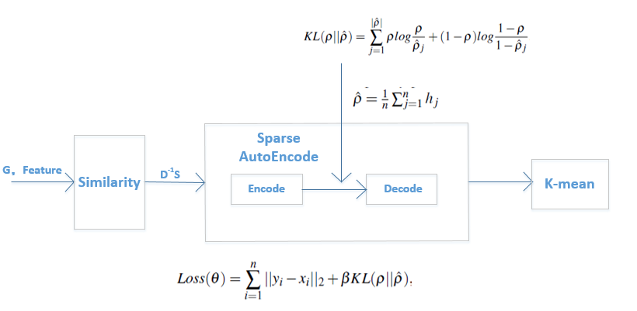
Sparse Autoencoder by DNN
S = {s_{ij}}: similarity matrix
D = diag(di)， di = Σ_{j} s_{ij}
L = D-S
Normalized Laplacian L = D⁻¹L = D⁻¹(D-S) = I - D⁻¹S

Slide 6
Normalized Mutual Information (NMI) [0,1]
Since it is normalized we can measure and compare the NMI between different clusterings having different number of clusters
a higher value is a better clustering

