Slide 1
HOW POWERFUL ARE GRAPH NEURAL NETWORKS?
GIN (2019)

Slide 2

Datasets
4 bioinformatics datasets
MUTA
PTC
NCI1
PROTEINS
5 social network datasets
COLLAB
IMDB-BINARY
IMDB-MULTI
REDDIT-BINARY
REDDIT-MULTI5K

Slide 3
Motivation
Limited understanding of representational properties and limitations in graph representation of GNNs
The design of new GNNs is mostly based on empirical intuition, heuristics, and experimental trial-and-error
Not easily generalize to multple architectures

Slide 4
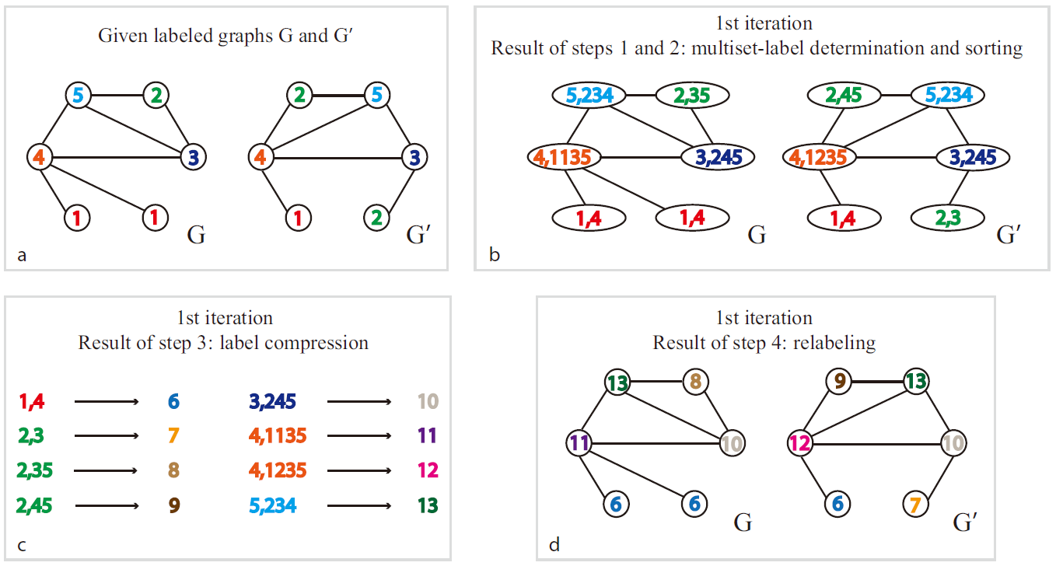
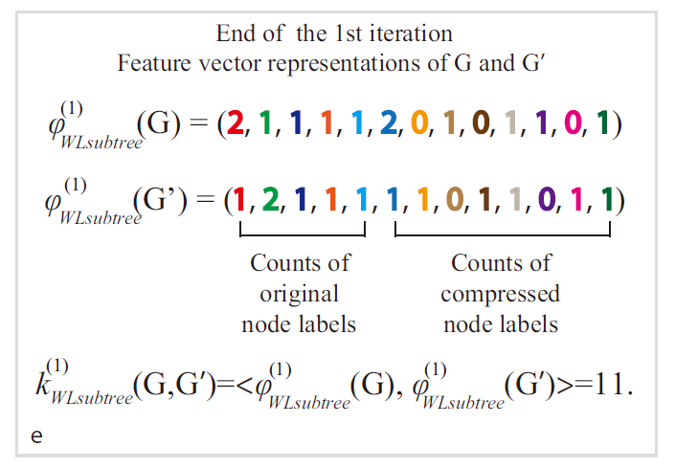
Weisfeiler-Lehman (WL) Test
full multiset of node neighbors

Slide 5




G = (V;E) node feature vectors X_{v}
Node classification: f(h_{v}) = y_{v}
Graph classification: g(h_{G}) = y_{G}
node embedding
graph embedding

Slide 6


Model
graph isomorphism network (GIN) (Injective)
multi-layer perceptrons (MLPs)

Slide 7
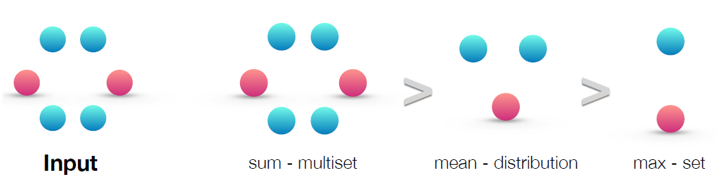
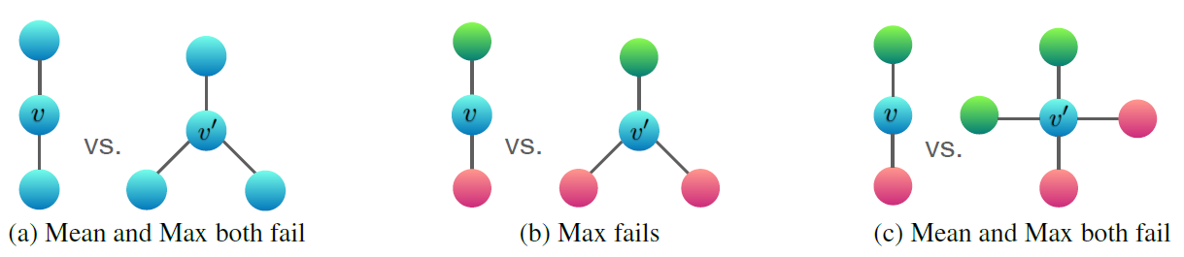

Slide 8
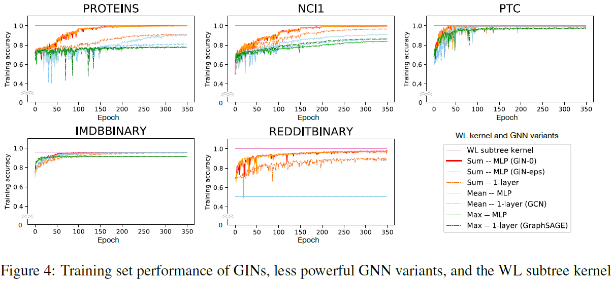
Experiments

Slide 9
