Slide 1
Higher-order Weighted Graph Convolutional Networks
HWGCN (2019)
Preprint.

Slide 2
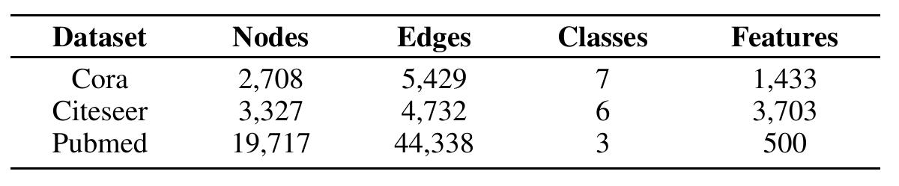
Dataset

Slide 3
Motivation
merely the first-order or few-order
drop-off for deeper structure
convolutional filter limits the representational capacity of the model

Slide 4
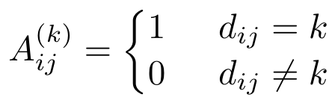



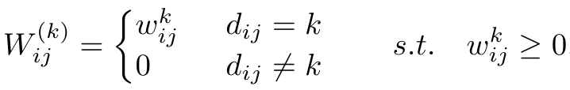
Model
k^{th}-order adjacency matrix A^{(k)}
k^{th}-order weight matrix W^{(k)}
L =

Slide 5
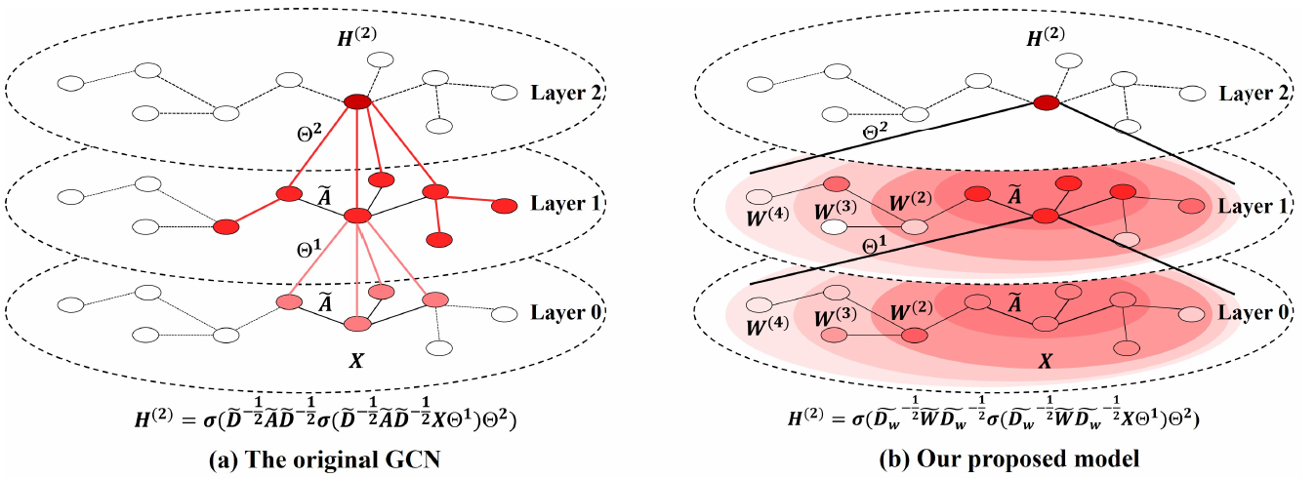

Slide 6


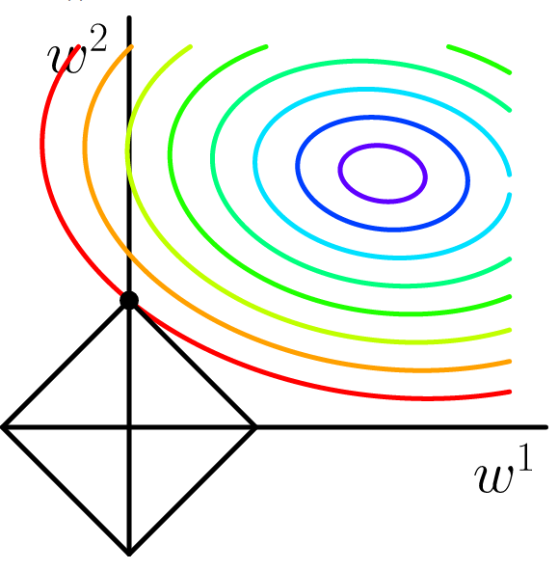
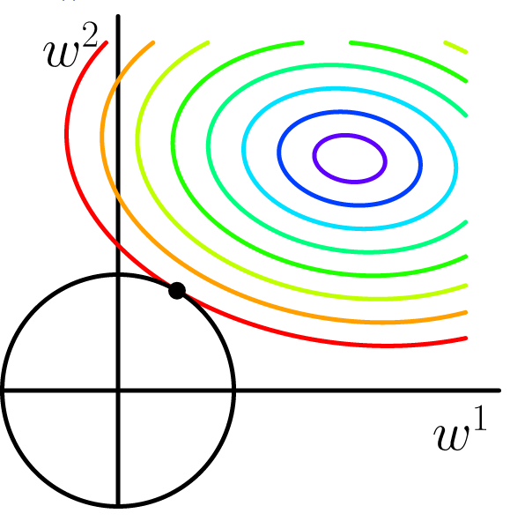
L1 Regularization → Sparsity → Feature Selection

Slide 7
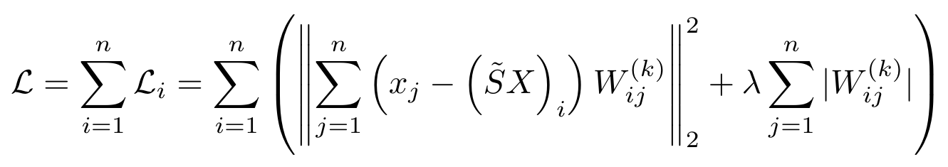

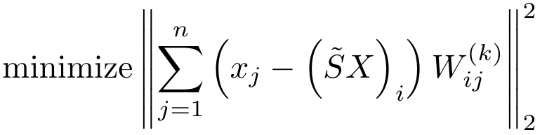
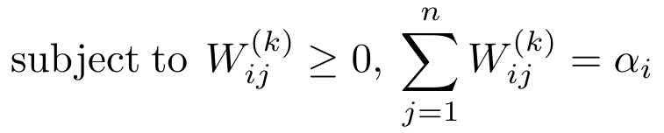

Lasso (for higher-order neighbor selection)
→

Slide 8
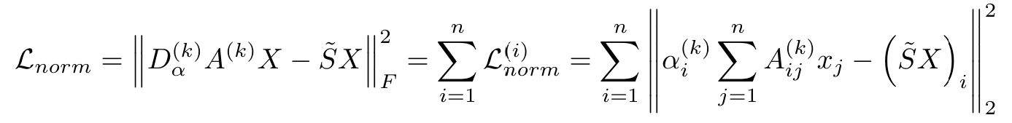
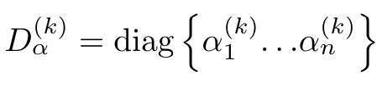
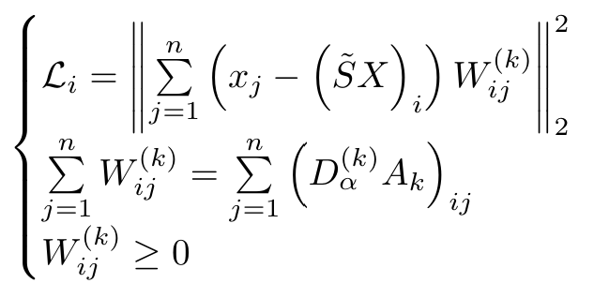
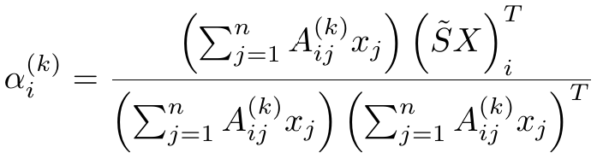

Slide 9
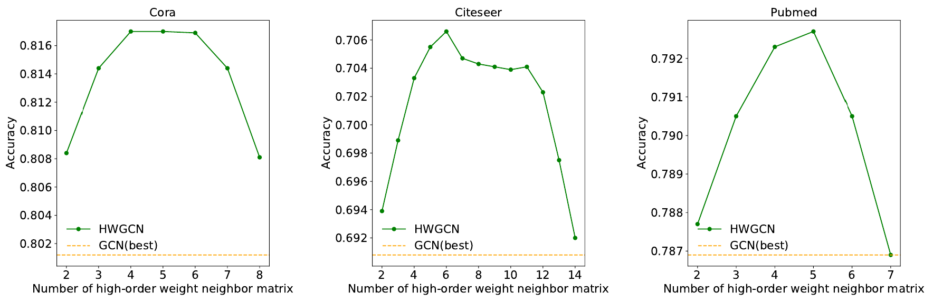
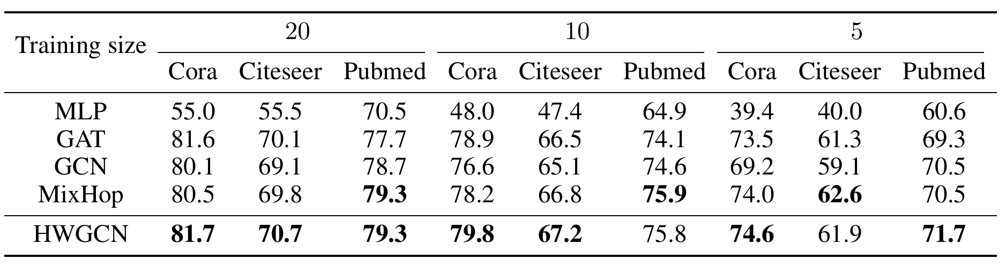
Experiment

Slide 10
