Slide 1
Attributed Graph Clustering:
A Deep Attentional Embedding Approach
(DAEGC) (2019)

Slide 2
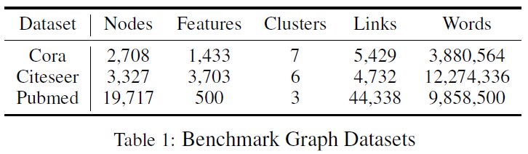
Datasets

Slide 3
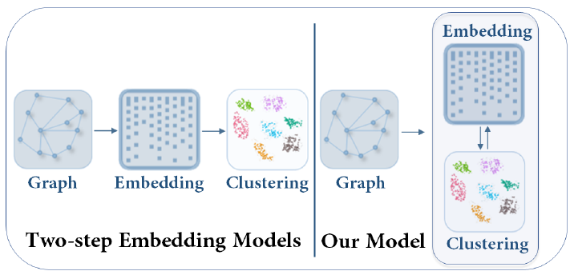
Motivation
two-step frameworks are difficult to manipulate and usually lead to suboptimal performance
graph clustering methods is the nonexistence of label guidance (soft label)

Slide 4
Graph Clustering
1. topological structure and node content
2. Attributed Graph (unweighted)
G = (V; E; X)
(Adjacency matrix A)
(X are the attribute values)
3. Clustering criteria：
i. close to each other in terms of graph structure while distant otherwise
ii. similar attribute values

Slide 5
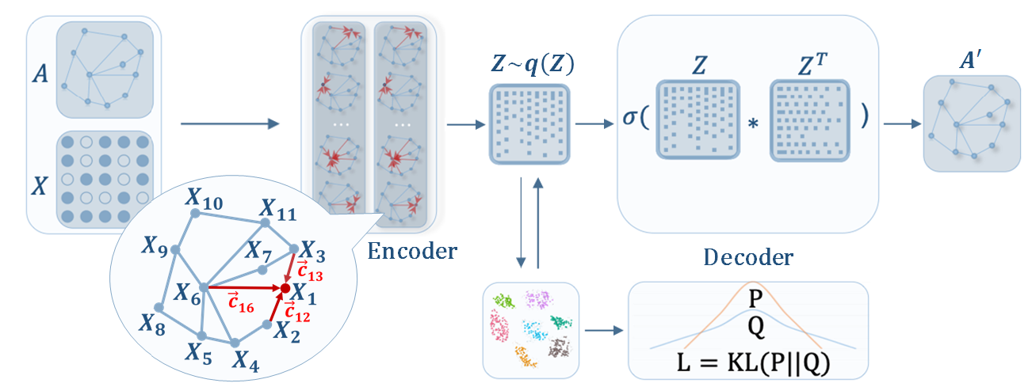
Model
Graph Attentional Autoencoder
(learns the latent embedding by graph structure and the attribute values) (clustering loss)
2. Self-training Clustering
(manipulates the latent representation according to the current clustering result) (reconstruction error)

Slide 6

Encoder
graph attention strategy
z_{i}^{l+1} denotes the output representation of node i
N_{i} denotes the neighbors of i
α_{ij} is the attention coefficient
(measure the importance of various neighbors)

Slide 7

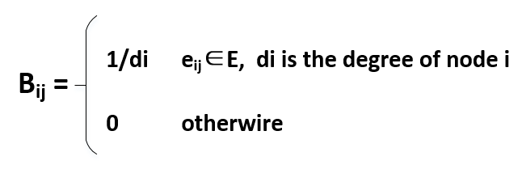
high-order neighbors M
(a proximity matrix by considering t-order neighbor nodes in the graph)
(M_{ij} denotes the topological relevance of node j to node i up t orders)
(If Mij >0 , node j is a neighbor of i)
(Ni = neighbors of node i in M)
(t could be chosen flexibly)

Slide 8
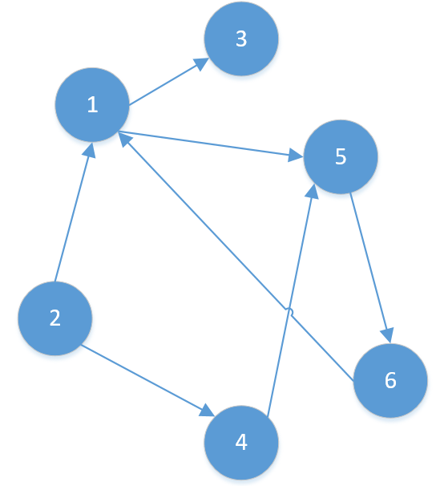
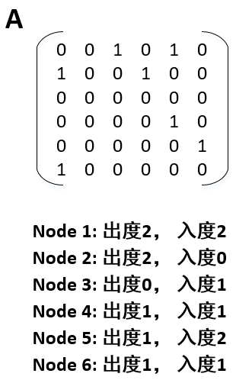
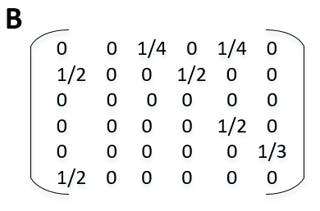

Slide 9


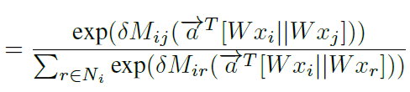

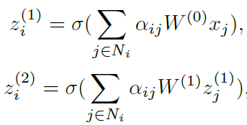

the concatenation of xi and xj with weight vector α
topological weights M_{ij}
activation function LeakyReLU
two graph attention layers

Slide 10


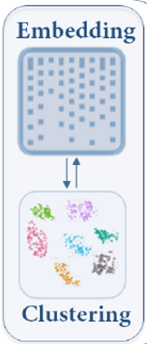

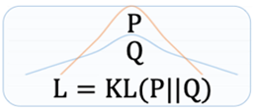
Self-optimizing Embedding
train the autoencoder without the self-optimize clustering part to obtain a meaningful embedding z_{i}
k-means initial cluster centers u_{u}
the soft-clustering assignment distributions of all the nodes Q
target distribution P (update P every 5 iterations) and Lc
q_{iu} measures the similarity between node embedding z_{i}
and cluster center embedding u_{u} (t-SNE)
p_{iu} is the target distribution (soft label)
soft labels to supervise Q’s embedding learning

Slide 11
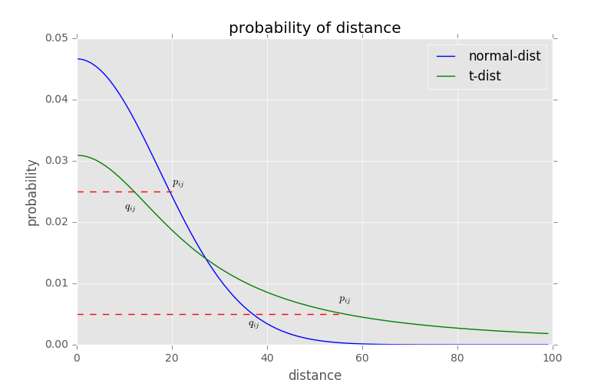
Stochastic Neighbor Embedding (SNE) starts by converting the high-dimensional Euclidean distances between datapoints into conditional probabilities that represent similarities. (Gaussian distribution)
t-SNE employs a Student t-distribution to replace Gaussian distribution

Slide 12
Greater difference in value
Q

Slide 13




Decoder
the reconstructed structure matrix of the graph (inner product)
reconstruction error
total objective function label estimated for node (form Q)

Slide 14
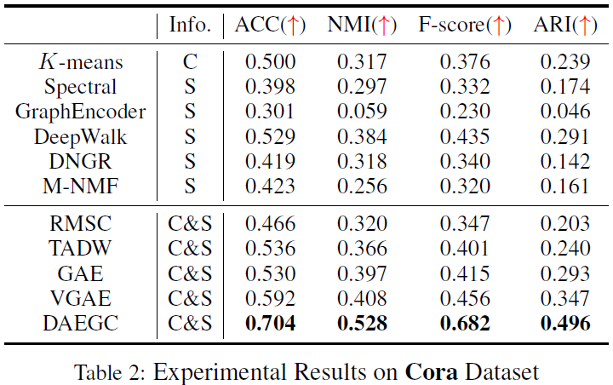
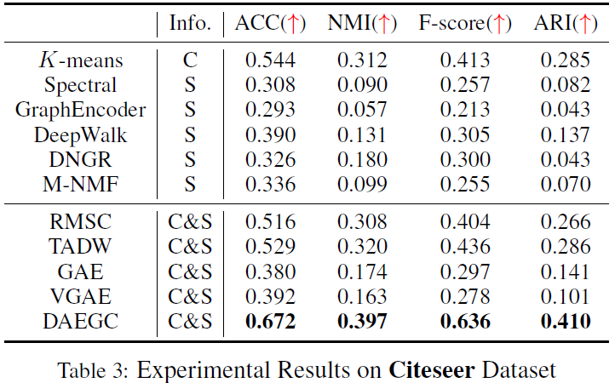
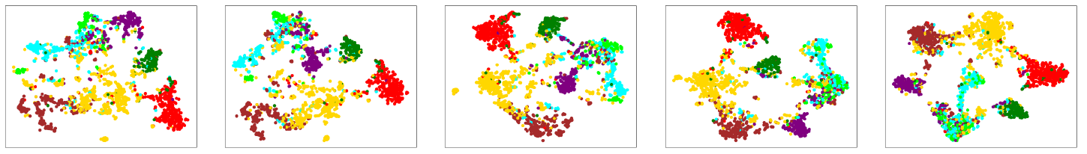
Experiments (y=10, M=(B+B²)/2, encoder-256, embedding-16)

Slide 15
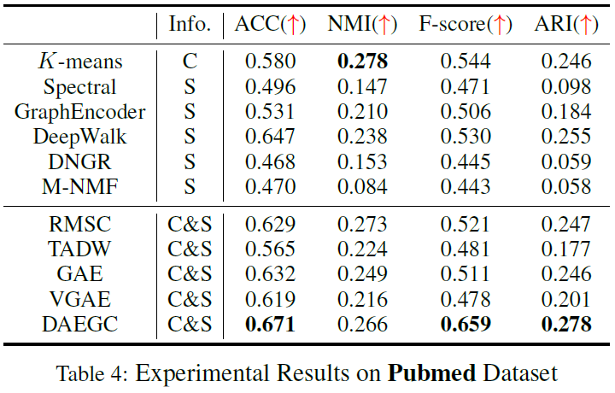
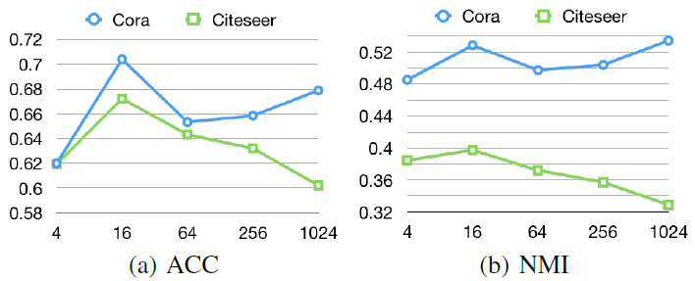
using both the structure and content information of the graph generally perform better than those using only one side of information.
by applying self-training clustering, less overlapping and each group of nodes gradually gathered together.
dimension of embedding from 4 neurons to 1024

