Slide 1
Learning Deep Representations
for Graph Clustering

Slide 2
Datasets

Slide 3
Dataset : Wine(3), 20-Newsgroup (documents), PPI (DIP, BioGrid)
cosine similarity
Normalized Mutual Information (NMI) [0,1]
DIP, BioGrid, cluster number from 5 to 400
Structures

Slide 4
Motivation

Slide 5
Motivation ：
1. employing deep learning in graph clustering
2. the similarity between autoencoder and spectral clustering
Method：
autoencoder will replace the expensive EVD in spectral clustering

Slide 6
Sparse Cluster

Slide 7
Conclusion:
i. unnormalized spectral clustering aims to minimize ratio Cut
(Laplacain)
ii. normalized spectral clustering aims to minimize normalized Cut
(normalized Laplacian)
ratio cut is the special case of normalized cut where D = I

Slide 8
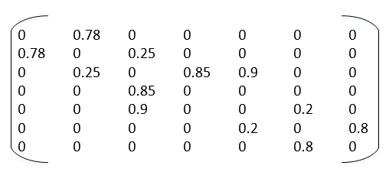
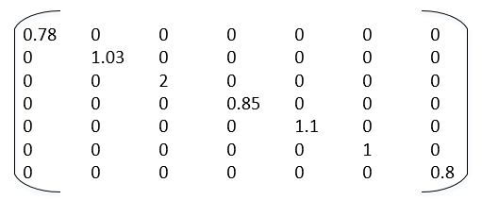
S = {s_{ij}}: similarity matrix
di = Σ_{j} s_{ij}
D = diag(di)
(K Clusters A , B, C)
Vol(A) = Σ_{i∈A} di
Link(A,B) = ½ Σ_{i∈A, j∈B} sij = cut(A, B)
Vol (A) = 1.81
Vol (B) = 3.95
Vol (C) = 1.8
Link (A,B) = (0.25+0.25)/2

Slide 9
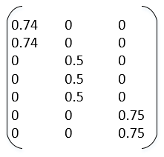
Spectral cluster coverts discrete optimization problem
min Trace(H^{T}LH) (NP-Hard)
s.t.
L = D-S

Slide 10
Model Description

Slide 11
H is consisted to the eigenvectors corresponding to the k smallest non-zero eigenvalues of the normalized Laplacian matrix D⁻¹L
Normalized L = Q
= D⁻¹L = D⁻¹(D-S) = I - D⁻¹S
= YΣY^{T}
D⁻¹S ~ Y_{k}Σ_{k}Y_{k}^{T}
Graph Embedding Y_{k} , r(Y_{k})=k, (n, n) (dense)

Slide 12
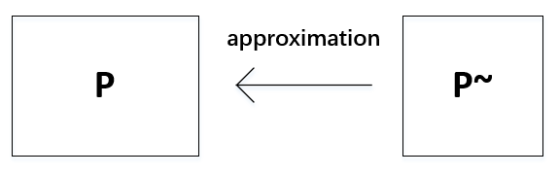

Eckart-Young-Mirsky Theorem
reconstruction nature of spectral clustering is related to the low-rank approximation of a matrix.
singular value decomposition (SVD) r(P)<n P = UΣV^{T} (faster)
eigenvalue decomposition (EVD) r(P)=n P = UΣU^{T}
Best result : P~ = UΣ~V^{T} = P_{k} = U_{k}Σ_{k}V_{k}^{T}
(Σ_{k} is k largest singular value in Σ, and others are replaced with 0)

Slide 13
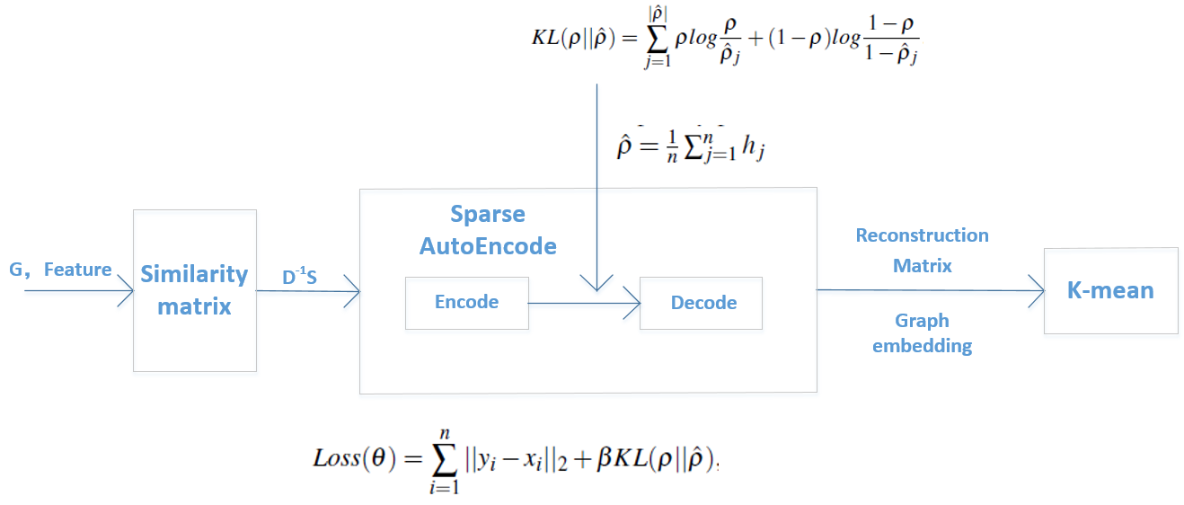
Sparse Autoencoder by DNN

Slide 14
Experiment

Slide 16
Normalized Mutual Information (NMI) [0,1]
Since it is normalized we can measure and compare the NMI between different clusterings having different number of clusters

Slide 18
END

