Slide 1
Adaptive Computation Time for Recurrent Neural Networks
ACT (2016)

Slide 2
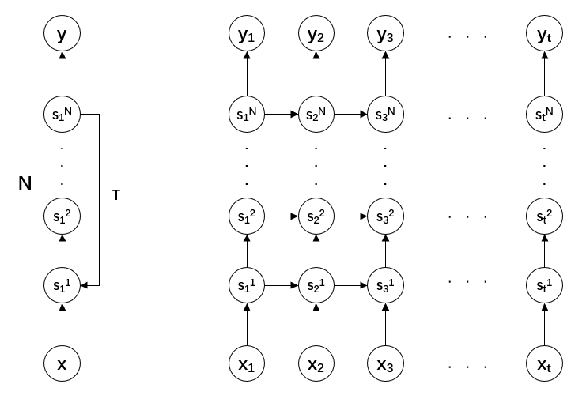
Normal RNN

Slide 3
Experiment
determining the parity of binary vectors
applying binary logic operations
adding integers
sorting real numbers
character-level language modelling results on the Hutter prize Wikipedia dataset

Slide 4
Motivation
unable to dynamically adapt the amount of computation
computational efficiency and ease of learning

Slide 5
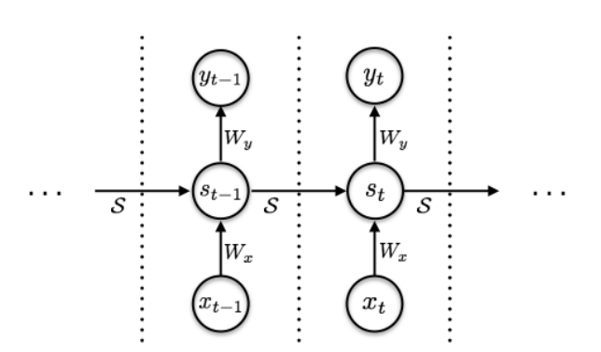

RNN

Slide 6

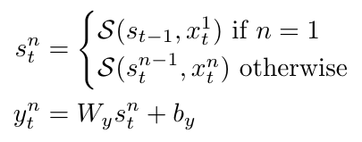
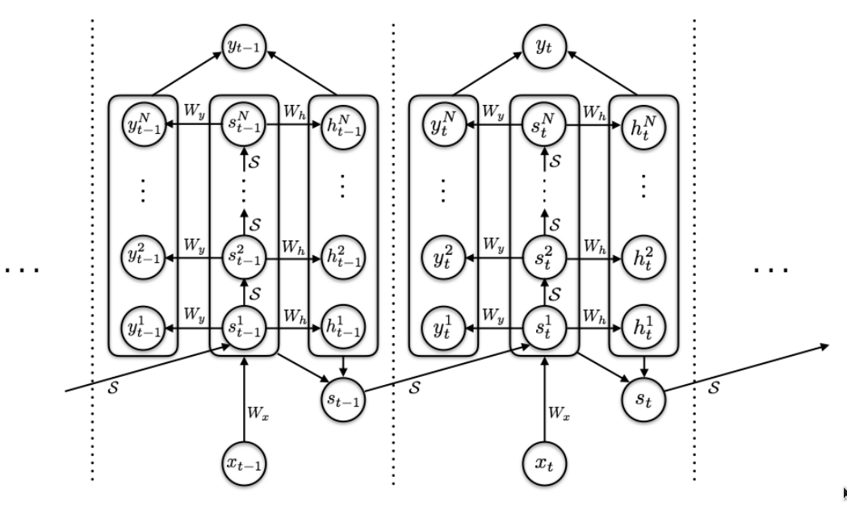

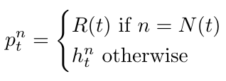
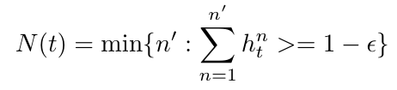
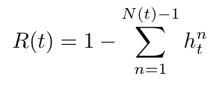
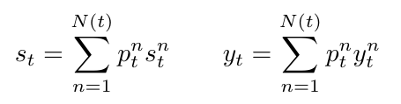
RNN with ACT

Slide 7
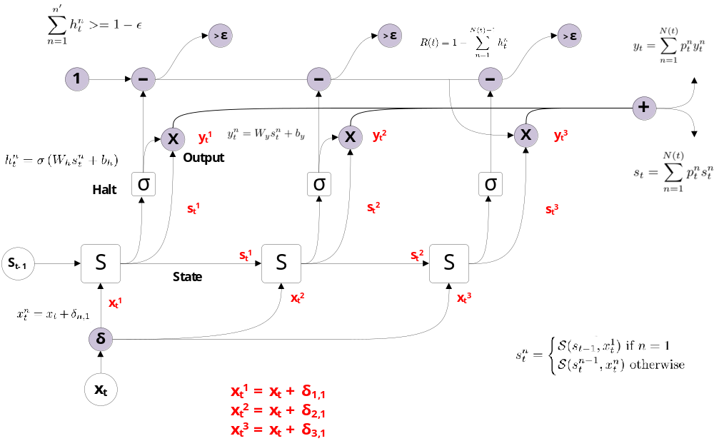


<
Notes:
the input at time t augmented with a binary flag that indicates whether the input step has just been incremented, allowing the network to distinguish between repeated inputs and repeated computations for the same input.
在时间t的输入增加了一个二进制标志，该二进制标志指示输入步长是否刚刚增加，从而允许网络区分重复输入和相同输入的重复计算。

Slide 8
when n=2, Σh_{t}^{n} = 0.9 < 0.99
when n=3, Σh_{t}^{n} = 1.1 > 0.99
when n=4, Σh_{t}^{n} = 1.3 > 0.99
N(t) = 3, R(t) = 1-0.9 =0.1

Slide 9
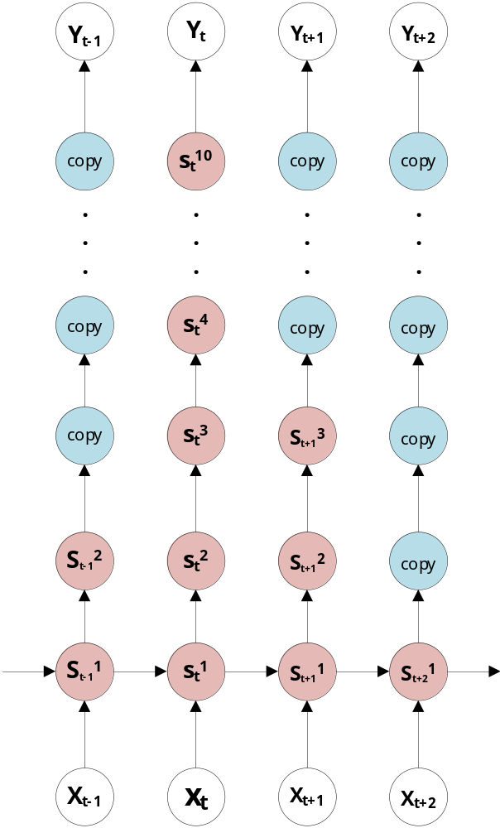

Slide 10
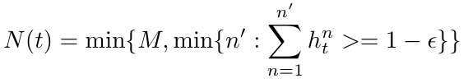

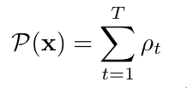
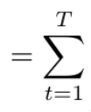
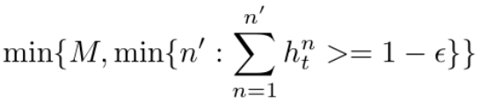
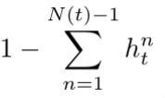


Limiting Computation Time
(quite sensitive to the value of τ)

Slide 11
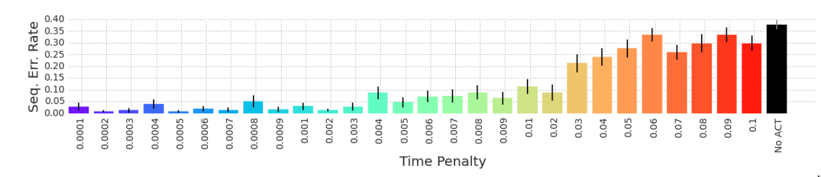
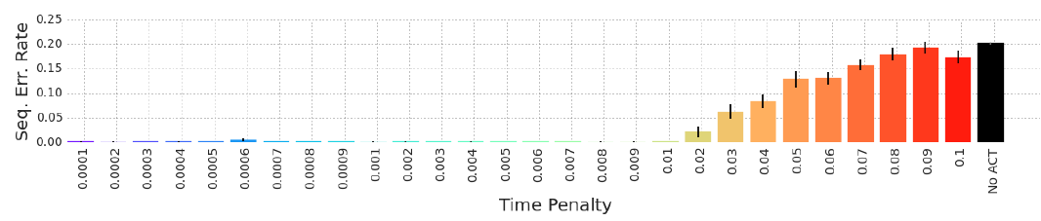
Experiments
1. Parity
2. Logic

Slide 12
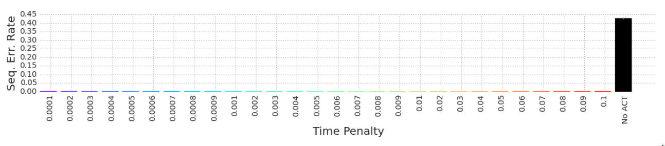
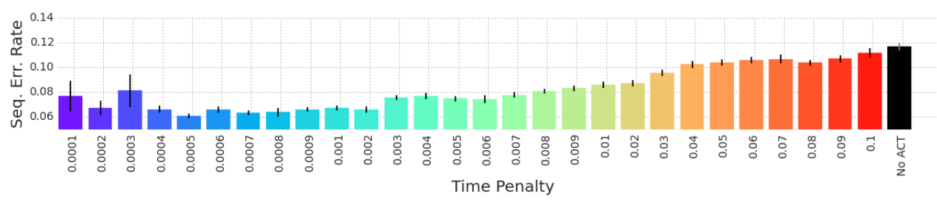
3. Addition
4. Sort

Slide 13
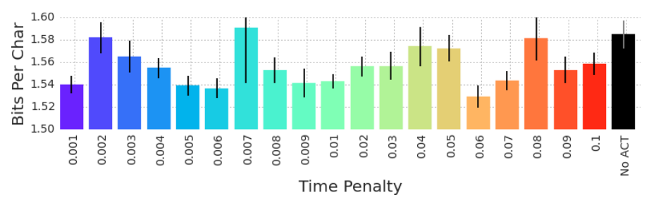
5. Wikipedia Character Prediction

