Slide 1
Universal Transformers
UT (2019)

Slide 2
Experiments
BABI QUESTION-ANSWERING
SUBJECT-VERB Agreement
LAMBADA Language Modeling
Algorithmic Tasks
Learning TO Execute (LTE)
MACHINE TRANSLATION

Slide 3
Motivation：
slow to train
fail to generalize
fixed stack

Slide 4
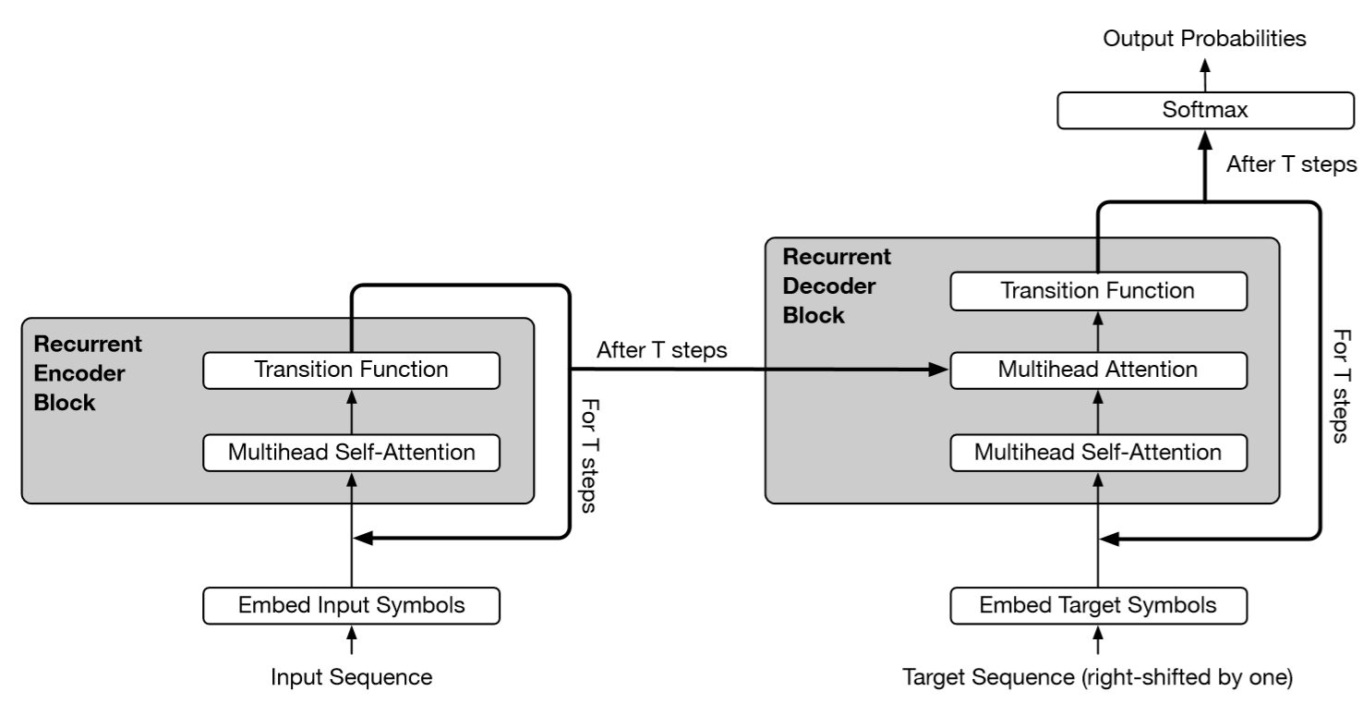
Model

Slide 5
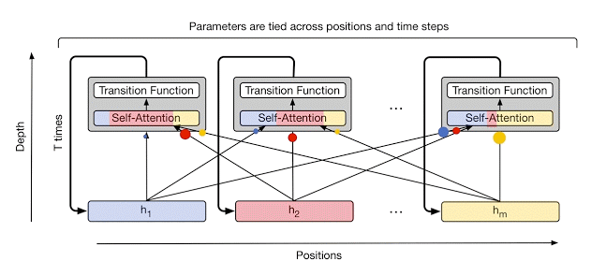

Slide 6

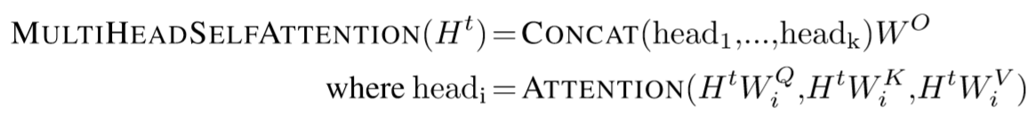
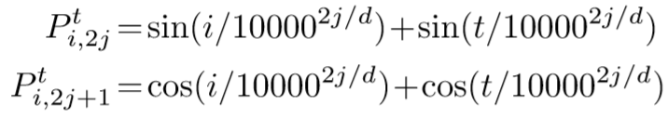
Encoder
Transition(): separable convolution or fully-connected neural network
ACT

Slide 7
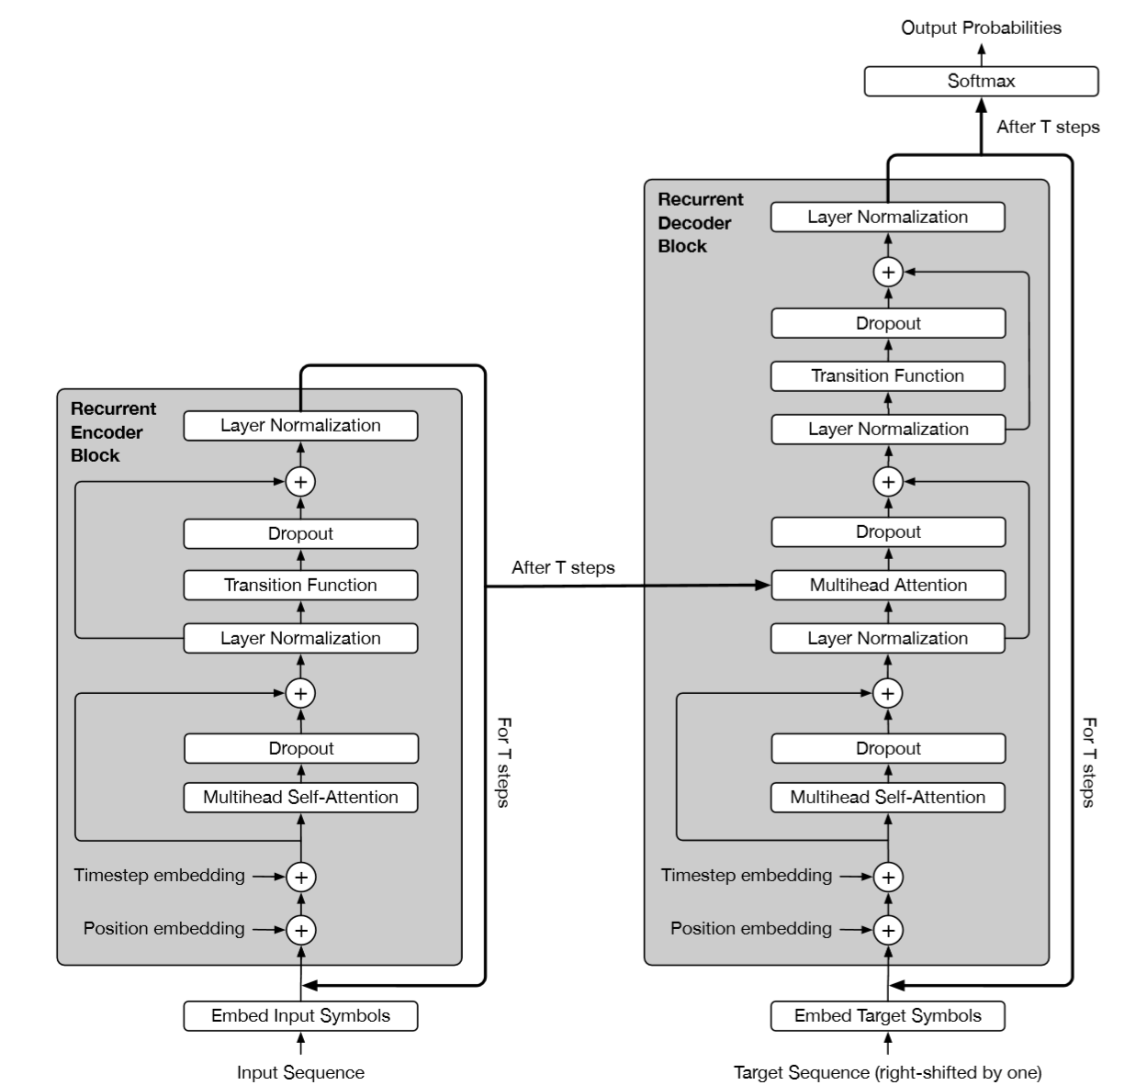
Decoder
H^{t}
K, V
A^{t}
Q
Q, K, V
P^{t}

Slide 8
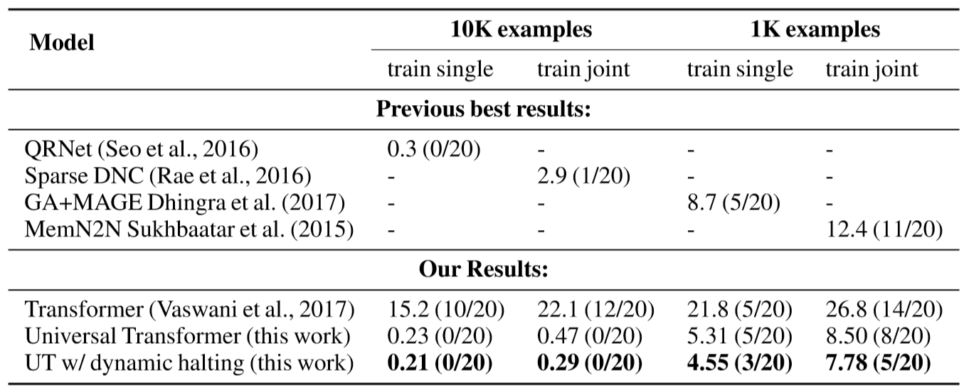
Experiments
BABI QUESTION-ANSWERING

Slide 9
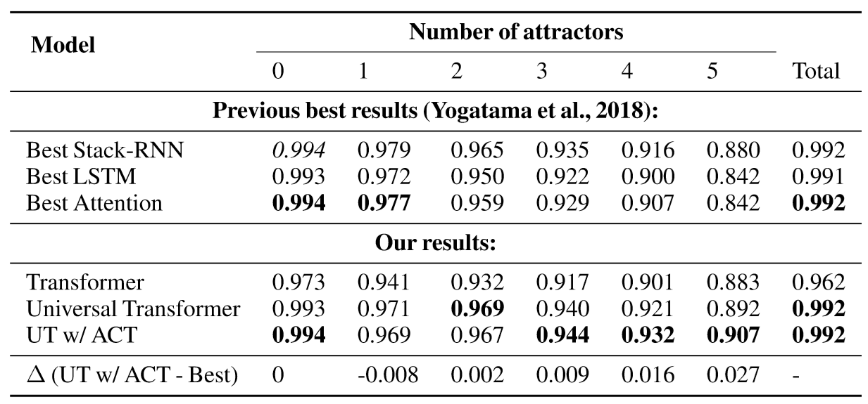
2. SUBJECT-VERB Agreement

Slide 10
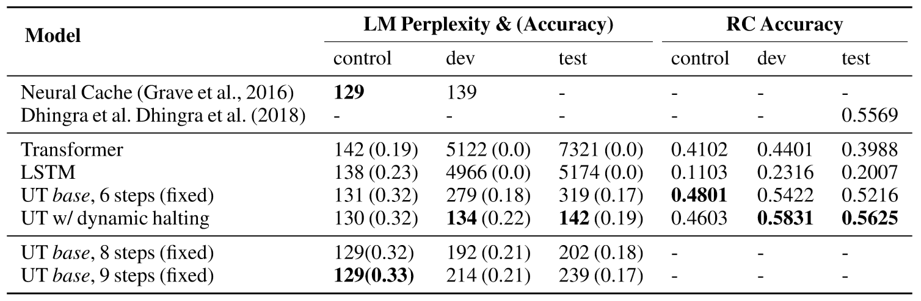
3. LAMBADA Language Modeling

Slide 11
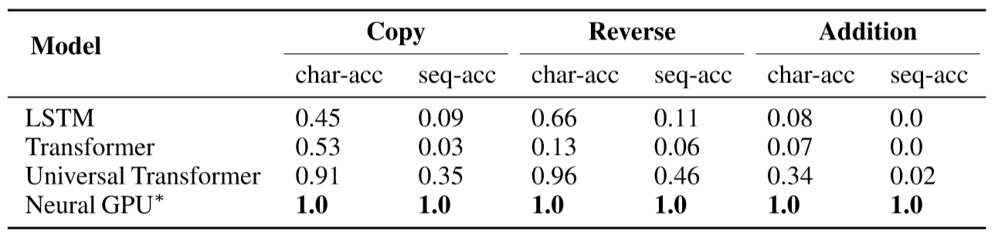
4. Algorithmic Tasks

Slide 12
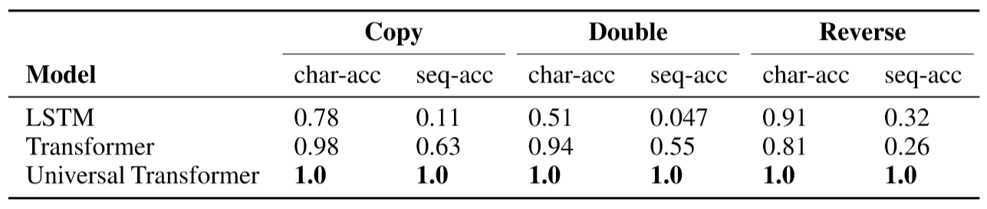
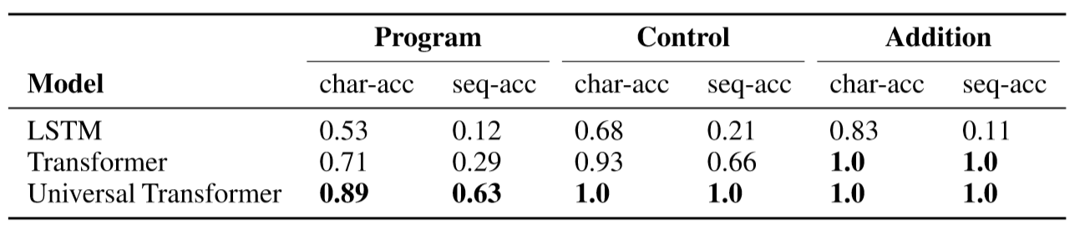
5. Learning To Execute (LTE)

Slide 13
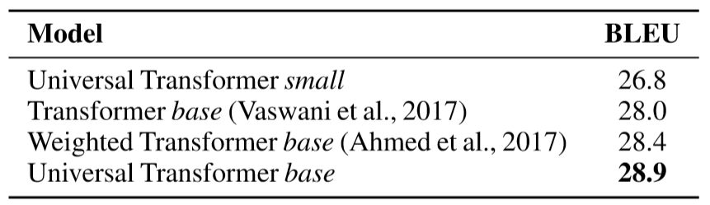
6. MACHINE TRANSLATION

