Slide 1
Attributed Graph Clustering via Adaptive Graph Convolution
(AGC) (2019)

Slide 2
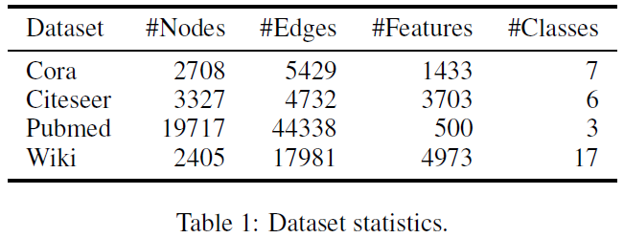
Datasets

Slide 3
Motivation
how graph convolution affects clustering performance
how to properly use it to optimize performance for different graphs

Slide 4
Graph
undirected graph G = (V, E, X)
A is adjacency matrix, D is degree matrix
X is feature matrix, X = [x₁, x₂, ..., x_{n}]^{T}
m clusters C = {C₁; C₂; ...; C_{m}}
v_{j} a k-hop neighbour of v_{i}, if v_{j} can reach v_{i} by traversing k edges
normalized Laplacian L_{s} = I-D^{-1/2}AD^{-1/2} = UΛU⁻¹
Λ = diag(λ₁, λ₂,..., λ_{n}), λ∈[0,2]
U = [u₁, u₂,..., u_{n}] (orthogonal)

Slide 5
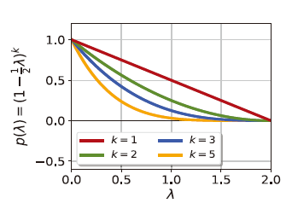
Graph Convolution
graph signal f = [f(v₁), f(v₂),..., f(v_{n})]^{T} -> X (node content)
real-valued function f(v_{i}) = x_{i}
graph filter G = Up(Λ)U⁻¹ -> A (structure)
frequency response p(Λ) = diag(p(λ₁), p(λ₂),..., p(λ_{n}))
p(λ) = (1-1/2λ)^{k} (decreasing and nonnegative)
λ ↓ p(λ) ↑

Slide 6



1-order graph convolution (k=1)
= ½(I + D^{-1/2}AD^{-1/2})

Slide 7



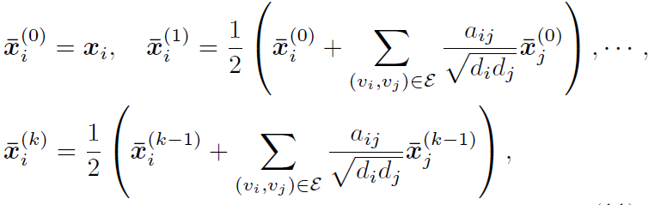
k-order graph convolution
= [½(I + D^{-1/2}AD^{-1/2})]^{k} X
k↑ -> smoother

Slide 8
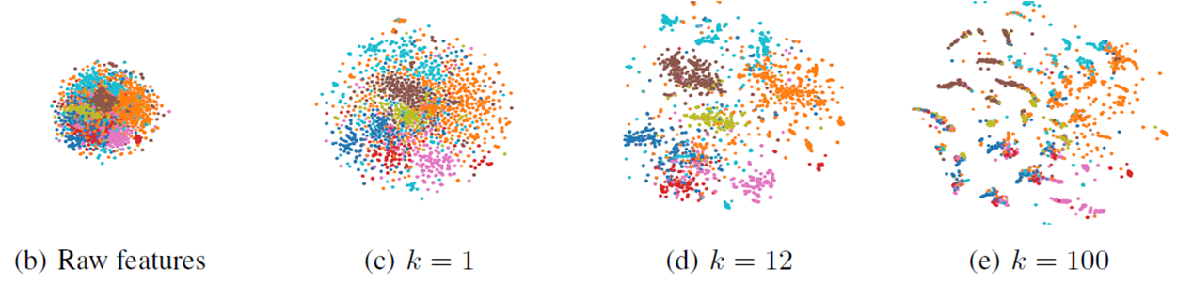
k-order

Slide 9
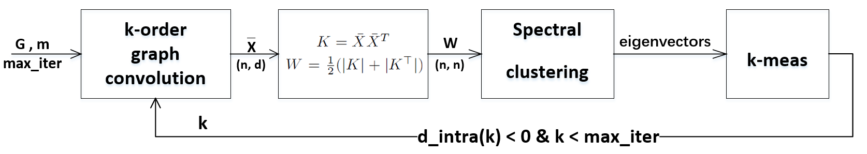


Model
m largest

Slide 10
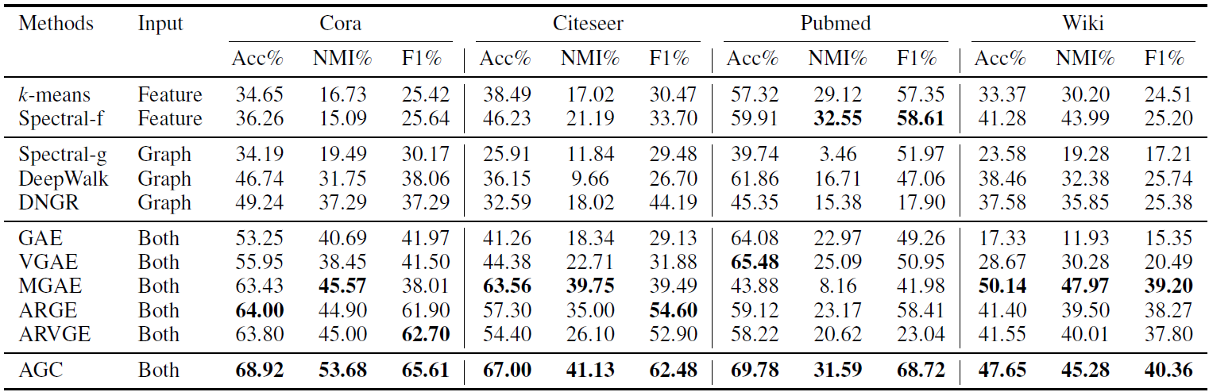
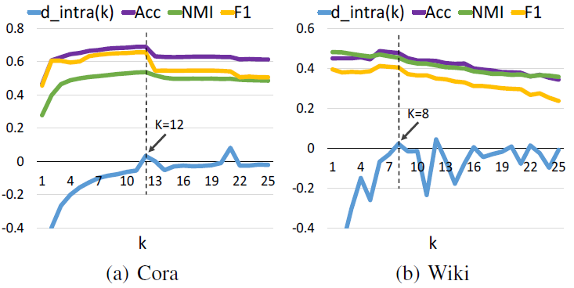
Experiments
5.78 s
62.06 s
584.87 s
10.75 s

