Slide 1
Attributed Graph Clustering via Adaptive Graph Convolution
(AGC) (2019)

Slide 2
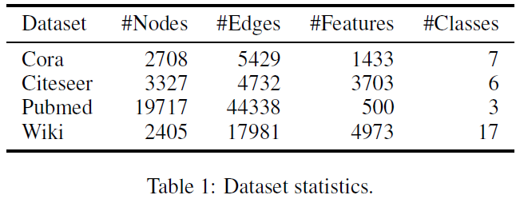
Datasets

Slide 3
Motivation
how graph convolution affects clustering performance
how to properly use it to optimize performance for different graphs

Slide 4
Graph
undirected graph G=(V, E, X)
A is adjacency matrix, D is degree matrix
X is feature matrix, X = [x₁, x₂, ..., x_{n}]^{T}
m clusters C = {C₁; C₂; ...; C_{m}}
v_{j} a k-hop neighbour of v_{i}, if v_{j} can reach v_{i} by traversing k edges
normalized Laplacian L_{s} = I-D^{-1/2}AD^{-1/2} = UΛU⁻¹
Λ = diag(λ₁, λ₂,..., λ_{n}), λ∈[0,2]
U = [u₁, u₂,..., u_{n}] (orthogonal)

Slide 5
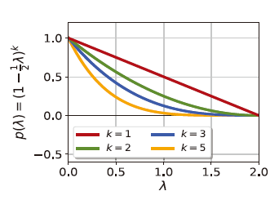
Graph Convolution
graph signal f = [f(v₁), f(v₂),..., f(v_{n})]^{T} -> X (node content)
real-valued function f(v_{i}) = x_{i}
graph filter G = Up(Λ)U⁻¹ -> A (structure)
frequency response p(Λ) = diag(p(λ₁), p(λ₂),..., p(λ_{n}))
p(λ) = (1-1/2λ)^{k} (decreasing and nonnegative)
λ ↓ p(λ) ↑

Slide 6


Graph convolution is defined as the multiplication of a graph signal f with a graph filter G :
‾f is the filtered graph signal
eigenvalues λ_{q} -> frequencies
eigenvectors u_{q} -> Fourier basis of the graph
|z_{q}| -> the strength of the basis signal u_{q} presented in f
z = [z₁, z₂,..., z_{n}]^{T}

Slide 7
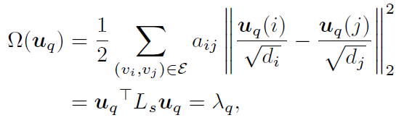

A graph signal f is smooth if nearby nodes on the graph have similar features representations
smoothness of a basis signal u_{q} can be measured by Laplacian-Beltrami operator
graph convolution with a low-pass graph filter G
λ_{q} ↓ Ω(u_{q}) ↓ -> smoother

Slide 8



1-order graph convolution (k=1)
= ½(I + D^{-1/2}AD^{-1/2})

Slide 9



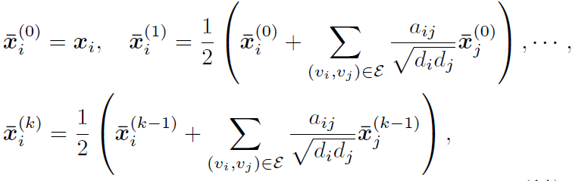
k-order graph convolution
= [½(I + D^{-1/2}AD^{-1/2})]^{k} X
k↑ -> smoother

Slide 10
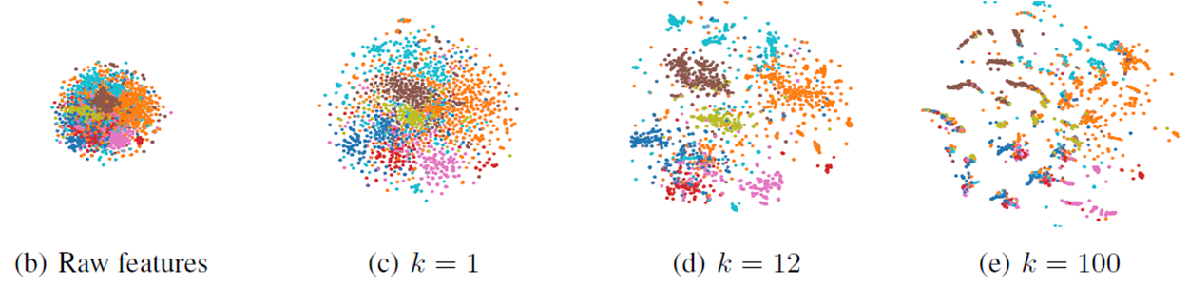
k-order

Slide 11
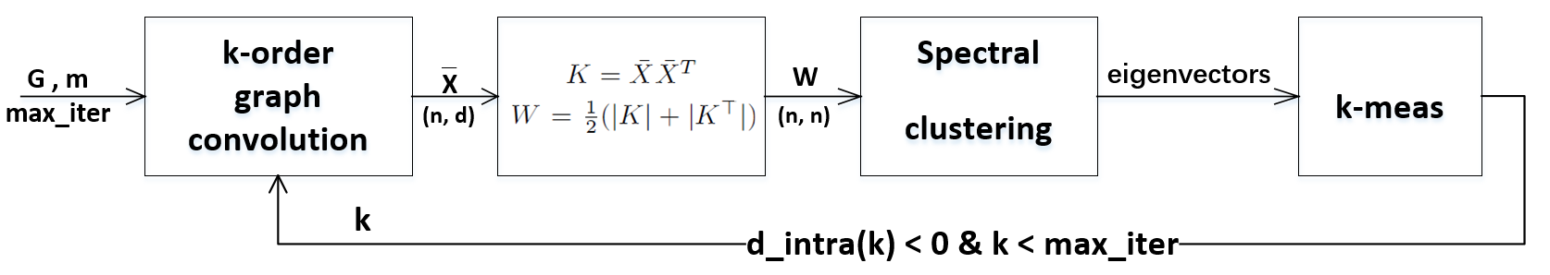

Model
m largest

Slide 12
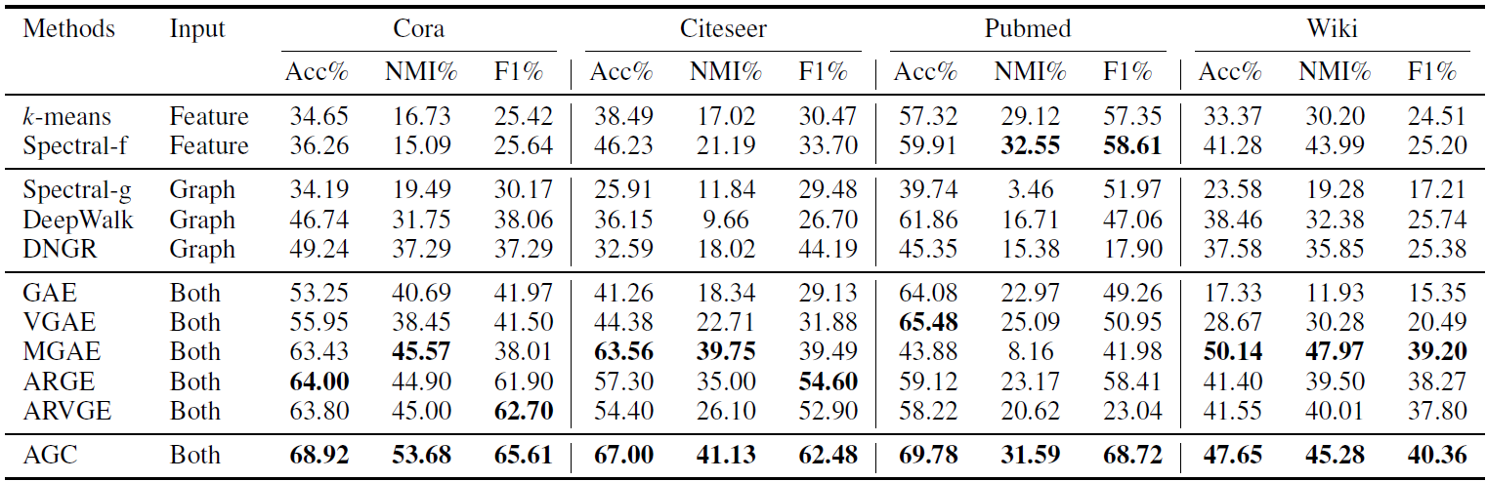
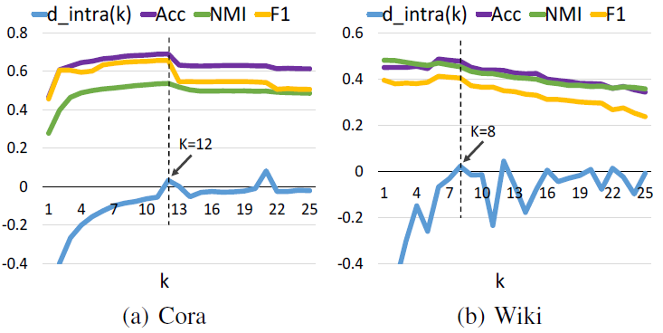
Experiments
5.78
62.06
584.87
10.75

