Slide 1

Genetic Algorithm
OPTIMIZATION LAB
2022-01-14

Slide 2


Content
NumPy Arrays review (again).
Introduction to Genetic Algorithm.
Population Initialization.
Parents Selection.
Crossover.
Mutation.

Slide 3
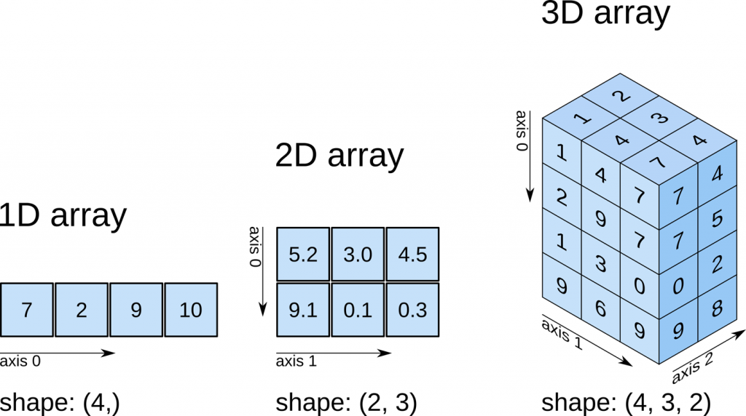
N-dimensional arrays indexing

Slide 4
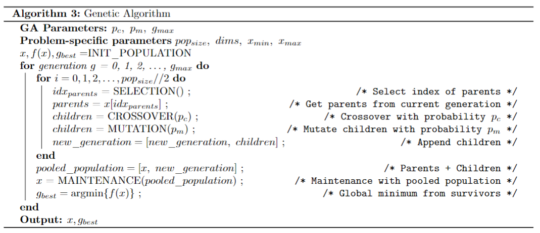
Genetic Algorithm

Slide 5
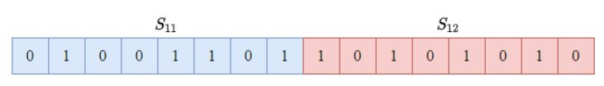



Solution Representation for Continuous Problem

Slide 6
Population Initialization
Population size
Dimensions
Precision (length)

Slide 7
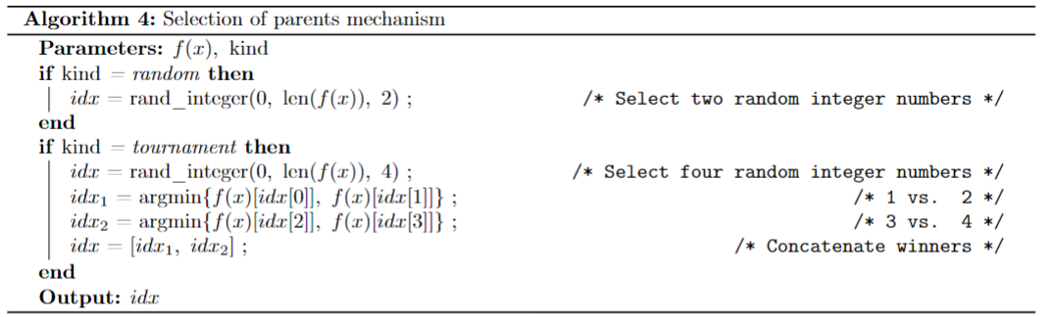
Parents Selection

Slide 8
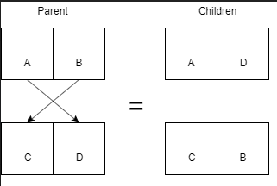
Crossover

Slide 9
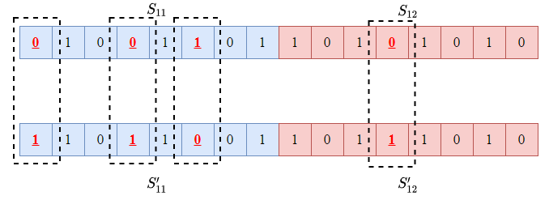
Mutation – Bit Flip

