Slide 1
Synchronous Sequential Circuits:
week 3 , part 1/3
Concept part

Slide 2
Synchronous
→ clocked,
deterministic timing,
easier verification.
Asynchronous
→ event-driven,
fast in small loops but prone to hazards and race conditions.
Synchronous Sequential Circuits:
Sync vs Async
Introduction & Context
What it is. A synchronous sequential circuit is a state-holding logic system whose flip-flops update only on a global clock edge. Its behavior at the next tick depends on the present state and the current inputs.
Why it matters. Clocked updates make timing deterministic and composable, so large designs can be verified, pipelined, and scaled without surprises from ripple delays.
How we will talk about it. We adopt the course vocabulary—state equation and flip-flop excitation equation—as the standard way to describe updates and required FF inputs (no derivations here, only terms, hints).٩( 'ω' )و
Where it lives.Typical blocks include registers, counters, shift registers, and FSM-based controllers in CPUs, controllers, image sensors, and digital interfaces.
Synchronous Sequential Circuit = 동기 순차 회로 • State Equation = 상태 방정식 • FF Excitation Equation = 플립플롭 여기식

Slide 3
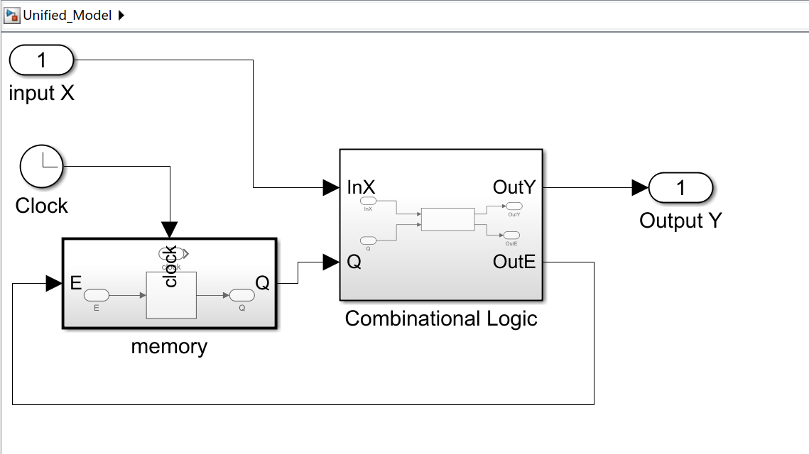
Core Model Structure
Idea: Inputs + Current State → Logic → Next State + Outputs, updated on clock
Main Components
Combinational Logic (CL): Processes current state Q and input X, produces two results:
Y: functional output to the outside.
E (Excitation / Next State): input to memory, decides the next state.
Memory (Flip-Flops, Q): Stores the present state. Updates only at the clock edge.
Clock (clk): Single timing reference, triggers all flip-flops at the same moment.

Slide 4
Core Model Structure
Idea: Inputs + Current State → Logic → Next State + Outputs, updated on clock
Why this wiring?
Clock only to Memory: Clock defines when state changes. Logic is free-running, memory locks values at edges. If the clock drives logic, transparency and hazards occur.
Feedback (Q → CL): Ensures outputs depend on both inputs and history (state).
Two outputs (Y and E):
Y = what the system shows to the outside.
E = what the system uses internally to decide the next state.
Example: In a counter, E = Q+1 (next count), Y = Q (current count
Output Styles
Mealy model: Y depends on inputs and state → Y = G(X,Q).
Moore model: Y depends only on state → Y = H(Q).
Both are standard ways to define synchronous sequential circuits.

Slide 5
how it work
Inputs + Current State → Logic → Next State + Outputs, updated on clock
Data lanes (what moves where)
State lane: Q → CL → E(NS) → FF → Q (state evolves, fed back).
Output lane: X,Q → CL → Y (what the outside sees).
Clock lane: clk → all FFs (one global commit event).
One clock cycle (k → k+1)
After edge k: All flip-flops expose Q[k]. CL starts rcomputing E[k→] and Y[k→] from X & Q[k].
Within the cycle: X may change; CL is free-running and updates tentative E and Y. Glitches are allowed here; nothing is committed yet.
Setup window before edge k+1: E must have settled long enough for FFs to safely sample.
At edge k+1 (commit): FFs sample E → Q[k+1]. All state bits update at the same instant.
Feedback: New Q[k+1] feeds CL; the process repeats for the next cycle.

Slide 6
how it work
Inputs + Current State → Logic → Next State + Outputs, updated on clock
Why the clock drives only Memory
The clock defines when the system commits a new state; CL defines what that state should be.
Clocking gates would create transparency/hazards; clocking FFs keeps updates atomic and analyzable.
Why two results from CL (Y vs E)
E (Next-State / Excitation): internal, drives FF inputs—decides the future.
Y (Functional output): external, expresses the current function.
Example: counter → E = Q + 1 (next count), Y = Q (current count).
Output styles in practice
Mealy: Y is taken directly from CL (depends on X & Q), may change within the cycle; register it if the interface needs edge-aligned stability.
Moore: Y is decoded from Q only; it changes on clock edges by construction.

Slide 7
Key Characteristics
Free-Running Logic
Combinational logic continuously responds to changes in inputs (X) and present state (Q). Its results (Y, E) may fluctuate during the cycle.
Edge-Defined Validity
Only the values present at the active clock edge are committed into memory. All intermediate fluctuations are ignored as transients.
Input Timing Constraints (Setup / Hold)
Inputs must remain stable for a short period before and after the clock edge to ensure reliable sampling.
Deterministic State Evolution
Every cycle follows a predictable pattern:
Q[k] → CL → E → FF → Q[k+1].
This makes analysis and verification systematic.
Reset / initialization semantics
A well-defined reset (sync or async) places the machine in a known initial state before edge-driven operation. Optional enable gates state updates by qualifying the E → Q commit.
Setup / Hold Time = 셋업 / 홀드 시간 Deterministic = 결정적

Slide 8
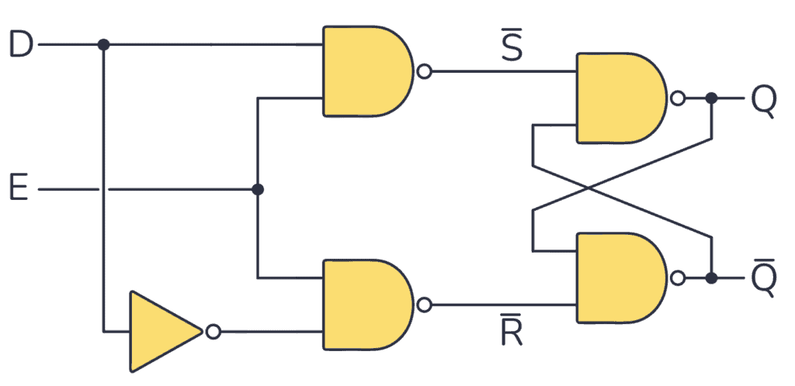
Example
Register (D Flip-Flop Bank)
CL
input (data)
output data
in this case there are no actual logic
D Flip-Flop
clk

Slide 9
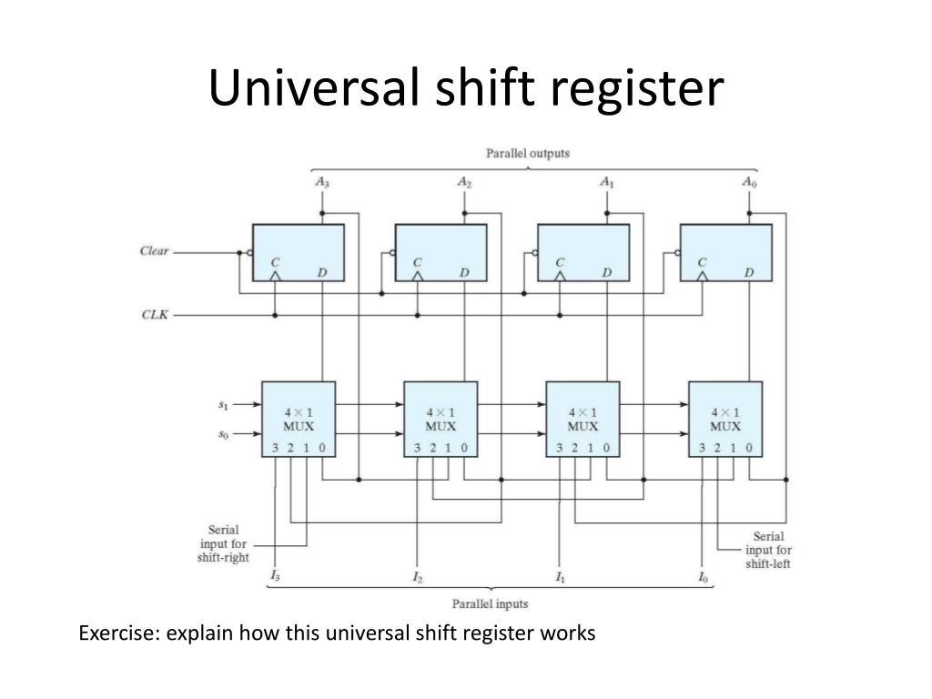
Example
Register 4bits
CL
SRinSLin
s0 s1
MUX
output data
input (data)
s1 s0 Mode Selection Tablet
FF
clk

Slide 10
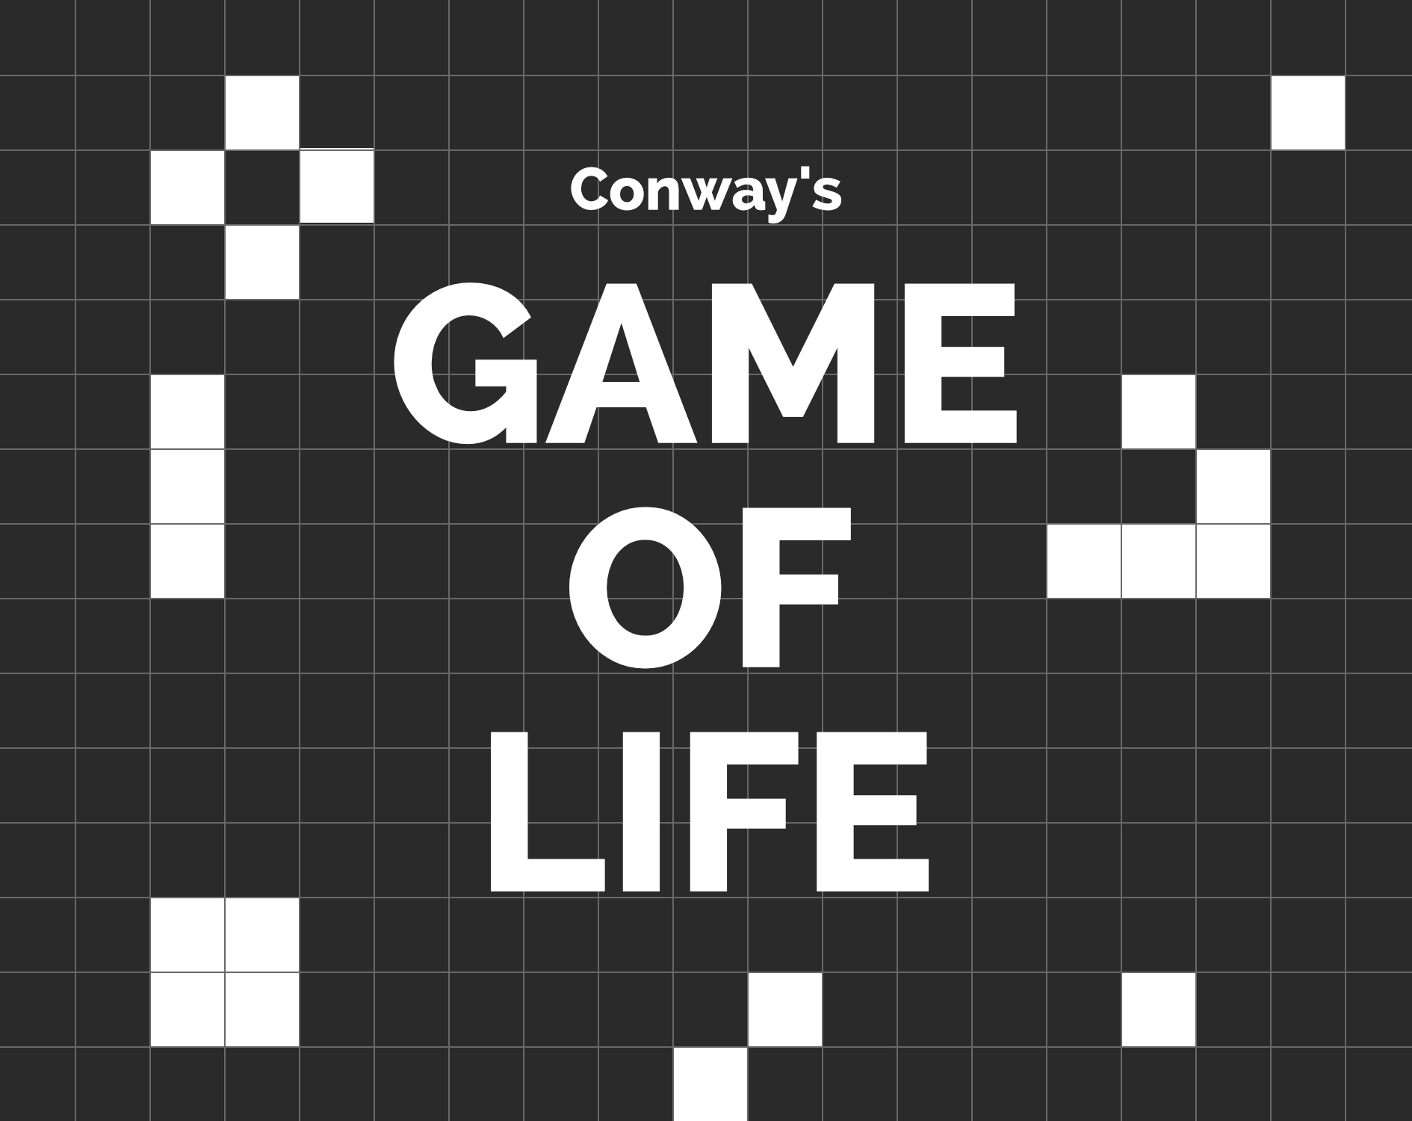
Application: Conway’s Game of Life
https://conwaylife.com/
Rules of the Game
Each cell is either Alive (1) or Dead (0).
Each cell has 8 neighbors (Moore neighborhood).
Updates happen synchronously across the grid.
Transition rules:
Alive with <2 neighbors → Dies (underpopulation).
Alive with 2 or 3 neighbors → Survives.
Alive with >3 neighbors → Dies (overcrowding).
Dead with exactly 3 neighbors → Becomes Alive (reproduction).
Why we use this as an application
It is a clear real-world analogy of synchronous sequential circuits:
The present state is the current grid.
The combinational logic (CL) is the neighbor-count + rule logic.
The next state (E) is the new grid.
Th flip-flop bank (Q) stores the entire board.
The clock updates all cells simultaneously → one “generation” per tick.
This example shows how abstract rules can be directly mapped to hardware circuits using the synchronous model.

Slide 11
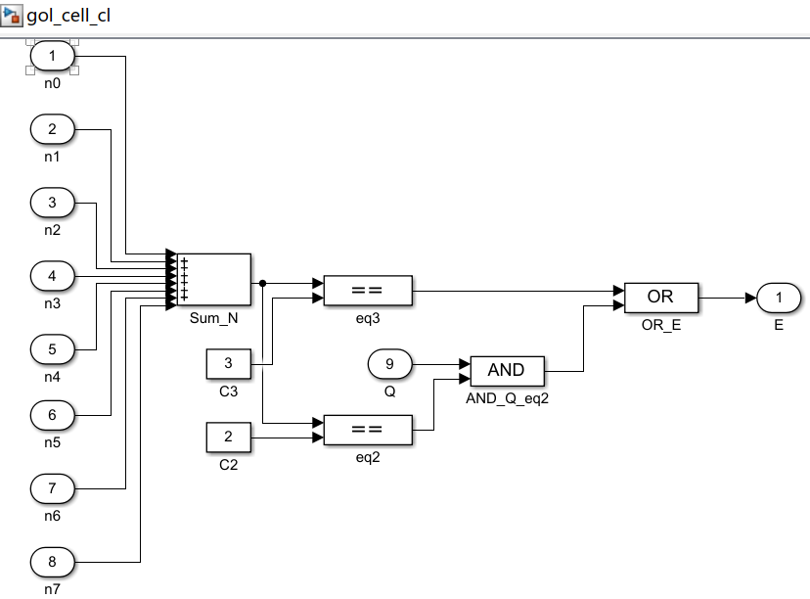
Application: Conway’s Game of Life
https://conwaylife.com/
From the rules to one equation
Given the Game-of-Life rules, the next state of a cell is:
E=(N==3) ∨ (Q∧(N==2))
Q: present state of this cell (0/1)
N: number of live neighbors (0–8) We use D flip-flops, so excitation = next state:D=Q⁺ The output can be taken as Y=Q(Moore style). Neighbor bits come from the current board state
Q, so no extra external X is required (beyond optional EN/LOAD/RST).
Abstract CL block (per cell)
Inputs (9): 8 neighbor bits and the cells own Q
CL function:compute N=∑nk compare with 2 and 3, then E=(N=3) ∨ (Q∧(N=2)) Output: Y=Q.
Initialization
Set each cell’s register to an initial pattern Qinitpower-up init or one-shot LOAD). Then tick the clock to evolve.
Conbinantional Logic

Slide 12
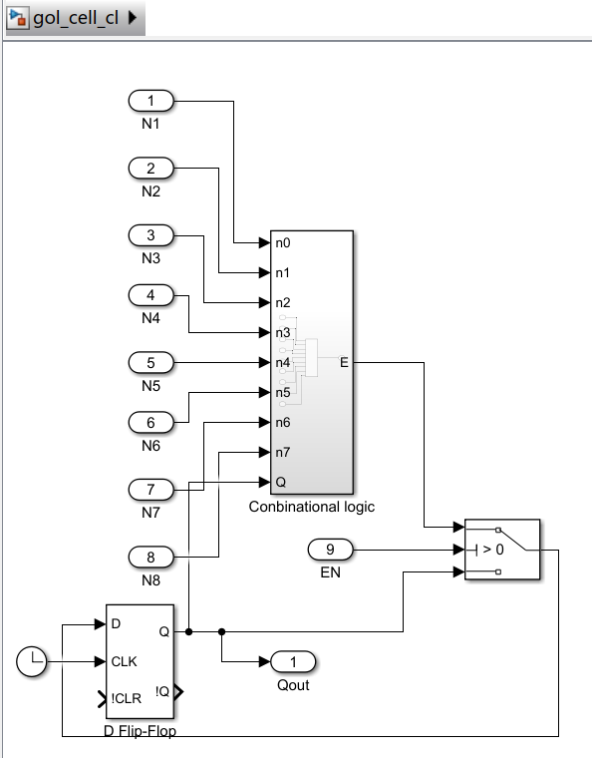
Application: Conway’s Game of Life
https://conwaylife.com/
CL
input (8data)
output data Qout
E=(N==3) ∨ (Q∧(N==2))
memory
1bit
1/0
clk
Logic and memory of a cell

Slide 13
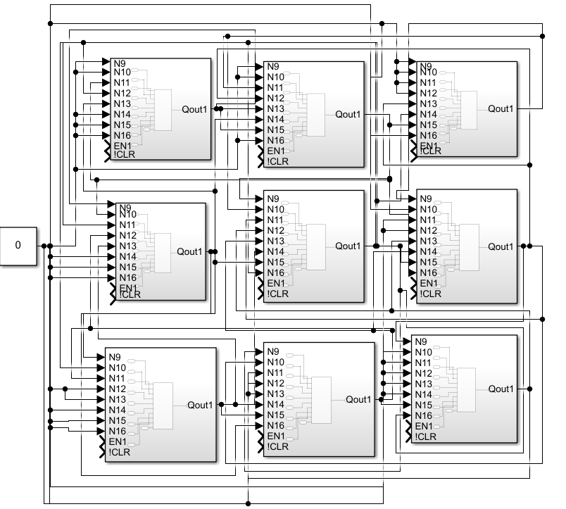
Application: Conway’s Game of Life
https://conwaylife.com/
map sturcture here is a 3*3 small map
result in
https://github.com/solomon0256/Game-of-Life-circuit-MATLAB-sim
So far, we have:
Defined synchronous sequential circuits and why they matter.
Introduced the core structure (Combinational Logic + Flip-Flops + Clock).
Clarified key characteristics (free-running logic, edge-defined validity, input timing constraints, predictable state evolution, reset).
Built examples (register, shift register, counter).
Extended to an application (Game of Life cell update rule) and implemented the CL logic + storage for a single cell, then connected them in a 3×3 grid

Slide 14
What comes next
Next, the focus is on analysis methods
In design so far, we only showed what the structure is and how to build it. The next step is to learn how to analyze its behavior systematically.
고마워요~ (＾▽＾)ノ

