Slide 1
Weekly Report
WEN YUHE 2026/2/11

Slide 2
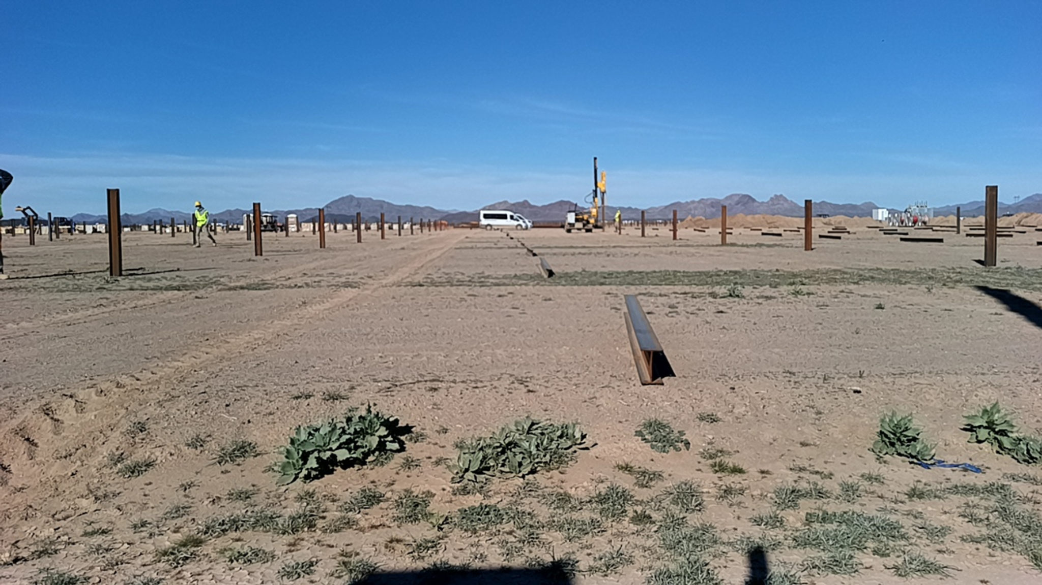
My task
major task: Xpanner Pile Detection & Distance Estimation System -Based on the current Xpanner dataset, build a pile detection module to:
monitor the two horizontal piles in front of the machine and estimate their distance,
and detect nearby vertical piles,
machines, and workers.
1
Notes:
2

Slide 3
Phase 1 (Data & Annotation Preparation)
1. Data Processing
Extract frames in 0.5FPS from Xpanner datase
Synchronize camera and 4D radar data
Organize images, radar point clouds, and calibration
2. 2D Annotation (Camera)
Use Roboflow to annotate pile, worker, machine
3. 3D Annotation (LiDAR)
Use LiDAR point clouds
Apply clustering to generate 3D bounding boxes
4. Merge Annotation
Align 2D boxes and 3D boxes verify major errors
Match corresponding objects Create unified training pairs for fusion models
2

Slide 4
Phase 2: 2D Detection Module
total labeled images amout: 4226 split: Train:3380,80% Val:445,10% test:401,10% Training: Model:YOLOv8 Input size:960 Epochs/Batch:60/16
Classes:
horizontal_pile
vertical_pile
machine
worker
。
3

Slide 5
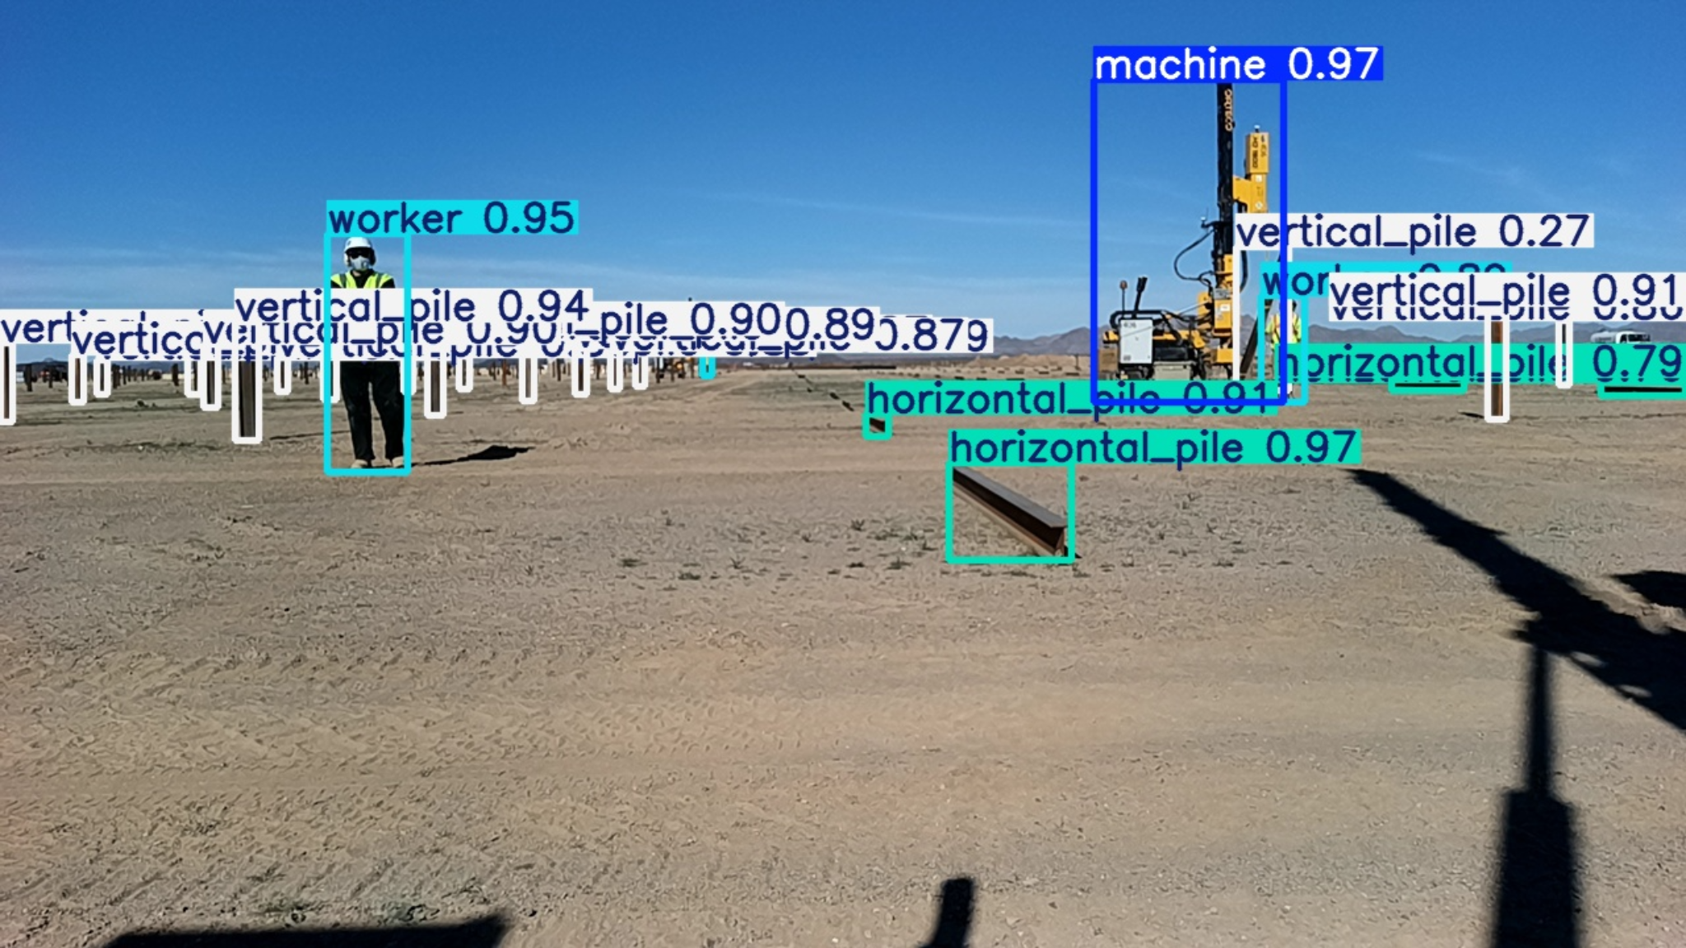
Phase 2: 2D Detection Module
Results:
In total:
mAP=0.94 mAP50-95 = 0.815
P = 0.905
R = 0.866
for every object:
horizontal_pile：0.838 vertical_pile：0.805
machine：0.812
worker：0.822
4

Slide 6
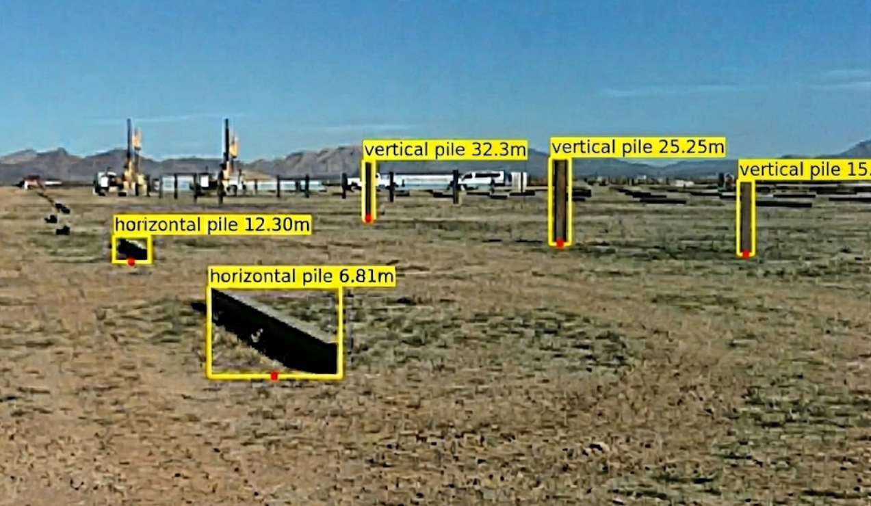
Phase 2: 2D Detection Module
Distance Estimation
Input: Camera Intrinsics(K) Camera height+pitch angle YOLO 2D bounding box Pipeline: 1.Select bottom-center pixel from bounding box 2.Back-project the pixel to a 3D ray and intersect with the ground plane to get distance.
5

Slide 7
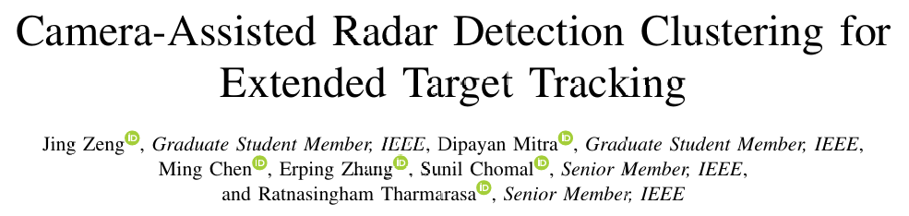
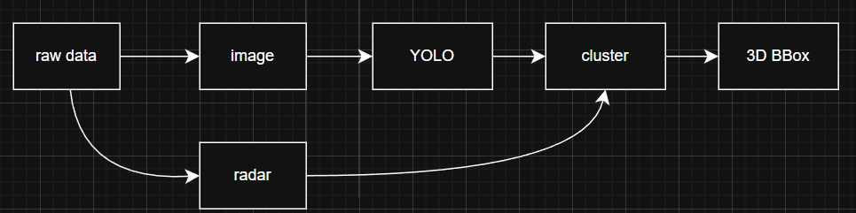
Phase 3: 3D annotation
Because manual 3D annotation is extremely time-consuming, I chose to use this clustering method to generate the annotations.
Camera-assisted Radar Detection Clustering works like this: decode the camera image, then YOLO gives 2D detection boxes. radar points are projected onto the image, points inside each 2D box are kept as candidates. These points are clustered in two steps: first by radar features (velocity, RCS, SNR), then by spatial distance (DBSCAN). The best cluster is treated as the object. Finally, Kalman + Doppler fusion stabilizes object position and motion, and a class-based size prior is used to generate the final 3D bounding box
6

Slide 8
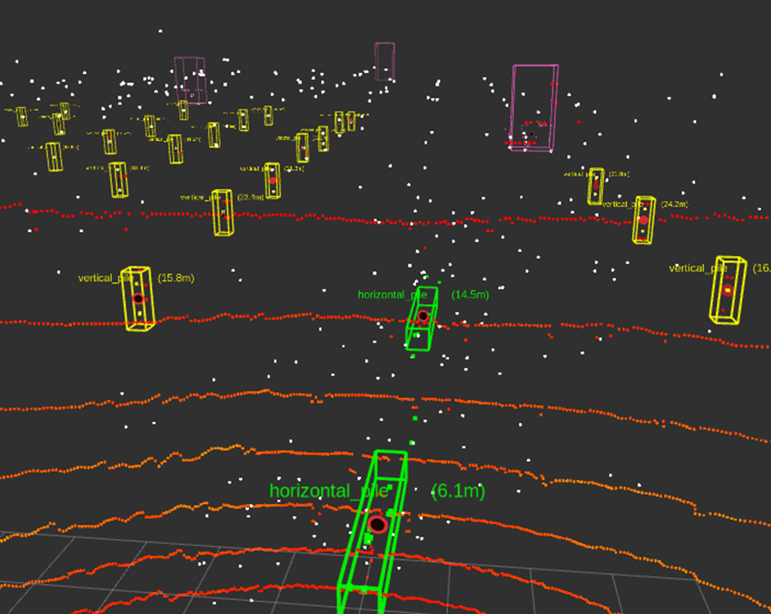
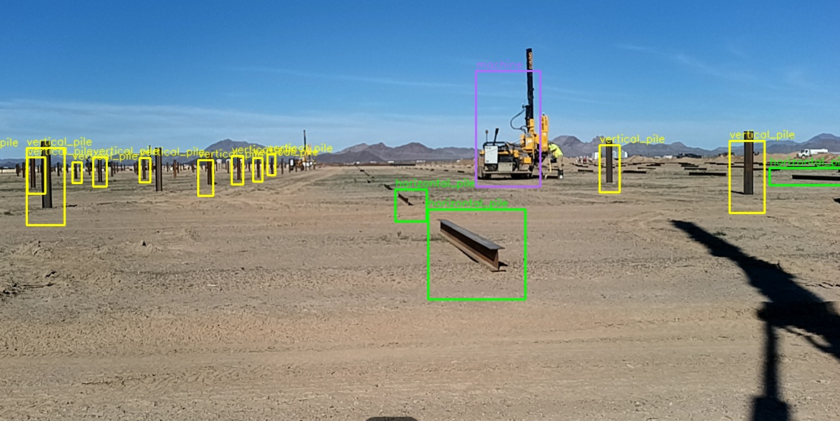
Next plan
result:
- Fix wrong BBOX and build training material - Do survey and find suitable camera + 4D radar fusion model for training
7

Slide 9
Thank you for listening!

