Slide 1
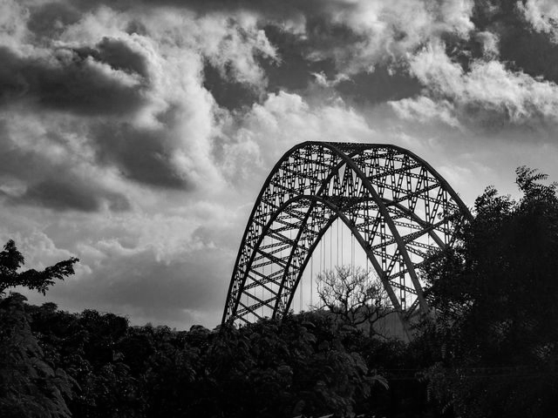
Ghana Adventures
Booking & Customer Analysis
Solomon Gyamfi

Slide 2
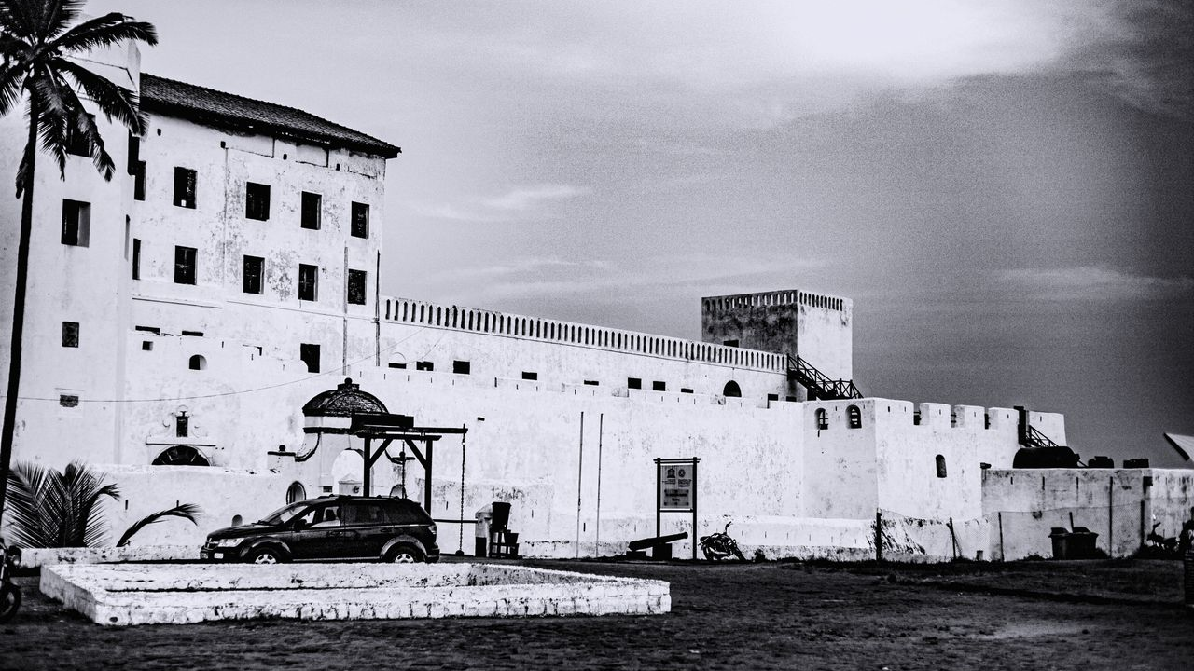
1
Executive Performance Overview
2
Seasons & Tour Packages
Agenda
3
Customer Retention and Spending Patterns
4
Strategies to Boost Off-Season Bookings
5
Business Insights & Recommendations

Slide 3
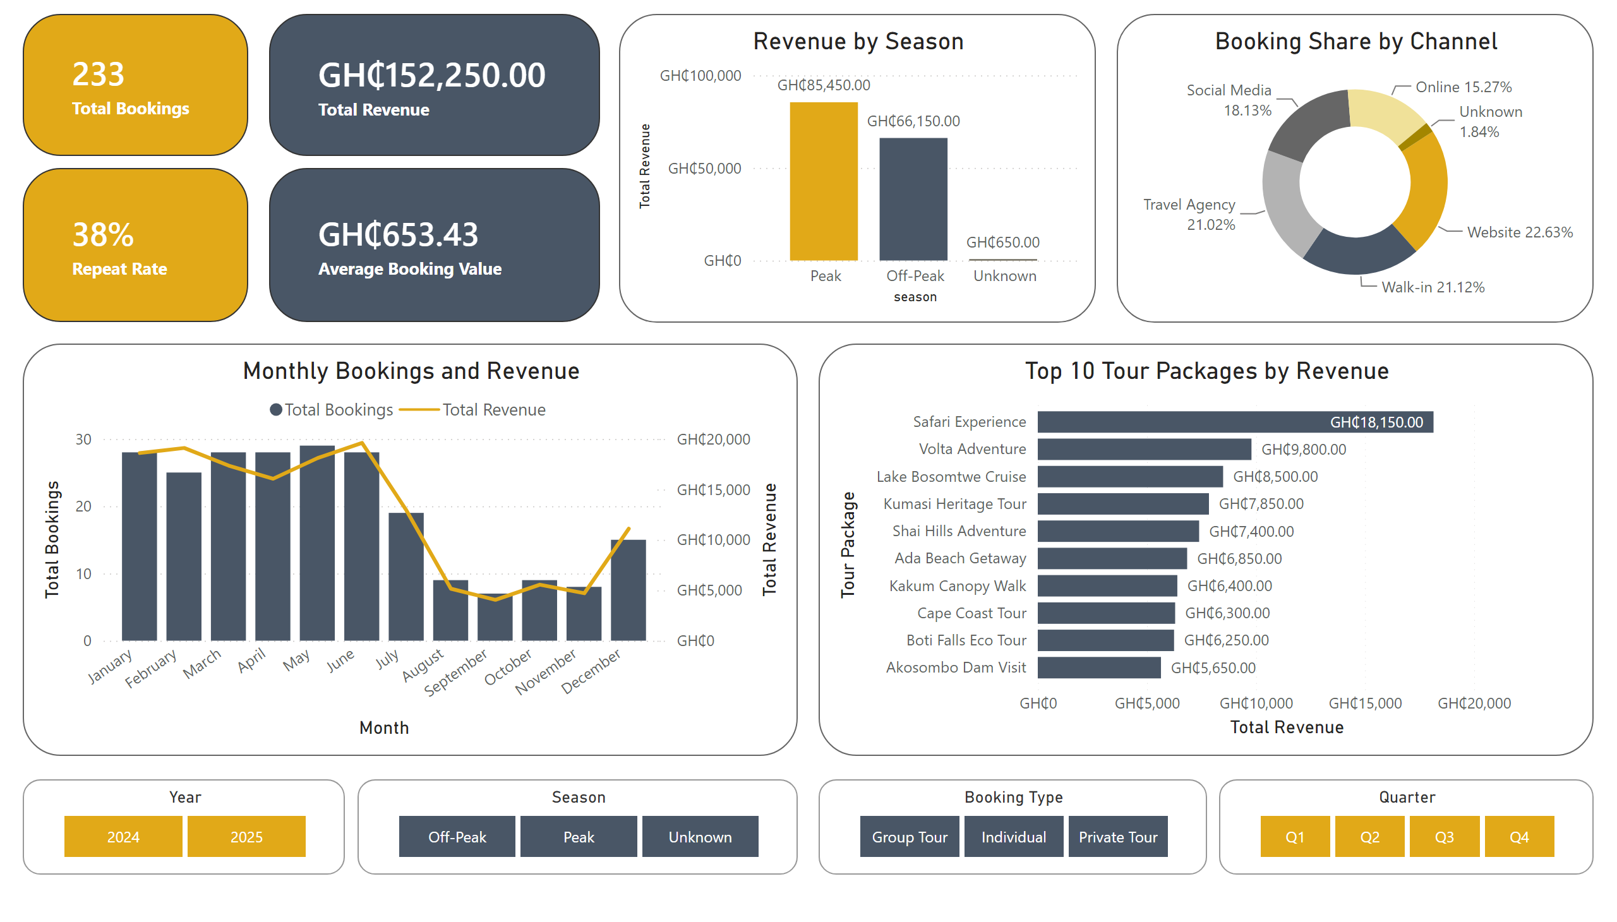
Executive Performance Overview

Slide 4
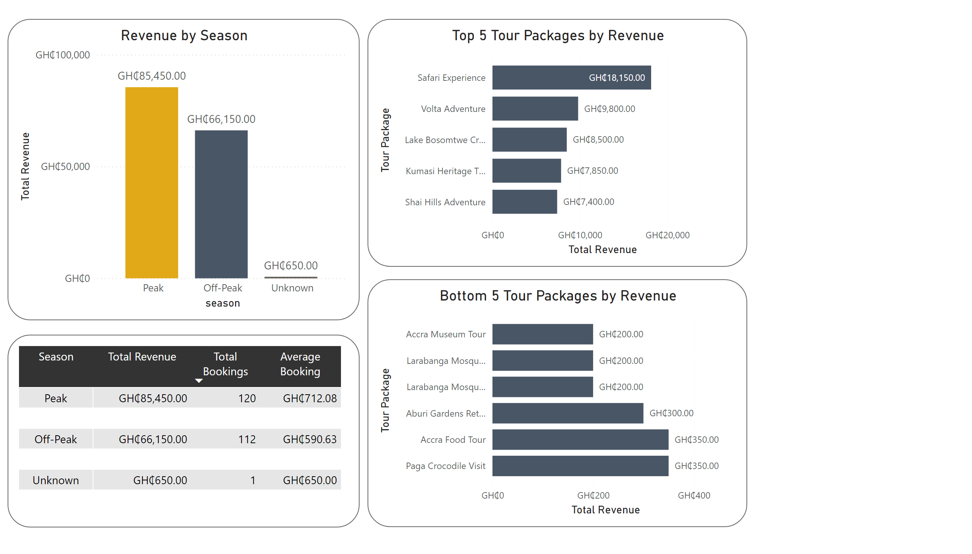
Seasons & Tour Packages
Key Insight – Seasons
Peak-season customers spent about 20.56% more per booking than Off-peak customers.
Key Insight – Tour Packages
Safari Experience was the best-selling tour package by revenue, while Larabanga Mosque Tour & Visit, and Accra City Tour were among the weakest performers due to their low revenue per booking.
Notes:
o increase bookings during this period, Ghana Adventures should run targeted digital promotions, offer early-booking and midweek discounts, create family and group packages, and bundle tours with transport, meals, accommodation, or photography services.

Slide 5
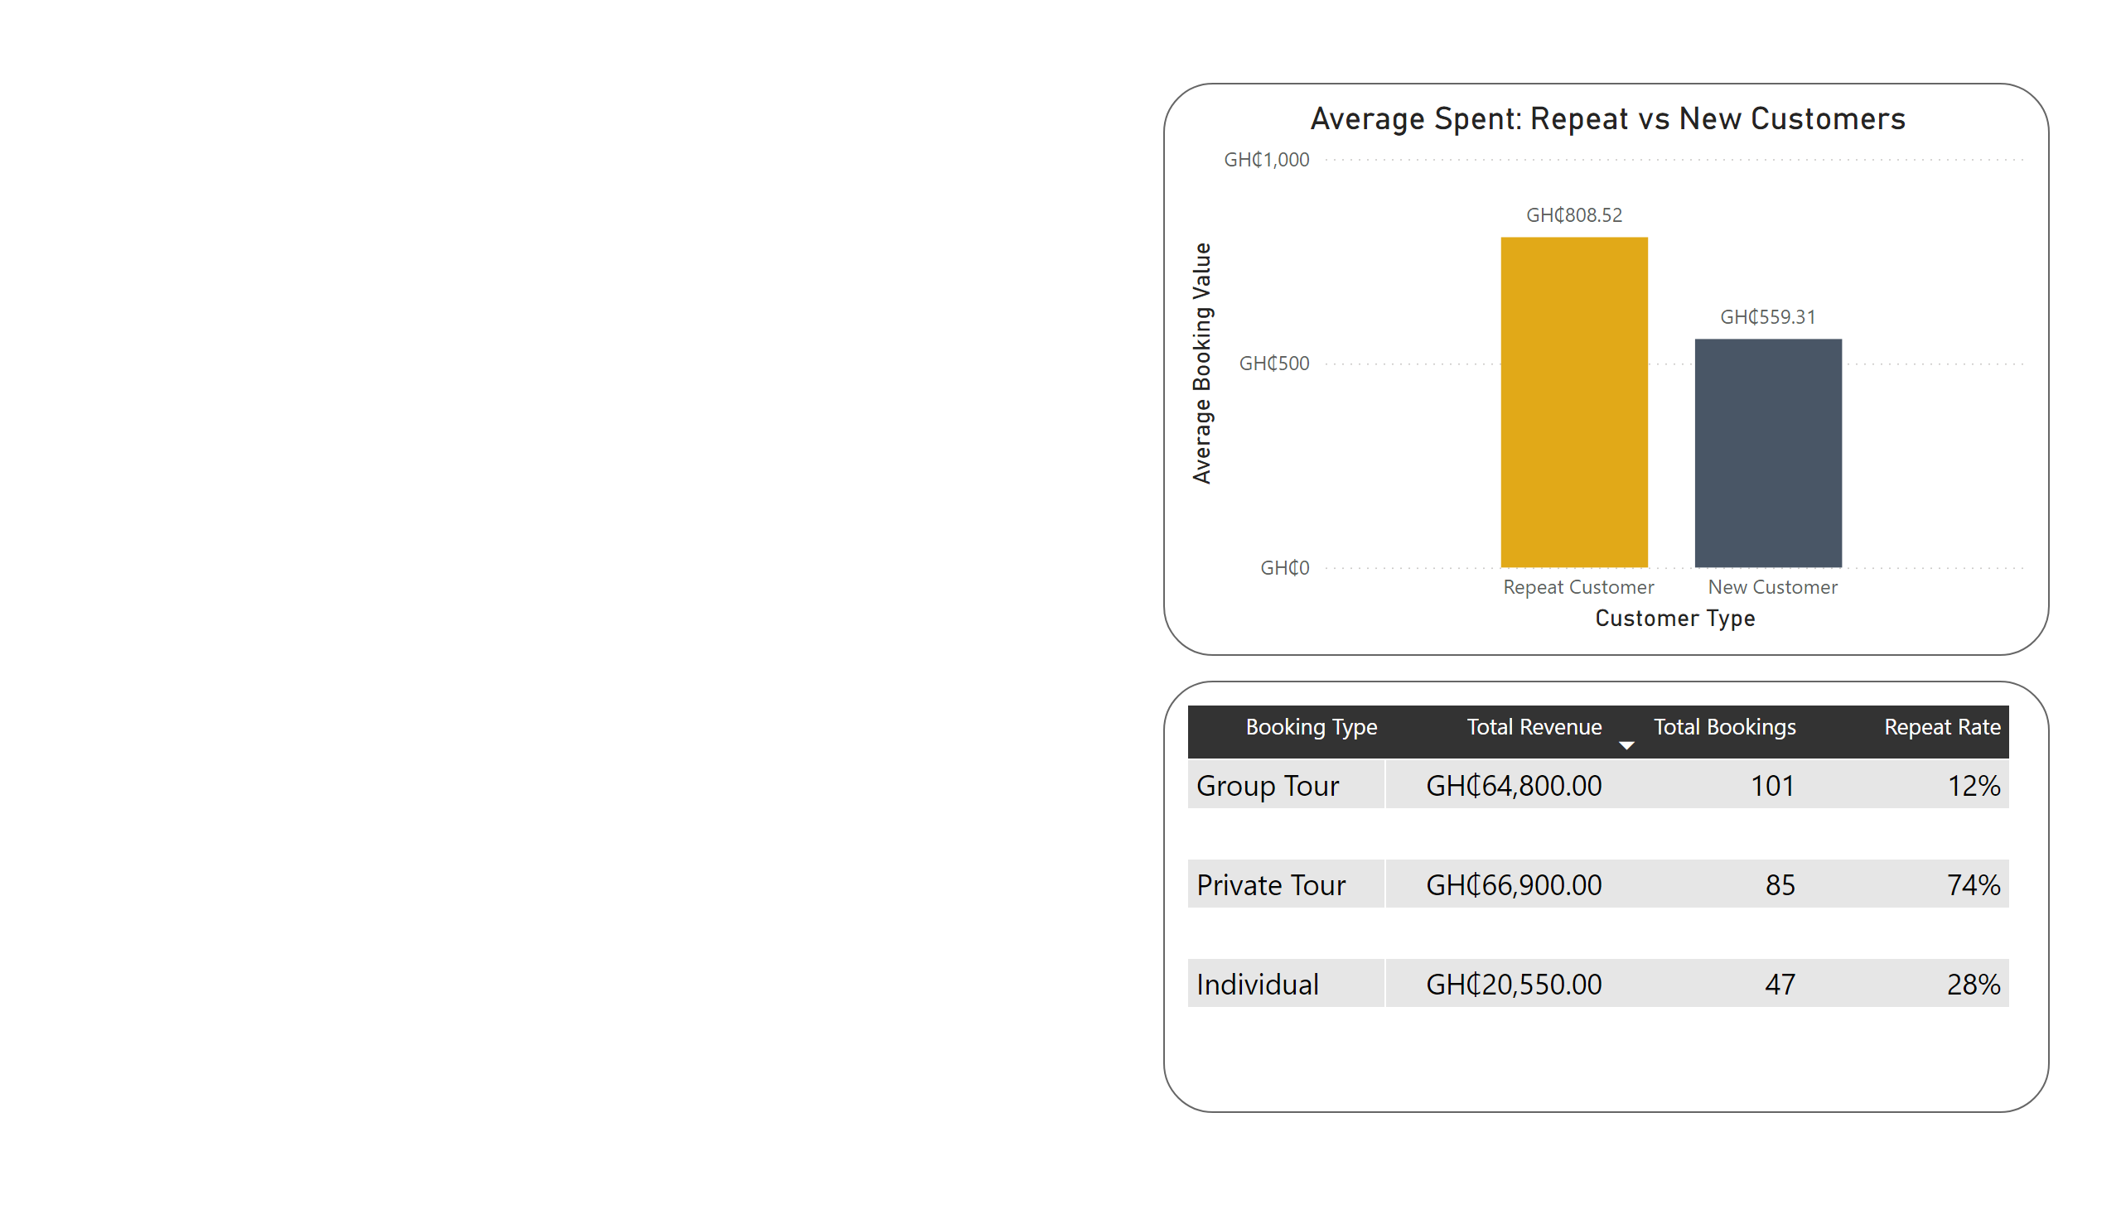
Customer Retention and Spending Patterns
Key Insight
Repeat customers spend an average of GHS 808.52 per booking, compared with GHS 559.31 for new customers, representing approximately 44.6% higher spending.
Recommended Actions
Build a loyalty programme around repeat-booking behaviour.
Introduce private-tour membership benefits and premium packages.
Use post-tour follow-ups to recommend customers’ next destinations.
Notes:
o increase bookings during this period, Ghana Adventures should run targeted digital promotions, offer early-booking and midweek discounts, create family and group packages, and bundle tours with transport, meals, accommodation, or photography services.

Slide 6
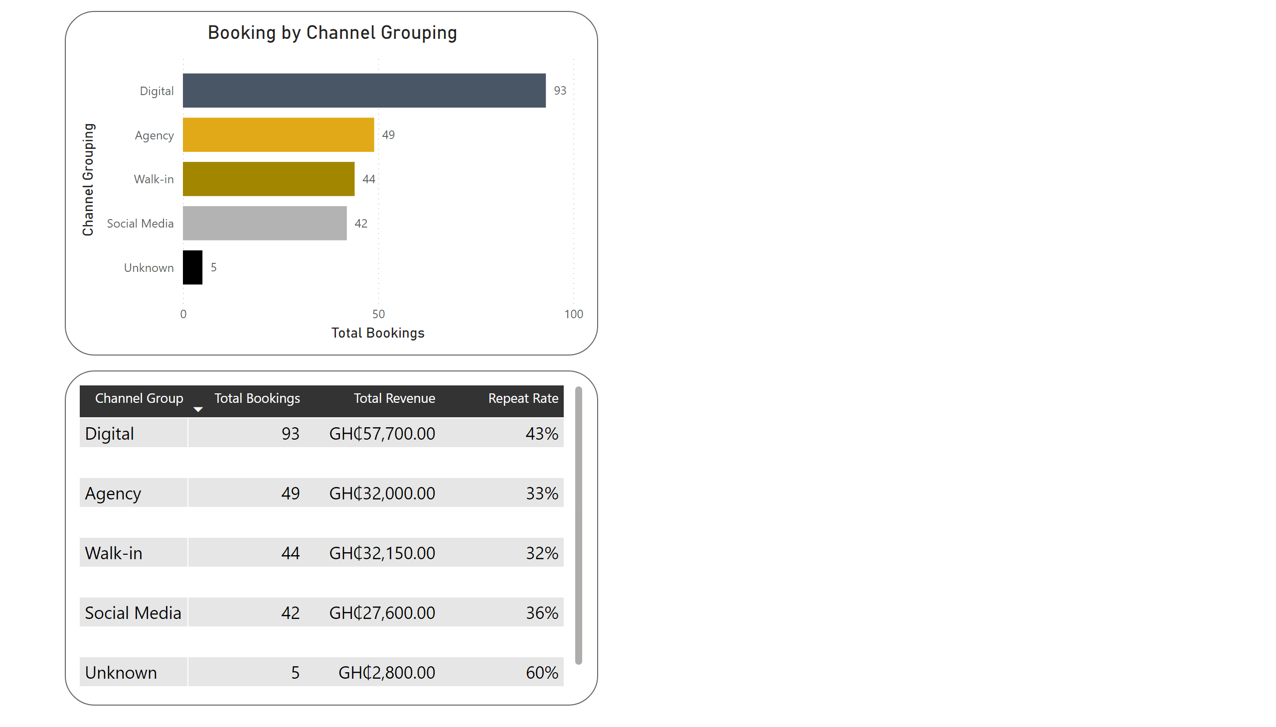
Strategies to Boost Off-Season Bookings
Off-Season Actions
Retarget previous customers through personalised emails, social media campaigns and digital advertisements.
Run time-limited promotions from August to November, with stronger campaigns in September, the weakest month.
Increase package value by combining tours with transport, meals, accommodation or guided experiences instead of relying on heavy discounts.
Introduce premium add-ons and private-tour upgrades for higher-spending customer segments.
Notes:
o increase bookings during this period, Ghana Adventures should run targeted digital promotions, offer early-booking and midweek discounts, create family and group packages, and bundle tours with transport, meals, accommodation, or photography services.

Slide 7
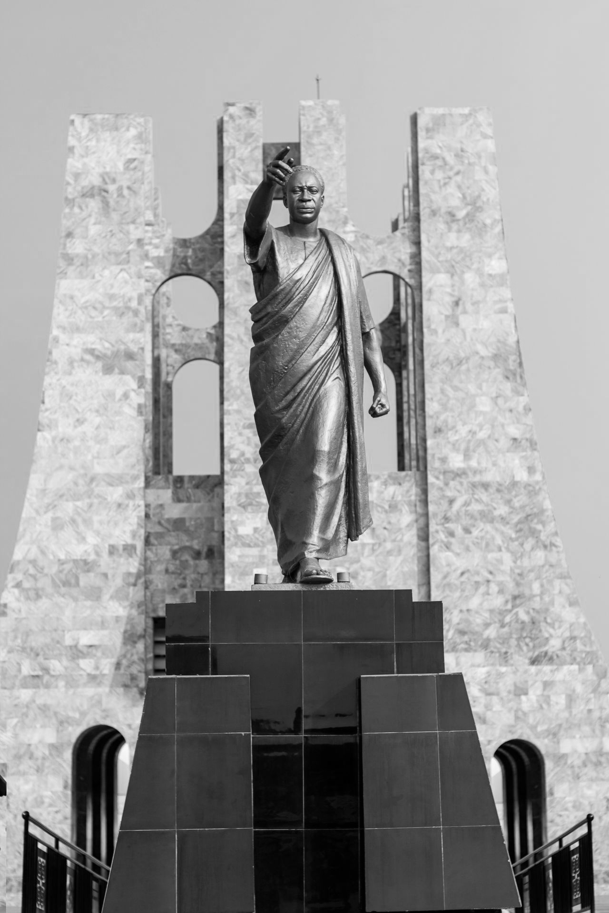
Business Insights & Recommendations
Safari Experience
Volta Adventure
Lake Bosomtwe Cruise
Kumasi Heritage Tour
Shai Hills Adventure
Customer Loyalty Plan
Expand
Introduce points, referral rewards and next-booking discounts
Send post-tour thank-you messages and personalised recommendations
Create exclusive benefits for private-tour customers
I do not recommend discontinuing any tour based on revenue alone. Before making that decision, I would first assess each package’s profit margin, operating capacity and customer feedback.
Discontinue Carefully
Data-Driven Marketing Plan
I recommend running targeted digital campaigns from August to November, with greater focus on September, the weakest booking month.
I would use customer booking history to send personalised offers through email, social media and online advertising.
I recommend introducing limited early-booking, weekday and group promotions to increase demand without relying on heavy discounts.
Bundle low-value tours such as Aburi Gardens, Accra City, Elmina Castle, Tafi Atome and Northern Cultural Tour.
Adjust

Slide 8
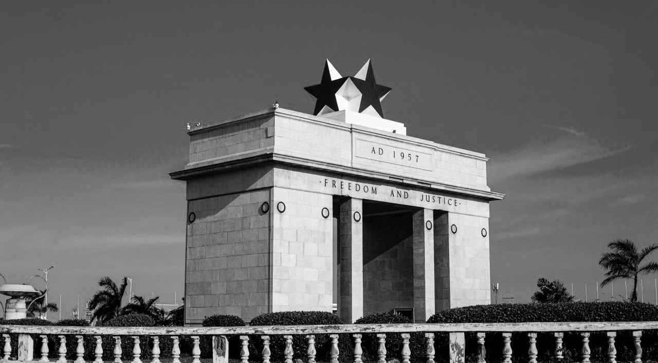
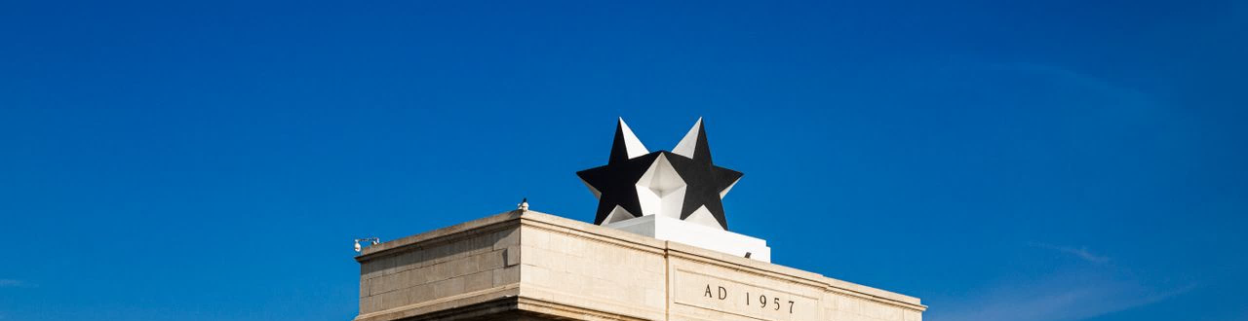
Ghana Adventures can grow by protecting high-value tours, improving lower-value packages, and using digital channels plus loyalty offers to strengthen off-season demand.
Thank You
Solomon Gyamfi

