Slide 1
Design, Implementation and Comparison of Software Emulation Techniques
by Oniga Andrei-Mihai
under the supervision of
Lect. Dr. Mihai Andrei

Slide 2
Motivation & Scope
Why was this done? Who for?
Why Brainfuck and CHIP-8?

Slide 3
Project Goals
Implementation
(interpreter / JIT compiler),
Program Analysis,
and Optimizations

Slide 4
Brainfuck Machine Model
Relatively infinite memory tape
with a pointer

Slide 5
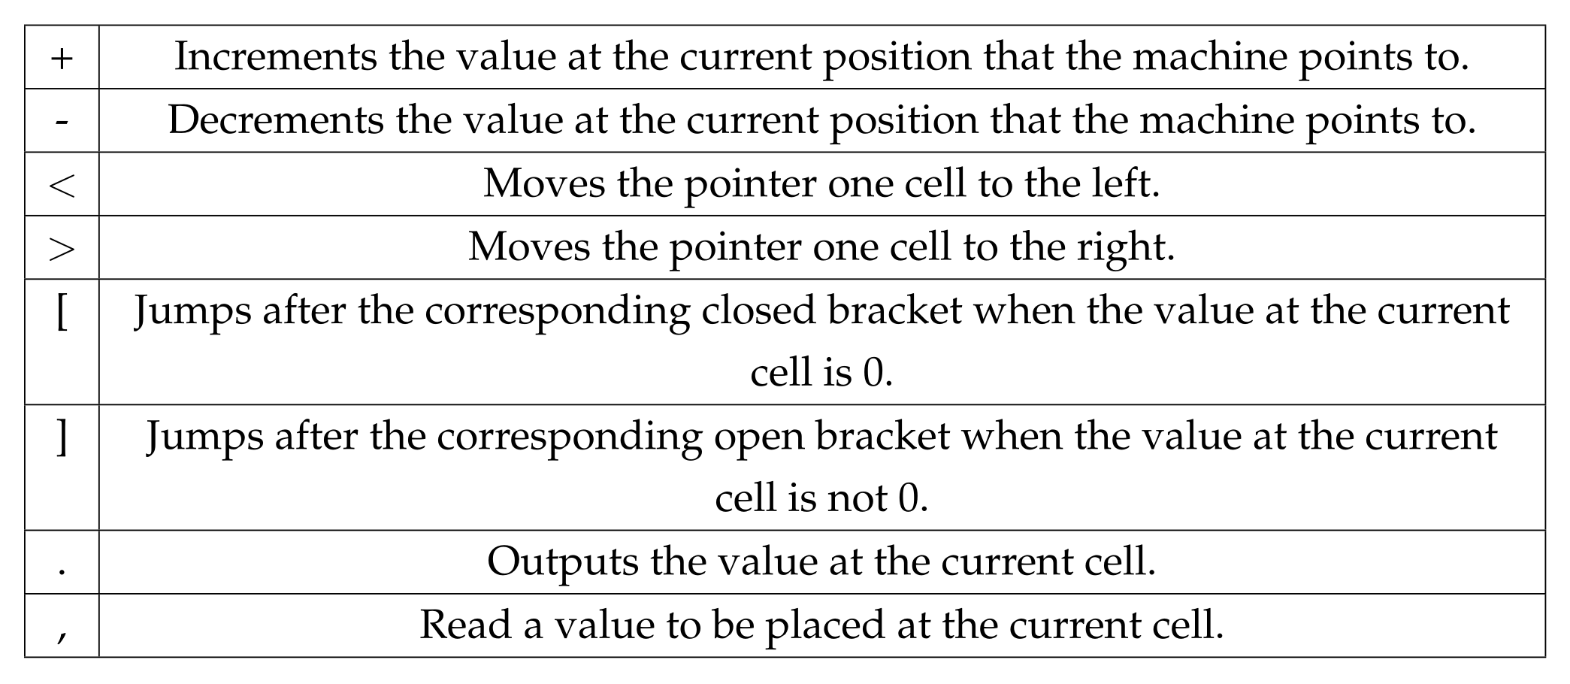
Brainfuck Language Overview

Slide 6
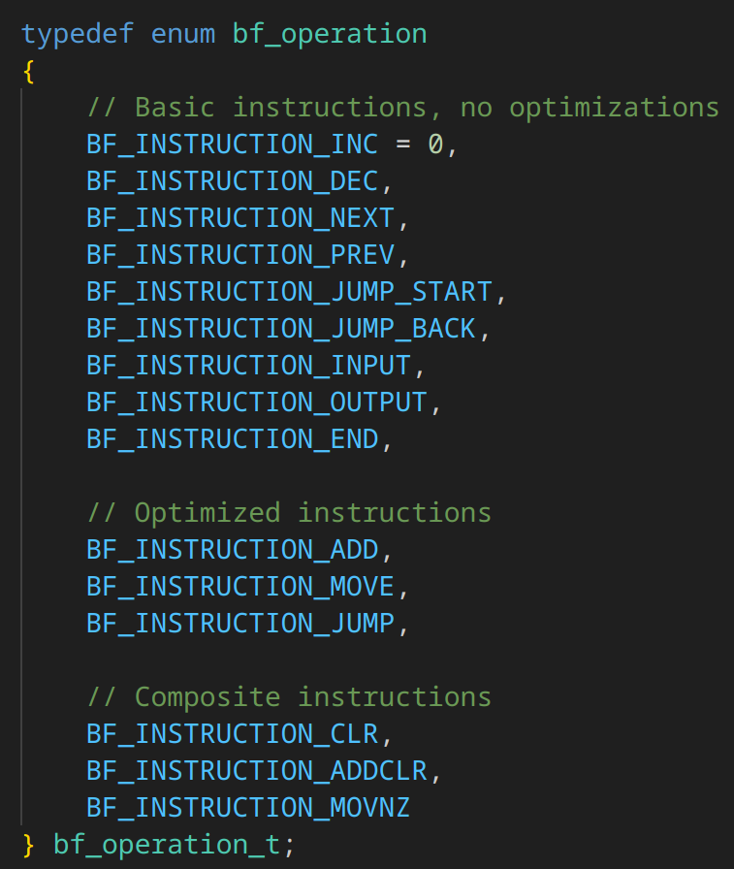
Intermediate Representation (IR)
Translating Brainfuck into Efficient Structures

Slide 7
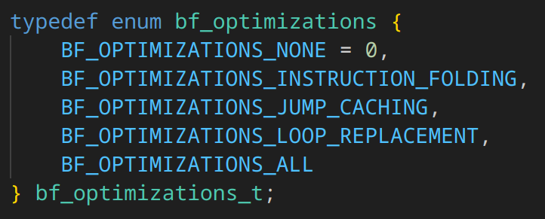
Optimizations Applied
Jump caching, Instruction Folding
and Pattern Matching

Slide 8
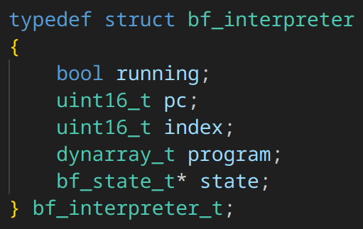
Interpreter Implementation
Basic Dispatch Loop and
The Fetch Decode Execute cycle

Slide 9
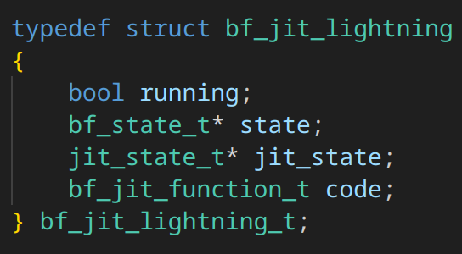
Static JIT Compilation
Choosing a library,
why GNU Lightning,
implementation Details

Slide 10
Optimization Insights
When Simplicity Beats Aggressiveness:
replacing too many loops becomes redundant
as the generated JIT code is identical

Slide 11
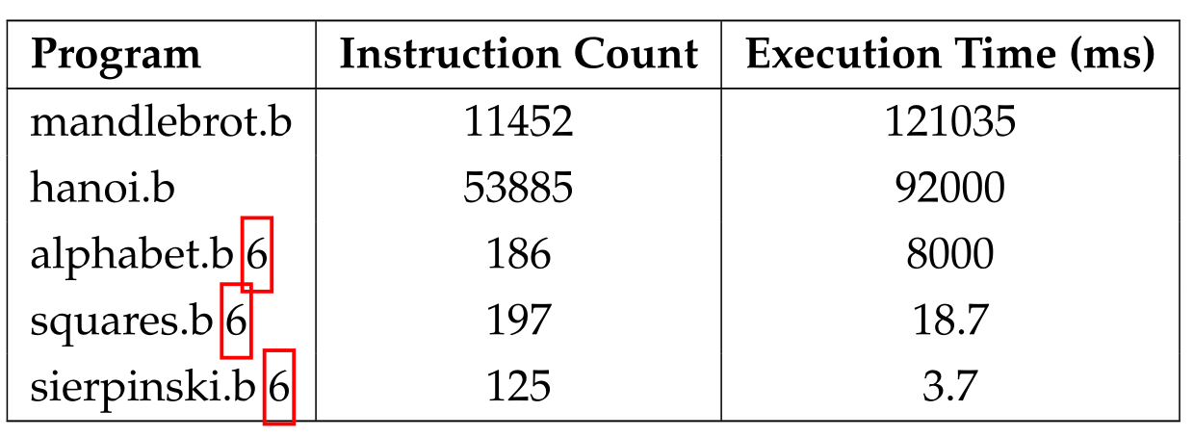
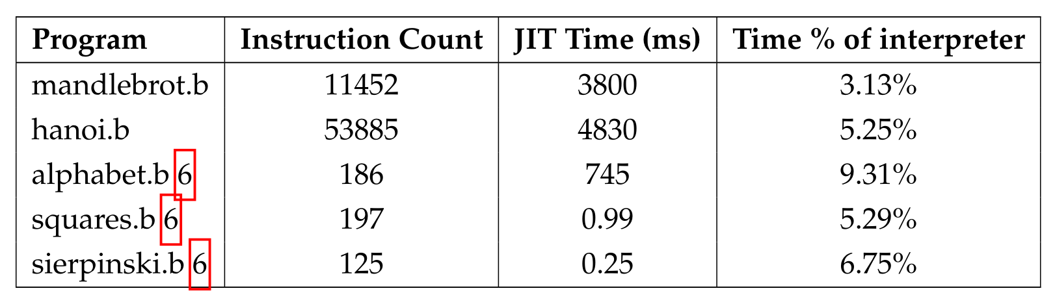
Performance Results (Brainfuck)
Results before all optimizations:

Slide 12
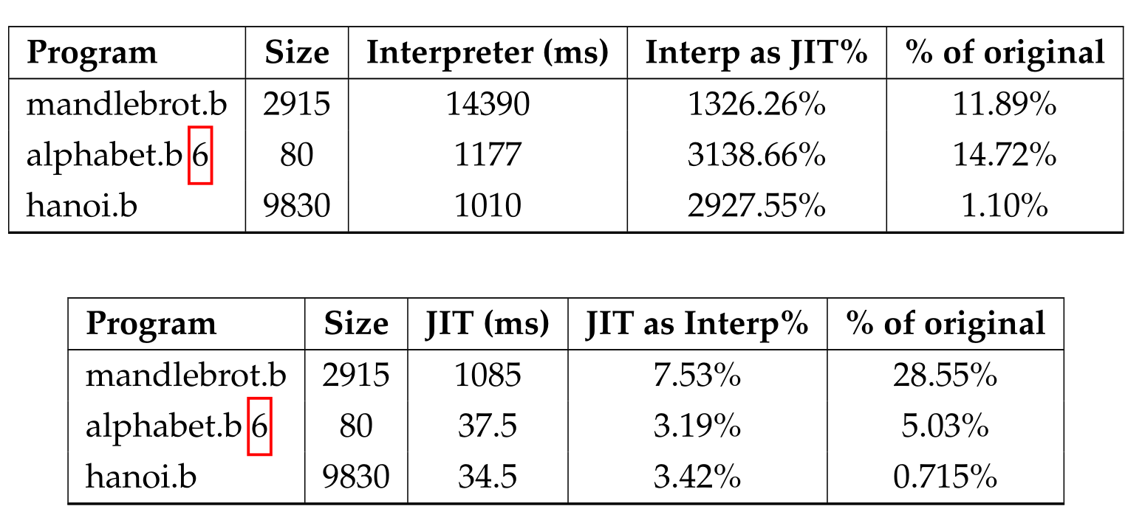
Performance Results (Brainfuck)
Results after all optimizations:

Slide 13
Brainfuck Testing Strategy
Ensuring Correctness with Unit Tests

Slide 14
CHIP-8 Architecture
64 KB Memory,
16 Registers,
35 Instructions, 2 Timers,
64 x 32 XOR Display
and 16-key Input

Slide 15
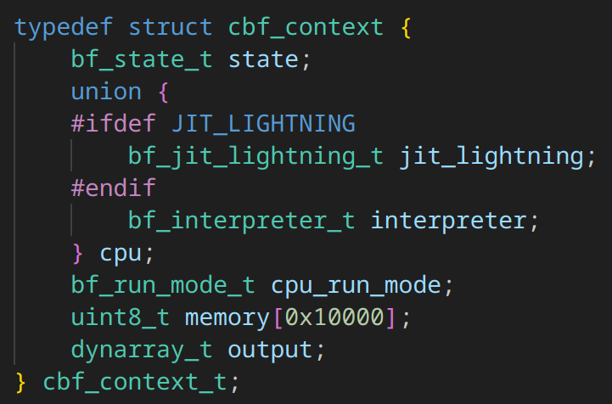
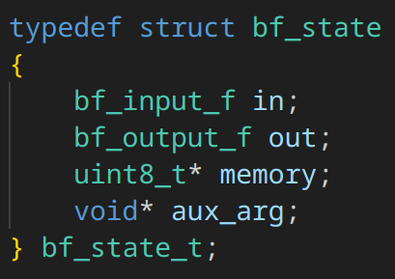
Interpreter Implementation
Modular Design and Execution Strategy

Slide 16
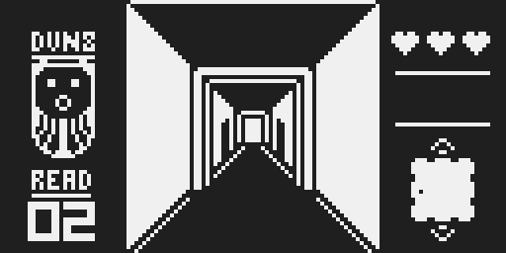
Quirks & Extensions
Modern SCHIP-8 Support and Differences

Slide 17
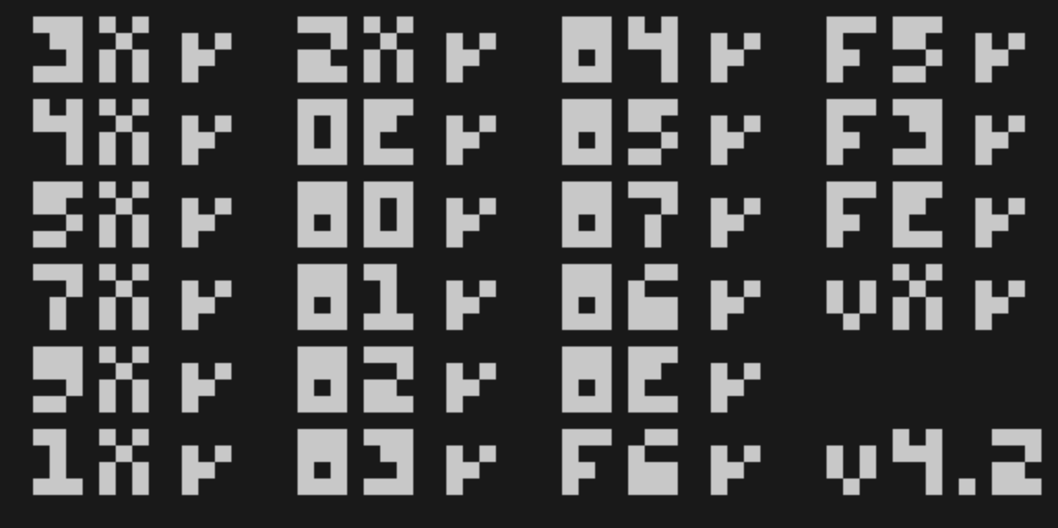
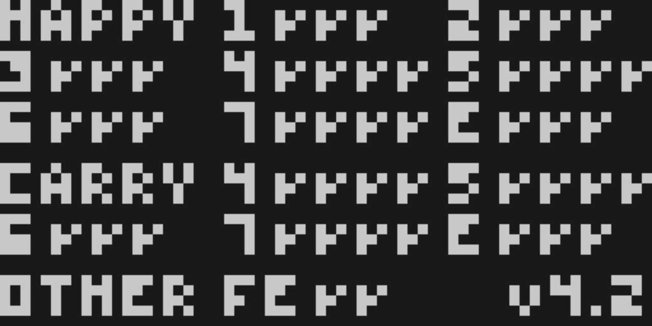
CHIP-8 Testing – Timendus’ Test Suite
Instruction corectness check
Flag corectness check

Slide 18
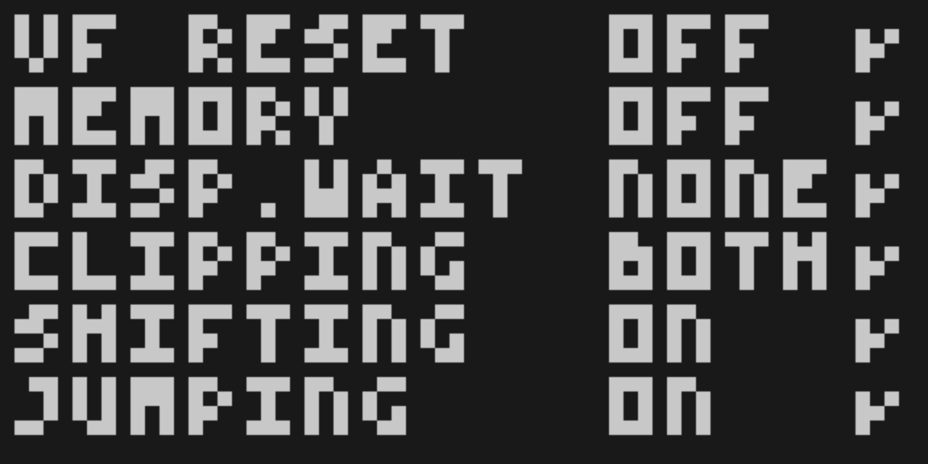
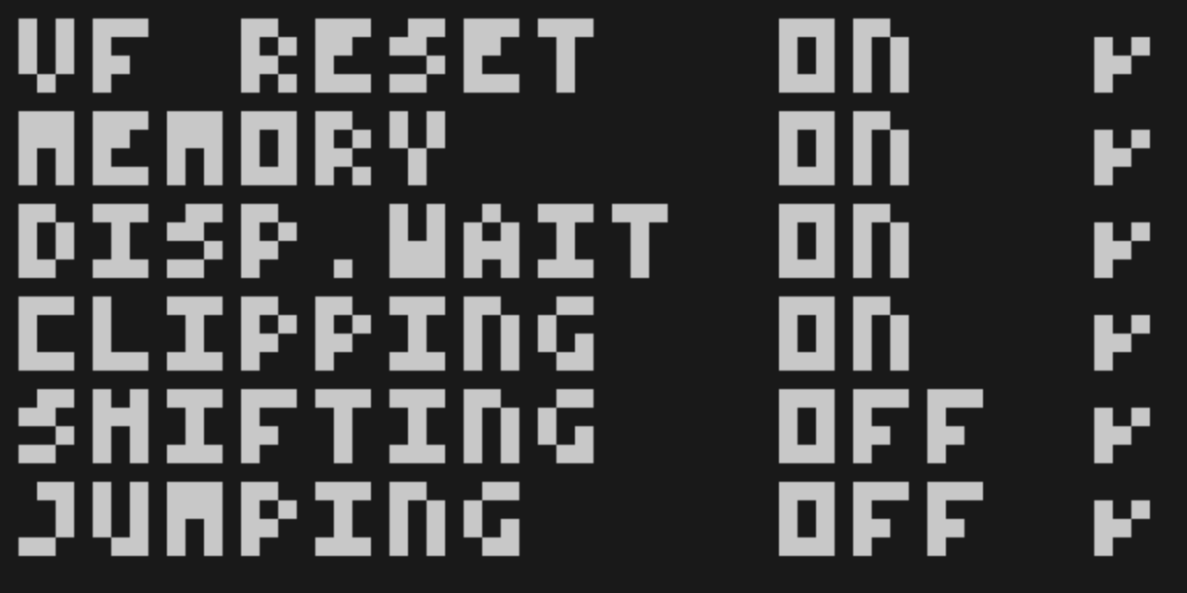
CHIP-8 Testing – Timendus’ Test Suite
Quirk Test in SCHIP Mode
Quirk Test in Normal Mode

Slide 19
The Final Application – Edra
Glueing everything toghether in C17

Slide 20
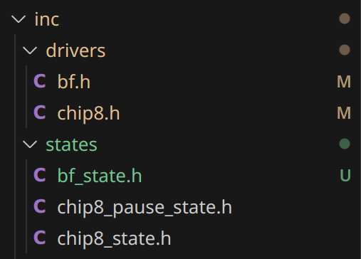
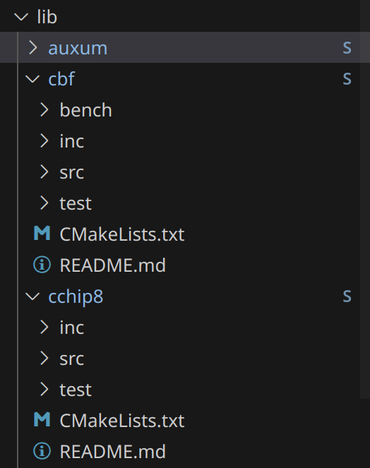
Design and Architecture
Modularity and separation of concerns.

Slide 21
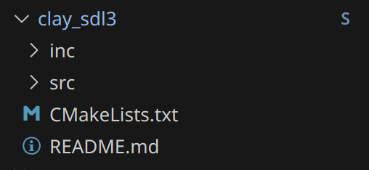
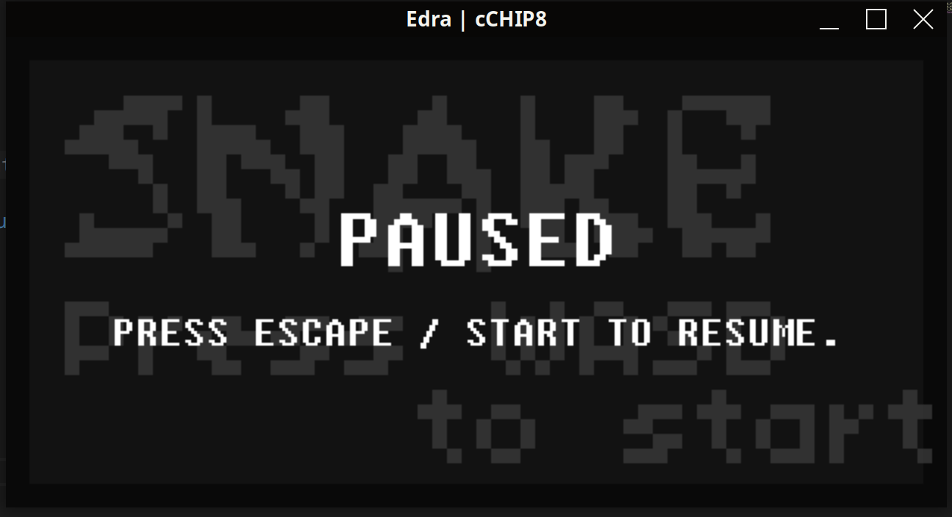
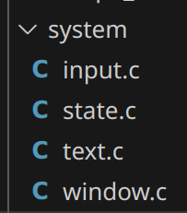
User Interface in SDL3 using CLay
Handling Graphics, Input, and Display

Slide 22
Cross-Platform Porting
Windows:
- No JIT as GNU Lightning works only on POSIX compliant systems.
Linux (+Android on Termux + Termux X11 display server):
- Works out of the box with all modules properly implemented.
PSVita:
- Gamepad input only and also no JIT as system is not POSIX compliant.

Slide 23
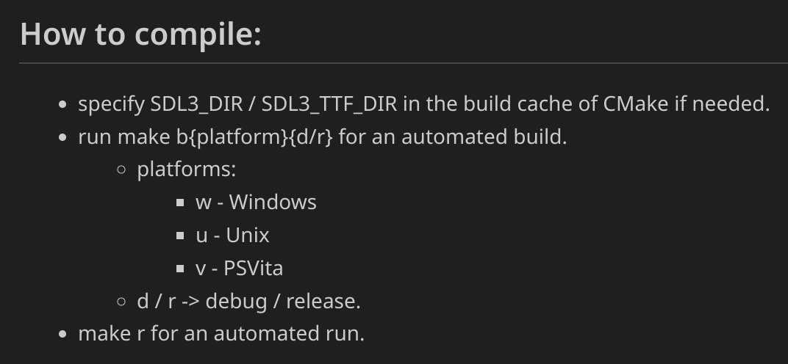
Build System & Usage
Makefile Structure and Platform Targets

Slide 24
Future Work
UX Improvements, More Platforms,
More Architectures

Slide 25
Final Thoughts
Contributions to entry level
Emulation and to Education

Slide 26
Showcase and Demonstration
Running on Desktop and PS Vita
Live!

Slide 27
The End
Thank You

