Slide 1
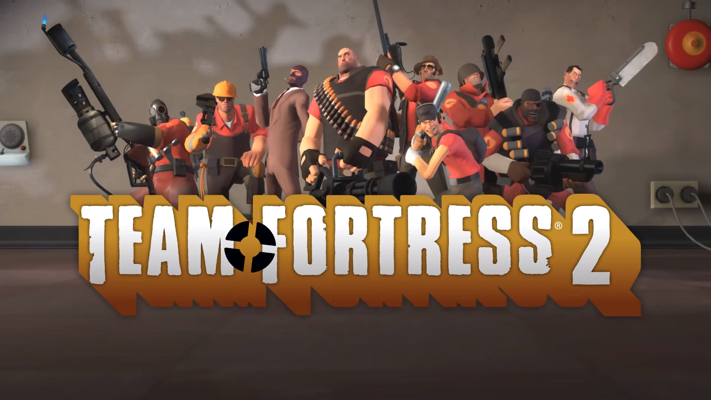
In-Game TF2 Economy

Slide 2
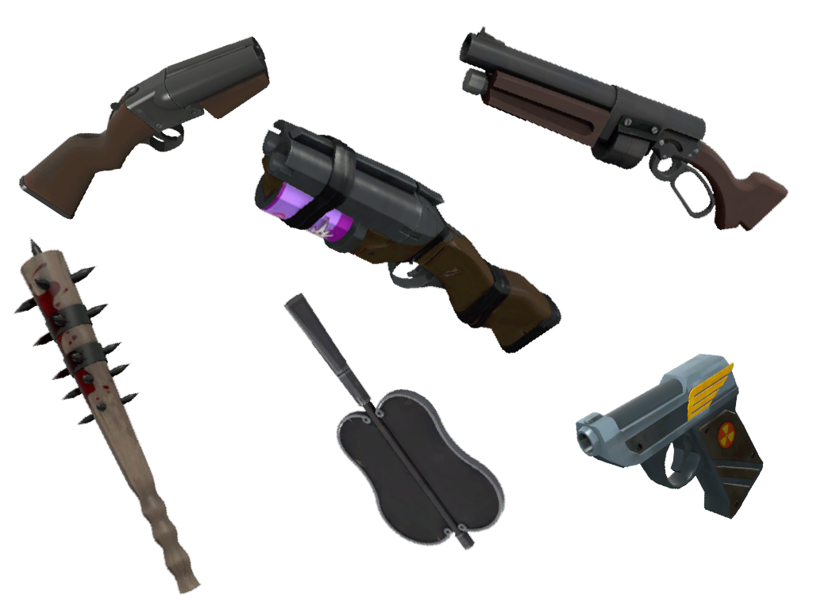

Slide 3

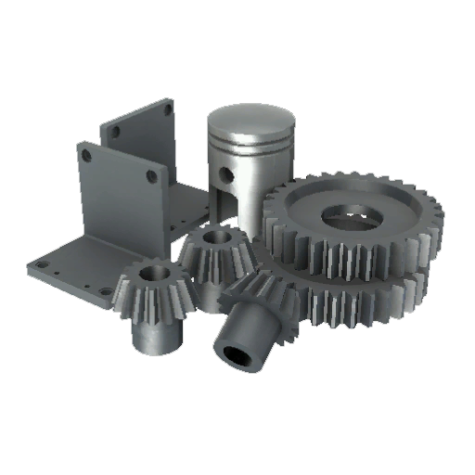

3 Currencies

Slide 4
“what do you want kid?”
— Bobsplosion

Slide 6



Slide 7
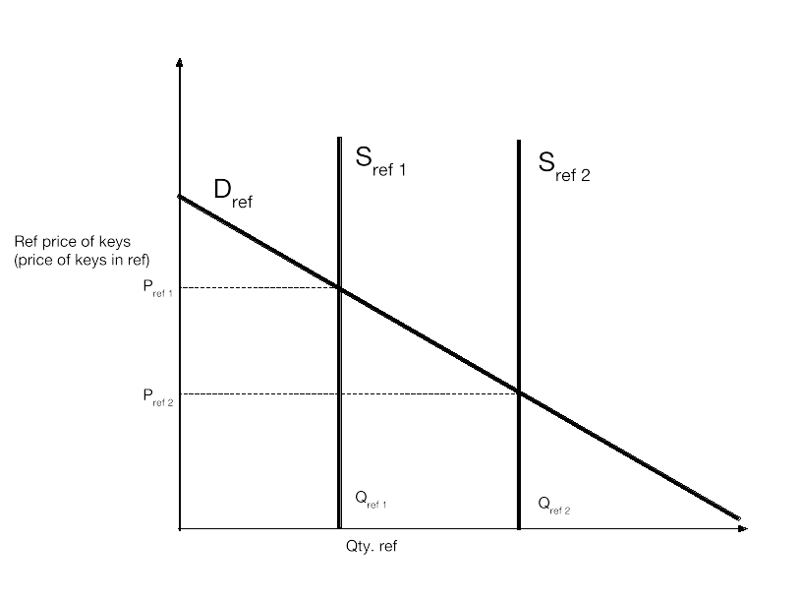

Slide 8
