Slide 1
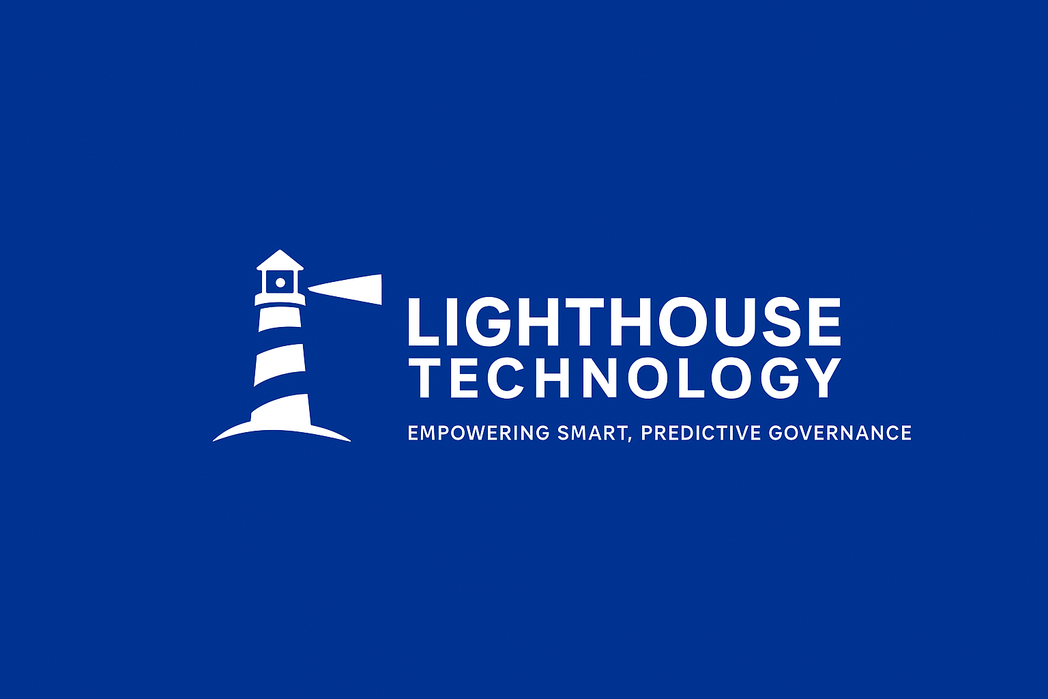
GRC Controls Framework Analytics
Empowering Smart, Predictive Governance with Automated Risk Intelligence and Resilient Cloud Compliance
Bassey Solomon Henry | Lighthouse Technology

Slide 2
Business Problem
• Traditional GRC systems struggle with real-time visibility.
• Manual audits delay executive reporting and compliance readiness.
• Inconsistent frameworks create fragmented risk posture awareness.
Bassey Solomon Henry | Lighthouse Technology
Notes:
Highlight pain points of legacy GRC approaches and lack of automation.

Slide 3
Solution Overview (STAR Framework)
• Situation: Fragmented compliance tools limited insight.
• Task: Integrate automation for predictive GRC analytics.
• Action: Built AI-driven dashboards and automated frameworks.
• Result: Achieved 75% faster audit readiness and 40% reduction in manual reporting overhead.
Bassey Solomon Henry | Lighthouse Technology
Notes:
Walk through the STAR method for business impact demonstration.

Slide 4
Business Impact Metrics
• ↑ 75% faster audit readiness
• ↓ 40% manual compliance reporting time
• ↑ 30% improved control maturity accuracy
• ↗ 99.3% uptime across cloud risk workflows
Bassey Solomon Henry | Lighthouse Technology
Notes:
Focus on quantifiable impact metrics achieved through automation.

Slide 5
Startup & Innovation Focus
• Built on Lighthouse Technology architecture for rapid scaling.
• Supports predictive analytics for enterprise GRC resilience.
• Integrates with multi-cloud, DevSecOps, and Active Directory systems.
Bassey Solomon Henry | Lighthouse Technology
Notes:
Position this as startup-aligned and innovation-driven architecture.

Slide 6
Future Roadmap
• Add Monte-Carlo Incident Response Simulator.
• Expand Board-Level GRC Insights Dashboard.
• Integrate ISO 27001 Clause-Automation Mapping Engine.
Bassey Solomon Henry | Lighthouse Technology
Notes:
Show readiness for iterative scaling into full GRC AI ecosystems.

