Slide 1

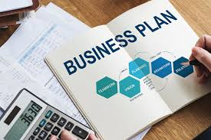
College of Business and Economics
Departement of Management
CHAPTER 2: BUSINESS PLANNING

Slide 2
_{Chapter Learning Outcomes}
After completing this chapter, students should be able to:
•Identify opportunities in environment
•Evaluate opportunities systematically
•Generate viable business ideas
•Explain business planning concepts
•Identify components of business plan
•Develop comprehensive business plan

Slide 3

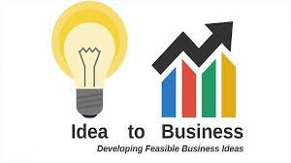
2.1 Introduction
To start any type of business or expand the existing one needs opportunity identification and evaluation, business idea development and prepare business plan.
Lack of proper opportunity identification and evaluation, idea development process and business planning are reasons for business failure.
This chapter summarizes opportunity identifying and evaluating processes, business idea development process, feasibility study, importance and preparation of a business plan.

Slide 4

2.2 Opportunity Identification and Evaluation
The initial stage in the entrepreneurial process is the identification and refinement of a viable economic opportunity that exists in the market.
Without the recognition of an opportunity the entrepreneurial process is likely to result in failure.
Opportunity recognition corresponds to the principal activities that take place before a business is formed or structured.
The opportunity identification and evaluation stage can be divided into five main steps:
  Getting the idea/scanning the environment
  Identifying the opportunity
  Developing the opportunity
  Evaluating the opportunity
  Evaluating the team

Slide 5


1)Scanning the Environment/ Getting the Idea
While scanning the environment it may provide you with idea and business opportunities.
Idea is a thought or suggestion about a possible course of action.
Opportunity is a favorable time or set of circumstances for doing something.
A business opportunity is a gap left in a market by those who currently serve it, giving a chance to others to add unrealized value.

Slide 6

Business opportunities Vs Ideas
Business opportunities are distinguished from ideas; an idea is not synonymous with opportunity.
An opportunity is the possibility of occupying the market with a specific innovative product that will satisfy a real need and for which customers are willing to pay.
Successful venturing may rest upon the ability to recognize or distinguish an opportunity from an idea.

Slide 7
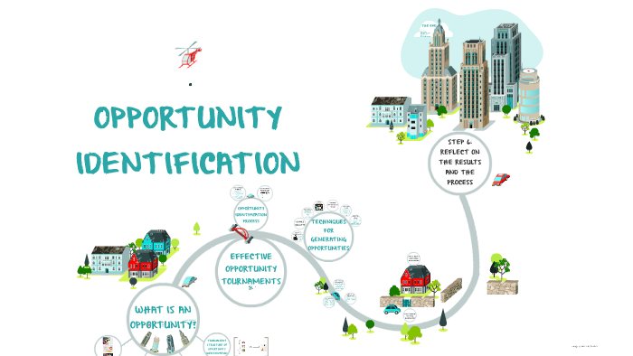
2. Opportunity Identification
Ability to see and discover opportunities others miss
Scan informational environment
Capture abstract, implicit, changing information
Understand opportunity causes:
  Technological change
  Market shifts
  Government regulation
  Competition
Opportunity identification is a very difficult task and results from an entrepreneur’s alertness to possibilities.
In developing countries, problems may be changed to business opportunities.

Slide 8

3. Opportunity Development
Having recognized the opportunity, timely adaptation of that opportunity to suit actual market need is key to new venture success.
Opportunity development is the process of combining resources to pursue a market opportunity identified.
This involves systematic research to refine the idea to the most promising high potential opportunity that can be transformed into marketable items.

Slide 9

4)Opportunity Evaluation
Opportunity screening and evaluation is a critical element of the entrepreneurial process.
  It allows the entrepreneur to assess whether the specific product or service has the returns needed to justify the investment and risk.
  It involves looking at the creation and length of the opportunity.
  It examines its real and perceived value, risks and returns.
  It considers its fit with the personal skills and goals of the entrepreneur.
  It evaluates its differential advantage in its competitive environment.

Slide 10

5)Assessment of the Entrepreneurial Team
Regardless of how right the opportunity may seem to be, it will not make a successful business unless it is developed by a team with strong skills.
Once the opportunity has been evaluated, the next step is to ask pertinent questions about the people who would run the company.

Slide 11

2.3 Business Idea Development
A business idea is a short and precise description of the basic operation of an intended business.
There are three types of business ideas. They are:
  Old Idea – Here an individual copies an existing business idea from someone.
  Old Idea with Modification – In this case the person accepts an old idea from someone and then modifies it in some way to fit a potential customer’s demand.
  A New Idea – This one involves the invention of something new for the first time

Slide 12
2.4 Business Idea Identification
Before starting a business, you need a clear idea of the business you want to run.
Your business idea will tell you:
  Which need your business will fulfill and what customers it will attract
  What goods or services your business will sell
  Who your business will sell to
  How your business will sell its goods or services
  How much your business will depend on and impact the environment
A good business idea is compatible with sustainable use of natural resources and respects the social and natural environment.
Not all business ideas are equally valuable; answering these questions helps identify promising ideas

Slide 13

2.4.1The Need will Your Business Fulfill for the Customers
Your business idea should always have customers and their needs in mind.

Slide 14

2.4.2 Good or Service will your Business Sell
Decide which good or service your business will sell based on your skills and customer needs.
Goods or services must be something people are willing to pay for at a price that allows profit.
Good:An item people pay for and use (e.g., tools, baked goods, clothes, retail items).
Service: Something you do for people for payment (e.g., delivering goods, banking, babysitting).

Slide 15
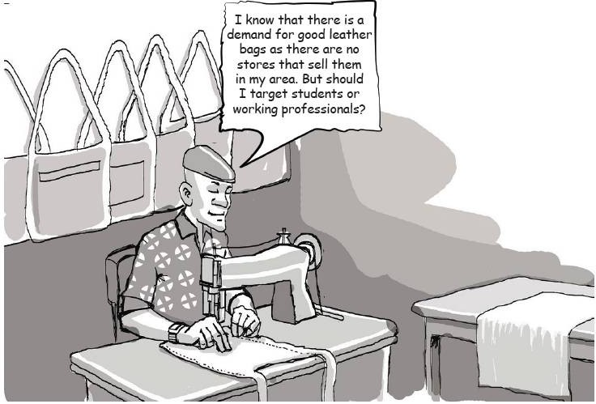

2.4.3 Identifies Potential Customer
Any business cannot succeed without customers.
It is essential to know who your customers will be.
Decide whether you will sell to a specific type of customer or to everyone in an area.
There must be enough people able and willing to pay for your goods or services for the business to survive.

Slide 16
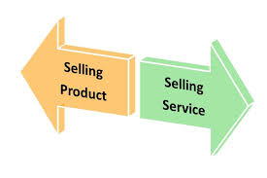
2.4.4 Strategy for Selling Goods or Services
How will your business sell its goods or services?
Shop owners know how they will sell, but manufacturers or service operators have multiple options.
A manufacturer can sell:
  Directly to customers
  To retailers
  To wholesalers

Slide 17

2.4.5 Relation between Business and Environment
A business is sustainable only if it works in harmony with the social and natural environment.
Consider:
How much does your business depend on the environment (weather, soil, natural resources)?
Does it require specific labor or support from the local community?
How can your business nurture the environment and help the community?
How to minimize or reverse any negative impact?

Slide 18
Activity 1:
Now if you already have a business idea, describe your idea using the form on Page 41

Slide 19
2.5 Methods for Generating Business Ideas
Every business idea should be based on knowledge of the market and its needs.
The market differs by location, depending on residents, lifestyle, and spending habits.
Understand the market to recognize potential business ideas previously ignored.
Keep an open mind and list as many ideas as possible to increase choices.
Scan the list to select ideas that are feasible and potentially profitable.
Methods include surveying local businesses or asking existing business owners.
Combining different approaches helps clearly describe your business ideas.

Slide 20
Approaches to generating business ideas.
Learn from successful business owners
Draw From Experience
  Draw From Experience, Other People’s Experience
Survey Your Local Business Area
Scanning Your Environment
  Natural Resources
  Characteristics and Skills of People in the Local Community
  Waste Products
  Import Substitution
  Publications
  Trade Fairs and Exhibitions
Brainstorming:Opening up your mind and thinking about many different ideas

Slide 21
Approaches to generating business ideas.
6.Structured Brainstorming: When you think of the different processes that are involved in the operation of a particular business and the goods/services that can be offered with respect to those processes.
7.Focus Group: Focus group is a group of individuals providing information on a structured format which is led by moderators.
8.Problem Inventory Analysis: Consumers are provided with a list of problems in general product category. It is a method of obtaining “New Idea” and solutions by focusing on problems.

Slide 22
Approaches to generating business ideas.
9. Free Association: A simple idea-generation method where a word or phrase related to a problem is written down, followed by additional words that build a chain of thoughts, leading to a new product/service idea.
10. Forced Relationships: A technique that forces connections among product combinations by asking structured questions about objects or ideas to generate new concepts.
11. Attribute Listing: An idea-finding technique in which the entrepreneur lists the attributes of a product or problem and examines each from different viewpoints to create new combinations and improved product/service ideas

Slide 23
2.6 Business Idea Screening
Idea screening: process to spot good ideas and eliminate poor ones.
1. Macro Screening – narrow ideas to 10:
  Are my competencies sufficient?
  Can I finance it mainly with my own equity?
  Will people buy my product/service (needed and affordable)?
2. Micro Screening – narrow ideas to 3:
  Solvent demand
  Availability of raw materials
  Availability of personal skills
  Availability of financial resources

Slide 24
Business Idea Screening
3. Scoring the Suitability of Business Idea – choose among multiple ideas:
  Assign rating from 1–3 for each criterion (3 = strongest)
  Sum total scores for each idea
  Select the idea with the highest score

Slide 25
2.7 Concept of Business Plan
Planning is the first and most crucial step for starting a business.
A well-designed business plan can turn a simple idea/innovation into a successful business venture.
A business plan is a roadmap for starting and running a business.
Identifies opportunities and assesses feasibility.
Allocates resources effectively to ensure success.

Slide 26
Importance of a Business Plan
Provides information to venture capitalists, financial institutions, investors, and employees.
Covers all functional requirements:
  Marketing
  Finance
  Operations
  Human resources
Acts as a blueprint for converting a business idea into a successful venture.

Slide 27
Objectives of a Business Plan
Guide the entrepreneur in the actual implementation of the plan.
Identify the strengths and weakness of the plan.
Identify challenges in terms of opportunities and threats
Clarify ideas and identify gaps in management information about their business, competitors and the market.
Identify the resources that would be required to implement the plan.
Document ownership arrangements, future prospects and projected growths of the business venture.

Slide 28
Objectives of a Business Plan
Give directions to the vision formulated by entrepreneur.
Objectively evaluate the prospects of business.
Monitor the progress after implementing the plan.
Persuade others to join the business.
Seek loans from financial institutions.
Visualize the concept in terms of market availability, organizational, operational and financial feasibility.

Slide 29
2.8Developing a Business Plan
2.8.1 Business Planning Process
A plan that seems feasible may not be when details are drawn.
Documenting the business plan is an early step for entrepreneurs.
The plan acts as a guiding tool and is dynamic.
Requires continuous review to remain viable in changing situations.
Steps involved in business planning process are discussed as follows:

Slide 30
Steps involved in business planning
Preliminary Investigation
Opportunity Identification and Idea Generation
Environmental Scanning
Feasibility Analysis
Report Preparation

Slide 31
1. Preliminary Investigation
Before preparing the plan entrepreneur should:
  Review available business plans (if any).
  Draw key business assumptions on which the plans will be based (e.g. inflation, exchange rates, market growth, competitive pressures, etc.).
  Scan the external environment and internal environment to assess the strengths, weakness, opportunities and threats.
  Seek professional advice from a friend/relative or a person who is already into similar business (if any).

Slide 32
2. Opportunity Identification and Idea Generation
Entrepreneurship is not just limited to innovation (entirely new concept, product, or service), but also includes incremental value addition to concepts/products/services for consumers, shareholders, and employees.
Opportunity identification and business idea generation is the first stage of the business planning process.
Involves generation of new concepts, ideas, products, or services to satisfy demand.

Slide 33
3. Environmental Scanning
Analyze prospective strengths, weaknesses, opportunities, and threats of the business.
Before setting up the business, scan:
  External environment: opportunities and threats
  Internal environment: strengths and weaknesses

Slide 34
4. Feasibility Analysis
Feasibility study determines whether the proposed project would be feasible.
Environmental scanning vs. feasibility study:
  Environmental scanning: assesses external and internal environment of the area where the business will be set up.
  Feasibility study: assesses the feasibility of the project itself in that environment in greater detail.

Slide 35
5.Report Preparation
After environmental scanning and feasibility analysis, a business plan report is prepared.
It is a written document describing, step-by-step, the strategies involved in starting and running a business.

Slide 36
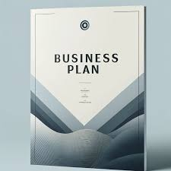
2.8.2 Essential Components of Business Plan
1.Cover Sheet:
Serves as the title page of the business plan.
Includes fundamental information:
  Project/Business Name
  Headquarters Address (if applicable)
  Details of Promoters or Business Owners
Ensures clarity and professionalism in the presentation.

Slide 37
2. Executive Summary
Provides a concise and compelling introduction to the business plan.
Typically 2–3 pages long, summarizing key aspects of the business.
Includes:
  Company overview
  Market potential
  Projected financials
  Unique features that differentiate the business from competitors
First section often read by investors; should be well-structured and engaging to generate interest.

Slide 38
3. Business Description
Explains the business concept, objectives, nature, and purpose.
If operational, includes brief history of past performance.
Defines form of ownership: sole proprietorship, partnership, cooperative, or registered company.
Provides headquarters or primary location details.

Slide 39
4. Funding Requirement
Outlines the financial needs of the business.
Specifies:
  Amount of capital required
  Sources of funding
  Funding strategy
Includes debt-equity ratio to illustrate financial structure.
Helps investors assess financial feasibility.

Slide 40
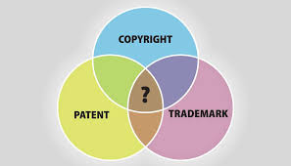
5: Products or Services
Comprehensive overview of products/services offered.
Includes:
  Key features and specifications
  Unique selling points (USPs)
  Product range and market demand
  Intellectual property protections (patents, trademarks, copyrights, franchises, licenses).

Slide 41
6: Functional Plans
Covers operational aspects and departmental management:
  Marketing Plan: Pricing, positioning, promotions, distribution, and customer acquisition.
  Operational Plan: Plant location, resource access, inventory, quality control, operational budget.
  Organizational Plan: Roles, responsibilities, authority flow, manpower plan, HR policies, organizational budget.
  Financial Plan: 2–5 year projections including sales, income statements, break-even, balance sheets, cash flows.

Slide 42
7. Critical Risks
Identifies potential risks affecting the business:
  Market fluctuations
  Operational challenges
  Financial risks
  Competitive threats
Helps stakeholders develop risk mitigation strategies.

Slide 43
8: Exit Strategy
Outlines procedures for business dissolution or strategic closure.
Specifies:
  Asset distribution among stakeholders
  Ownership transfer agreements
Demonstrates long-term planning and enhances investor confidence.

Slide 44
9: Appendix
Repository for supporting documents:
  Resumes of key owners and management team
  Ownership agreements and partnership contracts
  Legal documents and licenses
  Any other relevant paperwork to enhance credibility

Slide 45


